Slide 1
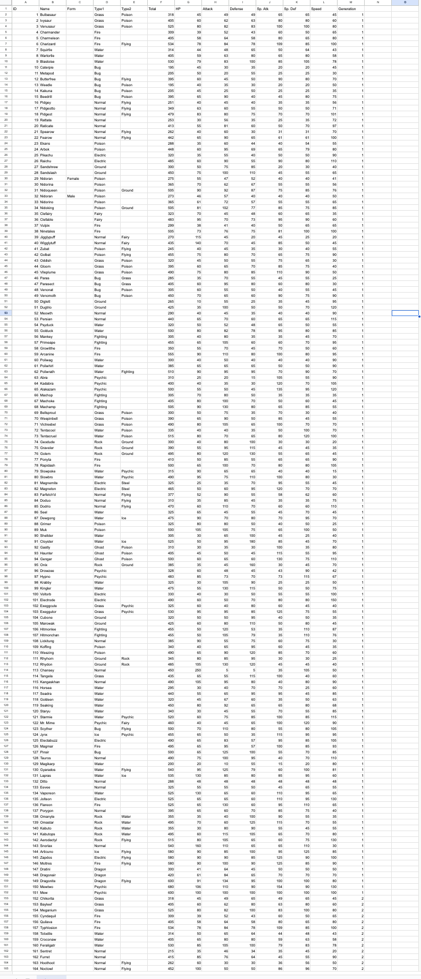

Slide 2
ID | Name | Form | Type1 | Type2 | Total | HP | Attack | Defense | Sp. Atk | Sp. Def | Speed | Generation
25 | Pikachu |  | Electric |  | 320 | 35 | 55 | 40 | 50 | 50 | 90 | 1

