Slide 1



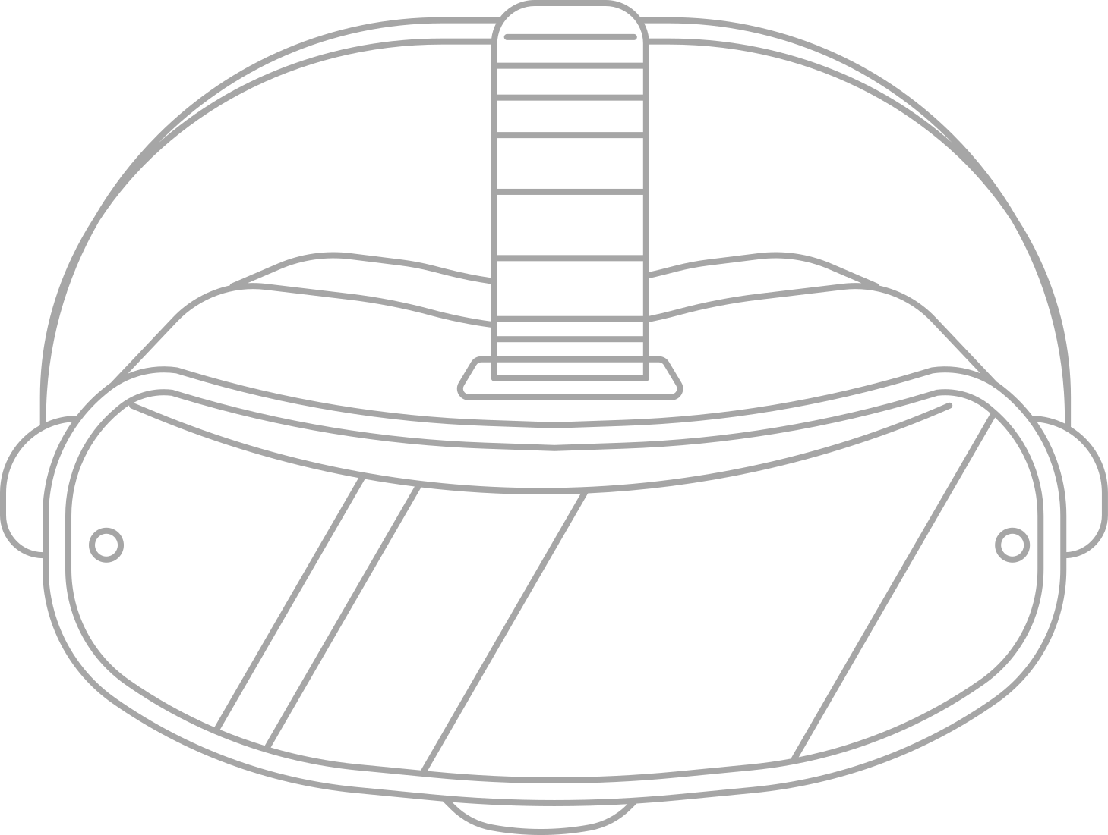

ZenFlora
ZenFlora_VR
D I S C O V E R L E A R N I N T E R A C T

Slide 2




Problem Statement
Traditional labs lack immersive experience, which limits students' engagement and understanding, specifically in subjects like biology and botany, where real-time experience is crucial.
Learning about plants is dull and theoretical!
Textbooks & 2D images fail to provide real-world understanding.
Virtual labs lack immersive, hands-on experiences for students.
Existing virtual tools do not offer true hands-on exploration.

Slide 3
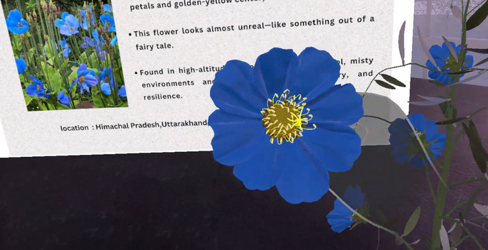
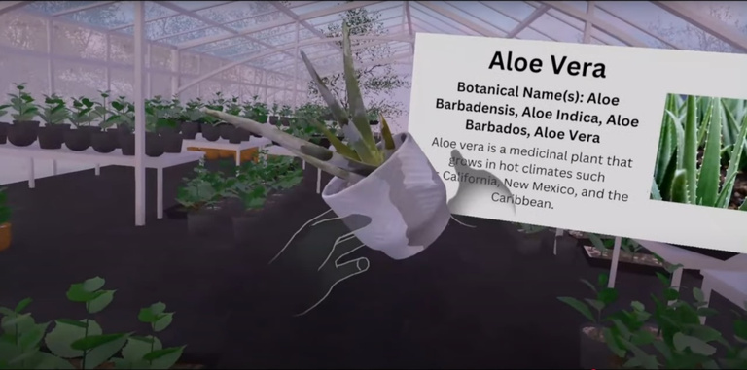
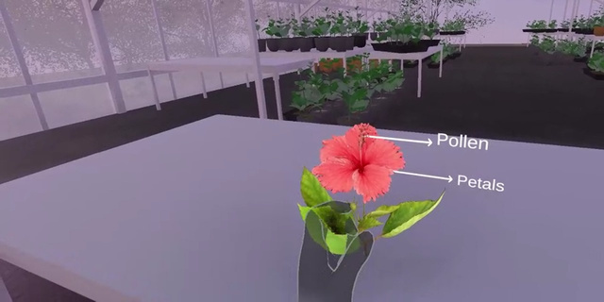
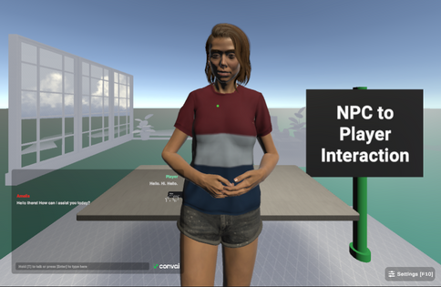
Walkthrough Mode
Zen Flora VR transforms plant science learning into an interactive and immersive experience through
Grab & Learn
Dissection Feature
NCP AI-Powered Lab Assistant

Slide 4
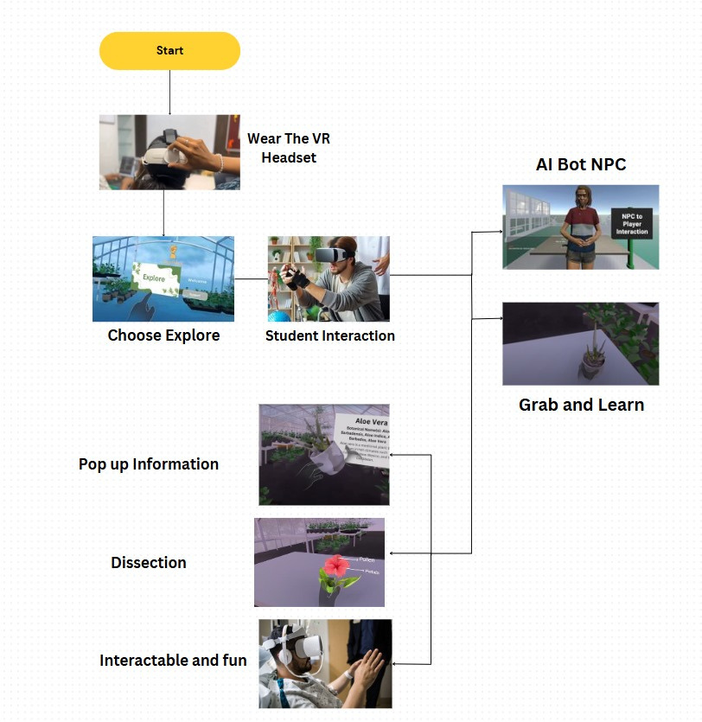
How
it
works?

Slide 5
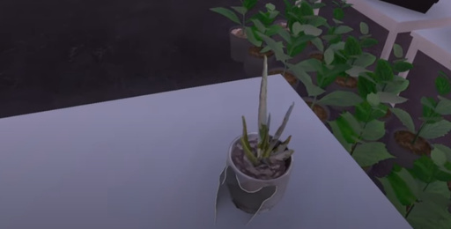
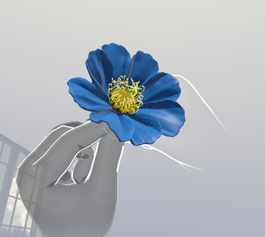

How Zen Flora VR Enhances the OLabs Platform
01
02
03
Unlike traditional Labs simulations, Zen Flora VR allows students to physically interact with plants using hand tracking and VR immersion.
The NCP AI Lab Assistant provides real-time explanations, quizzes, and interactive lessons, making learning more engaging and personalized.
Unlike static Labs experiments, students can grab, rotate, and dissect plants in a virtual space for deeper understanding.

Slide 6



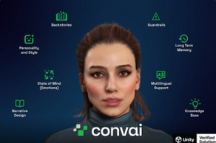

Ethical Statement
Unity
Blender
Unity is a powerful real-time 3D development platform for creating games, simulations, and interactive experiences across multiple devices.
Blender is a free and open-source 3D creation software.
Oculus SDK
Convai SDK
Blender is a free and open-source 3D creation software.
Convai SDK enables AI-powered conversational characters in real-time applications.
Sketch Fab
Sketchfab is a platform for publishing, sharing, and viewing 3D models online.

Slide 7
THANK YOU

