Slide 1
Gulp

Slide 2
ReFerence Link
https://www.youtube.com/watch?v=1rw9MfIleEg&t=47s
https://gulpjs.com/docs/en/getting-started/quick-start/
https://medium.com/@uix/enhancing-your-front-end-development-workflow-using-gulp-4- 51c5d265c1bd
https://www.sitepoint.com/how-to-migrate-to-gulp-4/
https://css-tricks.com/gulp-for-beginners/
https://developers.google.com/web/ilt/pwa/introduction-to-gulp
https://www.tutorialspoint.com/gulp/index.htm

Slide 3
Check for VERSION
Node
node --version
NPM
npm --version
NPX
npx --version
Gulp
gulp --version

Slide 4
Getting Start
Install the gulp
npm install --global gulp-cli (or) npm install gulp –g
Create a project directory
npx mkdirp my-project
Change Project directory
cd my-project
Create a package.json file
npm init
Install the gulp package
npm install --save-dev gulp

Slide 5
Functions
gulp.task - Define Tasks
gulp.src - Point tofiles to use / Read some source files
(Location of pre-processed HTML source files and folders.)
gulp.dest - Points to folder to output / Write the modified files to a destination directory (creating the directory if doesn't exist)
gulp.watch - Watch files and folders for changes
gulp.series - Combining Gulp tasks
gulp.pipe - Process these files with one or more functions
gulp.build - created automatically which contains the production files

Slide 6
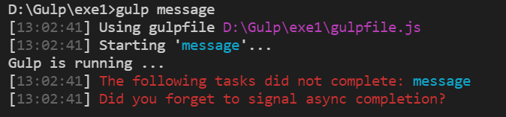
An issue with Gulp 4.
gulp.task('simpleTaskName', function() { // code... });
** Solve **
gulp.task('simpleTaskName', async function() { // code... });
OR
gulp.task('simpleTaskName', done => { // code... done(); });
OR
gulp.task('simpleTaskName', async() => { // code... done(); });

Slide 7
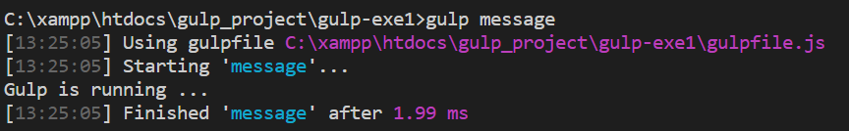
Logs Message(gulpfile.js)
const gulp = require('gulp’);
gulp.task('message', function() {
return console.log('Gulp is running ...’);
});
OR
const gulp = require('gulp’);
gulp.task('message', async() => {
return console.log('Gulp is running ...’);
});
** run in terminal “ gulp message “ **

Slide 8
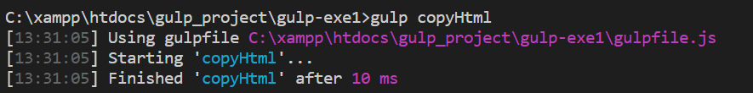
Copy All HTML File to Dist folder
gulp.task('copyHtml', async function () {
gulp.src('src/*.html')
.pipe(gulp.dest('dist'));
});
** run in terminal “ gulp copyHtml “ **

Slide 9
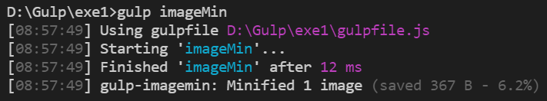
Optimize image
Install ImageMin Plugin
npm install --save-dev gulp-imagemin
** run in terminal “ gulp imageMin “ **
const imagemin = require('gulp-imagemin');
gulp.task('imageMin', async function (){
gulp.src('src/images/*')
.pipe(imagemin())
.pipe(gulp.dest('dist/images'))
});

Slide 10
Optimize image Error
https://www.npmjs.com/package/gulp-imagemin?activeTab=versions
gulp-imagemin version 7.1.0 install
npm install gulp-imagemin@7.1.0

Slide 11
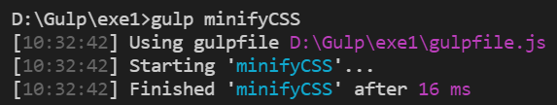
minify CSS
Install Minify-CSS Plugin
npm install --save-dev gulp-minify-css
** run in terminal “ gulp minifyCSS “ **
const minifyCSS= require('gulp-minify-css');
gulp.task('minifyCSS', async function (){
gulp.src('src/css/*.css')
.pipe(minifyCSS())
.pipe(gulp.dest('dist/css'));
});

Slide 12
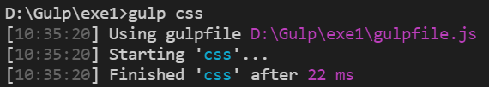
autoprefixer
To work with “gulp-minify-css plugin”, you need to install another plugin called “gulp-autoprefixer”
Install Autoprefixer Plugin
npm install --save-dev gulp-autoprefixer
const autoprefix = require('gulp-autoprefixer');
gulp.task('css', async function (){
gulp.src('src/css/*.css')
.pipe(autoprefix('last 2 versions'))
.pipe(minifyCSS())
.pipe(gulp.dest('dist/css'));
});
** run in terminal “ gulp css“ **

Slide 13
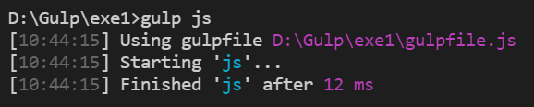
minify JS
Install Uglify Plugin
npm install --save-dev gulp-uglify
** run in terminal “ gulp js “ **
const uglify = require('gulp-uglify');
gulp.task('js', async function () {
gulp.src('src/js/*.js')
.pipe(uglify())
.pipe(gulp.dest('dist/js/'));
});

Slide 14
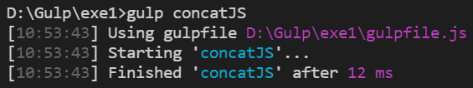
Concat JS File in Dist Folder
Install Concat Plugin
npm install --save-dev gulp-concat
** run in terminal “ gulp concatJS “ **
const concat = require('gulp-concat’);
gulp.task('concatJS', async function () {
gulp.src('src/js/*.js')
.pipe(concat('main.js'))
.pipe(uglify())
.pipe(gulp.dest('dist/js'));
});

Slide 15
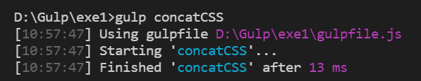
Concat CSS File in Dist Folder
Install Concat Plugin
npm install --save-dev gulp-concat
** run in terminal “ gulp concatCSS “ **
const concat = require('gulp-concat’);
gulp.task('concatCSS', async function () {
gulp.src('src/css/*.css')
.pipe(concat('main.css'))
.pipe(minifyCSS())
.pipe(gulp.dest('dist/css'));
});

Slide 16

Compile sass
Install SASS Plugin
npm install --save-dev gulp-sass
OR
const concat = require('gulp-sass’);
gulp.task('sass’, function() {
gulp.src('src/sass/*.scss')
.pipe(sass().on('error', sass.logError))
.pipe(gulp.dest('dist/css'));
});
const concat = require('gulp-sass’);
gulp.task('sass', async() => {
gulp.src('src/sass/*.scss')
.pipe(sass().on('error', sass.logError))
.pipe(gulp.dest('dist/css'));
});
** run in terminal “ gulp sass “ **

Slide 17
Gulp Watch
gulp.watch(src, gulp.series(task name));
Eg. gulp.task('watch', async function () {
gulp.watch('src/js/*.js', gulp.series('scripts'));
gulp.watch('src/sass/*.scss', gulp.series('sass'));
gulp.watch('src/*.html', gulp.series('copyHtml'));
});

Slide 18
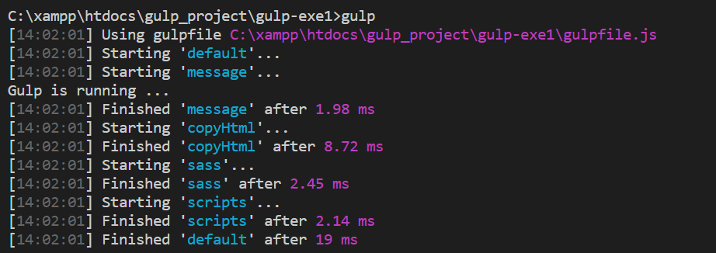
Default Run
gulp.task('default', gulp.series( 'task name', 'task name',));
Eg. gulp.task('default', gulp.series('message', 'copyHtml', 'sass', 'scripts'));
l

Slide 19
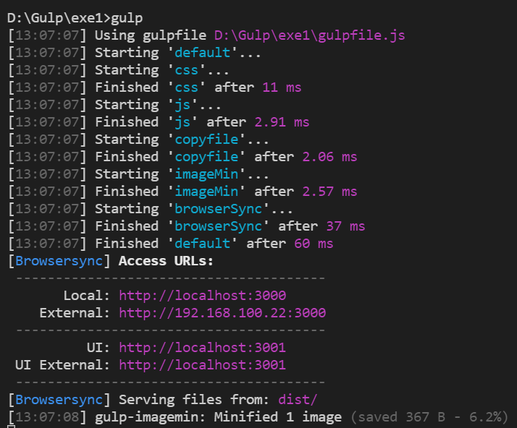
Live Reload
BrowserSync is used to watch all HTML and CSS files in the CSS directory and perform live reload to the page in all browsers, whenever files are changed.
Install BrowserSync Plugin
npm install --save-dev browser-sync
const browserSync = require('browser-sync');
gulp.task('browserSync', async function () {
browserSync.init({
server: {
baseDir: 'build’ // copy directory folder
},
});
});

Slide 20
Cleaning Unwanted Files
Cleaning - unnecessary files should be deleted before running your build
Install Del Plugin
npm install --save-dev del
const del = require('del');
gulp.task('clean:dist', async function () {
return del.sync('dist');
});

Slide 21
Popular plugins
https://gulpjs.com/plugins/
https://www.tutorialspoint.com/gulp/gulp_useful_plugins.htm

Slide 22
Run in Existing Project
npm install --save-dev gulp
gulp build
(OR)
npm install --save-dev gulp
npm install --save-dev gulp-sass
npm install --save-dev browser-sync
npm install --save-dev gulp-imagemin
gulp watch

Slide 23
Run tomoJob After
delete package file
npm install --global gulp-cli
npm init
npm install --save-dev gulp
npm install all package (eg. npm install autoprefixer)
npm install uuid@latest
npm install node-sass
Change sass const => const sass = require('gulp-sass')(require('sass’));
Image min version downgrade => npm i gulp-imagemin@7.1.0
Gulp task -> async change => async()=>{} instead function()

