Slide 1
SCSS

Slide 2
Reference Site
https://sass-lang.com/documentation/
https://www.w3schools.com/sass/default.php

Slide 3

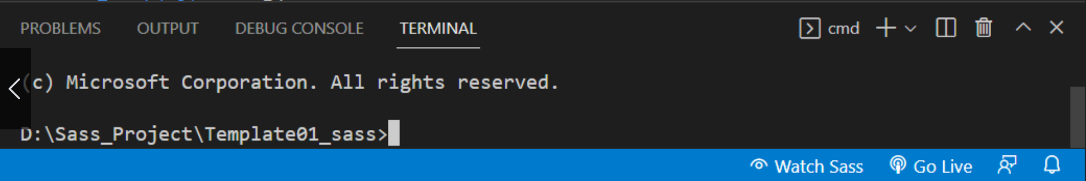
Run VS Code Plugin
Live Sass Compiler
Run in click watch sass ( compile scss to css file )

Slide 4
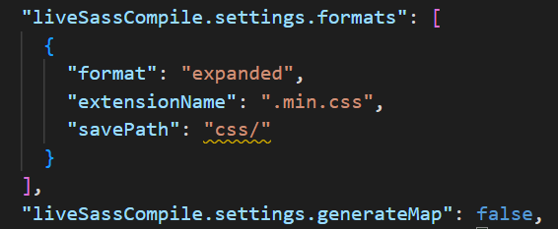
Plugin Setting
Setting.json file
"liveSassCompile.settings.formats": [
{
"format": "expanded", => expanded , compressed
"extensionName": ".min.css", => .min.css , .css
"savePath": "css /" => compile directory file
}
],
"liveSassCompile.settings.generateMap": false, => true , false
true => compile generate map file
false => uncompile generate map file

Slide 5
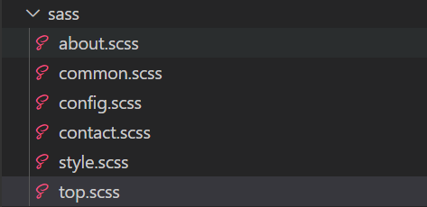
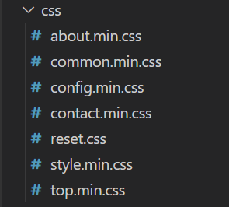
Compile File
all css file compile lote chin yin
Filename ashay mhr underscore ma htae pl file create pay ya pr ml.

Slide 6
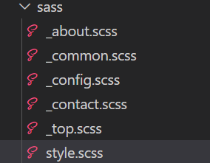

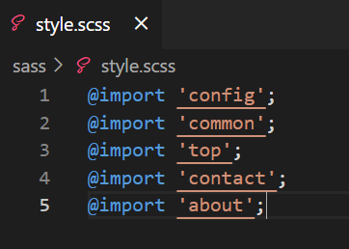
Compile File
all css file compile lote tr myo ma hote pl css file 1 ku pl htwet chin yin
Compile ma lote chin tae file ashay mhr underscore htae pi file create pay ya pr ml.
Compile lote mae file import nae other file name twe ko url chate pay ya pr ml.

Slide 7
Sass Variables
Sass Variable Syntax:
$variablename: value;
Eg.,
In SCSS
$myFontSize: 18px;
body { font-size: $myFontSize; }
In CSS
body { font-size: 18px; }

Slide 8
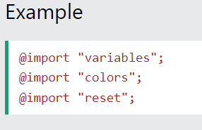
Sass @import and Partials
Sass Importing Files
Just like CSS, Sass also supports the @import directive.
The @import directive allows you to include the content of one file in another.
The CSS @import directive has a major drawback due to performance issues; it creates an extra HTTP request each time you call it. However, the Sass @import directive includes the file in the CSS; so no extra HTTP call is required at runtime!
Tip: You do not need to specify a file extension, Sass automatically assumes that you mean a .sass or .scss file. You can also import CSS files. The @import directive imports the file and any variables or mixins defined in the imported file can then be used in the main file.
Sass Import Syntax:
@import filename;

Slide 9
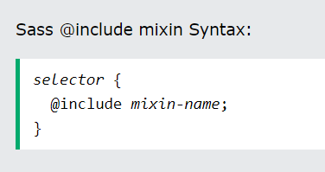
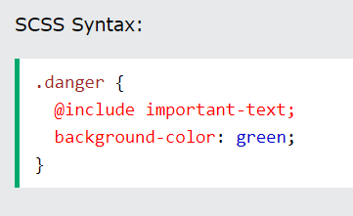
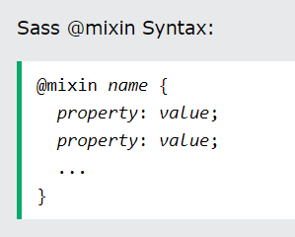
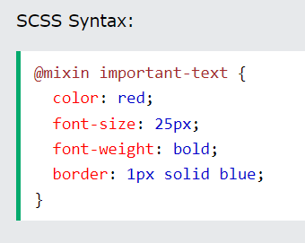
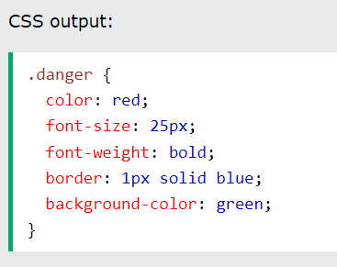
Sass @mixin and @include
Sass Mixins
The @mixin directive lets you create CSS code that is to be reused throughout the website.
The @include directive is created to let you use (include) the mixin.
Using a Mixin
The @include directive is used to include a mixin.

Slide 10
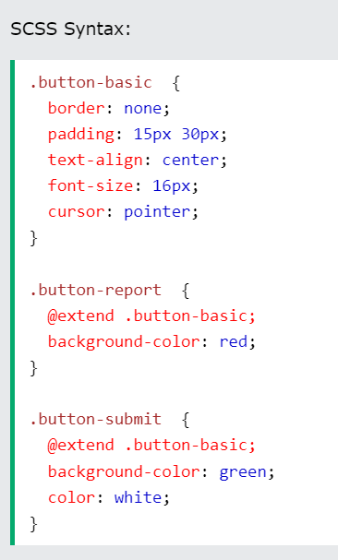
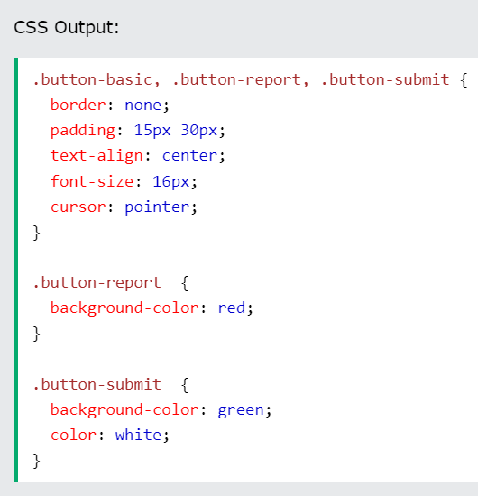
Sass @extend and Inheritance
The @extend directive lets you share a set of CSS properties from one selector to another.
The @extend directive is useful if you have almost identically styled elements that only differ in some small details.
The @extend directive helps keep your Sass code very DRY.
By using the @extend directive, you do not need to specify several classes for an element in your HTML code, like this: <button class="button-basic button-report">Report this</button>. You just need to specify .button-report to get both sets of styles.

Slide 11
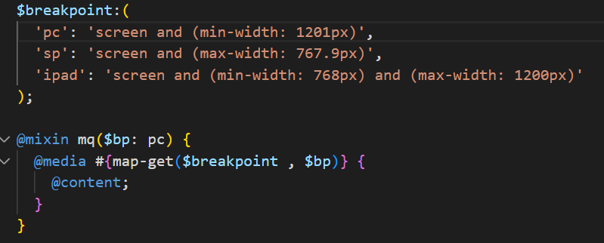
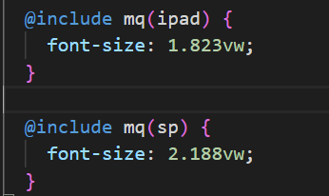
Breakpoints with map-get() function
map-get(map, key)
Returns the value for the specified key in the map.
@media #{map-get($breakpoint , pc)}
@include mq(pc) => media screen and (min-width: 1201px)
@media #{map-get($breakpoint , ipad)}
@include mq(ipad) => media screen and (min-width: 768px) and (max-width: 1200px)
@media #{map-get($breakpoint , sp)}
@include mq(sp) => media screen and (max-width: 767.9px)

Slide 12
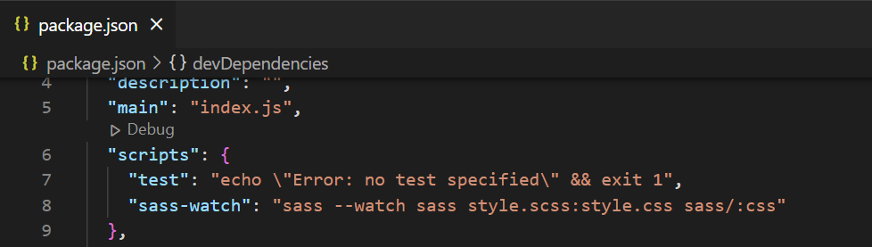
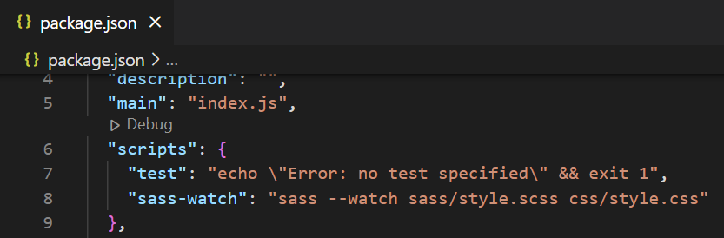
Run in Command Line
node js install
node -v , npm -v
npm init
npm install --save-dev sass
package.json ( sass --watch input.scss output.css / sass --watch sass input.scss:output.css sass/:css ) ( style.scss => input scss file , style.css => output css file )
"sass-watch": "sass --watch sass/style.scss css/style.css"
npm run sass-watch

