Slide 1

Data Analytics Introduction
“Analytics starts with questions, not tools.”

Slide 2

DATA ? information ?
KNOWLEDGE ?

Slide 3
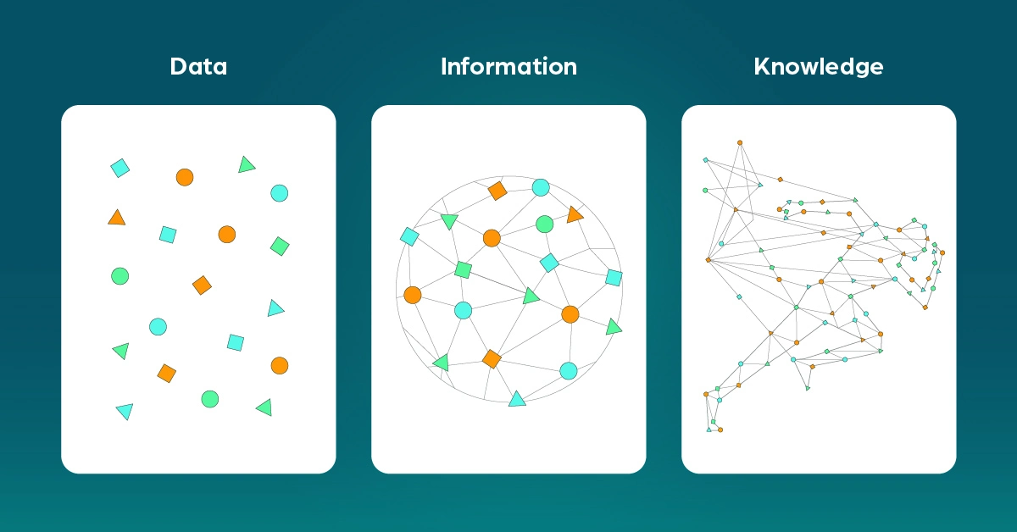
Data: Raw facts, figures, symbols, etc.
Information: Processed form of data which could be understood.
Knowledge: Information put to good use.

Slide 4

What does an analyst do?
Data Analyst vs Business Analyst

Slide 5
An analyst is someone who collects information, examines it carefully, and uses it to help people understand situations or make decisions. What they do day-to-day depends on the field they work in, but the core idea is the same: turn data into insights.
What analysts generally do?
Gather data (numbers, reports, surveys, trends, etc.)
Clean and organize information so it makes sense
Look for patterns or problems
Draw conclusions and explain what the data means
Make recommendations based on their findings
Present results in reports, charts, or presentations
Common types of analysts:
Data Analyst – works with data sets to find trends (often using Excel, SQL, Python)
Business Analyst – helps companies improve processes or make better decisions
Financial Analyst – studies money, investments, budgets, and financial performance
Market Analyst – looks at customers, competitors, and market trends
Policy Analyst – analyzes laws and public policies
Security/Cyber Analyst – focuses on protecting systems and data

Slide 6
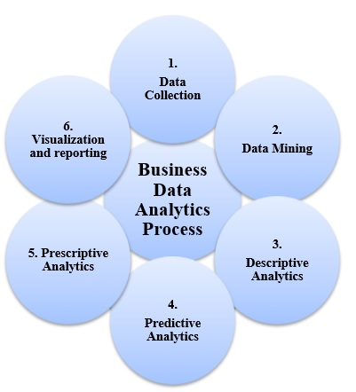
General process involved In analytics

Slide 7
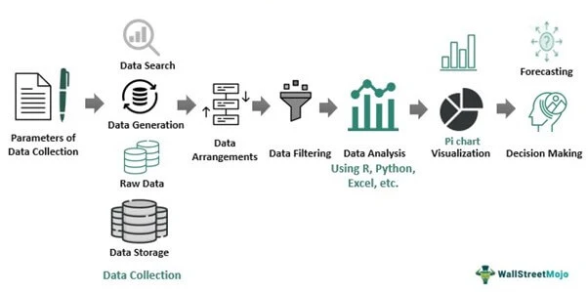

Slide 8

Types OF Analytics

Slide 9
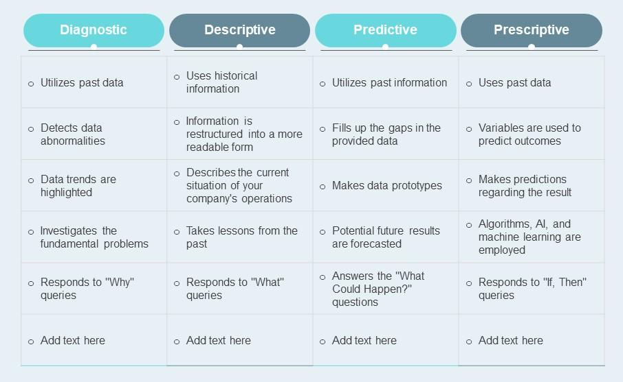

Slide 10

CASE STUDY TIME
Think of yourself as a doctor whose is treating a new patient. The patient is telling the doctor about his symptoms of illness. Doctor is trying to understand his illness.
To confirm the illness he suggests some tests and after analyzing the reports he writes some medicines and also suggest him to walk under the sun for at least 1 hour.
So, what type of analysis is the doctor doing?

Slide 11

Short cases
Suppose a company’s revenue is falling rapidly. What type of analysis would you perform?
Suppose you want to generate an annual report of the company what type of analytics you would perform?

Slide 12
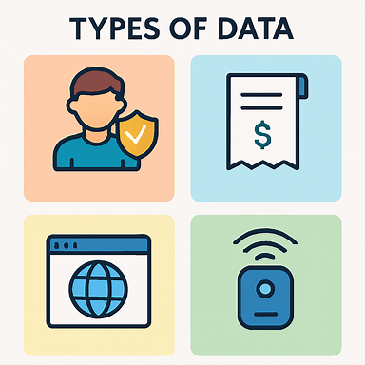
Types of data

Slide 13
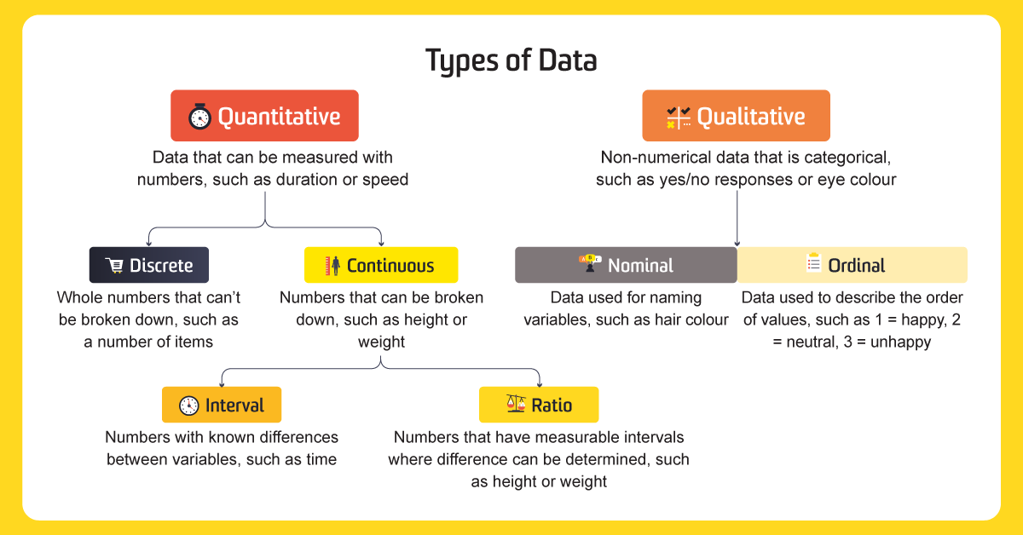

Slide 14
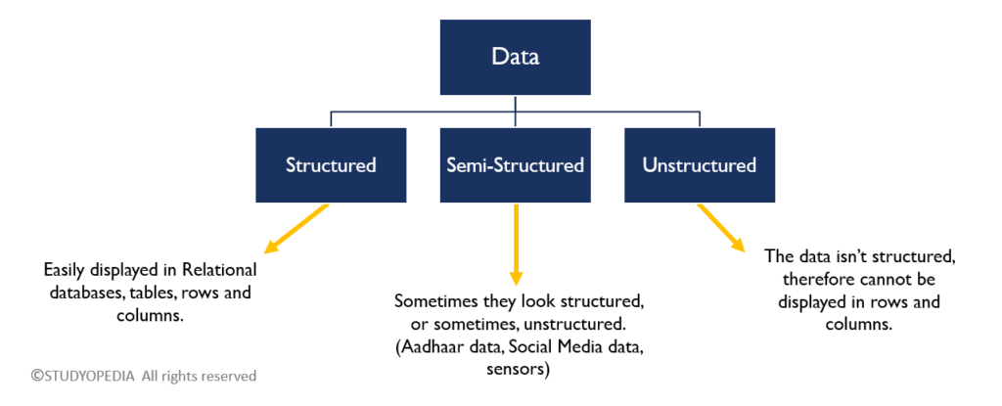

Slide 15
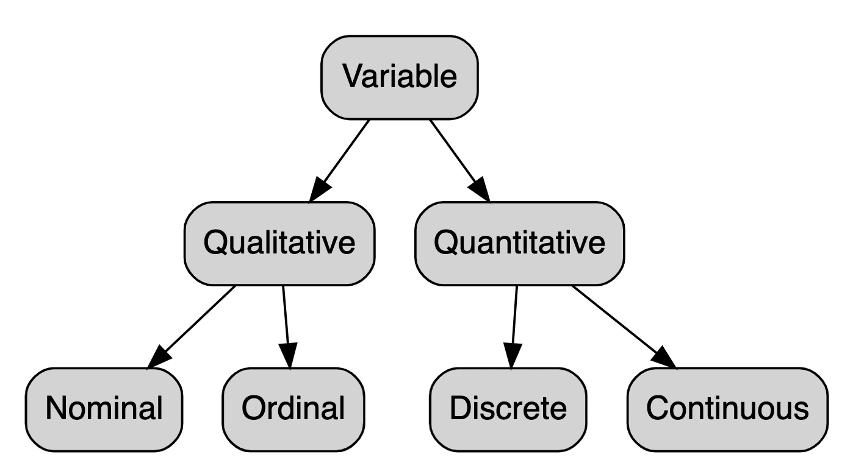
UNDERSTANDING VARIABLES OR ATTRIBUTES OR FEATURES

Slide 16
🟣 Qualitative (Categorical):
Describes qualities or categories — not numerical.
Nominal:
Labels without any order (e.g., gender, colors, brands).
Ordinal:
Categories with a meaningful order, but no fixed spacing (e.g., rankings, satisfaction levels).
🔵 Quantitative (Numerical):
Represents measurable quantities — always numerical.
Discrete:
Countable values, often whole numbers (e.g., number of students, cars).
Continuous:
Can take any value within a range, including decimals (e.g., height, temperature).

Slide 17
THANK YOU

