Slide 1
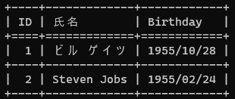
Left
InsideVertical
Right
Top
HeaderHorizontal
InsideHorizontal
Bottom

Slide 2
LeftStyle
IntersectionStyle
RightStyle
LineStyle

Slide 3

LeftStyle

