Slide 1
Coursera Final Project
Topic:-Finding-Appropriate-Place-for-customer-
By-Akash Sharma

Slide 2
Introduction/Business Problem A Martial Arts Teacher wants to set up his training centre in San Francisco . He wants to set his office in the location where the crime rates are high(as people would be more willing to learn martial arts) and also in the locality where people visit more often like places near restaurants, gym’s etc. So In order to solve this problem we will be taking the following steps:¶ 1.Taking the data base from police and checking which area has high crime Rates. 2.Then using our four Square API we will determine the best neighbourhood

Slide 3
To provide the information to the customer I have Taken the data from San Francisco Police database . It contains all the data of theft in San Francisco with Latitude and Longitude which is helpful in creating a clean structured data. Link: https://s3-api.us-geo.objectstorage.softlayer.net/cf-courses-data/CognitiveClass/DV0101EN/labs/Data_Files/Police_Department_Incidents_-_Previous_Year__2016_

Slide 4
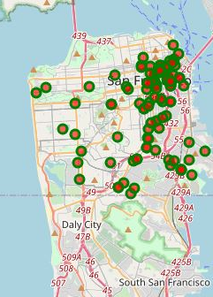
Plotting Map with all the crime data
I used a maps that could help Customer to decide the best neighborhood to open a martial arts center in San francisco based on crime records and nearby locality. In order to do that I've used the Data base provided by the police of San Francisco.

Slide 5
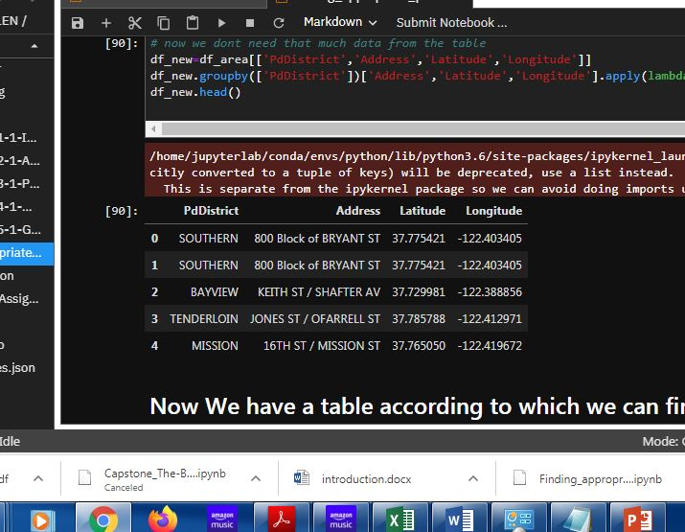
Creating data base of the area with most crime rate.
This data base helps in providing the clear picture of the locations in which crime rate is high.

Slide 6
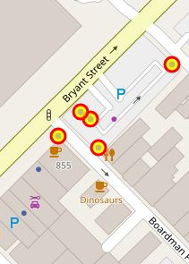
Superimposing the near by venues in the San Francisco map
The points determine the best area in which the customer can set up class.

Slide 7
Conclusion:- This report may be helpful for the customer on opening a martial arts class in locality in San Francisco by comparing the current offers and neighbourhood profiles, however it may not cover all variables such as access to public transportation. But the best thing about our project is that it can tell the appropriate information without visiting the place itself

