Slide 1

K.S.R. COLLEGE OF ENGINEERING DEPARTMENT OF COMPUTER SCIENCE AND ENGINEERING Mini Project-2024-25 AI-Code Translator With High Precision
GUIDE
Dr.E.Baby Anitha
ASP/CSE
KSR College of Engineering
PROJECT MEMBERS
Akash MG - 73152213009 Arul V - 73152213013 Kamalesh S - 73152213040 Kanishka VU - 73152213043

Slide 2
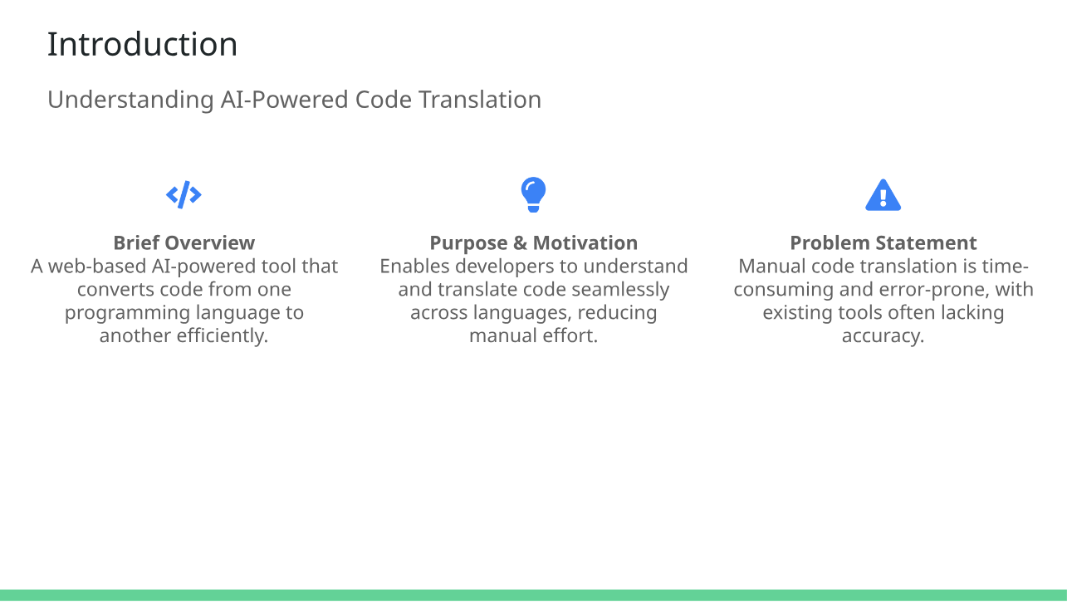

Slide 3
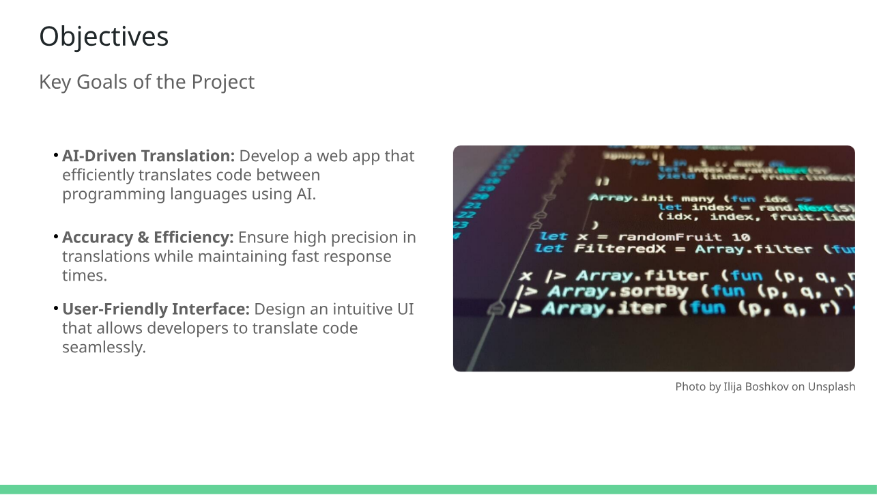

Slide 4
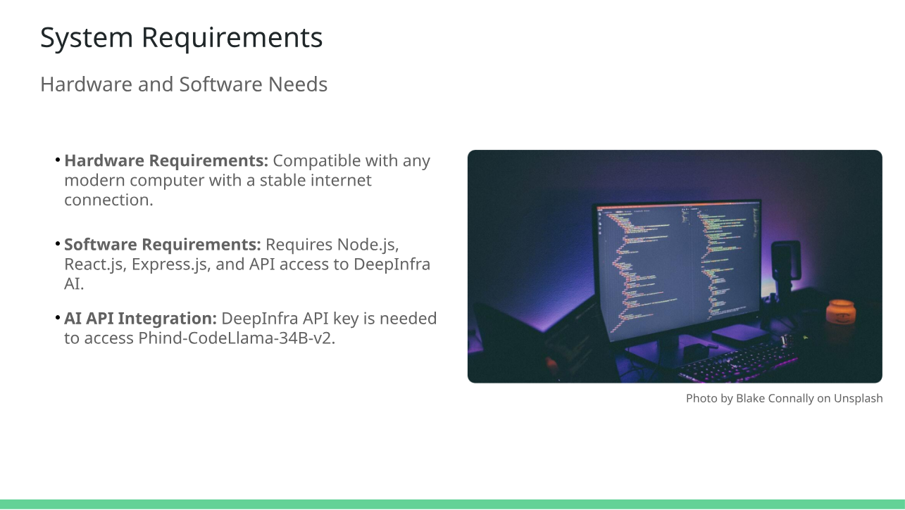

Slide 5
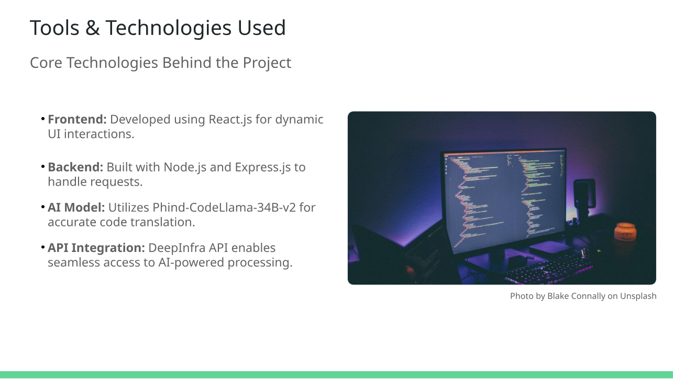

Slide 6
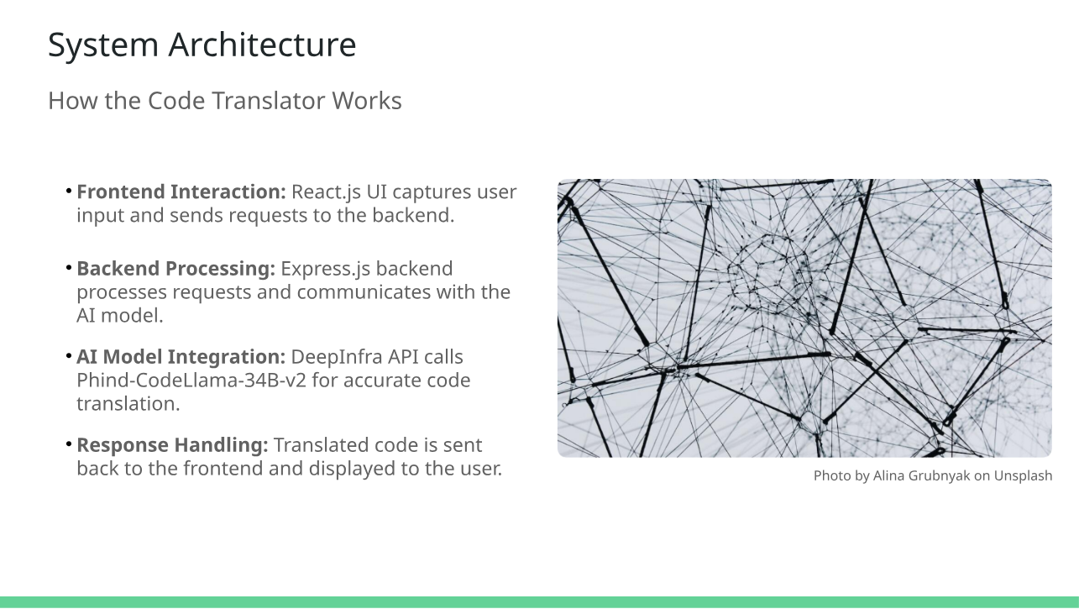

Slide 7
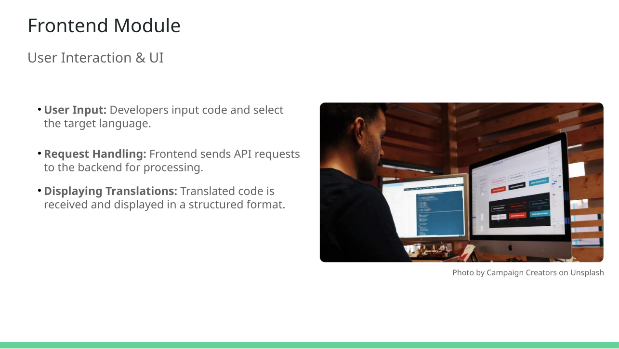

Slide 8
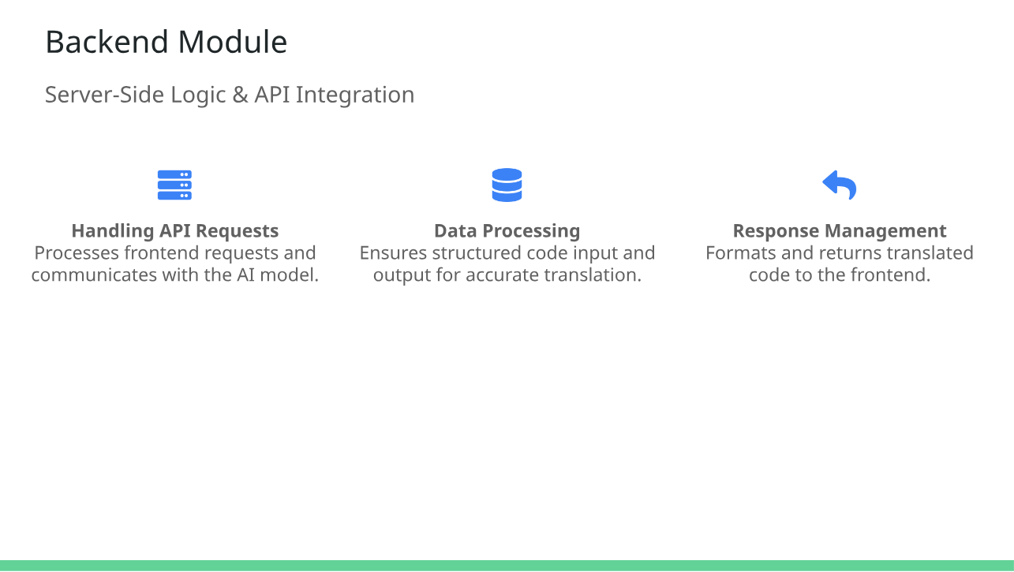

Slide 9
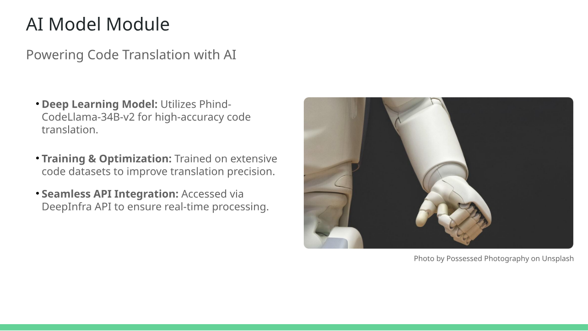

Slide 10
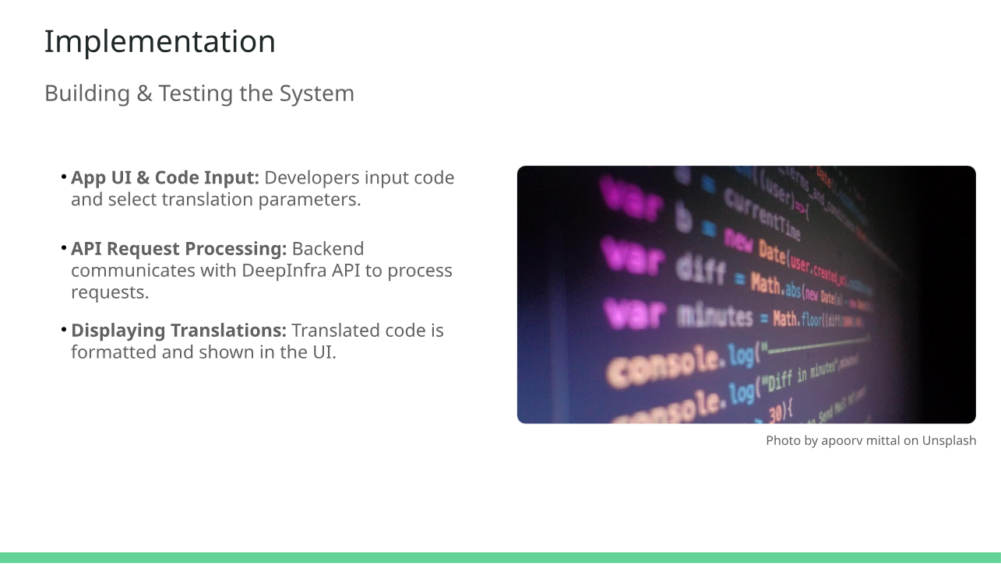

Slide 11
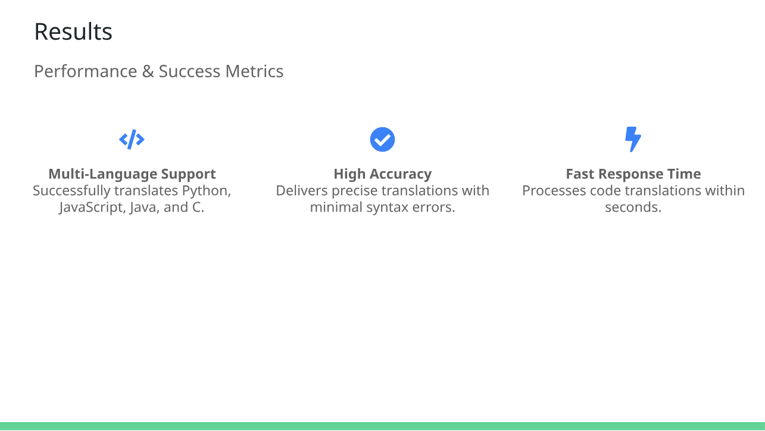

Slide 12
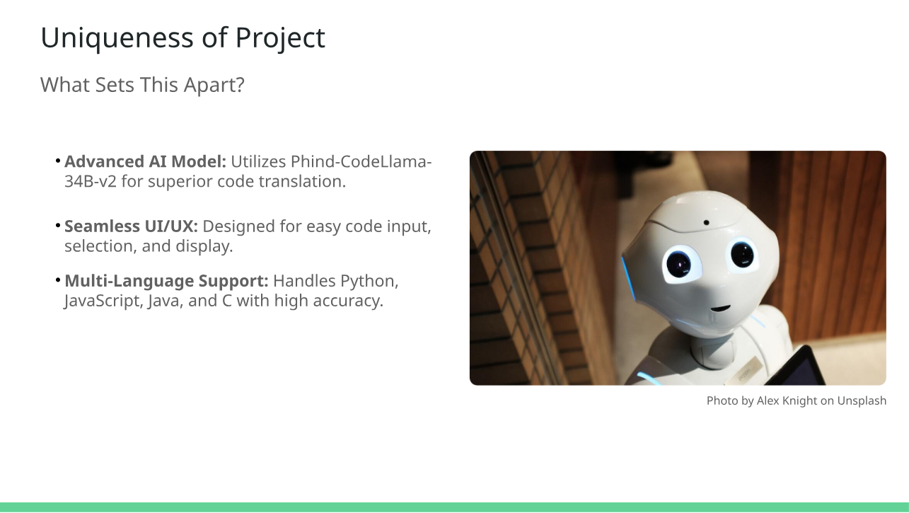

Slide 13
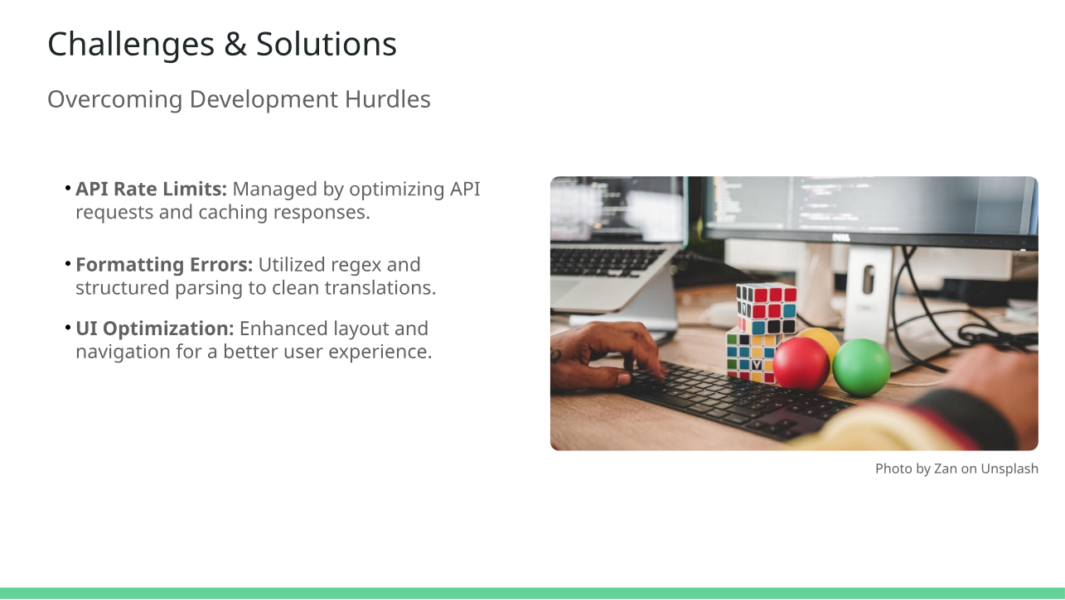

Slide 14
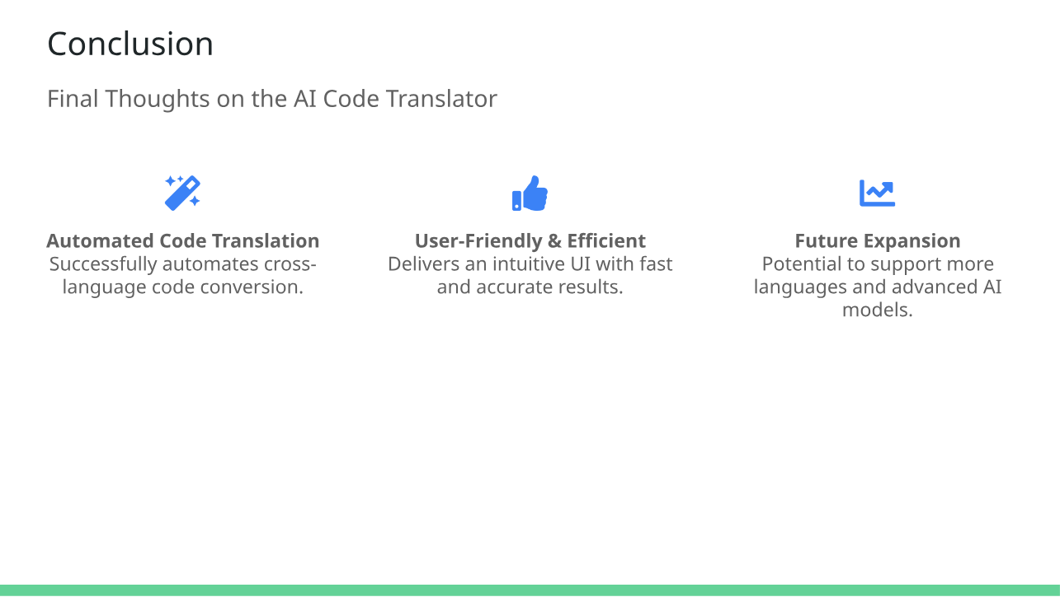

Slide 15
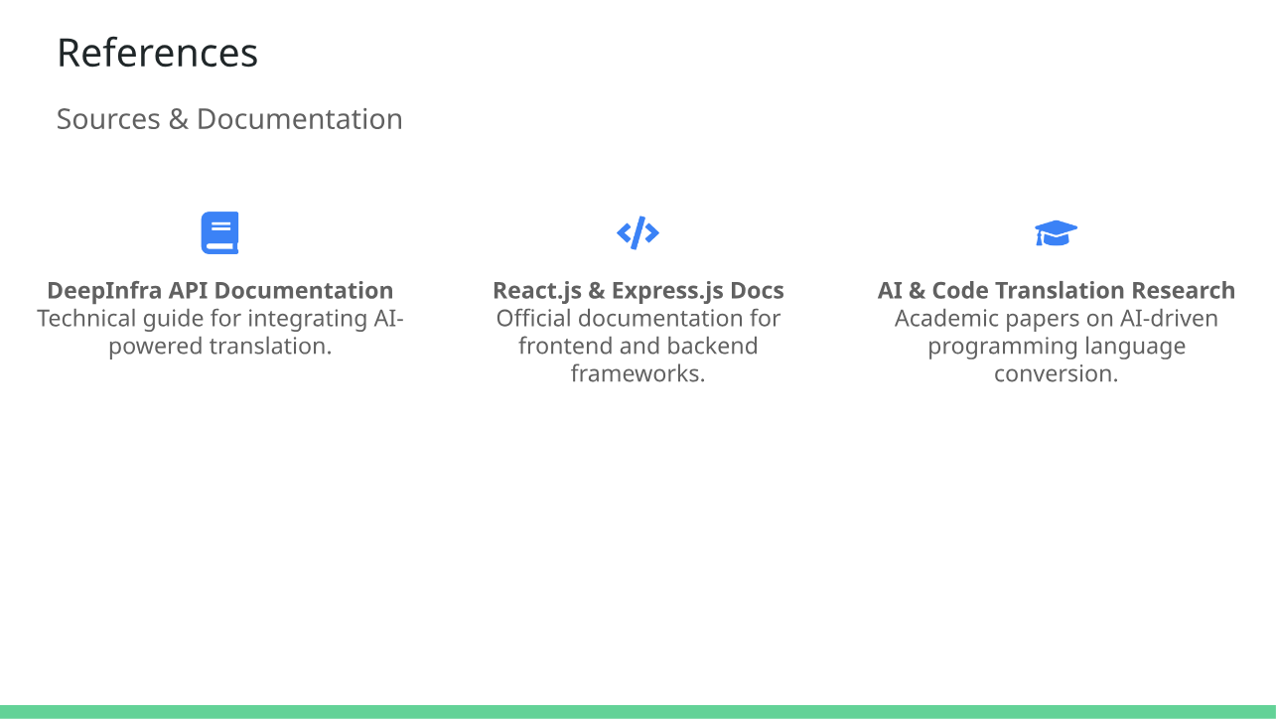

Slide 16


