Slide 1

DEPARTMENT OF
CSE (ARTIFICIAL INTELLIGENCE AND MACHINE LEARNING)
ACADEMIC YEAR 2025 - 2026
SEMESTER III
ARTIFICIAL INTELLIGENCE LABORATORY
MINI PROJECT REVIEW
NUMBER GUESSING AI WITH BINARY SEARCH ALGORITHM
REGISTER NUMBER | 2117240030004
NAME | AKASH M
YEAR | II
SECTION | A
FACULTY IN-CHARGE | Mrs. M. Divya

Slide 2
PROBLEM STATEMENT
Overview:
Number guessing is a classic game where a computer or user predicts a number within a given range.
This project enhances the traditional guessing game using Artificial Intelligence techniques to make the system intelligent and efficient in predicting numbers.
Problem Statement:
To develop an AI-based number guessing system that uses the Binary Search Algorithm to predict or identify a user’s secret number in the minimum possible attempts.
Expected Result:
An optimized number-guessing program that intelligently predicts the correct number with minimal guesses using binary search logic.
Possibilities:
Adaptive range expansion based on player feedback.
Integrating a GUI for better visualization.
Adding learning capability to adjust guessing strategy.

Slide 3
THEORETICAL BACKGROUND
Theoretical Background:
Binary Search is a divide-and-conquer algorithm used to find a target value efficiently in a sorted range.
It reduces the search interval by half on each iteration, making it an excellent approach for guessing problems.
Algorithm Steps:
Start with a defined lower and upper range.
Guess the middle value between both.
If the guess is correct → stop.
If the number is higher → shift the lower bound to mid + 1.
If the number is lower → shift the upper bound to mid - 1.
Repeat until the correct number is found.
Mathematical Formula: mid = (low + high) // 2
Literature Survey:
Knuth, D.E. (1973) – The Art of Computer Programming, Volume 3: Searching and Sorting.
GeeksforGeeks (2024) – Binary Search Algorithm Explained with Python Implementation.
Real Python (2023) – Interactive Games using AI Logic in Python.

Slide 4
IMPLEMENTATION AND CODE
Link to Code:
GitHub Repository – Number Guessing with AI Enhancement
Implementation Details:
Language Used: Python
Concepts Used: Binary Search, Conditional Logic, Loops, AI-based prediction improvement.
Modules: random, time, and basic I/O.
Functionality:
  System intelligently guesses the number chosen by the user.
  AI logic narrows down the search space after every feedback.
  Displays the number of attempts taken to reach the correct answer.

Slide 5
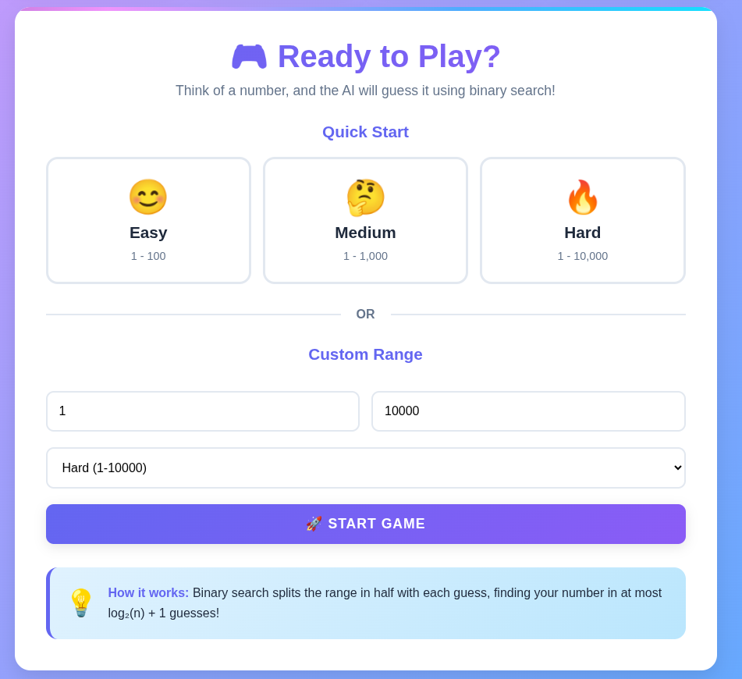
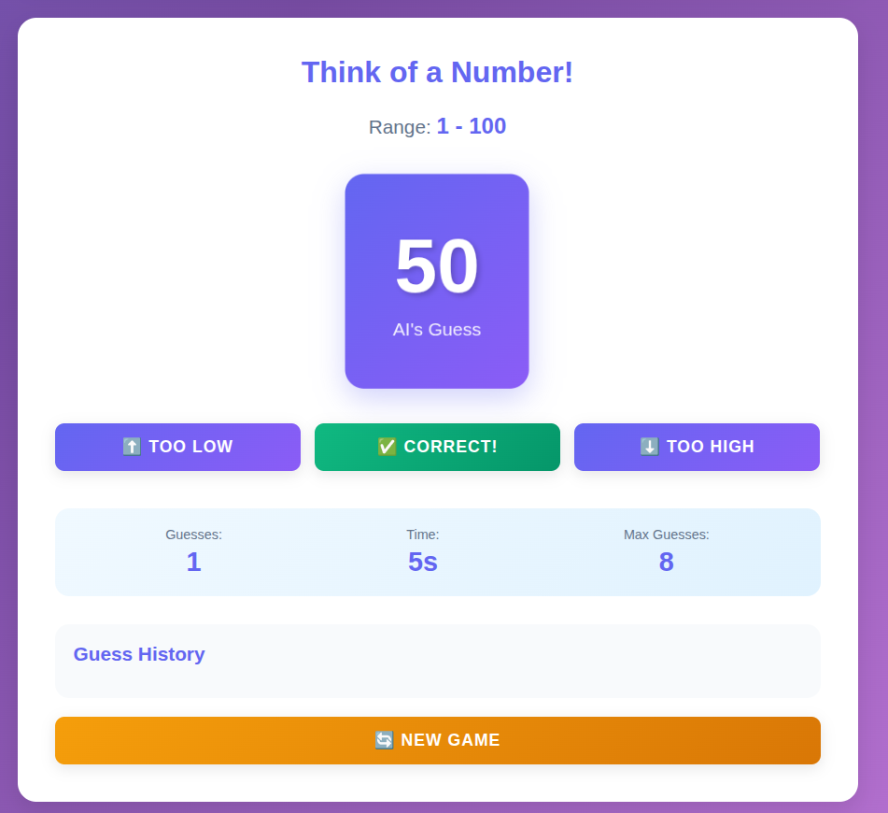
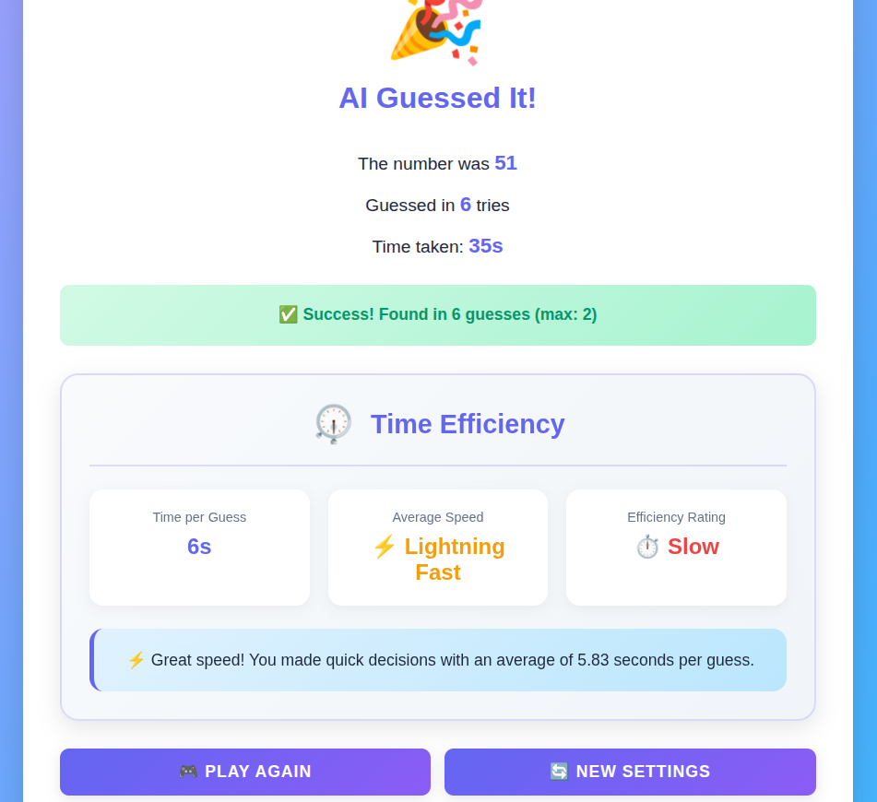
OUTPUT AND RESULTS

Slide 6
OUTPUT AND RESULTS
OUTPUT AND RESULTS
Explanation:
The AI-based program successfully predicts the user’s chosen number using a binary search approach.
It asks whether the guessed number is too high, too low, or correct and adjusts accordingly until success.
Results:
Achieved accurate predictions in log₂(N) attempts.
Demonstrated efficiency and intelligent feedback handling.
Enhanced user engagement through interactive gameplay.
Future Enhancements:
Integrate voice-based user feedback.
Add a graphical interface for visualization.
Extend to multi-level difficulty ranges.
Incorporate reinforcement learning for adaptive guessing strategies.

Slide 7
REFERENCES
REFERENCES
Knuth, D.E. (1973). The Art of Computer Programming – Searching and Sorting.
GeeksforGeeks (2024). Binary Search Algorithm.
Real Python (2023). Building Games with AI Logic in Python.
Python.org Documentation – Control Structures and Loops.

