Slide 1
Movie Booking System

Slide 2
High Level Assumptions
We are integrating with a payment engine/third party payment gateway like Paypal
There is a different Theatre Database/API to which our platform connects to
There could be multiple other similar platforms trying to hit the same theatre database/API
The load on application is heavy
Users are able to provide comments & ratings
Whatsapp notifications/Email notifications/SMS notifications would be sent post booking

Slide 3
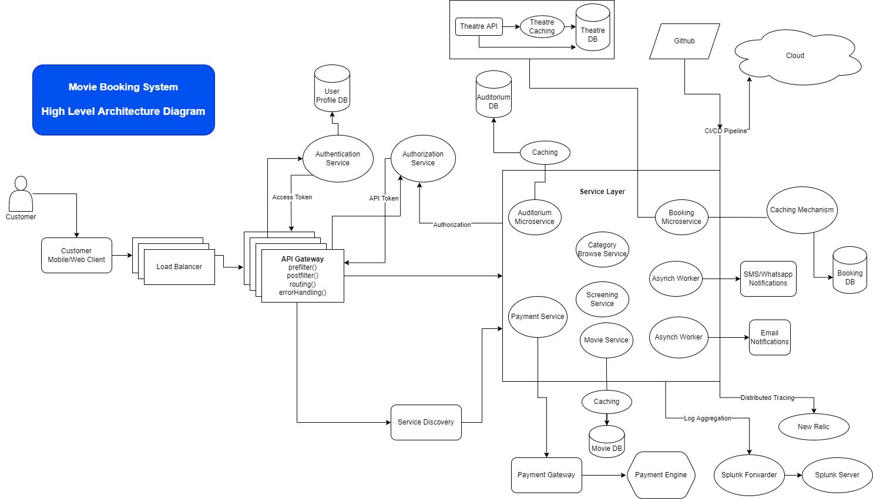

Slide 4
High Level Assumptions
We are integrating with a payment engine/third party payment gateway like Paypal
There is a different Theatre Database/API to which our platform connects to
There could be multiple other similar platforms trying to hit the same theatre database/API
The load on application is heavy
Users are able to provide comments & ratings
Whatsapp notifications/Email notifications/SMS notifications would be sent post booking

Slide 5
Technologies/Components
Load Balancing
Consistent hashing(preferred)
Round Robin
Least connection
CDN for caching image/video contents
API Gateway – Zuul(Netflix)
Service Discovery – Eureka
API/App Server Layer – Spring Boot

Slide 6
Technologies/Components
Log Aggregation
We can use Splunk
Caching
Redis is an open source, in-memory data structure store, used as a database, cache and message broker also. It is used as a caching layer for heavily read data.
We can have distributed caching with REDIS to avoid having single point of failure
Asynch Workers
We can have workers to execute the async task like Python celery workers execute time-consuming tasks like Sending SMS/Email or Watsap messages or Generating Tickets as PDF
Deployment
We can have Docker containers to deploy on Openshift Container Platform by Redhat

Slide 7
Technologies/Components
Security
Spring security
Authentication – User Profile Service that returns JWT token
Authentication can be memory based/possession based or multi-factor authentication
JWT(JSON Web token) /OAuth for Authorization
Asynch Workers/Messaging
Apache Kafka as it is fault tolerant/scalable & Distributed
Code repository
Git
CI/CD
Jenkins

Slide 8
Persistence Layer
In case of ticketing system
Need ACID & Relationship Representation
Need transactions
Tons of data like movies information, actors, crew, comments and reviews
We should be using both RDBMS & NoSQL to support these
For first & second, we should be using RDBMS e.g. MySQL as it ensures Consistency & Availability
The system is read heavy we will have sharded and master-master slave RDBMS where slaves are used for reads and master for writes. Master Master to avoid single point failure single point failure
For Third, we should be using NOSQL database e.g. MongoDB
Whereas NOSQL can be distributed and nodes are deployed in multiple regions to avoid latency.

Slide 9
Working Steps
Customer Will check Application with Location, Filters, Sorting, Categories, etc. Find location from APP or Location from ISP from Browser
Open a Movie — Check all Nearby theatres and there timing of Movie.
Select a theatre for a particular date and time. Now the seat information is fetched from the DB/API of the Movie theatre which is cached for a few seconds
A lock would be applied on the particular seat for 10 minutes as other booking apps would be using same theatre database/API
Lock can be applied on database or API need to make sure through concurrency & synchronization
Check Invoice with payment options and pay via gateway. Request will be redirected to payment gateway
Once the Payment succeeds theater gives a unique ID
Customer will get a ticket with Invoice with Encrypt QR code, Basic details of Movie, Address of theater, Timing, Theater Number, etc

Slide 10
Working Steps Continued…
A ticket will be generated then and there only using Unique Ticket ID
few more async tasks were invoked to send SMS, EMAIL and WHATSAPP the Tickets
Booking is now complete

