Slide 1

7-DAY STUDENT ACQUISITION
From 0 Shortlists
to a Top 1% Candidate
Bring 500+ engineering students into a career-focused AI placement workshop on a ₹2,000 budget.
500+
₹2,000
engineering students
campaign budget
Positioning
Audience
Deploy a live industry AI project on your resume in 60 minutes, with interview preparation for ₹8L–₹24L roles.
Final-year and pre-final-year students in Tier-2/3 engineering colleges.

Slide 2
BUDGET ALLOCATION
Student Placement Coordinators
Put the ₹2,000 behind peer networks, not paid ads
₹1,200
₹150 bounty to 8 coordinators for verified batch signups
280 registrations
Placement Survival Kit referral gate
Three prioritized channels are projected to deliver 530 registrations at a blended CAC of ₹3.77.
₹500
Invite 3 peers to unlock interview Q&As and the drive tracker
160 registrations
530
₹3.77
projected registrations
blended CAC
Off-campus communities
₹300
Through 6 regional Telegram channels
90 registrations
2

Slide 3
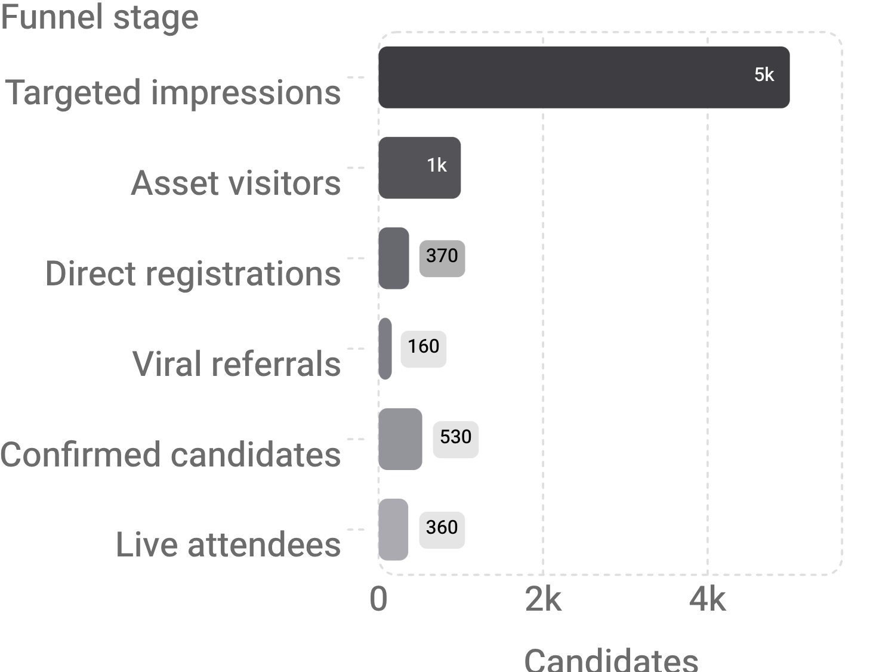
THE 7-DAY ENGINE
Seven days turn 5,000 impressions into 530 candidates
Seed the asset, activate peer distribution, then use scarcity and reminders to compound registrations.
Seven-day sequence
D-7 to D-6
Recruit 8 placement reps and launch the working asset; target 120 registrations.
D-5 to D-3
Open referrals, activate Telegram communities, and trigger the “110 seats remaining” follow-up; target 425 registrations.
D-2 to D-1
Run the ₹500 voucher leaderboard, then lock in admit passes; target 530+ registrations.
Peer referrals lift 370 direct registrations to 530 total confirmed candidates, with about 360 live attendees.
3

Slide 4

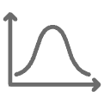



THE WORKING ASSET
Make the working asset do the selling
A five-part interactive application replaces a static form and creates value before registration.
Role and salary matcher
Shortlist probability estimator
Maps AI roles and ₹8L–₹24L targets to a project architecture and ATS-ready resume bullets.
Turns a profile assessment into an immediate “boost” action.
Admit pass
Referral gate
Generates a candidate ID, seat number, QR code, and calendar sync.
Tracks 1/3 → 2/3 → 3/3 invites to unlock the interview kit and drive tracker.
Light and dark mode
Keeps the experience legible across devices.
4

Slide 5



ATTENDANCE SYSTEM
Attendance is engineered, not assumed
Use three WhatsApp touches to push live attendance above 65%.
Instant
D-1
T-45 minutes
Admit pass plus one-tap Google Calendar sync.
A 30-second Google AI Studio API-key setup task.
Doors-open alert with an exclusive first-10-minutes hiring directory.
DELIBERATE REJECTIONS
Above 65%
Paid ads, cold-emailing HODs, and generic prompt-engineering messaging were rejected in favor of SPCs, peer distribution, and deployed AI capstones.
live attendance target

