Slide 1




•Problem Statement Title - Build an AI-powered assistant that helps students manage study schedules, reminds them of deadlines, and answers questions using a custom-trained academic knowledge base.
•Theme -ARTIFICIAL INTELLIGENCE
•Team ID –U.ADEV13
•Team Name (Registered on Website) - DevSquad
•Participant Names –U . Akash , N . Gopichand , M . John Nikhil ,
K . Karthikeya
Sri Indu College of Engg & Tech - Cyber Club, Department of Cyber Security
Page 01

Slide 2

Dev squad
Smart Student Assistant using AI
Proposed Solution
AI-powered virtual assistant for academic support
Features include smart study scheduling, deadline reminders, and
academic Q&A support
Addresses student productivity, time management, and learning
support
Innovation lies in combining NLP with a custom academic
knowledge base for contextual answers
Adaptive planning based on performance and study behavior
Sri Indu College of Engg & Tech - Cyber Club, Department of Cyber Security
Page 02

Slide 3
TECHNICAL APPROACH
Dev squad
•Frontend: React (Web frame work)
Backend: Node.js
Methodology:
User inputs schedule, syllabus, and preferences
AI generates a personalized plan
Deadlines tracked via integrated calendar sync
NLP chatbot answers queries based on trained content
Dashboard for tracking and recommendations
Sri Indu College of Engg & Tech - Cyber Club, Department of Cyber Security
Page 03

Slide 4
FEASIBILITY AND VIABILITY
Dev squad
Feasibility Analysis
A. Technical Feasibility
1. Core Technologies Required:
Natural Language Processing (NLP) for understanding and responding to queries.
Machine Learning for intelligent task scheduling and prioritization.
Custom Knowledge Base Integration using embeddings or retrieval-augmented generation (RAG).
APIs/Integrations with platforms like Google Calendar, Notion, MS Teams, etc.
Push Notification Systems for reminders (mobile/web).
2. Available Tools/Platforms:
GPT-based LLMs (e.g., OpenAI, Claude, etc.)
Vector databases (e.g., Pinecone, Weaviate, FAISS) for custom knowledge bases.
Front-end (React Native for mobile, React for web).
Backend services (Node.js, Flask, Firebase).
3. Risks & Challenges:
Custom knowledge base maintenance.
Ensuring response accuracy and avoiding hallucinations.
Privacy and data security compliance (especially student data - FERPA, GDPR).
Sri Indu College of Engg & Tech - Cyber Club, Department of Cyber Security
Page 04

Slide 5
IMPACT AND BENEFITS
Dev squad
•Target Audience Impact: Helps students stay organized and improve academic performance Reduces stress through automation and reminders
Benefits:
Social: Promotes self-discipline and accountability
Economic: Cost-effective digital mentor
Educational: Improves access to academic assistance
Sri Indu College of Engg & Tech - Cyber Club, Department of Cyber Security
Page 05

Slide 6
RESEARCH AND REFERENCES
Dev squad
OpenAI GPT (Language Model) : https://platform.openai.com/docs
Google Calendar API Documentation : https://developers.google.com/calendar
IEEE Research on Student Time Management and AI in Education
Article: "AI-Based Smart Study Planner“ : https://ieeexplore.ieee.org/document/9234293\
Firebase Realtime Database Docs (Optional for backend) : https://firebase.google.com/docs/database
Python Scheduler Library (e.g., APScheduler) : https://apscheduler.readthedocs.io/en/stable/
Sri Indu College of Engg & Tech - Cyber Club, Department of Cyber Security
Page 06

Slide 7
Dev squad
FUTURE ENHANCEMENTS
Integration with LMS platforms (Moodle, Google Classroom)
Voice assistant support
Real-time analytics and progress reports
Multi-language support for regional access
AI tutor for subject-wise concept teaching
Sri Indu College of Engg & Tech - Cyber Club, Department of Cyber Security
Page 07

Slide 8
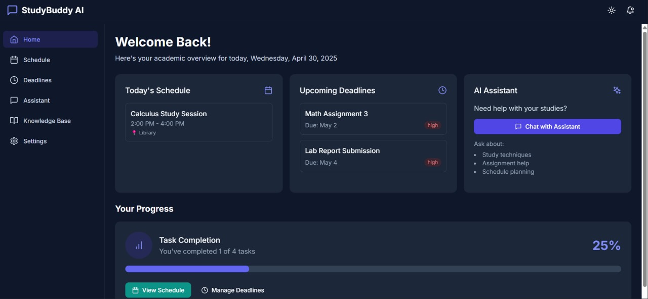
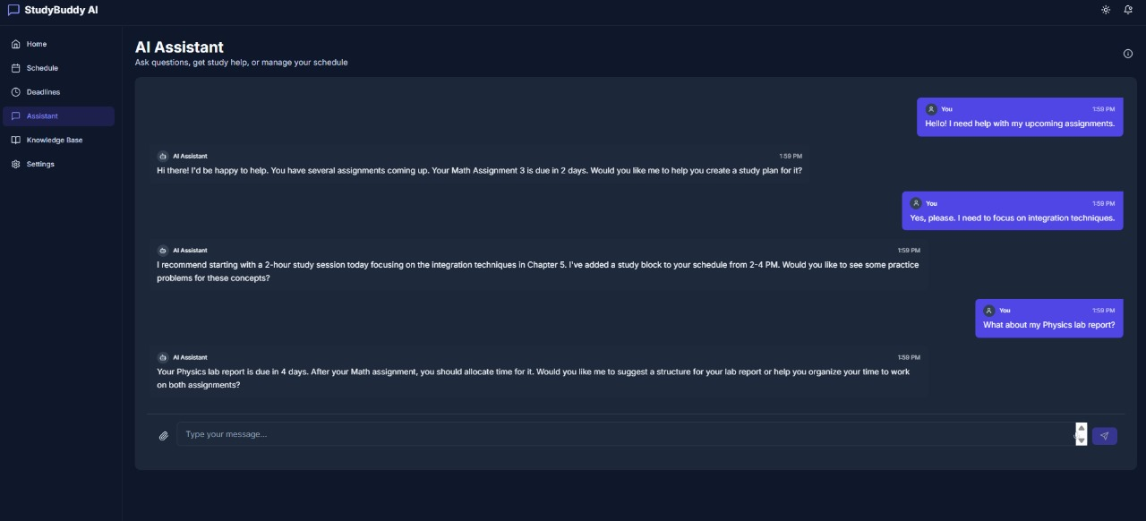
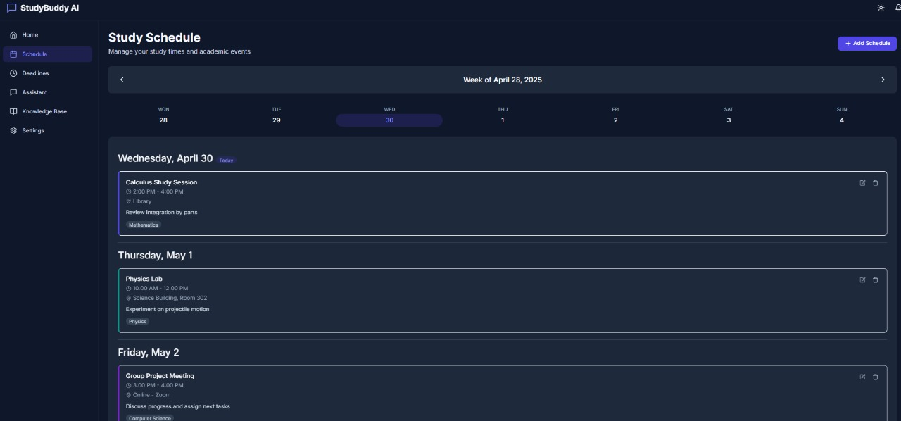
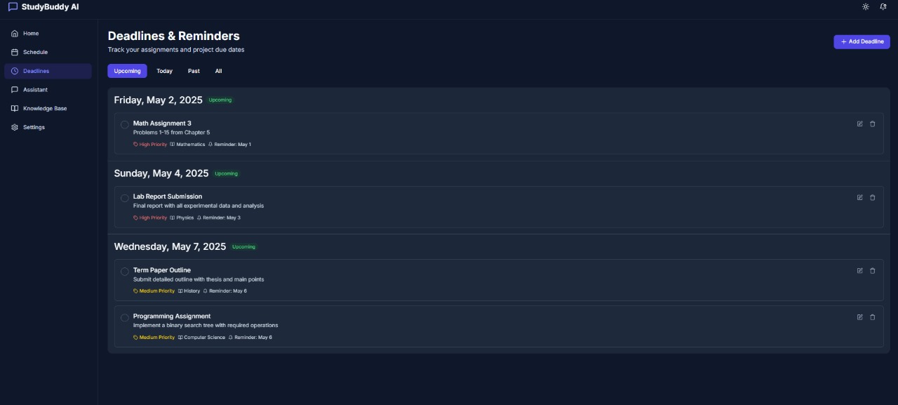
Dev squad
DEMO (IF APPLICABLE)
Sri Indu College of Engg & Tech - Cyber Club, Department of Cyber Security
Page 08

Slide 9
Dev squad
CONCLUSION & THANK YOU
The Smart Student Assistant using AI is a personalized academic helper that combines smart scheduling, reminders, and instant academic support to empower students.
Thanking you
Thank you to the organizers and mentors of Code Mania for this opportunity.
Sri Indu College of Engg & Tech - Cyber Club, Department of Cyber Security
Page 09

