Slide 1
Meal-Management System:
Submitted by:
1.Mehedi Hassan Shovo(181-15-1821)
2.Akash Ahmad(181-15-1714)
3.MD.Shihan Shah Murad(181-15-1838)

Slide 2
Abstract:
In this apps the hostel manager easily control the meal management System. Because of all information are here and easily find out a customer what they want.
In this apps we insert customer all information's. Such as name , Id, phone No,address,email,Food meanu,meal time etc. So the manager can easily calculate the total bill and total money which are they pay.
It has other good sides .All customer information are saved here .For this reason we can identify any one and also have insert, delete and update option. So we manager can also delete and update any customer easily.

Slide 3
Insert Option:
To insert data into a table using the INSERT statement ,I done the following steps:
1.First , connect to the SQL database .
2.Next prepare the INSERT Statement.I use parameter for the statement,use a question mark(?) for each parameter.
3.Then,create an instance of the PreparedStatement from the connection object.
4. After that, set the corresponding values for each placeholder using the set method of the preparedstatement object such as setInt(), setString() ect.
5. Finally, call the executeUpdate() method of the preparedstatement object to the statement.

Slide 4
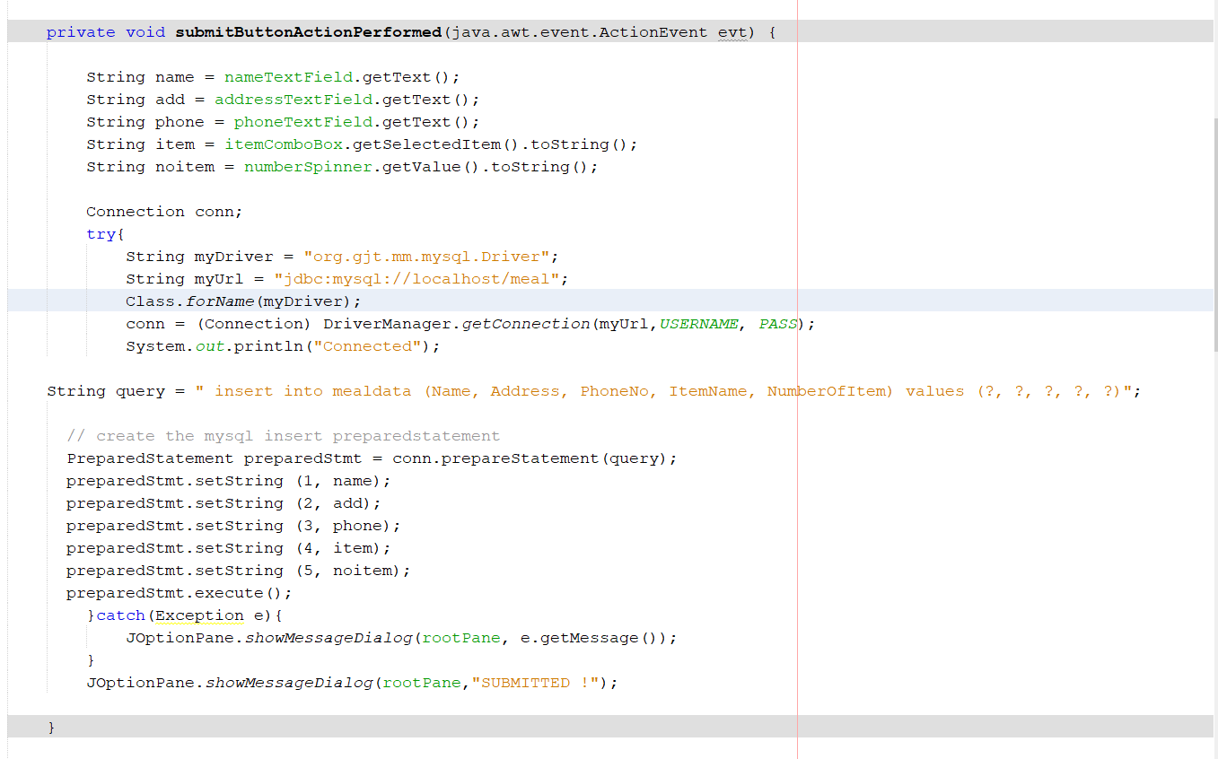

Slide 5
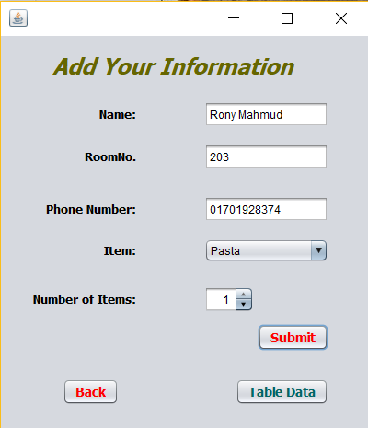

Slide 6
Update Operation:
To update existing data of a table, I done this steps below:
1.First, connect to the SQL database.
2.Next prepare the UPDATE statement.For the UPDATE statement that uses parameter, you use the question marks(?) placeholder in the SET and WHERE cluses.
3.Then instantiate an object the prepared Statement class by calling the prepareStatement() method of the connection object.
4. After that, set a value for each placeholder using the set* method of the preparedstatement object, for example,getString(), getName(), etc.
5. Finally, execute the UPDATE statement by calling the executeUpdate() method of the preparedstatement object.

Slide 7
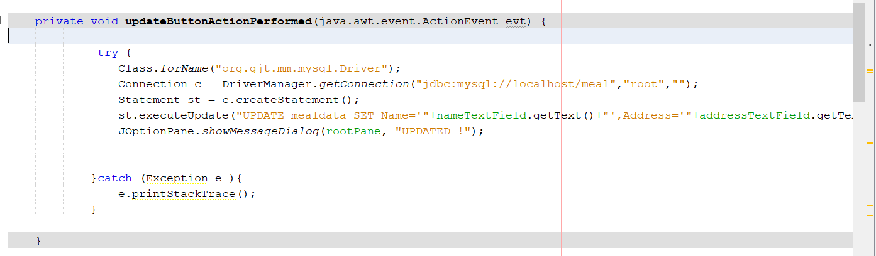

Slide 8
Delete Option:
To delete one or more rows of a database table :
1.First,Create a database connection to the SQL database.
2. Next, prepare the DELETE statement. In case I want the statement takes parameters, I use the question mark (?) placeholder inside the statement.
3. Then, create a new instance of the prepared Statement class by calling the prepareStatement() method of the connection object.
4. After that, supply values in place of the question mark placeholder using the set* method of the prepared Statement object e.g setInt(),setString() etc.
5.Finally ,execute the DELETE statement by calling the executeUpdate() method of the PreparedStatement object.

Slide 9
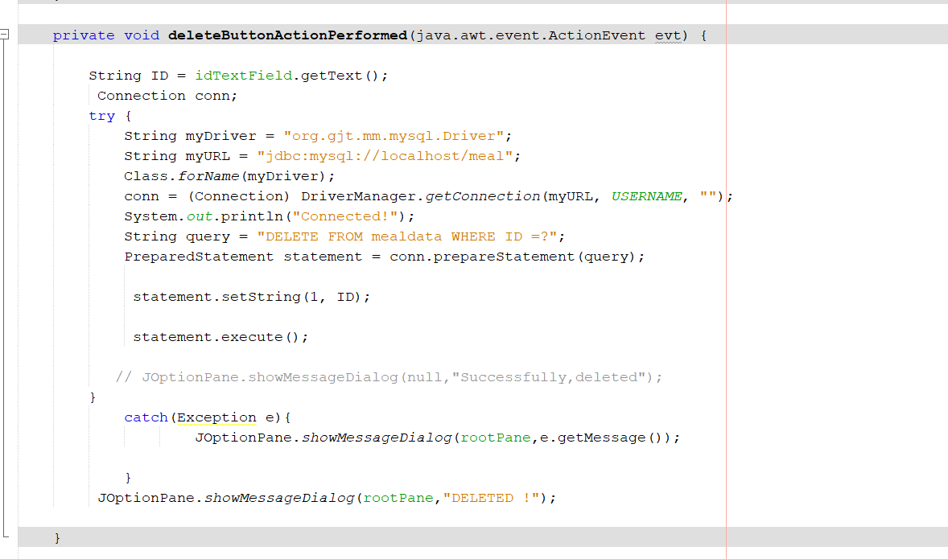

Slide 10
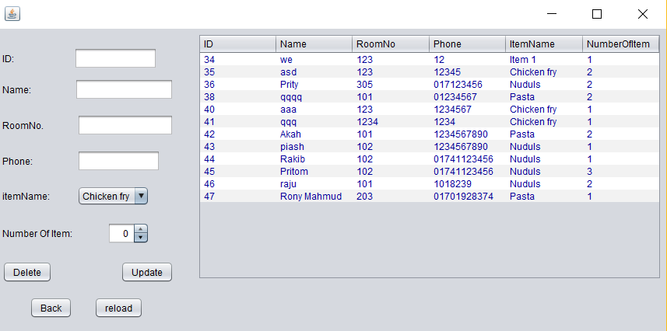

Slide 11
Data Retrieval:
In databases, data retrieval is the process of identifying and extracting data from a database, based on a query provided by the user or application. It enables the fetching of data from a database in order to display it on a monitor and/or use within an application.
Data retrieval typically requires writing and executing data retrieval or extraction commands or queries on a database. Based on the query provided, the database looks for and retrieves the data requested. Applications and software generally use various queries to retrieve data in different formats. In addition to simple or smaller data, data retrieval can also include retrieving large amounts of data.

Slide 12
Chalanges
Database connection
Update
Insert
Delete
Create a table
Design a project

Slide 13
Thank you ….

