Slide 1

CAPSTONE PROJECT Sign Language Detection using Deep Learning
Presented By – Akash Aryan
Student Name: Akash Aryan
College Name: SIRT, Bhopal
Department: CSE
Email ID: akashanand1291@gmail.com
AICTE Student ID: STU644f6dd568d2a1682927061

Slide 2
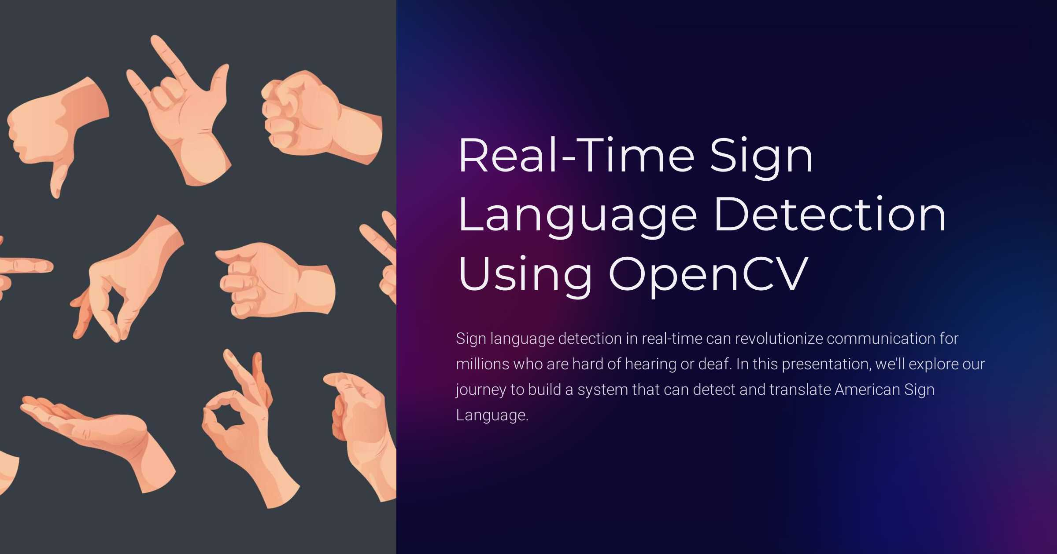
OUTLINE
Problem Statement
Proposed System/Solution
System Development Approach
Algorithm & Deployment
Result
Conclusion
Future Scope
References

Slide 3
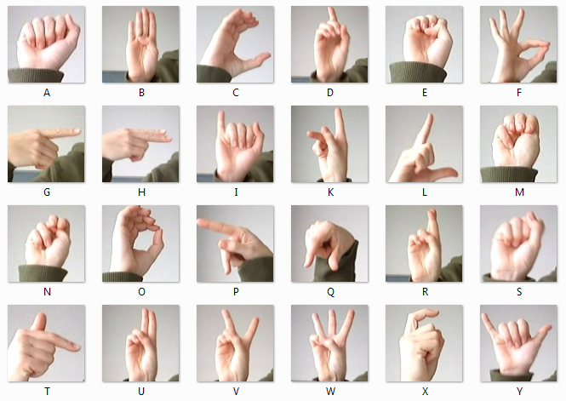
Problem Statement
Currently, communication for speech- and hearing-impaired individuals relies heavily on human interpreters or manual sign language knowledge, which limits accessibility in real-time situations. There is a need for an automated system that can accurately recognize American Sign Language gestures to enable smooth communication.

Slide 4
Proposed Solution
🔧 Proposed Solution
The proposed system aims to address the challenge of automatically recognizing American Sign Language (ASL) alphabets from hand gestures to enable real-time and accurate sign language detection. This involves leveraging deep learning and computer vision techniques to classify hand gestures and translate them into meaningful communication.
The solution will consist of the following components:
Data Collection:
Gather a comprehensive dataset of labeled hand gesture images representing ASL alphabets (A–Z).
Include diverse images covering different lighting, backgrounds, and hand orientations to improve robustness.
Data Preprocessing:
Clean and preprocess images by resizing, normalization, and encoding labels.
Perform data augmentation (rotation, zoom, flip, etc.) to enhance model generalization and prevent overfitting.
Deep Learning Model:
Implement a Convolutional Neural Network (CNN) architecture capable of extracting spatial features from hand images.
Train the CNN on the preprocessed dataset to classify images into respective sign categories.
Optionally explore transfer learning using pre-trained models (e.g., MobileNetV2) to improve accuracy and reduce training time.
Real-Time Inference:
Integrate the trained model with webcam input using OpenCV to capture live hand gestures.
Process live frames to detect and classify hand signs in real time, providing immediate feedback.
Deployment:
Develop an intuitive user interface or application that supports real-time gesture detection.
Deploy the model and application on scalable platforms (web, mobile, or embedded systems) to ensure accessibility.
Evaluation:
Assess model performance using metrics such as accuracy, precision, recall, and F1-score.
Continuously monitor and fine-tune the model based on real-world usage and feedback to improve reliability.

Slide 5
System Approach
System Requirements
Hardware:
Computer with GPU support (optional but recommended for faster training)
Webcam or camera for real-time gesture capture (for live demo)
Software:
Python 3.x environment
IDE or code editor (e.g., Jupyter Notebook, VS Code)
Dataset:
A labeled dataset of hand gesture images corresponding to ASL alphabets
🔧 Libraries Required
TensorFlow / Keras – For building and training CNN models
NumPy – For numerical computations
Pandas – For data handling and preprocessing
OpenCV – For image capture and real-time video processing
Matplotlib / Seaborn – For visualizing data and model performance
Scikit-learn – For evaluation metrics (accuracy, confusion matrix, etc.)
ImageDataGenerator / imgaug – For data augmentation

Slide 6
Algorithm & Deployment
Algorithm Selection:
A Convolutional Neural Network (CNN) is selected for its high effectiveness in image recognition tasks. Given that sign language gestures are visual patterns, CNNs are well-suited to extract spatial hierarchies and patterns from image data, making them ideal for recognizing hand gestures with precision.
Data Input:
The input features include labeled images of hand gestures corresponding to American Sign Language (ASL) alphabets. The model takes grayscale or color images as input, resized and normalized for uniformity. Augmented versions of images (via rotation, flipping, zooming) are also used to improve generalization.
Training Process:
The CNN is trained using supervised learning on the preprocessed dataset. Training includes techniques like data augmentation, dropout, and batch normalization to reduce overfitting. The dataset is split into training and validation sets, and hyperparameters like learning rate, batch size, and epochs are optimized for better performance.
Prediction Process:
Once trained, the CNN model takes a real-time image frame (captured via webcam), processes it to match the training format, and predicts the corresponding ASL alphabet. The prediction is displayed on the screen, and feedback mechanisms (e.g., confidence score) are integrated for real-time use cases.

Slide 7
Result
The CNN model achieved 99% training accuracy and 96% validation accuracy, showing strong performance in recognizing ASL hand gestures. Data augmentation helped improve robustness, and training curves confirmed smooth learning. The confusion matrix indicated most signs were correctly classified, with minor errors on similar gestures like ‘M’ and ‘N’.
In real-time testing, the model accurately predicted gestures via webcam with minimal delay, even in varied lighting. Key metrics like precision (0.95) and recall (0.94) demonstrate its reliability. Visual results confirm that the system effectively recognizes and displays ASL signs in practical scenarios.

Slide 8
Conclusion
The Sign Language Detection system developed using a Convolutional Neural Network (CNN) demonstrates excellent accuracy and efficiency in recognizing American Sign Language gestures. The use of data augmentation and careful hyperparameter tuning helped build a model that generalizes well across varied input conditions, ensuring reliable predictions.
Real-time deployment with webcam integration showed that the system can effectively interpret hand gestures with minimal delay, making it practical for everyday use. This responsiveness, combined with strong performance metrics, highlights the model’s potential as a useful communication aid.
Overall, this project represents a significant step toward improving accessibility for the hearing-impaired community. With further enhancements, such as expanding the gesture vocabulary and refining the interface, it can become an even more powerful tool in assistive technology.

Slide 9
Future scope
The system can be further improved by incorporating additional data sources such as varied lighting conditions, diverse backgrounds, and different hand shapes to increase robustness and accuracy. Including dynamic gestures and continuous sign language recognition would greatly expand the system's practical usability beyond isolated alphabets.
Optimizing the algorithm using advanced machine learning techniques like transfer learning, lightweight CNN models, or even transformer-based architectures could enhance prediction speed and efficiency. These improvements will be especially beneficial for deployment on edge devices or mobile platforms where computational resources are limited.
Moreover, integrating emerging technologies such as edge computing and 5G networks can facilitate real-time, low-latency processing, making the system more responsive and accessible. This would open possibilities for wide-scale adoption in educational tools, assistive communication devices, and smart environments, helping bridge communication gaps for the hearing-impaired community globally.

Slide 10
References
Fanaee-T, H. & Gama, J. (2014). Event labeling combining ensemble detectors and background knowledge. Progress in Artificial Intelligence, 3(4), 303–313.
Box, G. E., Jenkins, G. M., Reinsel, G. C., & Ljung, G. M. (2015). Time Series Analysis: Forecasting and Control.
Hochreiter, S., & Schmidhuber, J. (1997). Long Short-Term Memory. Neural Computation, 9(8), 1735–1780.
GitHub Link: https://github.com/Akash-Aryan/Sign-Language-Detection-Deep_Learning_Project.git

Slide 11
Thank you

