Slide 1
High dimensional data indexing
Using R-tree
Group Members:
Prakhar Singh 20CS10045
Atishay Jain 20CS30008
Rudrak Patra 20CS30044
Akash Das 20CS10006
Saras Pantulwar 20CS30046

Slide 2
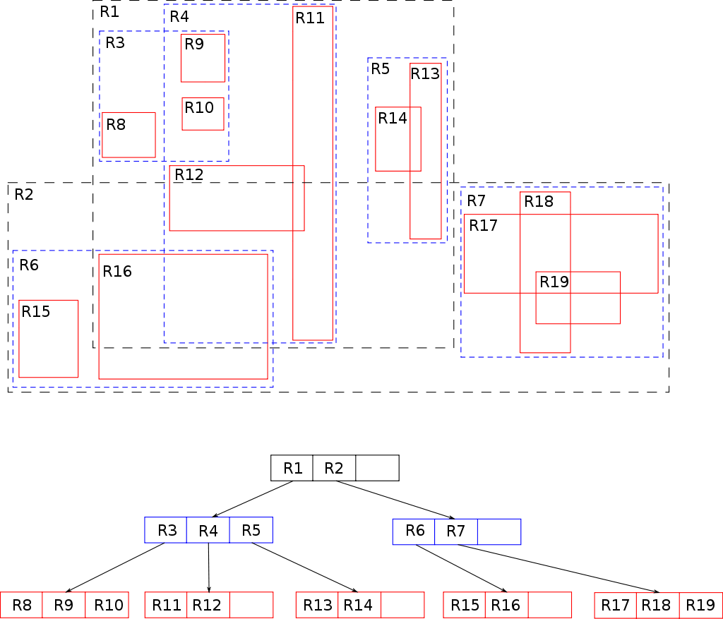
Introduction
What is high dimensional data indexing ?
High dimensional data indexing and searching is the process of storing and retrieving data points that exist in a high-dimensional space.
Traditional indexing and searching techniques are not effective for high dimensional data due to the exponential growth in the number of attribute combinations.
Space partitioning methods such as R-trees divide the space into subspaces for efficient search.
High dimensional data indexing and searching is important in domains such as image processing, computer vision, and machine learning.

Slide 3











Data Structure
Bulk-Algo
tree-based data structure, each node represents a minimum bounding rectangle (MBR) enclosing a set of objects.
for efficiently R-Tree, partition data objects into groups and recursively create nodes for each group. Nodes are merged to form a balanced tree.
Insertion
Split-Algo
objects are inserted by traversing the tree until we find the leaf node enclosing the object recursively.
R-Tree implementation
When splitting full nodes, find two new MBRs that cover the data objects with minimal overlap, using algorithms such as linear or quadratic split
Searching
Deletion
traverse the tree checking each node's MBR for overlap with the query region. We check data objects in leaf nodes and recurse to child nodes in internal nodes.
We remove the object, update the node's MBR, and propagate changes up the tree as needed

Slide 4





Bulk-Loading Algorithm
R-Tree
Resulting R-Tree is a balanced tree that minimizes overlap maximizes empty space in each node
Optimization
Perform necessary post processing steps, such as splitting or merging nodes and optimizing storage.
Merge-Group
Recursively merge the nodes into groups of size M and create new node with its MBR until the root node is reached.
Partition Data
Partition the sorted data objects into groups of maximum size M and create new node with its MBR
Sort Data
Sort the data objects along a single dimension using an external sorting algorithm.

Slide 5
Comparison with other Algorithms
Performance depends on the application and dataset.
Disadvantages
low-dimensional data
highly clustered data
skewed MBRs.
high-dimensional data
updates and deletions
Advantages
Evaluation of spatial indexing algorithms needed.

Slide 6


Extraction of image features using color histograms
Color space conversion
Bin counting
Histogram normalization
123
Convert the image to a suitable color space such as HSV or LAB for better color histogram representation.
Divide the color space into a set of bins and count the number of pixels that fall into each bin to represent the distribution of colors in the image.
Normalize the histogram to make it invariant to changes in image size and brightness for accurate comparison and retrieval in image retrieval systems.

Slide 7



Use of R tree to optimize image search
Extract image features Using Color histograms, texture analysis, and SIFT
Store image features in R-Tree As Feature Vector
R-Tree efficiently searches for images that match a given query specified by a set of feature vectors

Slide 8


Storing music in the R-Tree data structure
Storing music in R-Tree
Searching music in R-Tree
Representing each audio file with a MBR.
compute set of features that describe the audio content, such as MFCCs or chroma features.
Computing an MBR that represents the audio file using extracted features.
compute a query MBR that represents the desired audio content.
Find all audio files that intersect the query MBR.
Finding all music tracks that are similar to a given query track

Slide 9





Image size and brightness changes affect color histogram in retrieval
Effect of Changes
Solution
Normalization
Size Changes
Normalizing the histogram by dividing it by the total number of pixels in the image makes it invariant to changes in image size
Changes in image size can cause the color histogram to shift, resulting in loss of finer details and less detailed histogram
Histogram Equalization
Brightness Changes
redistributes the pixel values in the image to span the entire range of possible pixel values, making the histogram invariant to changes in brightness.
Changes in image brightness can cause the color histogram to become skewed towards the left or right
Invariance
Normalization and applying histogram equalization makes color histogram invariant to changes in image size and brightness.

Slide 10
Thank you !!

