Slide 1
Video Chat Website:
Connecting People Through Real-Time Communication
MADE BY:- G Akash, NIT Rourkela

Slide 2
Introduction:
Welcome to the presentation on our video chat website.
Developed under the internship program at Exposys Data Labs.
The goal is to connect people through real-time communication.

Slide 3
Tech Stack:
PHP: Server-side language handling functionality.
JavaScript: Enhancing interactivity and enabling real-time communication.
Scaledrone API: Facilitating real-time messaging and video streaming.

Slide 4
Functionality:
Share a unique link with friends or strangers.
Open the link simultaneously to establish a video chat session.
See and hear each other in real-time.
Provide a seamless and intuitive user experience.

Slide 5
Frontend Technology:
HTML: Structuring the website's content and layout.
CSS: Enhancing the visual presentation and styling.
User-friendly and visually appealing frontend for a positive user experience.

Slide 6
Key Features:
Real-Time Communication: Facilitating live video and audio communication.
Shareability: Conveniently sharing a unique link to invite others.
User-Friendly Interface: Intuitive interface for easy navigation and interaction.

Slide 7
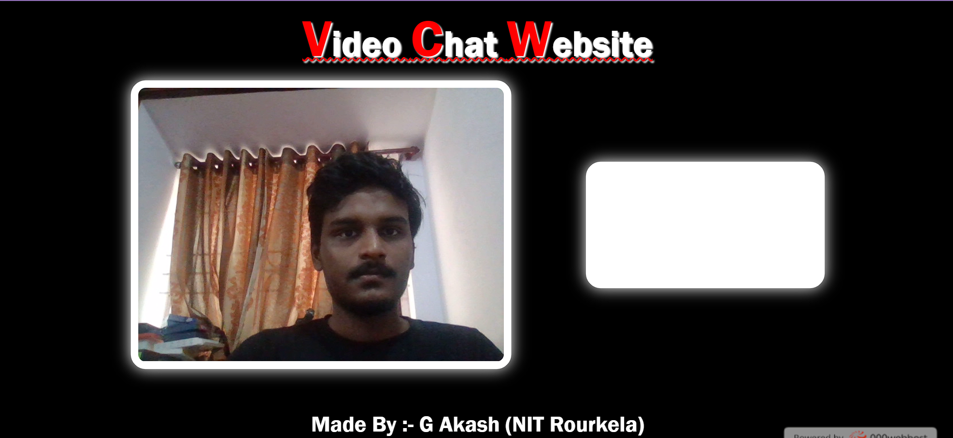
Demonstration:

Slide 8
Benefits and Applications:
Personal Use: Connect with friends and family regardless of distance.
Business Applications: Remote meetings, virtual collaboration, customer support.

Slide 9
THANK YOU
.
.

