Slide 1
AI Resume Builder
Kotha Akash , RA2312704010004
Yugeswar , RA2312704010006
Rajya Laxmi , RA2312704010046

Slide 2
Review -2 70% Completion

Slide 3
Project Implementation Status
S no | Module/Feature | Planned Features | Completion Status | Remarks
1 | User Authentication | Login, Signup, JWT Auth | 80% Done | Google access left
2 | Dashboard UI | User profile, stats | 80% Done | UI Need Improvement
3 | CRUD Operations (Backend) | Create, Read, Update etc | Completed
4 | API Integration (Frontend) | GET /users, POST /users, PUT /users/:id | Yet to Completed | Need to integrate
5 | AI Resume Generator | Generate resume using OpenAI API | 75% Done | Core feature, high priority
6 | Resume Templates | Multiple modern resume designs | Completed
7 | PDF Export | Download resume as PDF | Completed
8 | Deployment | Deploy on Vercel/Render | Not Started | Final stage

Slide 4
Front End Modules
Authentication Module
Login, Signup, JWT handling, session management
Dashboard Module
User overview, saved resumes, quick actions
Resume Builder Form Module
Input forms for personal details, education, skills, experience
AI Content Generator Module
Generate resume content using AI (OpenAI API integration)
Resume Preview Module
Live preview of resume while editing
Template Selection Module
Choose from multiple resume designs

Slide 5
Front End Modules
PDF Export Module
Download resume in PDF format
Edit & Update Module
Modify existing resumes
API Integration Module
Connect frontend with backend services using Axios/Fetch
UI Components Module
Reusable components like navbar, buttons, forms, cards

Slide 6
Resume Builder Page (Component 2) Display a form to collect user details (name, education, skills, experience) Generate resume content using AI (via OpenAI API) Show real-time preview of the resume while editing Allow users to select different resume templates Responsive layout (works on mobile, tablet, desktop) Option to edit, update, and regenerate content Download resume as PDF

Slide 7
Dashboard Page (Component 1)
Display user profile and saved resumes
Create new resume option
Edit/Delete existing resumes
Quick navigation to builder
Responsive UI design

Slide 8
Resume Builder Page (Component 2)
Display a form to collect user details (name, education, skills, experience)
Generate resume content using AI (via OpenAI API)
Show real-time preview of the resume while editing
Allow users to select different resume templates
Responsive layout
Option to edit, update, and regenerate content
Download resume as PDF

Slide 9
Login Page (Component 3)
Simple login form with email/username and password fields
User authentication using JWT (or dummy validation if backend not connected)
Error handling for invalid credentials
Option for signup navigation (new users)
Styled using Tailwind CSS / Bootstrap for clean UI
Responsive design for mobile and desktop

Slide 10
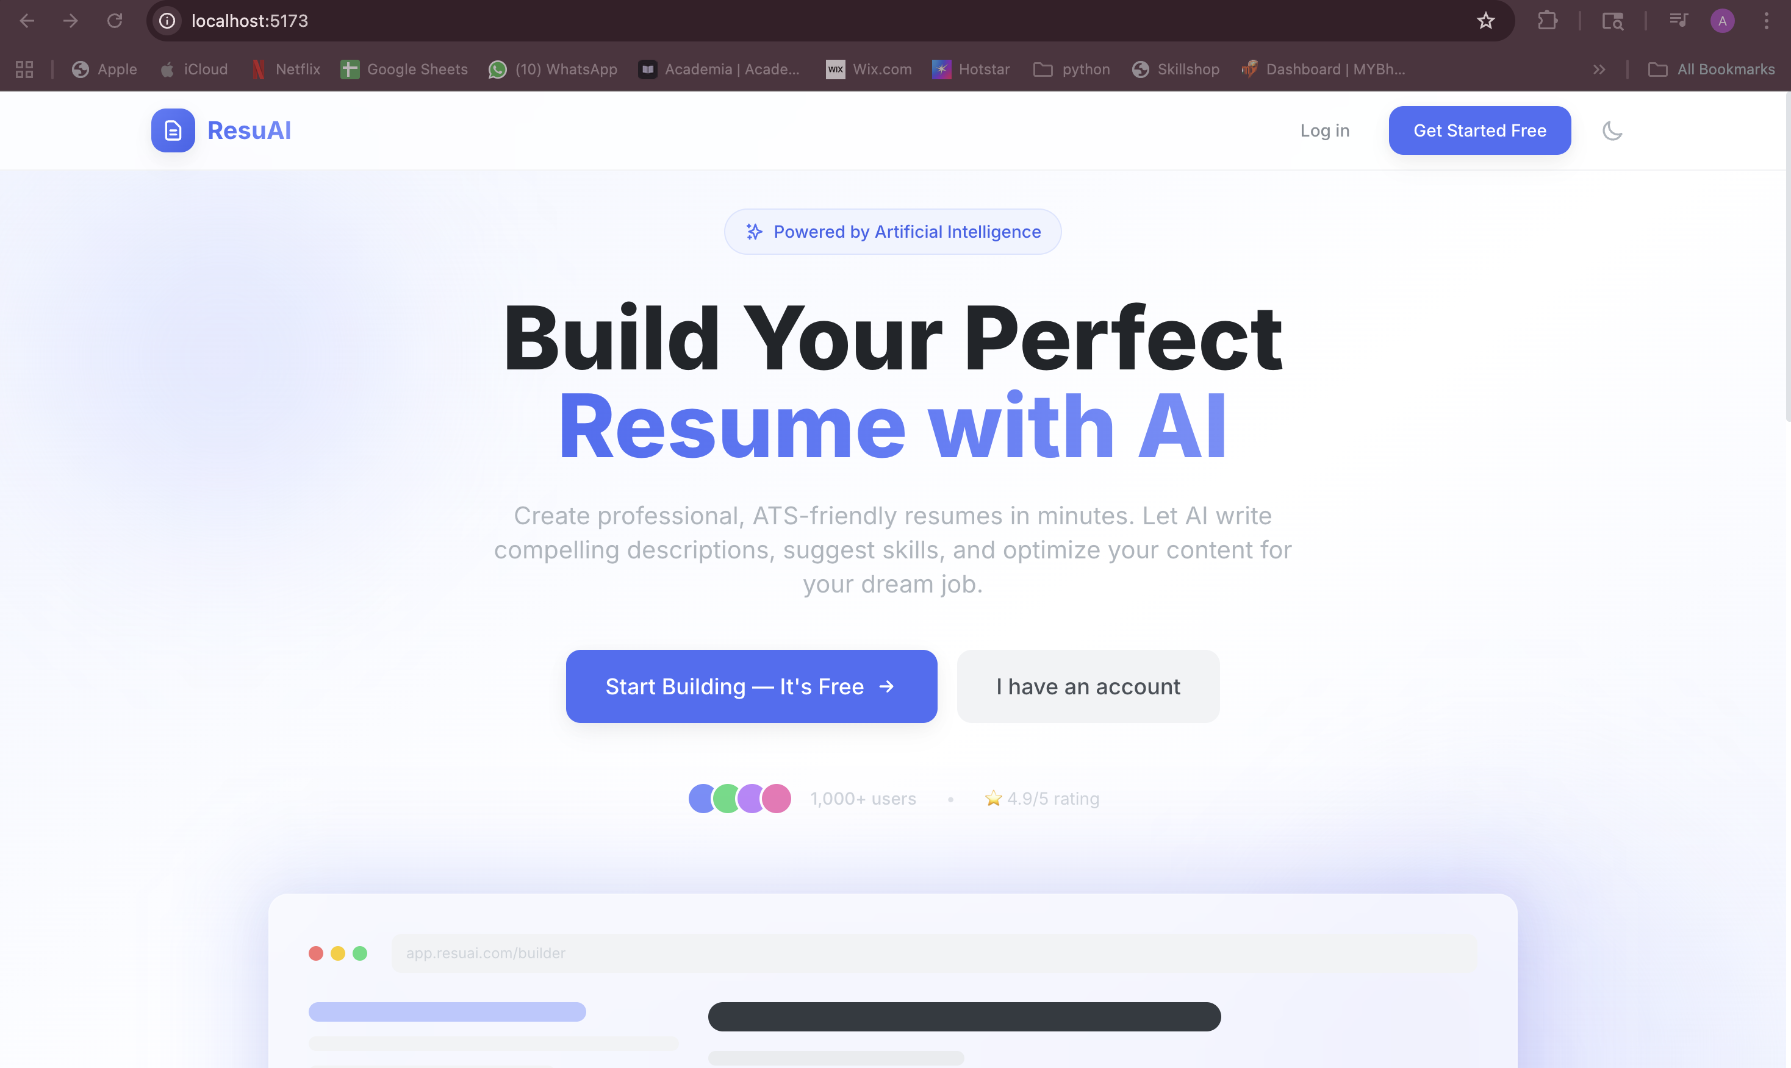
UI/UX Screenshots & Demo

Slide 11
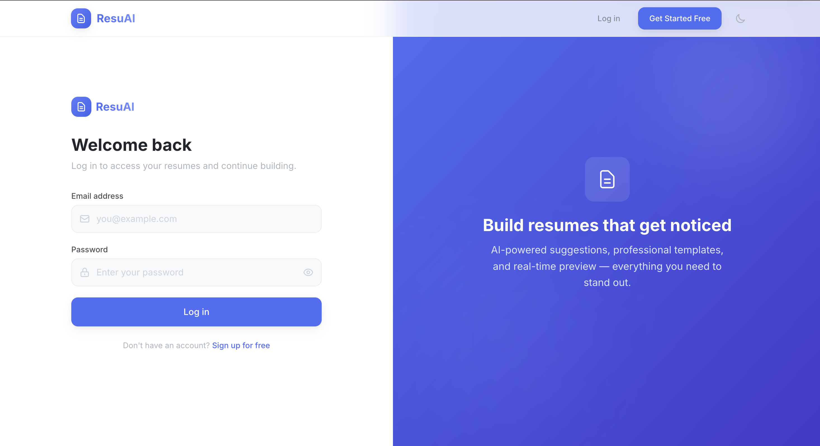
UI/UX Screenshots & Demo

Slide 12
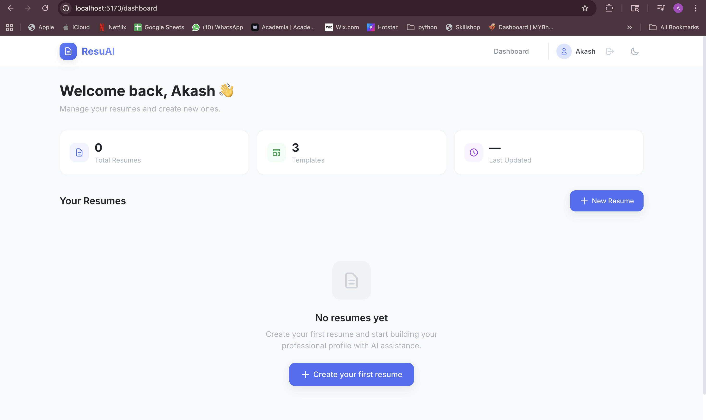
UI/UX Screenshots & Demo

Slide 13
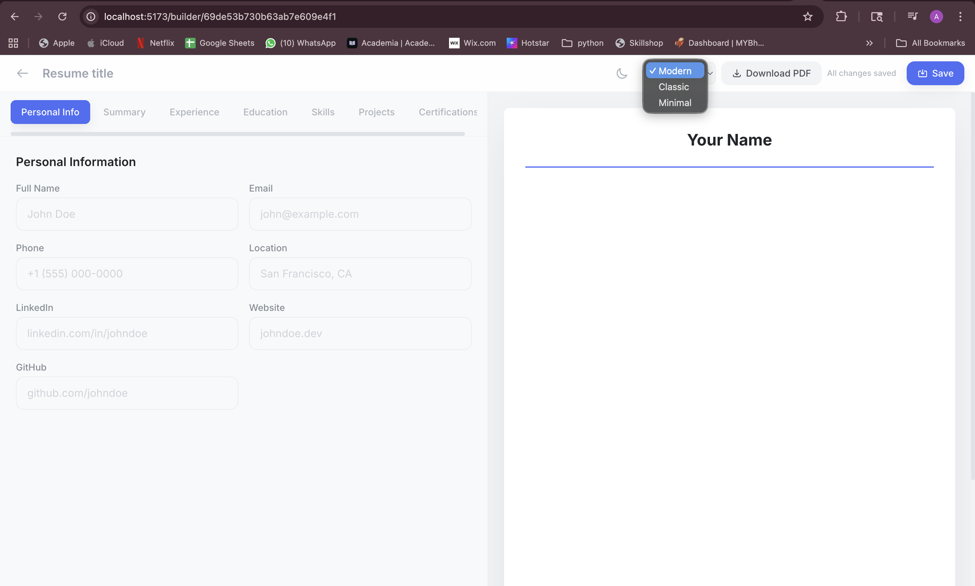
UI/UX Screenshots & Demo

