Slide 1
IDP – DASHBOARD FOR MONITORING THE OUTBOUND BAGGAGE HANDLING
By Akash Manjunath and Prateek Bagrecha
Advisor: Christian Ruf

Slide 2

Project Description
The Chair of Operations Management, TUM School of Management is involved in the implementation of a solution for management of outbound baggage handling, which has been a concern for the Operation Research Community over the last decade.
The solution provided by the chair consists of two parts: Optimization and Simulation. The Optimization phase consists of Outbound baggage handling and Work-Group pairings. The simulation part consisting imitating the real-world baggage handling process and applying optimized solutions to baggage handling.
The output of Optimization is fed as input to Simulation. On detection of any disruption at some time period, the optimization is run in order to slow down the process at the next time period and the change is then reflected on a real time basis using Simulation.
Current system of simulation lacks a human readable console or front-end. the outputs generated during simulations are events that are updated into a log file. The goal is to redirect these events to a dynamic web-based system. The web system processes these events, determines the type of event and presents the event in a human-readable format using tables, graphs and other visual elements.
Notes:
http://www.gliffy.com/go/publish/9760315

Slide 3
Team Information
Name | Akash Manjunath | Prateek Bagrecha | Christian Ruf
Field | Pursuing Masters in Informatics, TUM | Pursuing Masters in Informatics, TUM | M.Sc. Business Computer Science, TUM
Roles | Developer | Developer | Advisor
Notes:
http://www.gliffy.com/go/publish/9760315

Slide 4
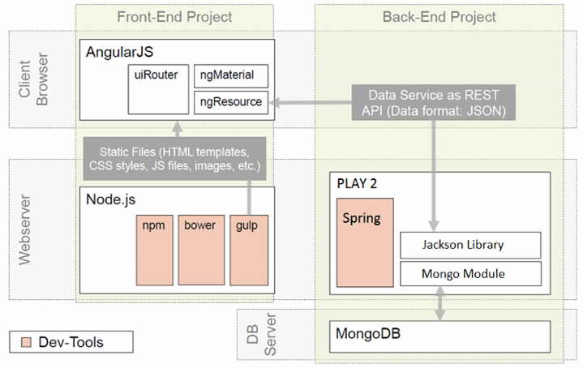
Application Model
Notes:
http://www.gliffy.com/go/publish/9760315

Slide 5
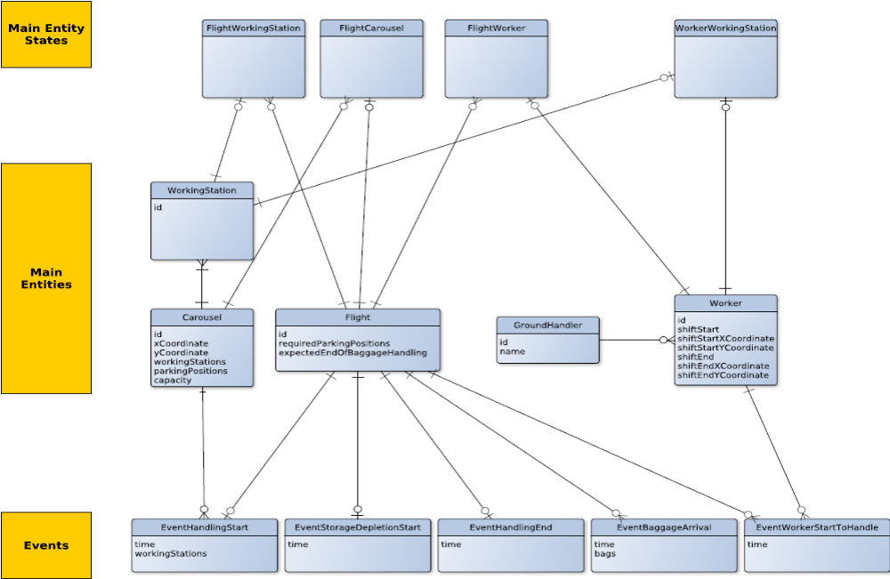
Data Model
Notes:
http://www.gliffy.com/go/publish/9760315

Slide 6
Reference :
Disruption Management for Outbound Baggage Handling with Work Group Pairings by Christian Ruf, Markus Frey, Rainer Kolisch, TUM School of Management, Technische Universität München
MongoDB Architecture Guide, June 2016 by MongoDB
Top 5 Considerations When Evaluating NoSQL Databases, June 2016 by MongoDB
Storing Log Data in MongoDB: https://docs.mongodb.com/ecosystem/use-cases/storing-log-data/
MongoDB Driver for Java: http://mongodb.github.io/mongo-java-driver/3.2/
Play for Java Developers: https://www.playframework.com/documentation/2.5.x/JavaHome
AngularJS: https://material.angularjs.org/latest/
Git - https://git-scm.com/, https://github.com/
Notes:
http://www.gliffy.com/go/publish/9760315

