Slide 1
COMPARATIVE STUDY AND ANALYSIS OF CREDIT CARD FRAUD DETECTION USING MACHINE LEARNING TECHNIQUES

Slide 2
Why is credit card fraud a significant concern in the digital world?
H.W.
02/06/2023
Q.1-
Minimizing financial losses.
Protecting cardholders Information.
Securing the Integrity of the payment ecosystem.
Smooth and Reliable Transactions.
Improving customer experience.
Promoting Secure Digital Transactions

Slide 3
Q. 2-
What challenges exist in detecting credit card fraud using traditional methods?
False Positives
Manual Review Processes
Limited Data Analysis
Lack of Real-time Analysis
Lack of Contextual Information
Cross-channel Fraud Detection
Data Privacy Concerns
Cost and Scalability

Slide 4
A credit card fraud detection system using machine learning can accurately
distinguish between legitimate and fraudulent transactions in real-time by using
advanced algorithms and data analysis of transactional data.
Q.3-
How can machine learning algorithms improve credit card fraud detection?

Slide 5
Q.4-
What key indicators help identify fraudulent transactions?
Step (Duration of completion)
Type of transaction
Amount of transaction
Old balance at origin
New balance at origin
Old balance at destination
New balance at destination

Slide 6
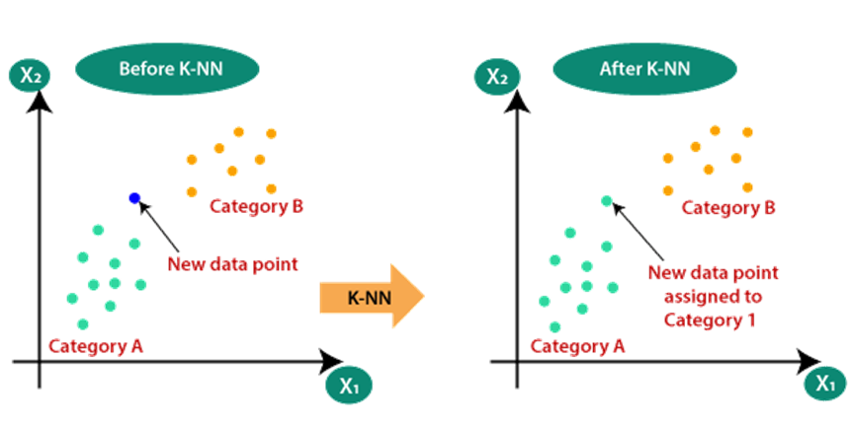
Q.5-
Which ML algorithms were used and why?
Gradient Boosting
XGBoost
Logistic Regression
Decision Tree
Random Forest
KNN

Slide 7
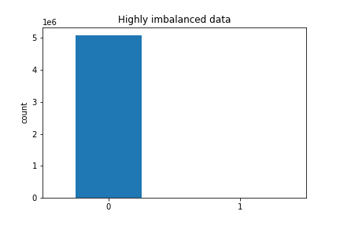
Q.6-
How was the dataset collected and prepared for analysis?
"Online Payments Fraud Detection Dataset" is a dataset obtained from Kaggle.
The dataset contained 6,362,620 instances.
6,354,407 instances labelled as non-fraudulent (0's).
8,213 instances labelled as fraudulent (1's).

Slide 8
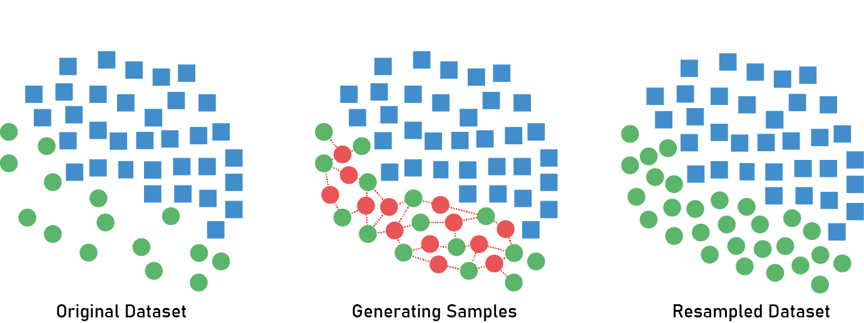
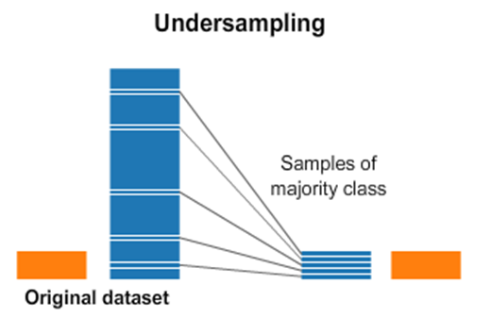
SMOTE - Synthetic Minority Over-sampling Technique

Slide 9
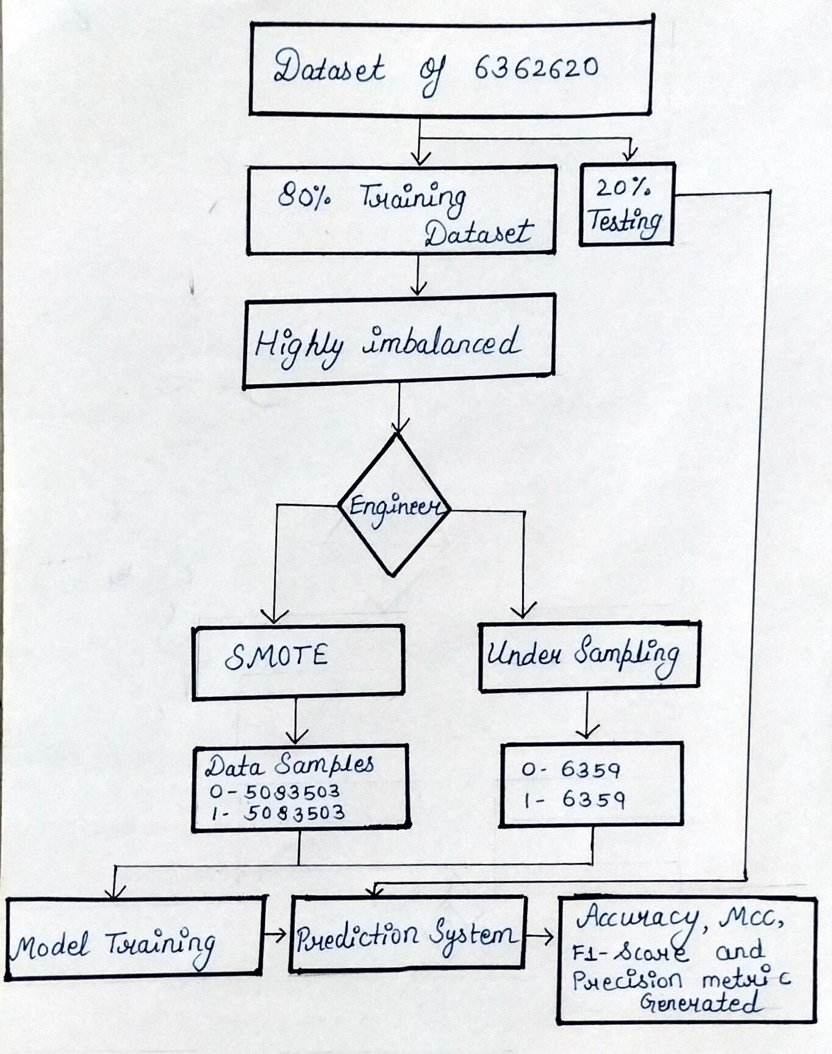
System Archietecture

Slide 10
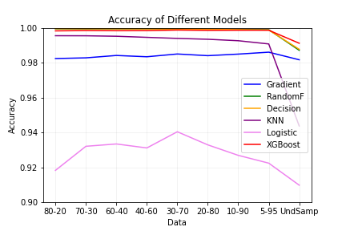
Q.8-
What were the findings of the comparative study?
Accuracy | Gradient | RandomF | Decision | KNN | Logistic | XGBoost
80-20 | 0.98232 | 0.99934 | 0.99945 | 0.99541 | 0.9182 | 0.99818
70-30 | 0.98272 | 0.9993 | 0.99944 | 0.99537 | 0.93202 | 0.99836
60-40 | 0.98408 | 0.99929 | 0.9994 | 0.99511 | 0.93334 | 0.99827
40-60 | 0.98334 | 0.99922 | 0.9993 | 0.99448 | 0.93106 | 0.99831
30-70 | 0.98493 | 0.99915 | 0.99926 | 0.99387 | 0.94035 | 0.99866
20-80 | 0.98397 | 0.99911 | 0.99914 | 0.99338 | 0.93283 | 0.99848
10-90 | 0.98487 | 0.99902 | 0.9989 | 0.99254 | 0.92681 | 0.99855
5-95 | 0.98597 | 0.99886 | 0.99866 | 0.99069 | 0.92235 | 0.99856
UndSamp | 0.98162 | 0.98707 | 0.98765 | 0.94366 | 0.90972 | 0.99114
The RandomForest model consistently outperformed other models, achieving the highest accuracy in all data splits except for the 80-20 split, where the Decision tree model showed the highest. While under sampling XGBoost has the best performance.

Slide 11
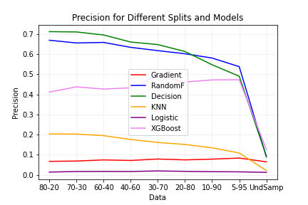
Precision | Gradient | RandomF | Decision | KNN | Logistic | XGBoost
80-20 | 0.06693 | 0.66941 | 0.7122 | 0.20357 | 0.01363 | 0.41187
70-30 | 0.06843 | 0.6559 | 0.71059 | 0.20258 | 0.01651 | 0.43753
60-40 | 0.07416 | 0.6586 | 0.6956 | 0.19482 | 0.01701 | 0.42645
40-60 | 0.07146 | 0.634 | 0.66046 | 0.1758 | 0.01652 | 0.43265
30-70 | 0.07856 | 0.61769 | 0.64778 | 0.16095 | 0.01939 | 0.49282
20-80 | 0.0743 | 0.6022 | 0.61335 | 0.15088 | 0.01723 | 0.46154
10-90 | 0.07795 | 0.58084 | 0.54744 | 0.13443 | 0.01569 | 0.47199
5-95 | 0.08334 | 0.53807 | 0.4905 | 0.10861 | 0.01476 | 0.47292
UndSamp | 0.06464 | 0.08941 | 0.09314 | 0.02135 | 0.01233 | 0.12555
Decision tree model consistently achieves higher precision scores across different data splits.
The XGBoost model also performs well, consistently obtaining competitive precision scores. It demonstrates a good balance between precision and recall, making it a suitable choice for classification tasks.
Undersampling lead to a loss of precision and overall performance.
Notes:
the Decision model consistently achieves higher precision scores across different data splits, It demonstrates a higher ability to accurately predict positive instances with a low false positive rate.
The XGBoost model also performs well, consistently obtaining competitive precision scores. It demonstrates a good balance between precision and recall, making it a suitable choice for classification tasks.
The RandomF model shows moderate precision scores, indicating its ability to predict positive instances. However, it tends to have slightly lower precision scores compared to the Decision and XGBoost models.
The GradientBoosting and KNN models exhibit lower precision scores across different data splits, suggesting their limitations in accurately predicting positive instances.

Slide 12
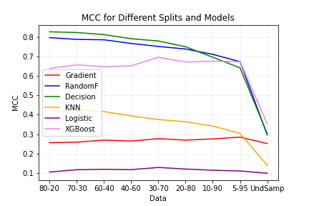
MCC | Gradient | RandomF | Decision | KNN | Logistic | XGBoost
80-20 | 0.25583 | 0.79872 | 0.82896 | 0.42535 | 0.10412 | 0.63919
70-30 | 0.25855 | 0.78953 | 0.82522 | 0.42446 | 0.11618 | 0.65791
60-40 | 0.26912 | 0.78766 | 0.81451 | 0.41674 | 0.11841 | 0.64885
40-60 | 0.26436 | 0.76879 | 0.79315 | 0.39404 | 0.11657 | 0.65324
30-70 | 0.27677 | 0.75324 | 0.78139 | 0.3758 | 0.12788 | 0.6972
20-80 | 0.26895 | 0.73993 | 0.75185 | 0.36393 | 0.11972 | 0.67285
10-90 | 0.27541 | 0.71249 | 0.69729 | 0.34165 | 0.11348 | 0.67729
5-95 | 0.28453 | 0.67457 | 0.6428 | 0.3038 | 0.1096 | 0.67437
UndSamp | 0.25158 | 0.2966 | 0.30253 | 0.13912 | 0.09827 | 0.352428
It is evident that the Random Forest model consistently demonstrates the highest MCC scores for most data splits.
The Decision tree model also shows competitive performance, consistently achieving high MCC values across multiple splits.
When applying undersampling, the MCC value decreases compared to the other models and data splits, potentially due to the loss of valuable information present in the original dataset.

Slide 13
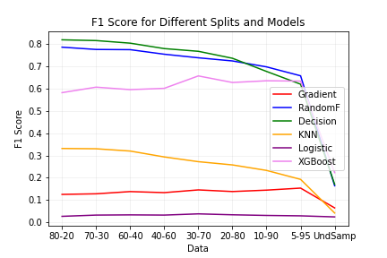
F1-score | Gradient | RandomF | Decision | KNN | Logistic | XGBoost
80-20 | 0.125432 | 0.78665 | 0.8197 | 0.33161 | 0.02685 | 0.58238
70-30 | 0.12805 | 0.77639 | 0.81629 | 0.33035 | 0.03242 | 0.60704
60-40 | 0.13801 | 0.77546 | 0.80469 | 0.3201 | 0.0334 | 0.59594
40-60 | 0.13334 | 0.75499 | 0.78028 | 0.29357 | 0.03246 | 0.60178
30-70 | 0.14557 | 0.73894 | 0.76811 | 0.27233 | 0.03797 | 0.65755
20-80 | 0.13823 | 0.72481 | 0.73682 | 0.25781 | 0.03382 | 0.62804
10-90 | 0.14451 | 0.69821 | 0.67771 | 0.23311 | 0.03085 | 0.63572
5-95 | 0.15368 | 0.65807 | 0.6204 | 0.19288 | 0.02904 | 0.63435
UnderSamp | 0.06464 | 0.1641 | 0.17033 | 0.04178 | 0.02432 | 0.22304
It is evident that the Decision tree and XGBoost models consistently achieve higher F1 scores across different data splits.
The Random Forest model also performs well, consistently obtaining competitive F1 scores.
The Gradient Boosting, KNN models show lower F1 scores across different data splits, indicating their limitations in accurately predicting positive instances.
When applying undersampling, the F1 score decreases significantly compared to the other models and data splits.

Slide 14
 | Our findings | [1] | [3] | [4] | [6] | [7]
Logistic regression | 98.23% | 97.18 | 99.074 | 90.448 | 97.70 | 96.694%
Decision tree | 99.945% | 97.08 | - | 90.998 | 95.50 | 99.958%
Random forest | 99.934 | 99.98 | - | 94.9991 | - | 99.950%
XGBoost | 99.818 | - | - | - | - | -
KNN | 99.541 | - | 96.91 | 94.999 | 97.69 | 99.681%
Gradient Boosting | 98.232 | - | - | 94.001 | - | -

Slide 15
conclusion
The Decision tree emerged as the top-performing model in this study
The RandomForest and XGBoost models also showed strong performance across the evaluation metrics
This make them viable alternatives depending on the specific requirements of the classification task.
The findings of this study highlight the importance of carefully evaluating and selecting machine learning models based on multiple performance metrics.
The Decision tree, with its consistent high performance in accuracy, MCC, F1 score, and precision, demonstrates its potential as a reliable choice for classification tasks.

Slide 16
Thanks!
Any questions?

