Slide 1

AI-Powered Fake News Detection
A From-Scratch Machine Learning Pipeline for Binary News Classification
Akash | AI & ML Summer Internship Program 2026
Indian Institute of Computing and Technology (IICT)

Slide 2



THE PROBLEM
Misinformation Outpaces Manual Fact-Checking
Scale
Speed
Triage
Millions of articles published daily -- far beyond what human fact-checkers can review.
Misinformation spreads fastest in the hours right after publication, before fact-checks land.
Even an imperfect classifier helps direct scarce human review to the content that needs it most.
2

Slide 3




PROJECT OVERVIEW
A Complete Pipeline, Built From Scratch
Collect &
Clean Data
Preprocess &
Tokenize
Feature
Engineering
Train 4
Models
Evaluate &
Validate
No pre-built vectorizers or end-to-end libraries -- tokenization, Bag-of-Words, and TF-IDF are all implemented from their mathematical definitions.
3

Slide 4
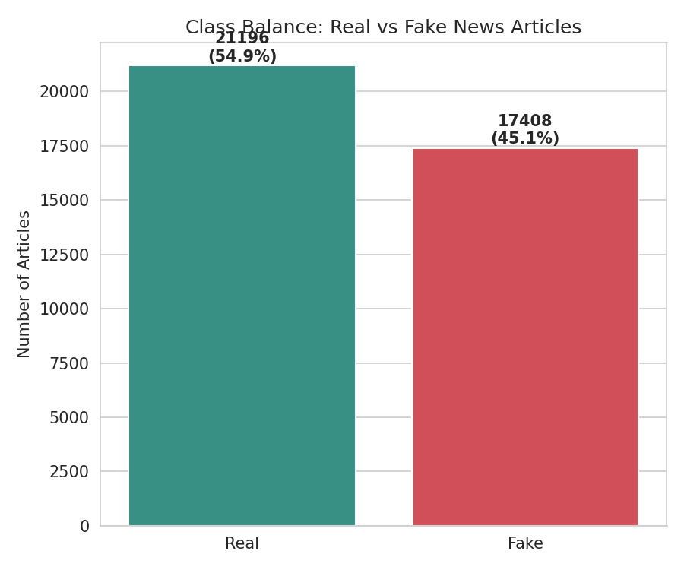
DATASET
38,604 Articles, After Careful Cleaning
44,898
6,434
38,604
54.9 / 45.1
raw articles
(Fake + Real)
removed: corrupted,
empty, or duplicate
final clean
dataset
Real / Fake
class split
Kaggle: Fake and Real News Dataset (clmentbisaillon)
4

Slide 5

A KEY FINDING
Two Leakage Traps -- Caught Before They Mattered
“Subject” Category
Reuters Dateline
Fake and Real articles used completely separate subject tags with zero overlap -- a model could hit ~100% accuracy without reading a single word.
99.8% of Real articles opened with a wire-service dateline (“WASHINGTON (Reuters) - ”). Left in, the model would key off source formatting, not content.
Both were identified during EDA and corrected before modeling began.
5

Slide 6
METHODOLOGY
Three Feature Representations, Built From Scratch
Bag-of-Words
TF-IDF
Word2Vec
5,000-word vocabulary.
Raw word counts per document.
Length-normalized term frequency × smoothed inverse document frequency, L2-normalized.
Skip-gram embeddings trained on the corpus. Documents = averaged word vectors.
Sparse · 5,000 dims
Sparse · 5,000 dims
Dense · 100 dims
6

Slide 7


METHODOLOGY
Four Models, Four Modeling Philosophies
K-Nearest Neighbors
Non-Parametric
Classifies by majority vote among the k closest training points.
Logistic Regression
Parametric
Learns a fixed set of weights defining a linear decision boundary.
Random Forest
Ensemble
Combines many decision trees trained on bootstrapped samples.
Neural Network
Deep Learning
Feedforward network with dropout regularization and early stopping.
7

Slide 8
RESULTS
Logistic Regression Leads -- By a Fine Margin
Best Feature Set
TF-IDF (3 of 4 models)
Top ROC AUC
0.9985 (Logistic Regression)
Robustness
All models: std dev < 0.3%
8

Slide 9
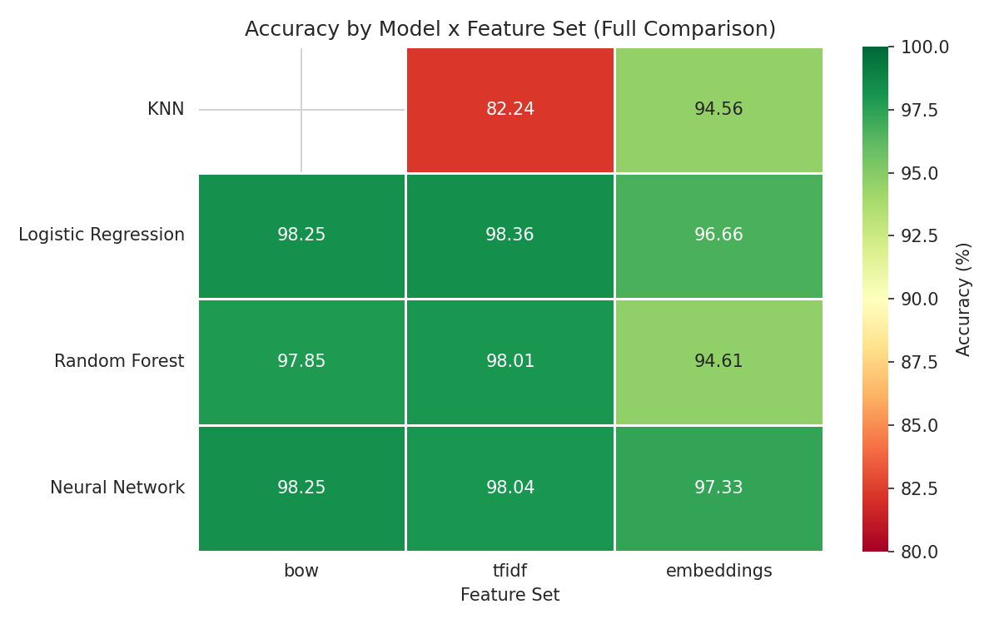
KEY FINDING
Feature Choice Swung KNN's Accuracy by 12 Points
The Curse of Dimensionality
KNN scored just 82.2% on 5,000-dim TF-IDF, but 94.6% on 100-dim Word2Vec embeddings -- the same algorithm, only the feature space changed.
In high-dimensional sparse spaces, distances between points become nearly uniform -- “nearest neighbor” stops being meaningful.
9

Slide 10
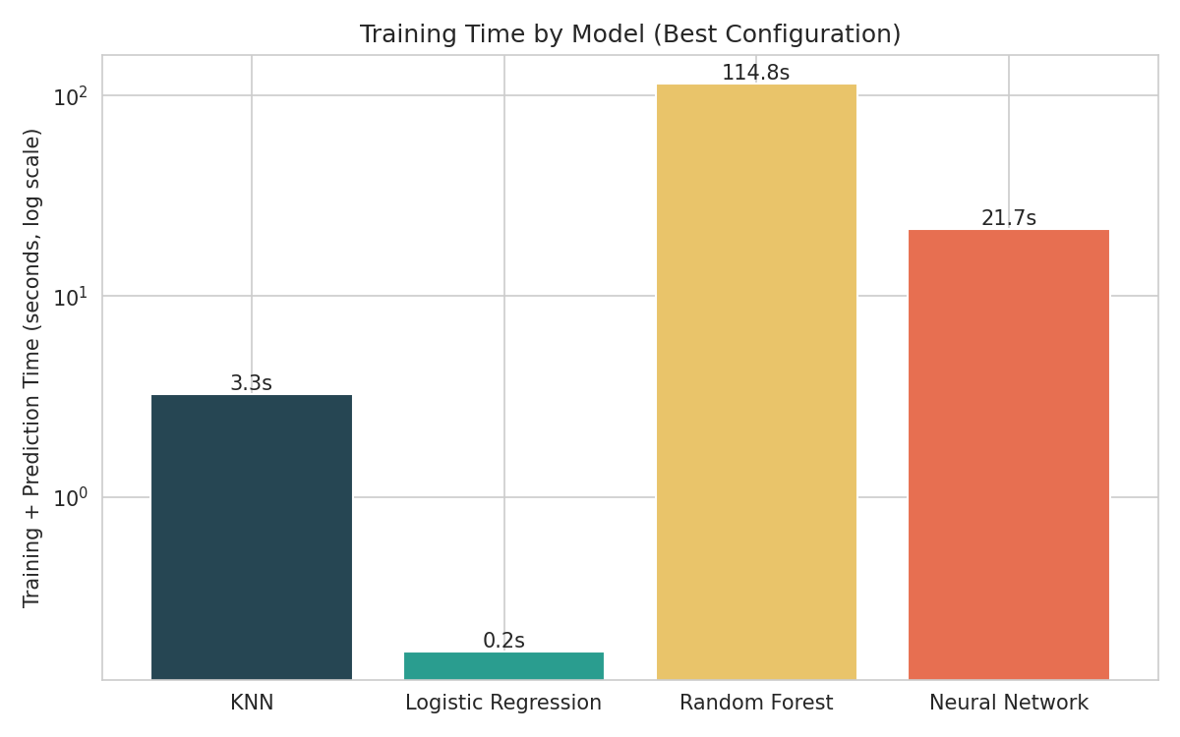
KEY FINDING
More Complexity Didn't Mean More Accuracy
0.17s
Logistic Regression
training time
~120s
Random Forest
training time
≤ 0.35%
Accuracy gap between
top 3 models
10

Slide 11
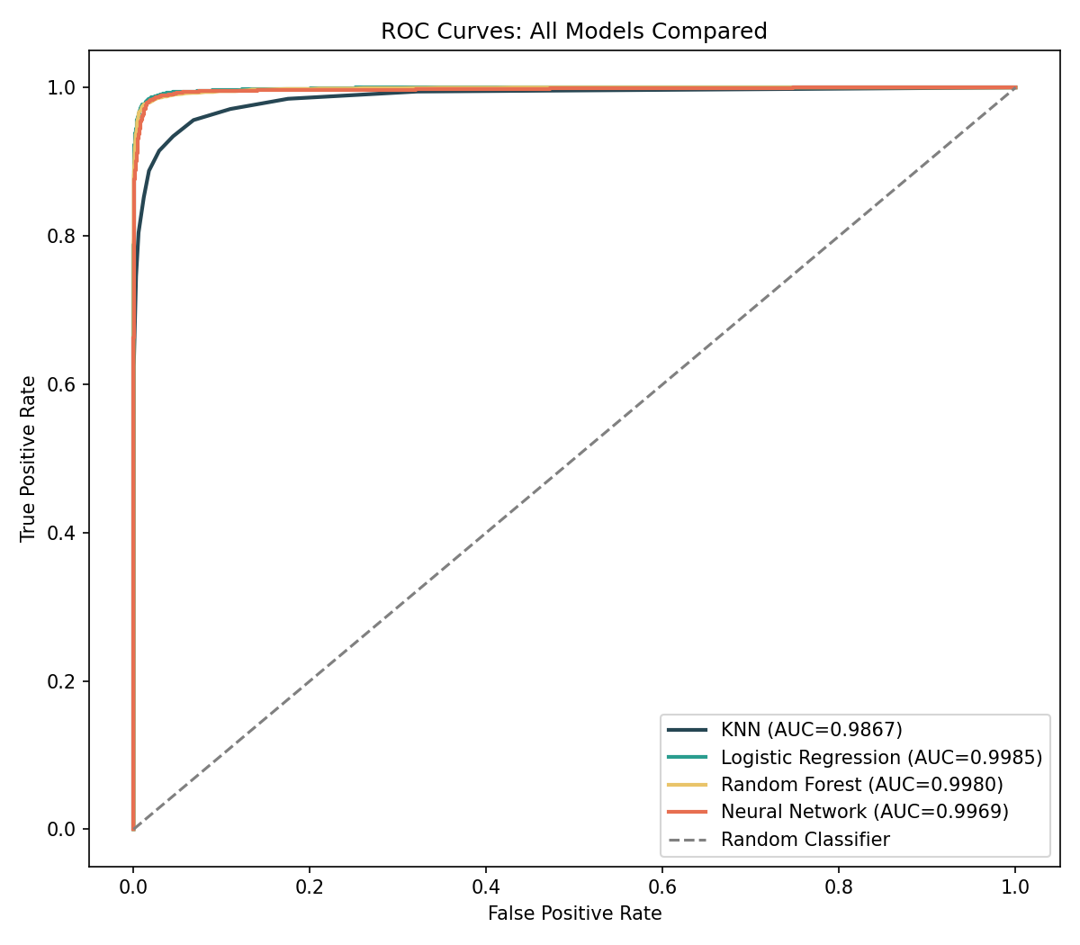
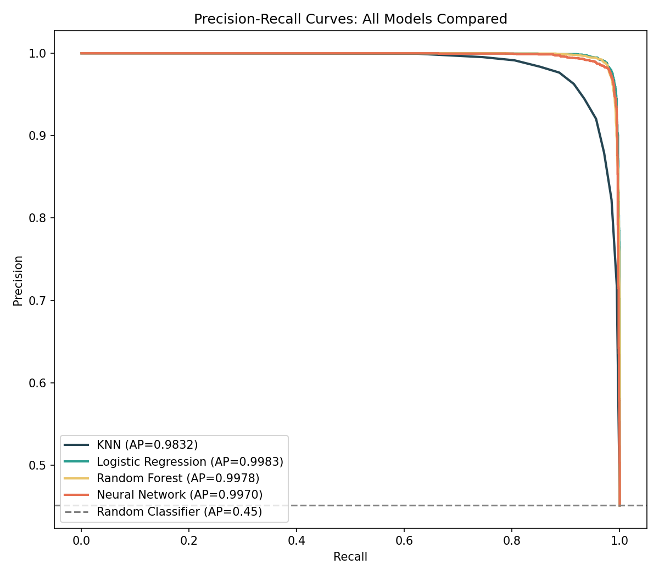
RESULTS
All Models Discriminate Well -- KNN Trails Modestly
11

Slide 12
HONEST LIMITATION
Style vs. Substance: A Necessary Caveat
Top predictive words: via, pic, featured, getty, image (Fake) · reporters, citing, weekday names (Real)
These are formatting and sourcing conventions -- not claims about factual accuracy.
The ~98% accuracy reflects strong performance at detecting this dataset's stylistic signature of Real vs. Fake --
a narrower, more honest claim than “detecting fake news” in general.
12

Slide 13

CONCLUSION
Key Insights
Feature representation matters more than model choice for distance-based methods.
Model complexity did not translate to better accuracy on this task.
Dataset metadata can silently solve a task without genuine content understanding.
What the model learns is narrower than general-purpose fake news detection.
13

Slide 14
FUTURE SCOPE
Where This Project Could Go Next
1
Test generalization on an independent, more recent fake-news dataset
2
Train Word2Vec on a larger corpus to test if the gap with TF-IDF closes
3
Add non-leaking metadata features as a secondary experiment
4
Extend to a sequence-based architecture (LSTM / attention) for richer context
14

Slide 15

Thank You
Questions?
Akash · AI & ML Summer Internship Program 2026 · IICT

