Slide 1
AI-DRIVEN PHISHING EMAIL DETECTION
Using Natural Language Processing
Internship Project | Indian Institute of Computing and Technology (IICT)
Akash • AI & ML Internship

Slide 2
The Problem: Phishing Hides in Plain Language
Phishing emails rely on language tricks rather than malware -- urgency, fake offers, and manipulative calls to action designed to bypass a reader's judgment before it bypasses any firewall.
60.7%
Safe Emails
39.3%
!
Urgency
"Act now or your account will be suspended"
Phishing Emails
@
Deceptive Links
18,650
URLs disguised as trusted domains
Total labeled emails (Kaggle)
$
False Reward
"You've won" / "Claim your prize"
AI-Driven Phishing Email Detection Using NLP | 2

Slide 3
Objective & Scope
Design and implement a machine-learning system that automatically detects phishing emails using text analysis and metadata features -- built entirely from scratch: preprocessing, feature extraction, model training, and evaluation.
1
2
3
4
Collect & Clean
Extract Features
Train & Compare
Analyze & Report
Kaggle dataset, HTML/punctuation/stopword removal
TF-IDF + structural metadata (URLs, caps, punctuation)
4 classifier families evaluated on identical test data
Feature importance, error analysis, recommendations
AI-Driven Phishing Email Detection Using NLP | 3

Slide 4
Methodology: From Raw Text to Predictions
Data
Cleaning
→
Metadata
Extraction
→
TF-IDF
Vectorization
→
Train/Test
Split
→
Model
Training
→
Evaluation
Key engineering decision: leakage prevention
Train/test split happens BEFORE fitting the TF-IDF vectorizer and metadata scaler. Fitting on the full dataset first would let test-set information leak into the vocabulary and feature scaling, silently inflating every reported metric.
18,634
5,000
7
80/20
Emails after cleaning
TF-IDF features
Metadata features
Train/test split
AI-Driven Phishing Email Detection Using NLP | 4

Slide 5
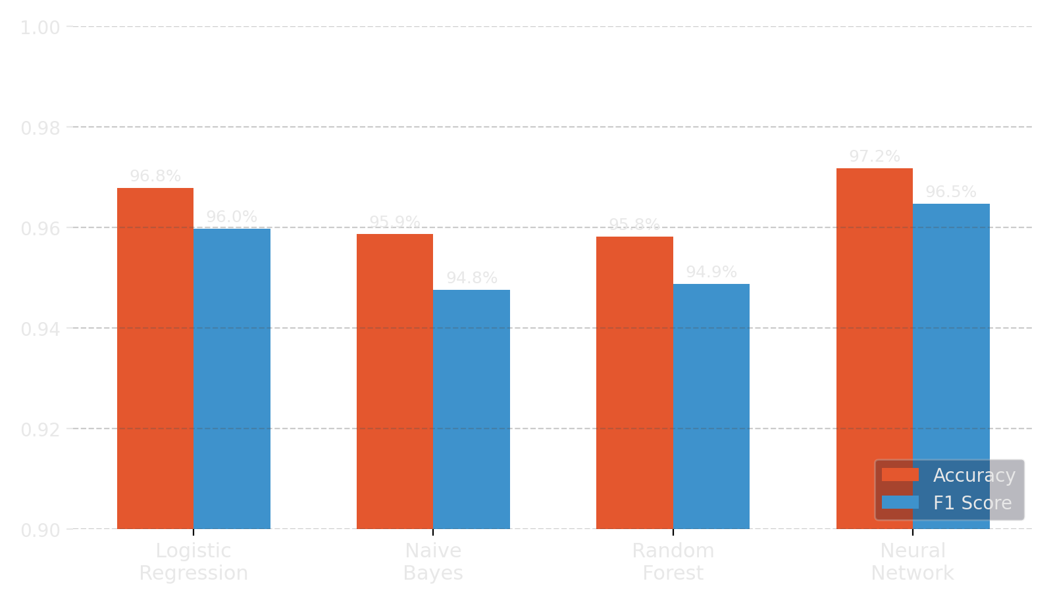
Four Models, One Test Set
All classifiers evaluated on the same held-out 3,726 emails
Neural Network
97.18%
Best overall
Logistic Regression
96.78%
Naive Bayes
95.87%
Random Forest
95.81%
AI-Driven Phishing Email Detection Using NLP | 5

Slide 6
Which Model, When?
Metric leadership doesn't point to one universal winner -- it depends on the cost you're optimizing for.
Neural Network
Logistic Regression
Random Forest
Naive Bayes
97.18% accuracy
95.97% F1
98.70% recall
94.75% F1 (text only)
Best overall performance
Fully interpretable coefficients
Catches the most phishing
Works with no metadata available
AI-Driven Phishing Email Detection Using NLP | 6

Slide 7
What the Model Actually Learned
Logistic Regression coefficients directly show which words push toward each class
→ PHISHING signal
→ SAFE signal
click
remove
enron
thanks
free
http
wrote
university
money
site
vince
linguistics
removed
info
edu
attached
AI-Driven Phishing Email Detection Using NLP | 7

Slide 8
A Caveat Worth Naming
"Safe" terms like enron, vince, and university reflect this dataset's specific source -- Enron corporate mail and academic discussion threads -- not legitimate email in general. The model may have partly learned "corporate/academic English" as a proxy for safety.
Where the Neural Network still fails
Label ambiguity
Content obfuscation
Missing content
General spam misread as phishing, or vice versa -- a genuinely blurry line even for humans.
Messages padded with unrelated text (quotes, trivia) to dodge keyword-based detection -- a structural blind spot of TF-IDF models.
A subset of false positives are placeholder/empty-body rows -- a data quality artifact, not a model failure.
AI-Driven Phishing Email Detection Using NLP | 8

Slide 9
Recommendations & Future Work
Deployment guidance
Future work
• Neural Network -- when raw performance is the priority
• Context-aware embeddings (transformers) to close the obfuscation blind spot
• Logistic Regression -- when explainability / audit trail matters
• Validate generalization beyond the Enron corpus
• Random Forest -- when missing phishing is costlier than false alarms
• Stress-test against modern LLM-generated phishing samples
All four models exceeded 95% accuracy -- confirming phishing carries strong, learnable signal.
AI-Driven Phishing Email Detection Using NLP | 9

Slide 10
Thank You
Questions & Discussion
github.com/Akash-N1406

