Slide 1

AUTOENCODERS
DONE BY
AKASH NAGARAJAN M

Slide 2
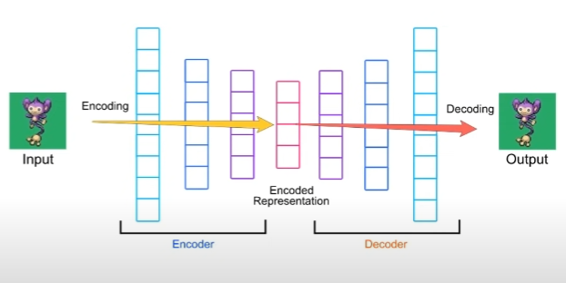
INTRODUCTION TO AUTOENCODERS
An autoencoder neural network is an unsupervised Machine learning
algorithm that applies backpropagation, setting the target values to be equal to the inputs.

Slide 3
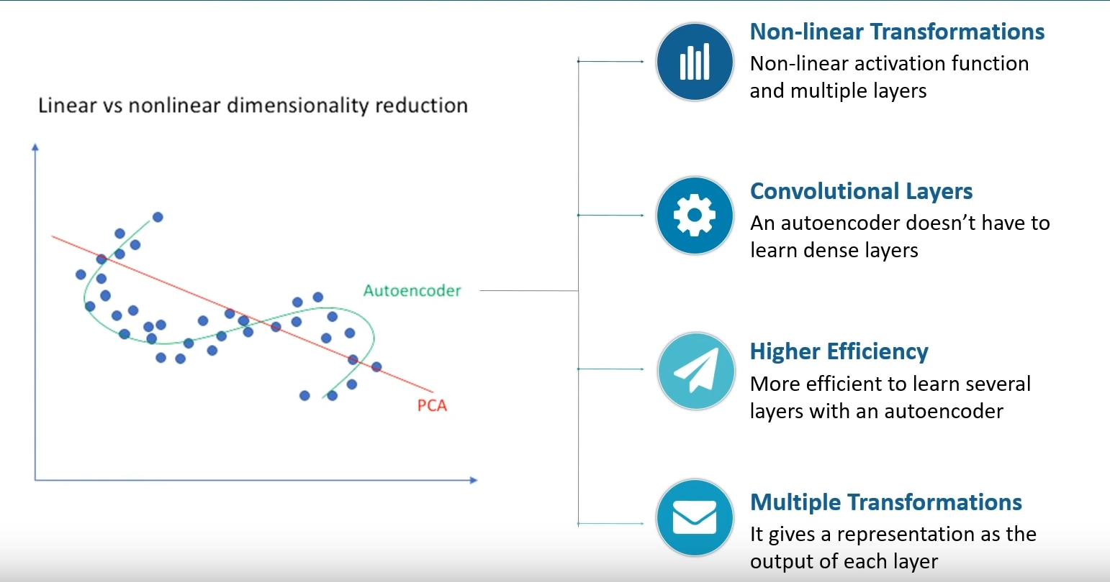
PCA (PRINCIPAL COMPONENT ANALYSIS) VS AUTOENCODER

Slide 4
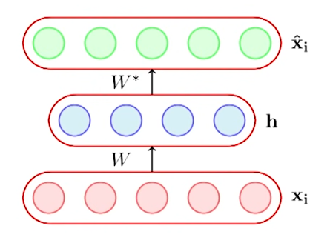
AUTOENCODERS WORKING
Bottleneck approach is an approach to for deciding which aspects of observed data are relevant information and what aspects can be thrown away
ENCODING :
h = g(W xi + b)
DECODING
Xi = f(W*h+c)
W = matrix
Xi = input
b= bias
f,g = functions

Slide 5
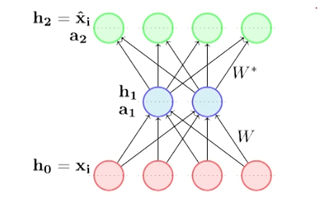

LOSS FUNCTION

Slide 6




LOSS FUNCTION
FOR BINARY INPUT
Cross entropy is better for Bernoulli Distribution
FOR REAL VALUES INPUT
Squared error

Slide 7
TYPES OF AUTOENCODERS
UNDERCOMPLETE AUTOENCODER
OVERCOMPLETE AUTOENCODER
SPARSE AUTOENCODERS
DENOISING AUTOENCODERS
CONTRACTIVE AUTOENCODERS
VARIATIONAL AUTOENCODERS

Slide 8
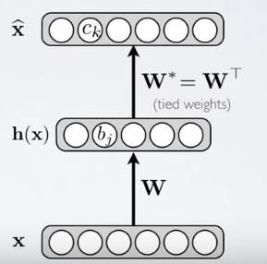

UNDERCOMPLETE AUTOENCODERS
HIdden layer is undercomplete if smaller than the input layer
Compresses the input
Will compress well only for training distribution
Good features for training distribution
Bad for other types of input

Slide 9
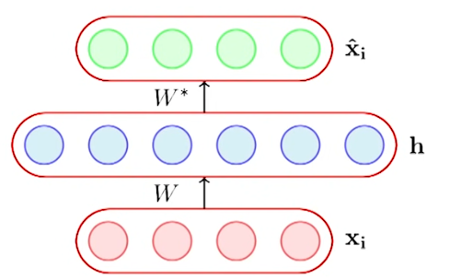
OVERCOMPLETE AUTOENCODERS
dim(h) > dim(xi)
In such a case the autoencoder could
learn a trivial encoding by simply
copying Xi into h and then copying h into Xi
Then why do we need overcomplete autoencoders??
Eg: BMI Ht Wt

Slide 10
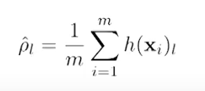
SPARSE AUTOENCODERS
A hidden neuron with sigmoid activation will have values between 0 and 1
We say that the neuron is activated when its output is close to 1 and not activated when its output is close to 0.
A sparse autoencoder tries to ensure the neuron is inactive most of the times.

Slide 11
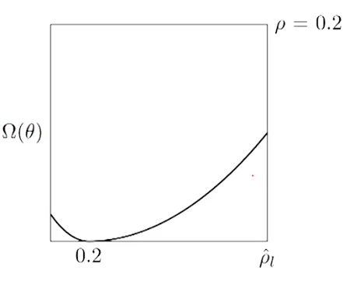
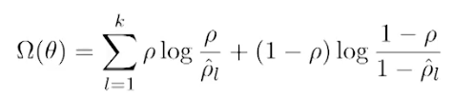

SPARSE LOSS FUNCTION
If the neuron l is sparse (i.c. mostly inactive) then p= 0
A sparse autoencoder uses a sparsity parameter p (typically very close to 0, say, 0.005) and tries to enforce the constraint pi = p
One way of ensuring this is to add the following term to the objective function

Slide 12
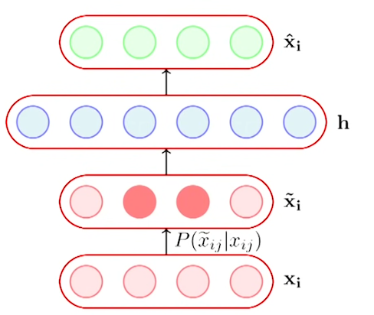
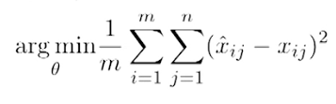
DENOISING AUTOENCODERS
Data is corrupted by adding Xi
Now what will autoencoder do?
It still keeps working since it memorizes Xi' data.
This should not happen.
We should minimize the error between a Xi^ and Xi' .

Slide 13
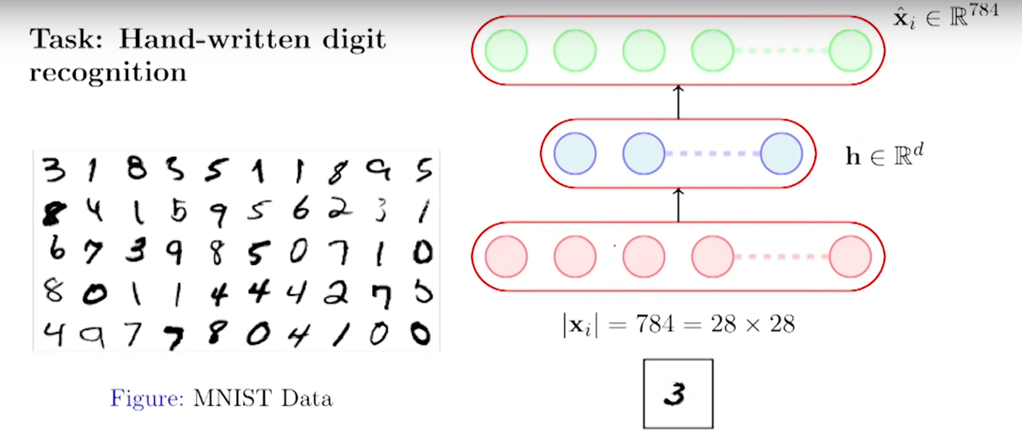
DENOSING EXAMPLE
EDGE DETECTION

Slide 14

CONTRACTIVE AUTOENCODERS
A contractive autoencoder also tries to prevent an overcomplete autoencoder from learning the identity function.
It does so by adding the following regularization term to the loss function

Slide 15
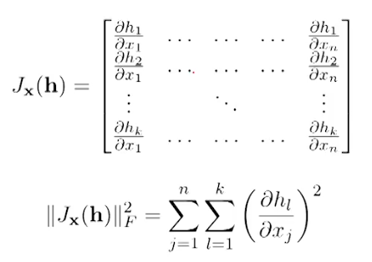
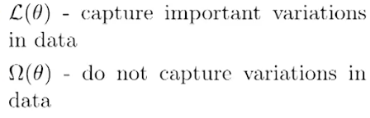
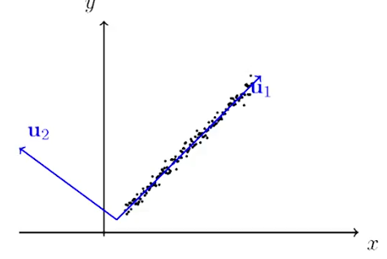
If the input has n dimensions and the hidden layer has k dimensions.
In other words, the (j,l) entry of the Jacobian captures the variation in the output of the ith neuron with a small variation in the jth input.

Slide 16
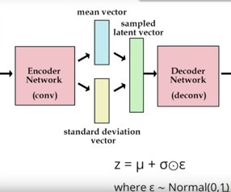

VARIATIONAL AUTOENCODERS
KL DIVERGENCE
(NORMAL 1,0)
RECONSTRUCTION LOSS

Slide 17
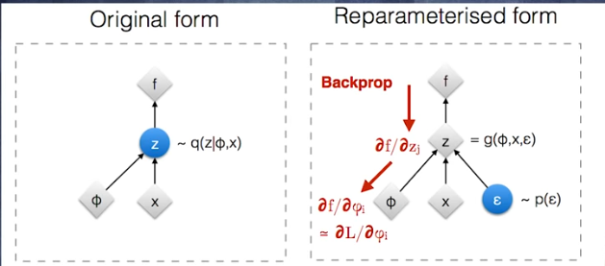
REPARAMETRIZATION TRICK(FOR BACKPROPAGATION)

Slide 18
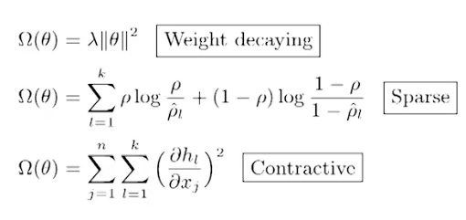
REGULARIZATION
DENOISING

Slide 19
APPLICATIONS OF AUTOENCODERS
Dimensionality Reduction
Feature Extraction
Image Denoising
Image Compression
Image Search
Anomaly Detection
Missing Value Imputation

Slide 20
DEMO
AUTOENCODERS MNIST DEMO

Slide 21
REFERENCES
AUTOENCODERS PLAYLIST (CHECK FROM 7.1 TO 7.6)
VARIATIONAL AUTOENCODERS
AUTOENCODERS CODE IN PYTHON

