Slide 1
ToyCraft Tales: Tableau’s Vision into Toy Manufacturer Data
Data Analytics with Tableau | Project Presentation

Slide 2
Project Overview
Analyze toy manufacturing data using Tableau to uncover trends, preferences, and performance across markets.

Slide 3
Skills & Tools Used
• Tableau
• SQL
• MySQL/PostgreSQL
• Excel/CSV
• Data Cleaning & Transformation

Slide 4
Project Objectives
• Identify seasonal trends
• Understand consumer preferences
• Compare product performance by region
• Provide interactive dashboards for decision-making

Slide 5
Project Flow - Step 1: Data Collection & Extraction
• Acquired toy sales dataset
• Stored data in MySQL
• Cleaned and joined tables using SQL

Slide 6
Project Flow - Step 2: Data Preparation
• Connected Tableau to database
• Created calculated fields
• Filtered and organized data for visualization

Slide 7
Project Flow - Step 3: Visualizations
• Seasonal Sales (Line Chart)
• Demographics (Heatmap)
• Regional Sales (Map)
• Category Performance (Bar Chart)

Slide 8
Project Flow - Step 4: Interactive Dashboards
• Filter by year, region, age group
• Tooltips, actions, highlights
• Mobile-friendly design

Slide 9
Scenario 1: Seasonal Trend Analysis
• Identified high-demand holiday periods
• Suggested optimized production scheduling

Slide 10
Scenario 2: Consumer Preference Analysis
• Age and gender-specific toy choices
• Helped customize product offerings

Slide 11
Scenario 3: Regional Product Performance
• Mapped sales by location
• Aligned inventory with demand

Slide 12
Project Outcomes
• Better marketing and inventory planning
• Data-driven decisions for product strategy
• Real-time monitoring via dashboards

Slide 13
How Others Can Do This Project
1. Get toy sales dataset
2. Store and clean in SQL
3. Connect to Tableau
4. Build charts and dashboards
5. Publish and share

Slide 14
Deliverables
• SQL Scripts
• Tableau Workbook (.twbx)
• Project Documentation
• Screenshots / Dashboard Link

Slide 15
Conclusion
A powerful use of Tableau to transform raw toy industry data into strategic insights for manufacturers.

Slide 16
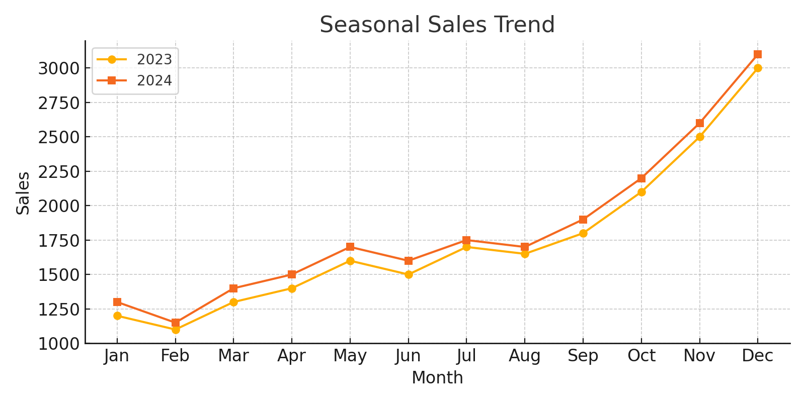
Seasonal Sales Trend
Sales comparison for 2023 and 2024 across months.

Slide 17
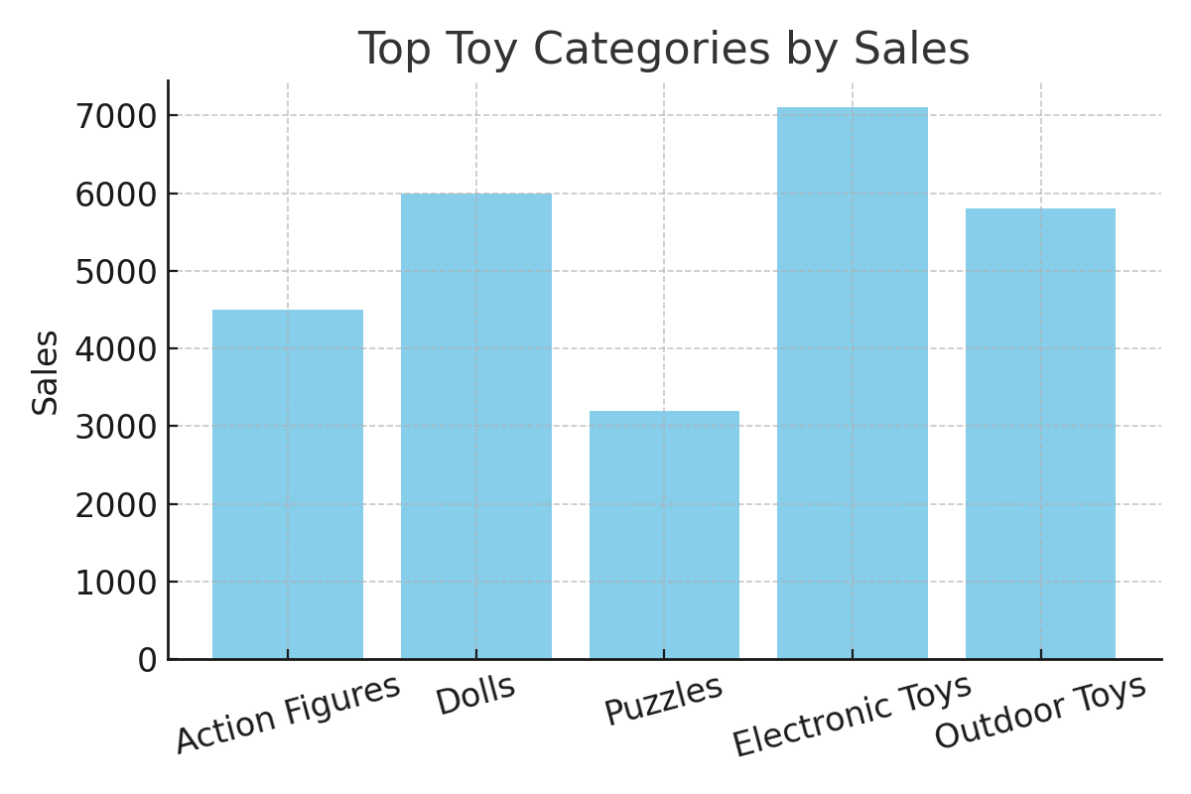
Top Toy Categories by Sales
Bar chart representing the most sold toy categories.

Slide 18
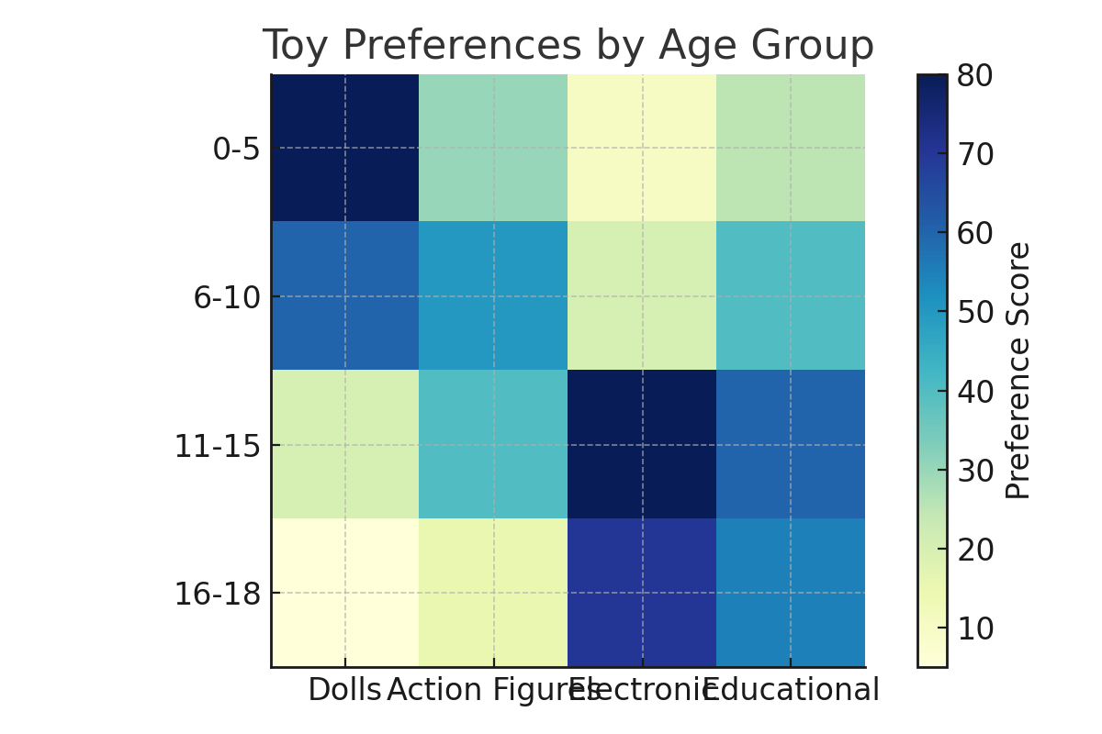
Toy Preferences by Age Group
Heatmap showing preference scores by age groups and toy types.

Slide 19
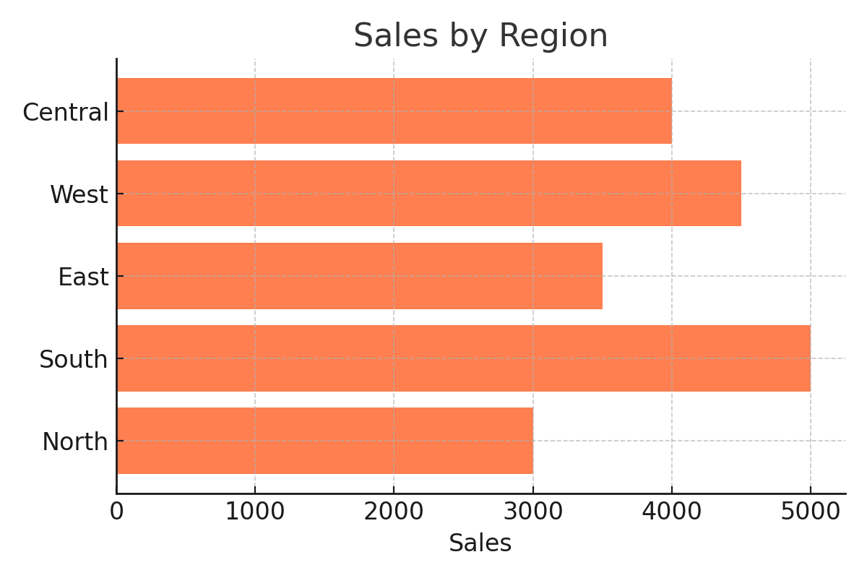
Sales by Region
Horizontal bar chart displaying regional sales performance.

