Slide 1
THEFT DETECTOR
DONE BY
AKASH.A(180701017)
AKASH.V(180701018)
ARUN KUMAR.M(180701035)
BALAJI.V(180701047)
CHRIS GAVIN.B(180701056))

Slide 2
Contents
Motivation
Components
Architectural Design
Software
Working
Result
Conclusion
References

Slide 3
Motivation
In the modern era, security and surveillance are important issues. Recent acts of theft/terrorism have highlighted the urgent need for efficient video surveillance and on-the-spot notification of ongoing thefts to house owners and other household members
A number of surveillance solutions are currently available on the market, such as CCTV cameras and digital video recorders (DVRs) that can record the unauthorized activities of a trespasser, but cannot distinguish between human and non-human objects
The major flaw with this kind of arrangement is that it demands the 24/7 availability of a house owner or member, or manual video surveillance, which is almost impossible
In addition, it is a tedious task to go through all the recorded video clips after a possible theft has become known. It might be that the storage server contains a large amount of family member footage, which is of no use in identifying trespassers

Slide 4
Nowadays, intruders have become more technologically aware and have carried out burglaries using smart gadgets like gas-cutters, smart anti-lock systems, and many more
For such intruders, it is straightforward to disconnect CCTV camera surveillance, which has an indirect connection to the digital video recorder and a database server residing at home
Therefore, there is a need to modify existing systems and propose an intelligent approach
Which can not only provide unsupervised human activity monitoring, but can also stop an ongoing theft by notifying the house-owner at the earliest opportunity

Slide 5
Components
Raspberry Pi Zero
Camera
Raspberry Pi Zero
camera
Raspberry pi board Architecture

Slide 6
Architectural Design
NO
YES
NO
YES
start
On camera with program
Checking for movement in each frame
Movement detected
Take image and send to cloud message and call the owner
Checking for movement in each 100th frame
Movement detected
Take image and send to cloud, message the owner

Slide 7




Software
OpenCV Twilio
Firebase Yolo

Slide 8
OPEN CV:
Open CV (Open Source Computer Vision Library) is an open source computer vision and machine learning software library. Open CV was built to provide a common infrastructure for computer vision applications and to the use of machine perception in the commercial products. Being a BSD licensed product, Open CV makes it easy for businesses to utilize and modify the code. It is free for both commercial and non-commercial use.
Firebase
Firebase is a Backend-as-a-Service (Baas). It provides developers with a variety of tools and services to help them develop quality apps, grow their user base, and earn profit. It is built on Google's infrastructure. Firebase is categorized as a NoSQL database program, which stores data in JSON-like documents.

Slide 9
Twilio
Twilio is an American cloud communications platform as a service (CPaaS) company based in San Francisco, California. Twilio allows software developers to programmatically make and receive phone calls, send and receive text messages, and perform other communication functions using its web service APIs
YOLO
YOLO, a single CNN simultaneously predicts multiple bounding boxes and class probabilities for those boxes. YOLO trains on full images and directly optimizes detection performance. This model has a number of benefits over other object detection methods: YOLO is extremely fast

Slide 10
WORKING
When program starts, camera will be activated with openCV function and checks for movement in each frame.
If any movement is detected then it captures image and apply image processing for object detection with the help of deep learning pretrained model of yolo.
Then the processed image will be forwarded to raspberry pi, In raspberry pi the received image will be stored locally in the system and upload the image to the cloud which is firebase cloud .
It then alerts the owner by calling the registered number which is done with the help of twilio and also sent the messag to the registered number with image which is accessed by the cloud,So we can access it globally.

Slide 11
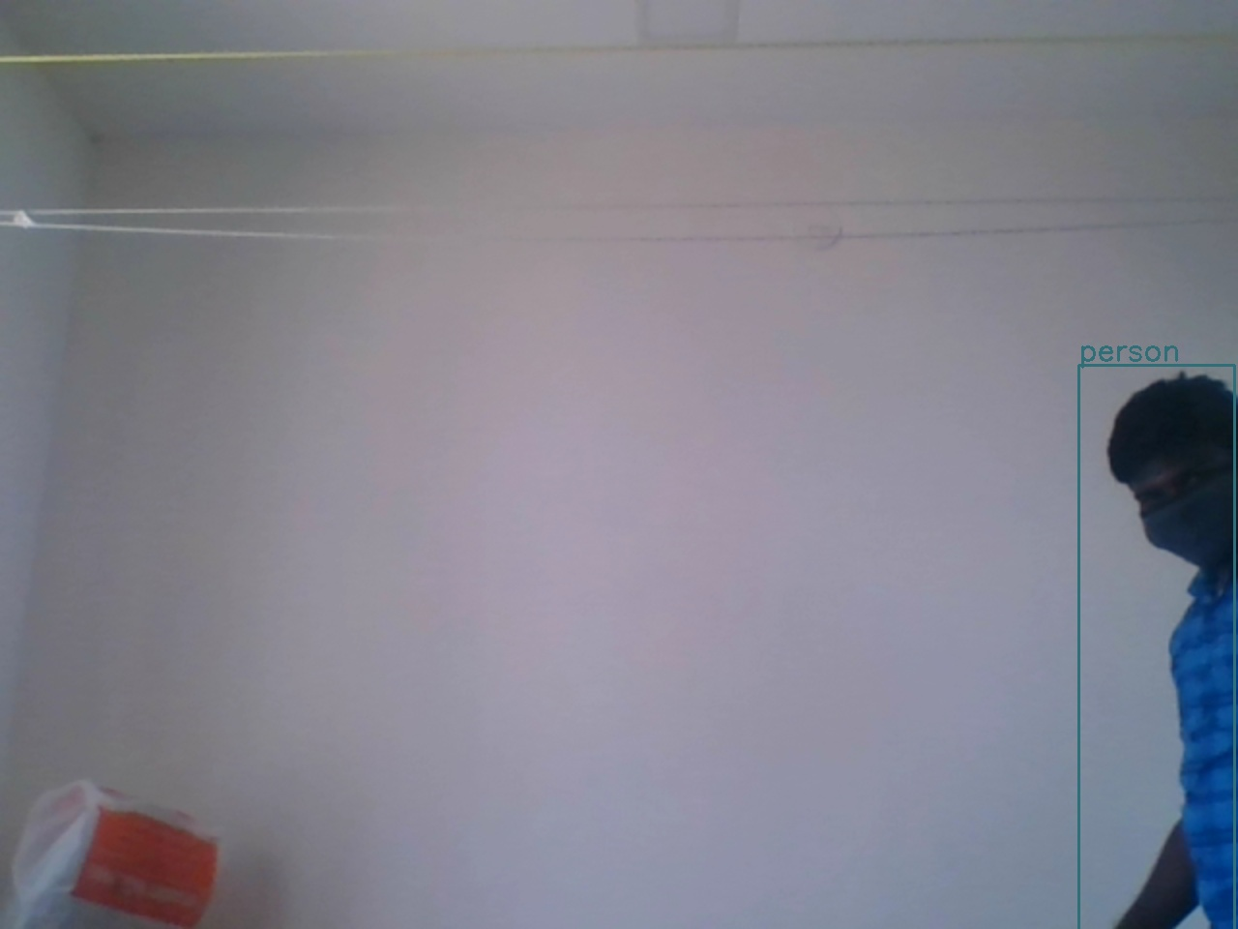
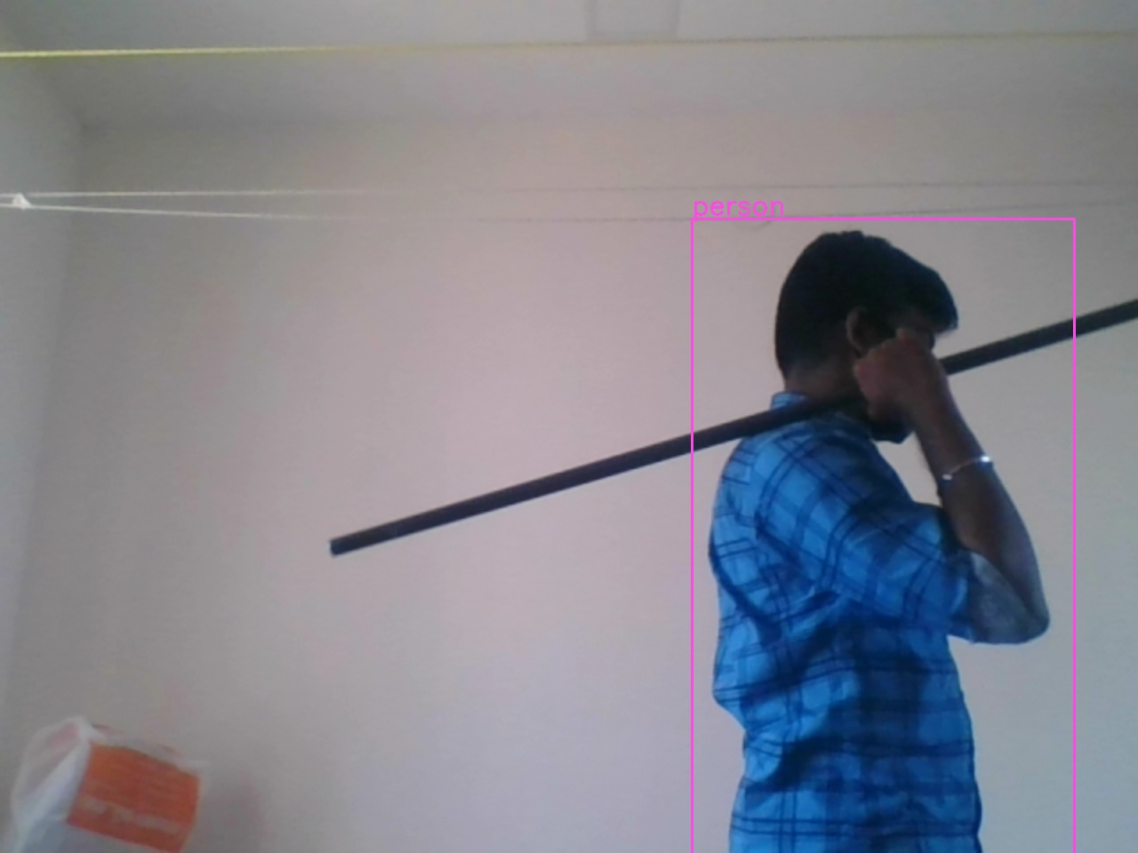
RESULT

Slide 12
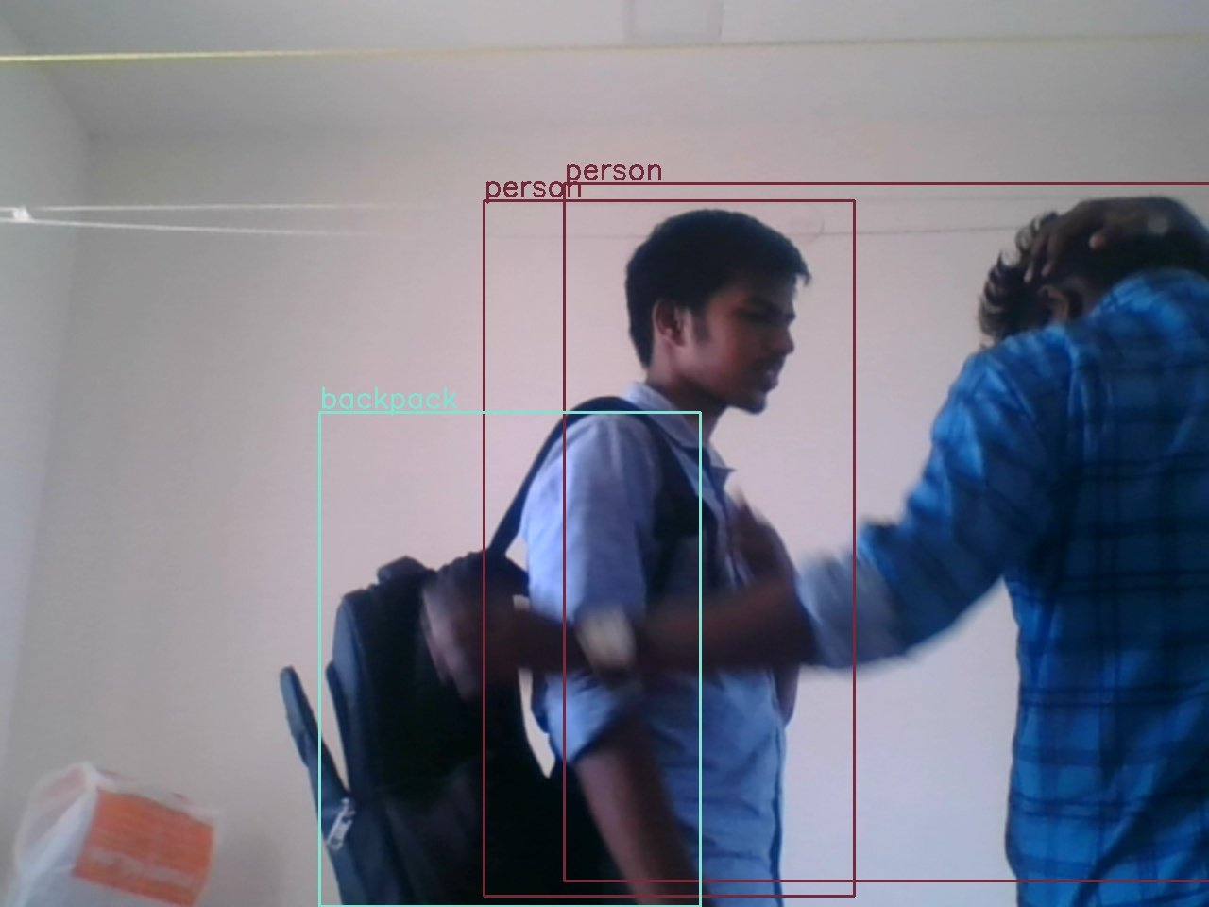

Slide 13
CONCLUSION
The research work that will be carried out in this thesis would be mainly focused to design and develop efficient and convenient motion detection surveillance i.e. an Anti-Theft device to solve security problems which will help to reduce/stop theft.
This system is suitable for small personal area surveillance. I.e. personal office cabin, bank locker room, parking entrance. Whenever the motion is detected through. The main Advantage of the project is Easy to implement, Low cost with High quality.

Slide 14
REFERENCES
answers.opencv.org
stackoverflow.com
Stackexchange.com

