Slide 1

PAID PROMOTERS RECOMMENDATION SYSTEM
Department of Computer Science and Engineering
Mentor:
Mrs. Ponmani S,
Associate Professor
Team Members
1. Akash A - 180701017
2. Chris Gavin B - 180701056
Dept. of CSE, Final Project Review

Slide 2
ABSTRACT
Ads are one of the key revenue in today's digital world.
Ads are approaching users in multiple ways and have been evolving from generation to generation.
Previously we could only see ads on tv, radio, and newspaper but nowadays in the modern world ads reach us mostly through online platforms such as Youtube, Facebook, Instagram, etc.
In today's digital platform YouTube is one of the immense benefiter from ads by running video ads on start and in between a content video.
In the first quarter of 2021 Youtube’s income was about 8.6 billion U.S. dollars from advertisements alone
Dept. of CSE, Final Project Review

Slide 3
ABSTRACT
One step ahead, apart from the YouTube-generated ads, content creators who make and publish videos on the YouTube platform and personally promote advertisements are called Paid Promoters.
The impact of advertisement when delivered by paid promoters will have more impact on the viewers than auto-generated youtube ads.
So, advertisers contact these paid promoters to advertise their products on youtube. But these advertisements have very less impact on the viewers.
Our project idea is to make a recommendation system that recommends content creators relevant to ads of advertisers with a possibility of viewership.
Using this the advertisers can reach their relevant audience and make their investment in ads in a guaranteed way.
Dept. of CSE, Final Project Review

Slide 4
KEY CHALLENGES
Building enterprise level product.
Understanding the working of Classifications.
Business considerations related to advertisers management.
Motivating the participants to use this application.
Challenges associated with flow of commodity.
Dept. of CSE, Final Project Review

Slide 5
MOTIVATION
Business advertisers now tend to invest more in Social media advertising.
In today's digital platform YouTube is one of the immense benefiter from ads by running video ads on start and in between a content video.
In 2021, YouTube's global advertising revenues amounted to approximately 28.84 billion U.S. dollars, up by almost 46 percent from 19.7 billion U.S. dollars in the preceding fiscal period.
But these types of advertisements had very less impact on the consumers as they were irrelevant.
Youtube has a very less advertisement conversion ratio.
Youtube promoters who are the major influencers were never involved so there is a need to connect the advertisers with promoters whose content is relevant to the content of the advertisement.
Dept. of CSE, Final Project Review

Slide 6
OBJECTIVE
The paid promoter’s recommendation system is a user-friendly application that can be used by both the advertisers and the paid promoters. The paid promoters need to request to add their channel to the portal. The advertiser can choose the language in which the advertisement needs to be promoted according to their needs, then the advertiser can choose the advertisement category according to the content of the advertisement. After selecting the category of the advertisement, the of list YouTubers available be will display in an orderly manner. The contact information of every YouTuber will be displayed accordingly. There will be a linear graph that displays the latest view count rate of every youtube channel. Based on the interest of the advertisers one can choose the YouTuber.
The main objectives of this project are:
To connect the advertisers with promoters whose content is relevant to the content of the advertisement.
To increase the advertisement conversion ratio.
To connect advertisers with the relevant audience which will maximize their profit.
Dept. of CSE, Final Project Review

Slide 7
Existing System
The existing system was only a youtube advertisement recommendation system.
Ensemble methods were used on the generated dataset to generate useful information like target audience demographics, genre, etc.
The advertisements which were displayed by this recommendation system had very less impact on the consumers.
These existing systems never involved YouTubers who are the major influencers.
Dept. of CSE, Final Project Review

Slide 8
PROPOSED SYSTEM
Paid promoters web portal connects the advertisers with the relevant promoters.
Ad conversion ratio will increase which in turn will increase the business of the advertisers.
Our model can identify 4 regions.
Model has an accuracy of 90%.
Model takes an average of 5 seconds to recognize the category and region.
Current status will get updated every 24 hours.
Dept. of CSE, Final Project Review

Slide 9
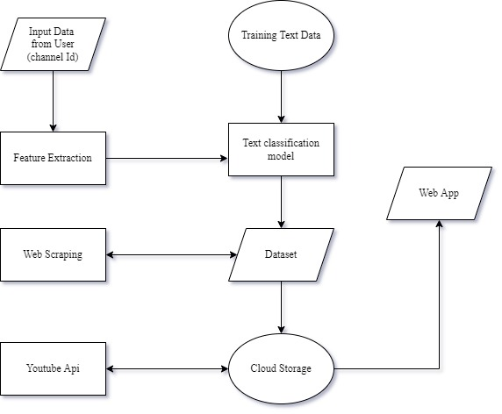
Architecture Diagram
Dept. of CSE, Final Project Review

Slide 10
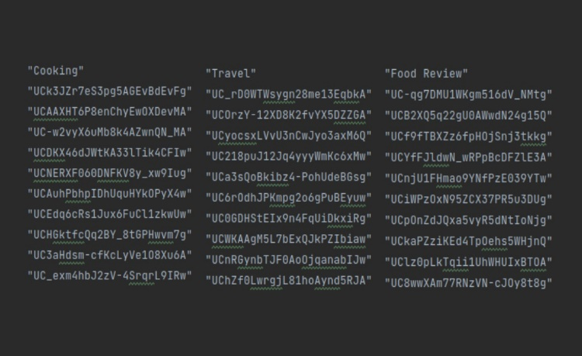
Functional Description and Implementation of Modules
(A) Dataset Creation:
1. Gathering Data:
A Comma Separated Values(CSV) file that contains a list of youtube channel IDs from various regions and their respective categories is created manually for training purposes. It is used to fetch information such as channel title and description through web scraping. After fetching data, We use the CSV format to store that information.
Dept. of CSE, Final Project Review

Slide 11
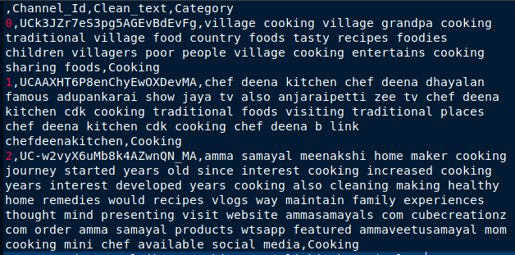
Functional Description and Implementation of Modules
2. Data Cleaning and Preprocessing:
Title and Description are unprocessed raw texts. Therefore, to filter out the noisiness, we’ll follow certain approaches for cleaning the text:
Converting to Lowercase: This step is performed because capitalization does not make a difference in the semantic importance of the word.
Removing numerical values and punctuations: Numerical values and special characters used in punctuation($,! etc.).
Removing extra white spaces: Such that each word is separated by a single white space, else there might be problems during tokenization.
Dept. of CSE, Final Project Review

Slide 12
Functional Description and Implementation of Modules
Tokenizing into words: This refers to splitting a text string into a list of ‘tokens’, where each token is a word. Removing non-alphabetical words and ‘Stop words’: ‘Stop words’ refer to words like and, the, is, etc, which are important words when learning how to construct sentences, but of no use to us for predictive analytics.
Stemming: Stemming is a technique used to extract the base form of the words by removing affixes from them. It is just like cutting down the branches of a tree to its stems. For example, the words ‘traveling’ and ‘traveler’ will both be converted into their simplest meaning ‘travel’.
Label Encoding: The ‘Category’ column in the dataset is an output variable, Thus we need to encode each class as a numerically based feature.
TF-IDF Vectorizer: To extract data from the above-processed text as features and represent them in a numerical format, a common approach is to vectorize them. TF-IDF(Term Frequency-Inverse Document Frequency) calculates the frequency of each word inside and across multiple documents to identify the importance of each word.
Dept. of CSE, Final Project Review

Slide 13
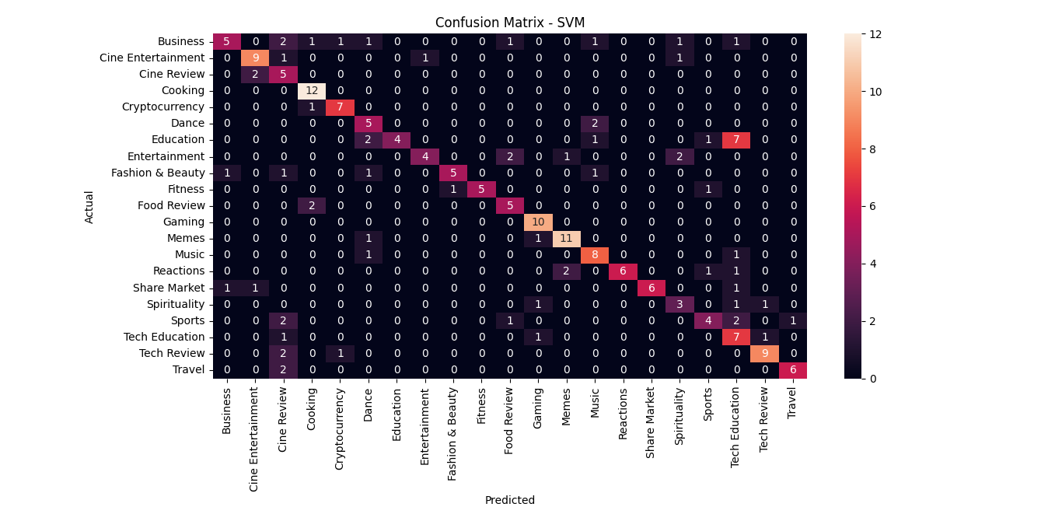
Functional Description and Implementation of Modules
3. Modeling and Training:
The dataset is split into Train and Test sets with a split ratio of 8:2.
Features for Title and Description are concatenated to construct a final feature matrix. The Stochastic gradient descent(SGD) is an optimization algorithm to find the model parameters that correspond to the best fit between predicted and actual outputs and a highly robust classifier used to train the model.
Dept. of CSE, Final Project Review

Slide 14
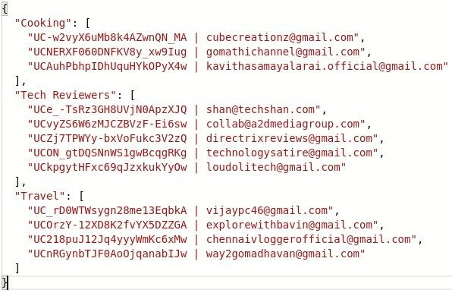
Functional Description and Implementation of Modules
(B) Web Scrapping:
Web scraping is the process of extracting content and data from a website, web scraping extracts underlying HTML code, we use this technique with Python to extract contact details from their channel if the channel owner published one.
Dept. of CSE, Final Project Review

Slide 15
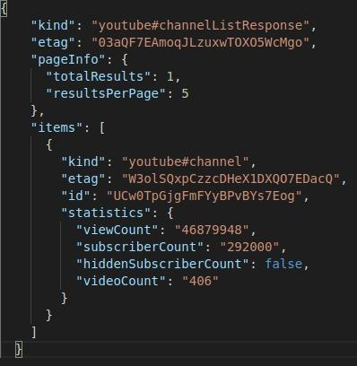
Functional Description and Implementation of Modules
IMPLEMENTATION
(C) Fetching youtube channel details
With the YouTube Data API, we request Advertisers focused information and receive responses in JSON format. Such as subscribers count, Total view count of the channel, Total videos posted in a channel, Latest video uploaded, and View count for latest videos.
Dept. of CSE, Final Project Review

Slide 16
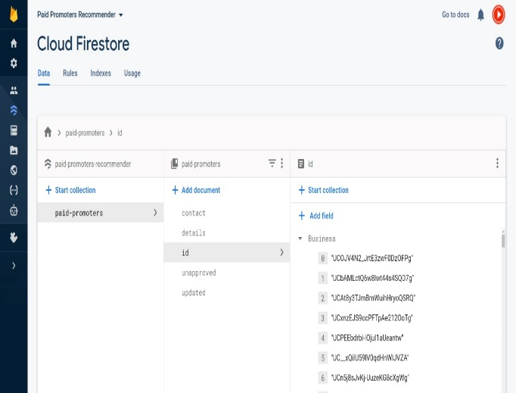
Functional Description and Implementation of Modules
(D) Cloud Storage
Firebase is a Backend-as-a-Service (Baas) from Google. The Firebase Firestore Database allows secure access to the database directly from client-side code. We use firebase to store our data such as Youtube Channel Ids, Channel details, and Contact details.
Dept. of CSE, Final Project Review

Slide 17
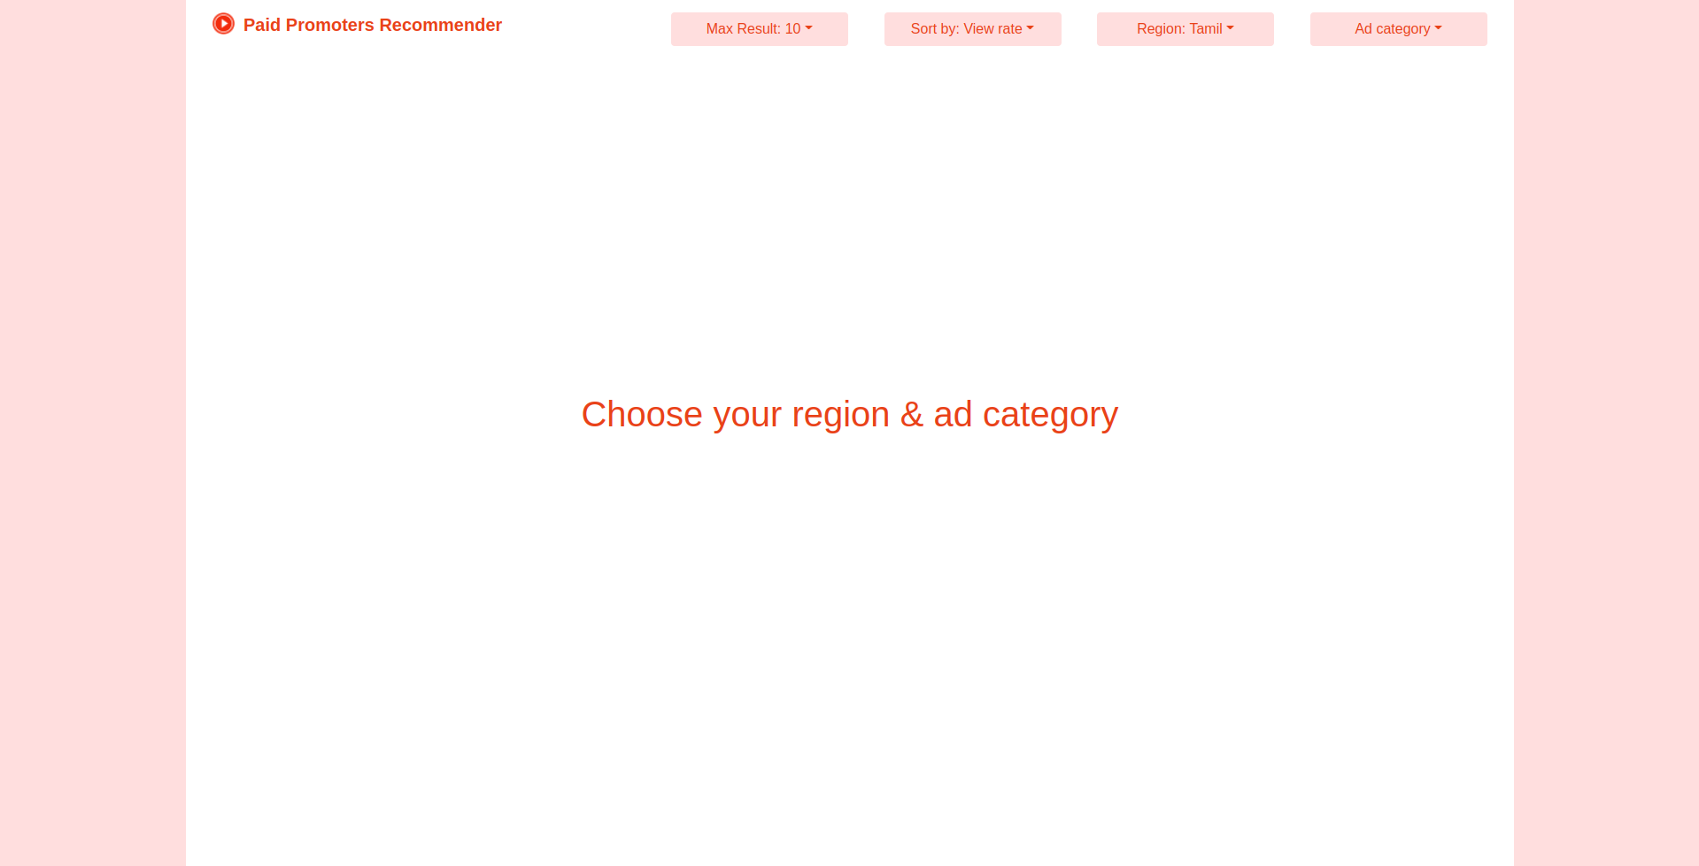
Functional Description and Implementation of Modules
(E) Web Application:
React-js is an open-source JavaScript library from meta that is used for building user interfaces specifically for single-page applications. We used reactjs to build our website to showcase the youtube channels and new YouTubers can also make a request to add their channel to our application.
IMPLEMENTATION
Dept. of CSE, Final Project Review

Slide 18
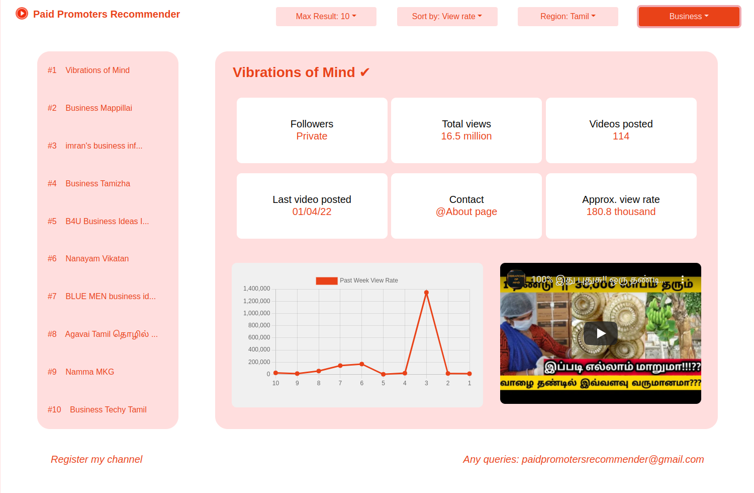
Result
IMPLEMENTATION
Dept. of CSE, Final Project Review

Slide 19
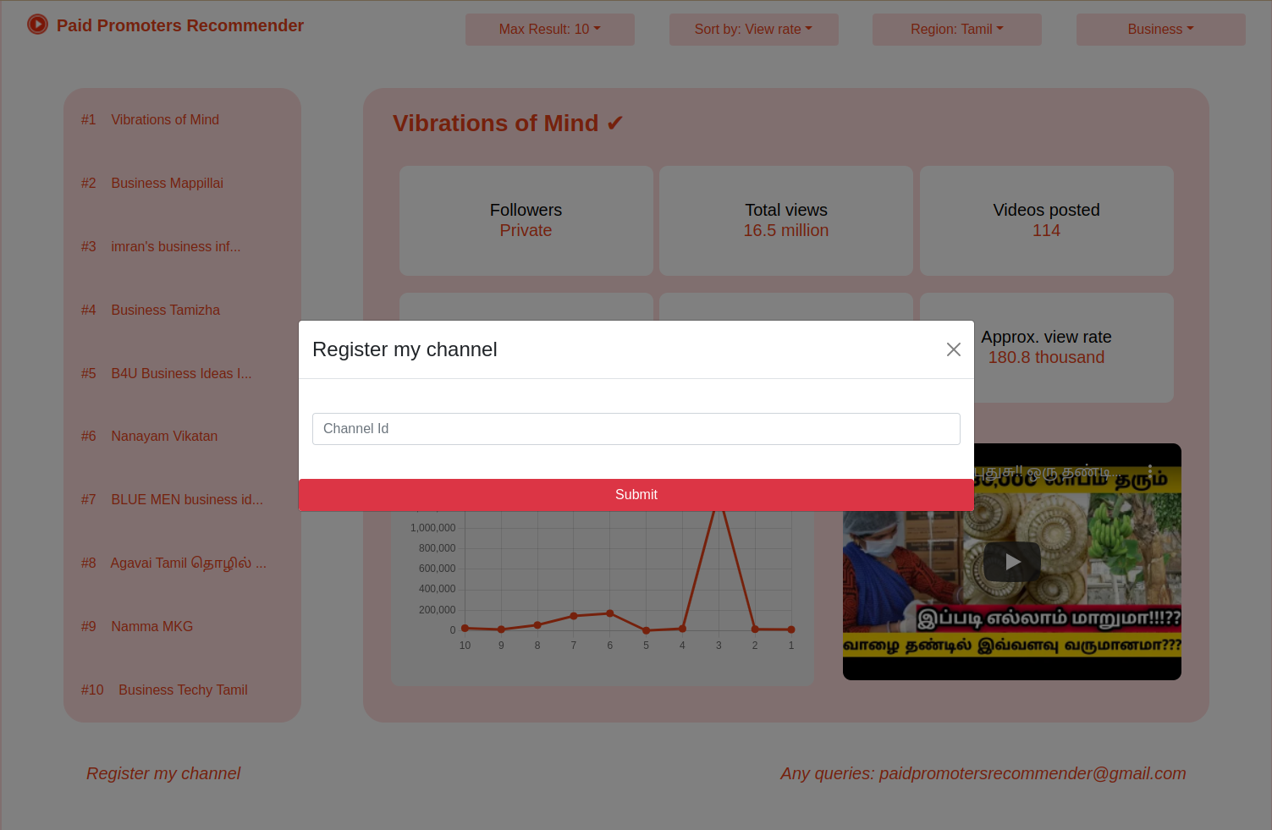
Result
IMPLEMENTATION
Dept. of CSE, Final Project Review

Slide 20
Conclusions
Paid promoter’s web application is developed for easy interaction with the current status of all youtube channels. This interactive portal will allow advertisers to compare and choose the best relevant paid promoter for their advertisements. A prototype system is implemented and various test scenarios were considered to validate the proposed system.
Dept. of CSE, Final Project Review

Slide 21
Future Enhancements
The current proposed system is available in 4 regions, so the future work lies in enlarging the dataset so that the website will be available in 22 regions recogonized by the constitution of India.
The web portal needs to be improved so that the end-user will get a great user experience.
Dept. of CSE, Final Project Review

Slide 22
Bibliography
Journals:
Shanmuga Skandh Vinayak E, Venkatanath A G S, Shahina A, Nayeemulla Khan A. Advertisement Recommendation Engine - Improving YouTube Advertisement Services. International Journal of Recent Technology and Engineering (IJRTE) ISSN: 2277-3878 (Online), Volume-9 Issue-4 November 2020.
Veluchamy R, Sans RK, Rajagopal P. TO STUDY THE IMPACT OF YOUTUBE TECH INFLUENCERS ON THE CONSUMER BUYING BEHAVIOR OF ELECTRONIC GADGETS.
Chang JY. Applying AHP to Comprehend the Factors Influencing Consumer Attention to Sponsored Ads by YouTubers. 2018 June 12.
Wickramasinghe SP, Welgama SD, Rajapakse RP, Jayasuriya N, Munasinghe AA. The Impact of Viewers’ Behavior and YouTubers’ Credibility in Advertainment on Building Consumer Trust.
Kujur F, Singh S. Emotions as predictor for consumer engagement in YouTube advertisement. Journal of Advances in Management Research. 2018 May 14.
Dept. of CSE, Final Project Review

Slide 23
Bibliography
Journals:
Vedula N, Sun W, Lee H, Gupta H, Ogihara M, Johnson J, Ren G, Parthasarathy S. Multimodal content analysis for effective advertisements on youtube. In2017 IEEE international conference on data mining (ICDM) 2017 Nov 18 (pp. 1123-1128). IEEE.
Abdelkader OA. A study of “forced-ad resistance” leading to “Skip Ad” on YouTube. Turkish Journal of Computer and Mathematics Education (TURCOMAT). 2021 Apr 28;12(10):7263-71
Dehghani M, Niaki MK, Ramezani I, Sali R. Evaluating the influence of YouTube advertising for attraction of young customers. Computers in human behavior. 2016 Jun 1;59:165-72.
Tangmanee C. Fixation and recall of YouTube ad banners: An eye-tracking study. International Journal of Electronic Commerce Studies. 2016 May 10;7(1):49-76.
Rybaczewska M, Jebet Chesire B, Sparks L. YouTube vloggers as brand influencers on consumer purchase behavior. Journal of Intercultural Management. 2020;12(3):117-40.
Dept. of CSE, Final Project Review

Slide 24
Bibliography
Websites:
https://developers.google.com/youtube/v3
https://reactjs.org/
https://firebase.google.com/
https://scikitlearn.org/stable/modules/generated/sklearn.linear_model.SGDClassifier.html
https://scikitlearn.org/stable/modules/generated/sklearn.feature_extraction.text.TfidfVectorizer.html
Dept. of CSE, Final Project Review

Slide 25
Questions ?
Dept. of CSE, Final Project Review

Slide 26
Thank You
Dept. of CSE, Final Project Review

