Slide 1
Dr. K.P. Vijayakumar, VIT Chennai
PL/SQL –Exceptions

Slide 2
PL/SQL Exception
Exception is an error that affect the execution of Program
Type of Exception
System defined exception
User defined exception
Source: www.tutorialspoint.com

Slide 3
PL/SQL Exception
System defined exception are predefined in PL/SQL which get raised WHEN certain database rule is violated
Two categories
Named system exception
Unnamed system exception
Source: tutorialpoint.com, geeksforgeeks.com

Slide 4
PL/SQL Exception
Named System Exception
NO_DATA_FOUND
Select returns more than one row
TOO_MANY_ROWS
Select returns more than one row
VALUE_ERROR
Invalid data error
ZERO_DIVIDE
Attempt to divide by zero
ACCESS_INTO_NULL,DUP_VAL_ON_INDEX, LOGIN_DENIED etc..
Source: tutorialpoint.com, geeksforgeeks.com

Slide 5
PL/SQL Exception
Syntax of PL/SQL
DECLARE
<declarations section>
BEGIN
<executable command(s)>
EXCEPTION
WHEN exception1 THEN
exception1-handling-statements
WHEN exception2 THEN
exception2-handling-statements
END;
Syntax
EXCEPTION
WHEN exception1 THEN
exception1-handling-statements
WHEN exception2 THEN
exception2-handling-statements
Source: tutorialpoint.com, geeksforgeeks.com

Slide 6
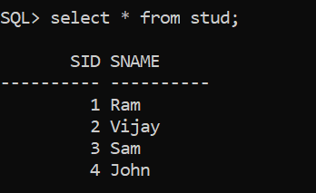
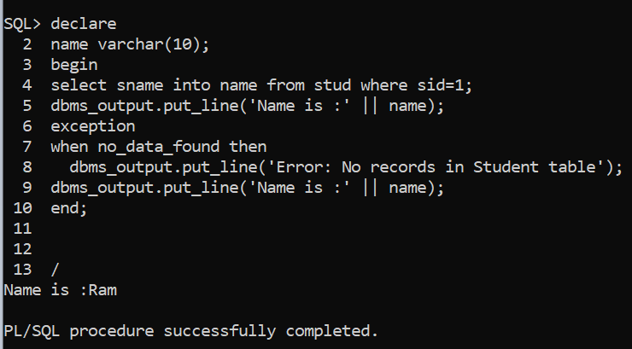
PL/SQL Exception
NO_DATA_FOUND
Source: tutorialpoint.com, geeksforgeeks.com

Slide 7
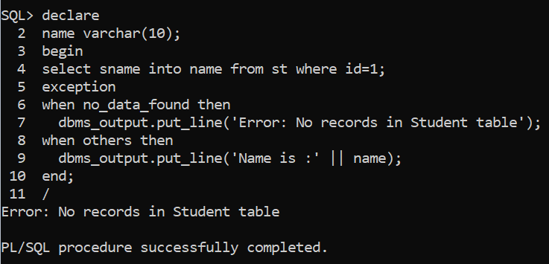

PL/SQL Exception
NO_DATA_FOUND
Source: tutorialpoint.com, geeksforgeeks.com

Slide 8
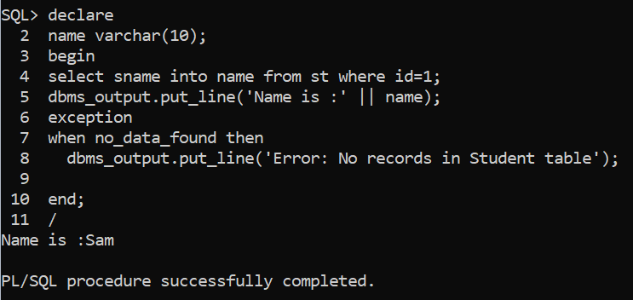

PL/SQL Exception
NO_DATA_FOUND
Source: tutorialpoint.com, geeksforgeeks.com

Slide 9
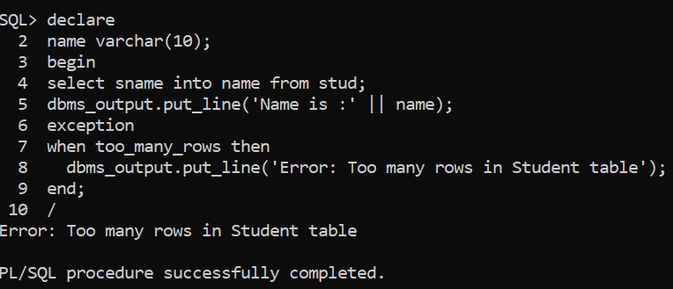
PL/SQL Exception
TOO_MANY_ROWS
Source: tutorialpoint.com, geeksforgeeks.com

Slide 10
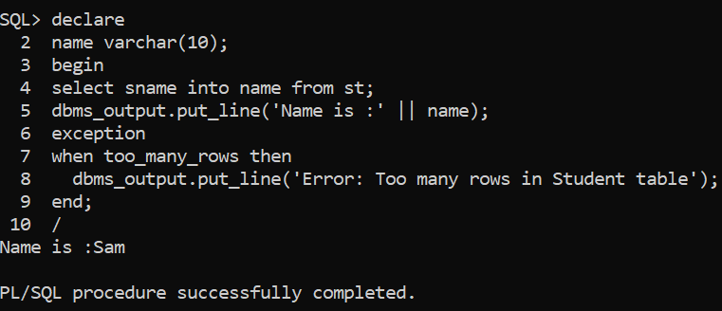
PL/SQL Exception
TOO_MANY_ROWS
Source: tutorialpoint.com, geeksforgeeks.com

Slide 11
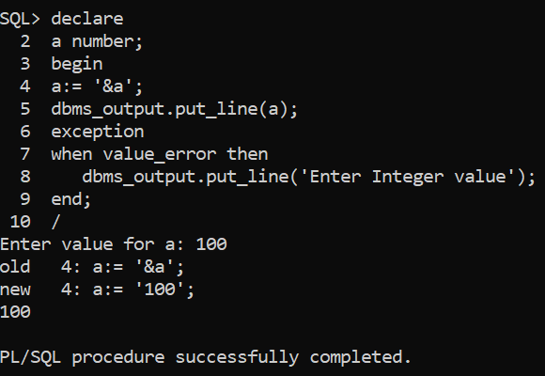
PL/SQL Exception
VALUE_ERROR
Source: tutorialpoint.com, geeksforgeeks.com

Slide 12
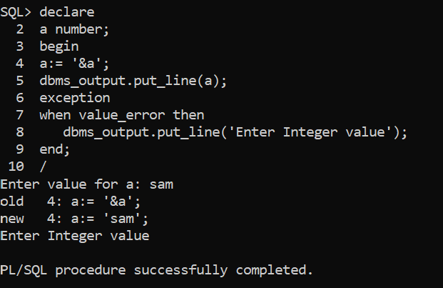
PL/SQL Exception
VALUE_ERROR
Source: tutorialpoint.com, geeksforgeeks.com

Slide 13
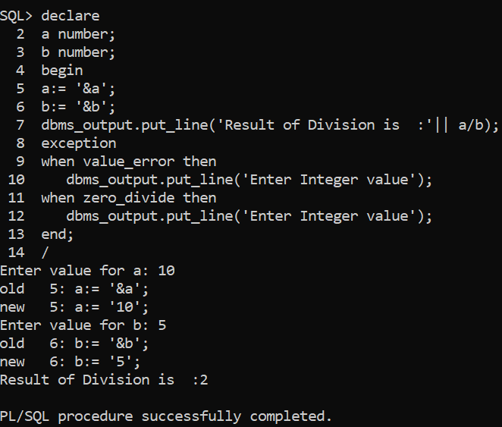
PL/SQL Exception
ZERO_DIVIDE
Source: tutorialpoint.com, geeksforgeeks.com

Slide 14
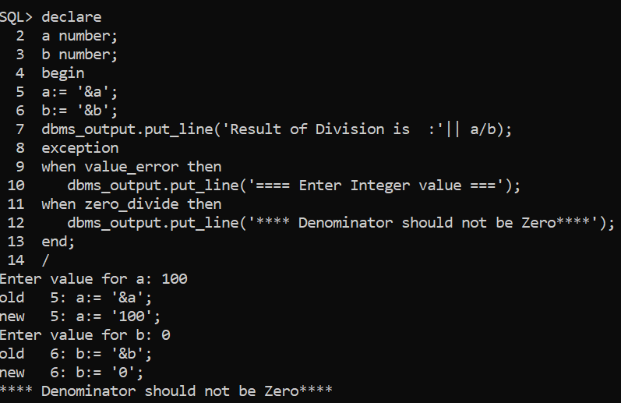
PL/SQL Exception
ZERO_DIVIDE
Source: tutorialpoint.com, geeksforgeeks.com

Slide 15
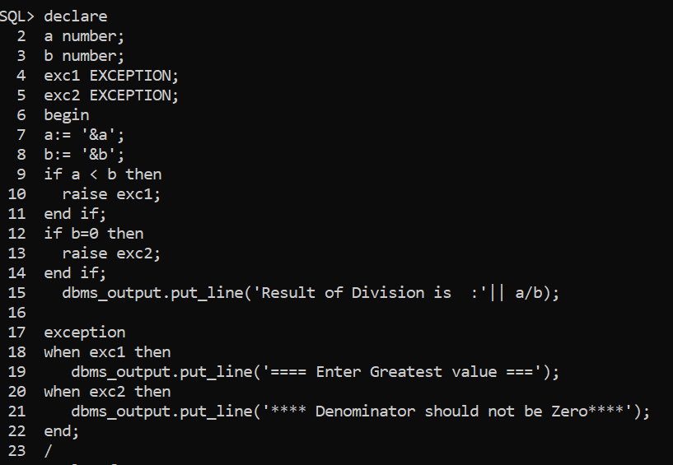
PL/SQL Exception
User defined Exception
Source: tutorialpoint.com, geeksforgeeks.com

