Slide 1

Cyber security for embedded systems
F214426

Slide 2
Part 1: deployment and assessment of cryptographic models
Objectives:
Deploy XTEA and Blowfish encryption algorithms.
Collect their inference times and memory utilisation under O0 and O3 optimisations.
Compare them with AES algorithm.
Implement firmware integrity check (SHA256).
Choose a suitable algorithm to be used for part 2

Slide 3
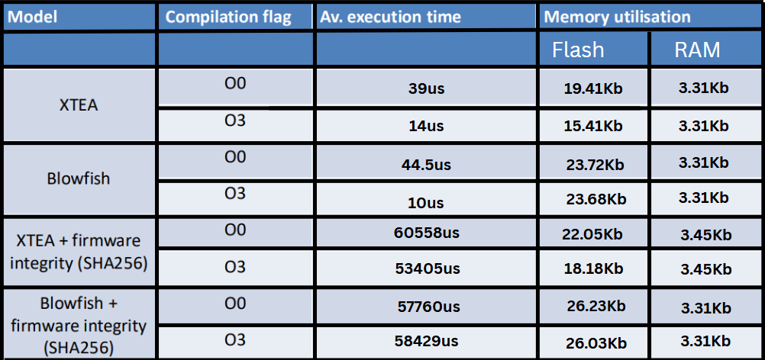
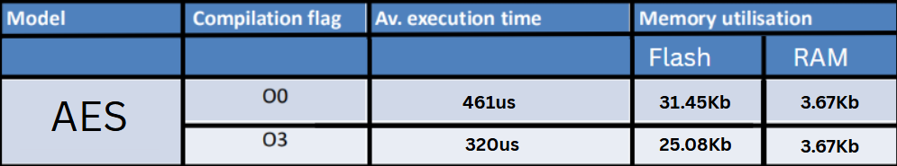

Slide 4
XTEA algorithm was chosen for part 2 because of its low execution time and lower memory requirements compared to Blowfish and AES.
It is best suited for resource constrained embedded systems such as the drone that is used in part 2.
It maintains a good balance of speed and its cryptographic encryption strength.

Slide 5
Part 2: mission validation
Objectives:
Simulate communication between ground station and drone
Protect long term credentials
Generate random car plates and encrypt it before sending it to ground station.
Encrypt the secret message before sending it to ground station.
Achieve security level 3.

Slide 6

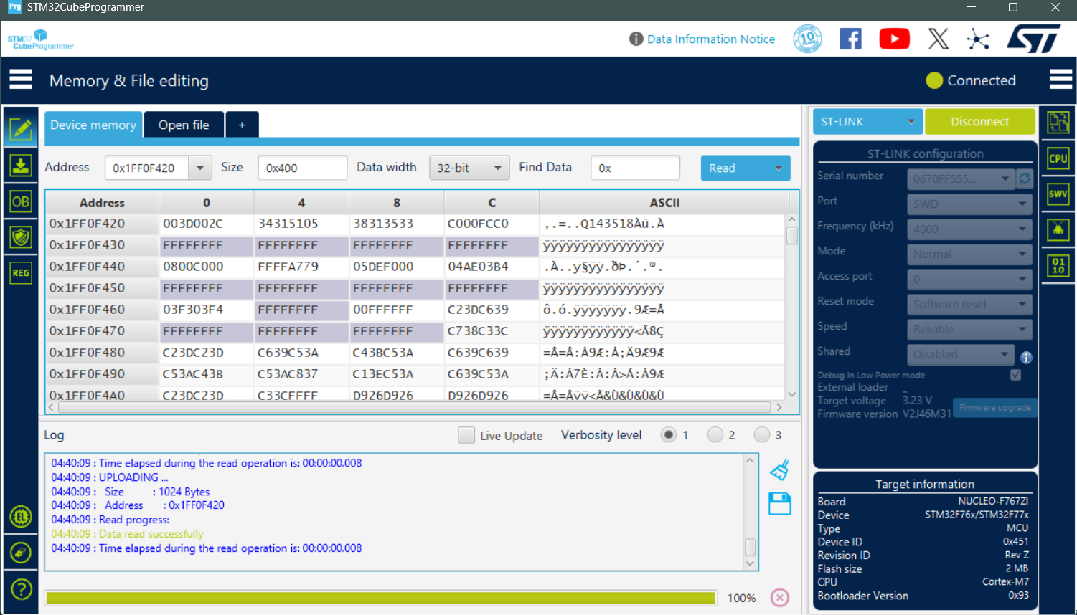
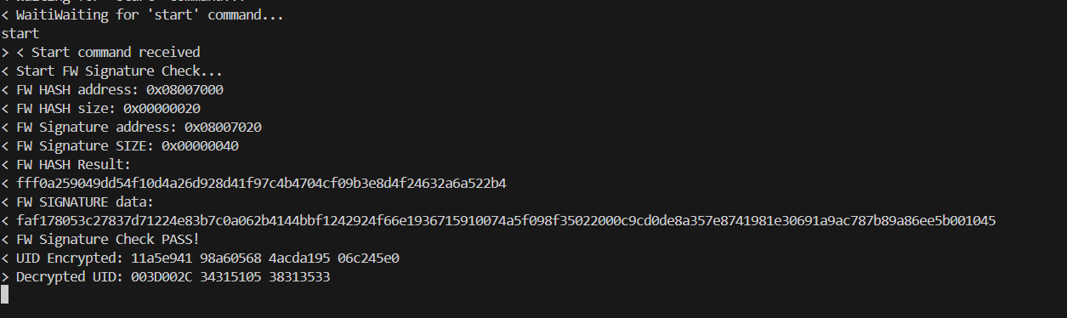
Board uid located at 0x1FF0F420

Slide 7
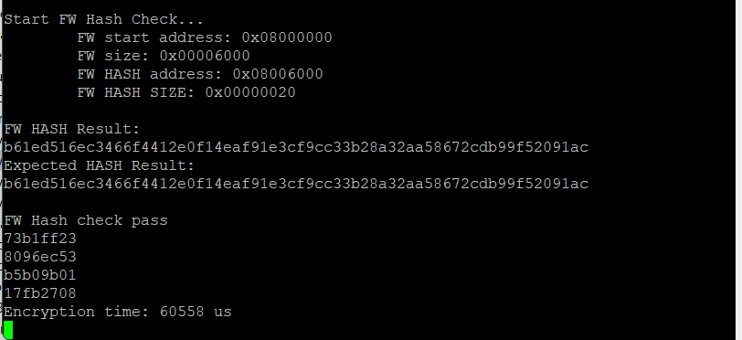
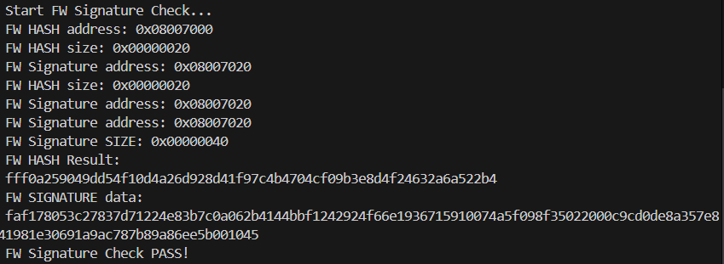
Hash check and signature check

Slide 8
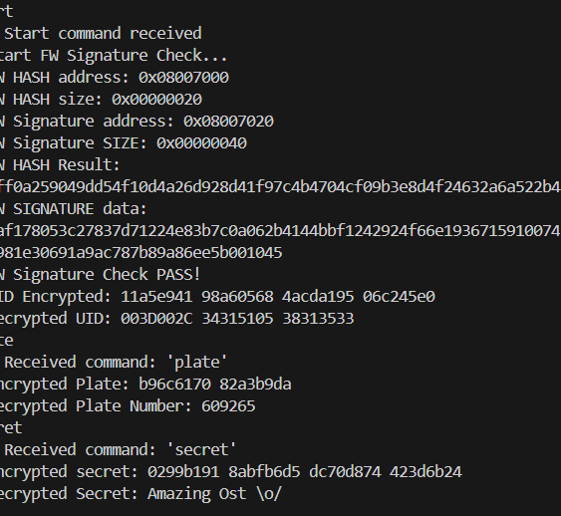

Full communication between ground station and drone

Slide 9
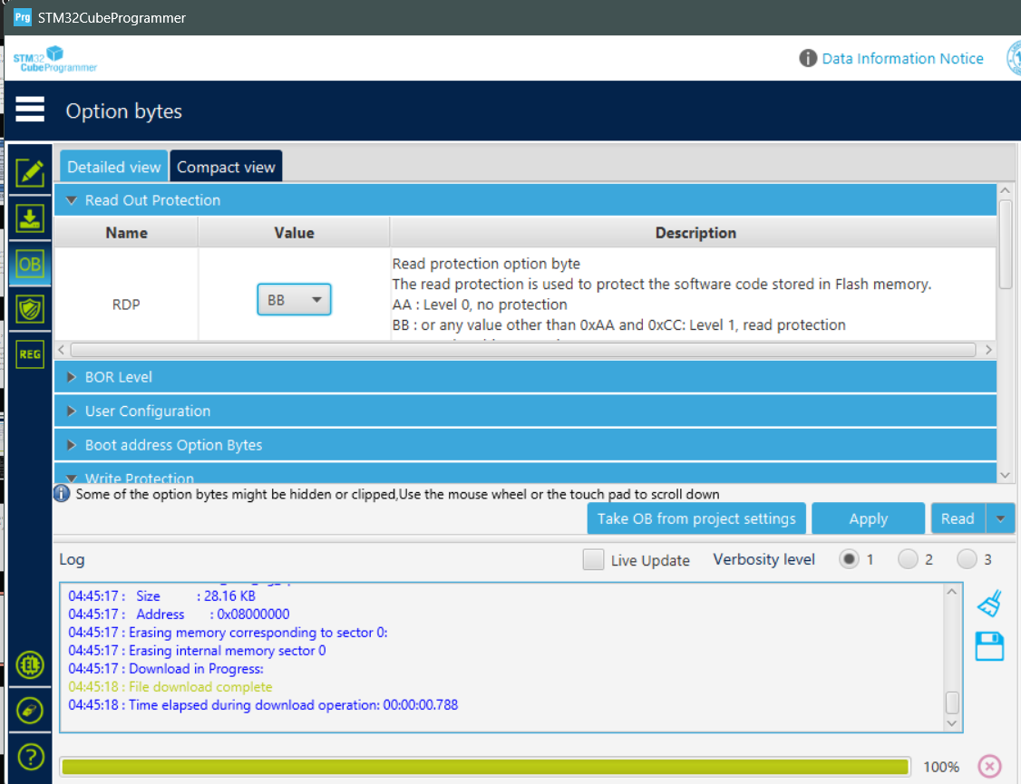
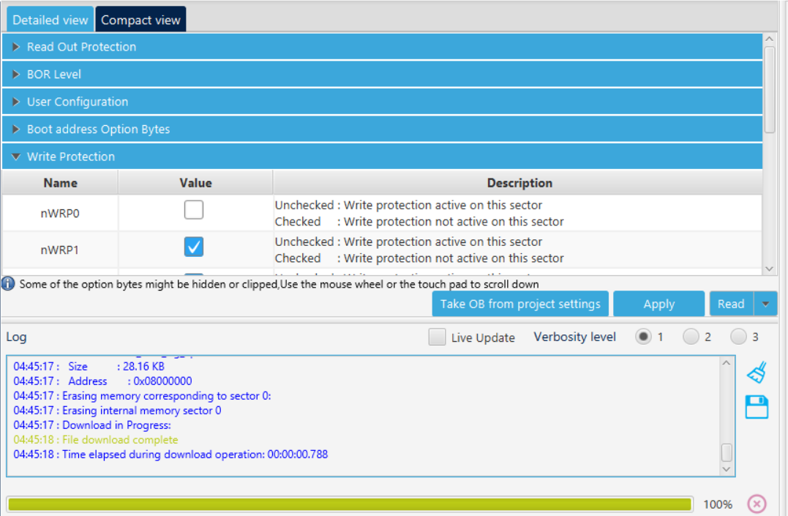
Write protection and read out protection

Slide 10
thank YOU !

