Slide 1
Docker

Slide 2
What is Docker :
platform as a service
use OS-level virtualization
to deliver software in packages
Containers are isolated
lightweight than virtual machines

Slide 3
Why do we use docker ?
Docker provides us with containers. And containerization consists of an entire runtime environment, an application, all its dependencies, libraries, binaries and configuration files needed to run it, bundled into one package. Each application runs separately from the other. Docker solves the dependency problem by keeping the dependency contained inside the containers. It unites developers against dependency of their project.

Slide 4
Advantages of using Docker
Virtual Machines are slow and take a lot of time to boot.
Containers are fast and boots quickly as it uses host operating system and shares the relevant libraries.
Containers do not waste or block host resources unlike virtual machines.
Containers have isolated libraries and binaries specific to the application they are running.
Containers are handled by Containerisation engine.
Docker is one of the containerisation platforms which can be used to create and run containers

Slide 5
Docker concepts :
Flexible
Lightweight
Portable
Loosely coupled
Scalable
Secure

Slide 6
Containers and virtual machines
A container runs natively on Linux and shares the kernel of the host machine with other containers. It runs a discrete process, taking no more memory than any other executable, making it lightweight.
A virtual machine (VM) runs a full-blown “guest” operating system with virtual access to host resources through a hypervisor. In general, VMs incur a lot of overhead beyond what is being consumed by your application logic.

Slide 7
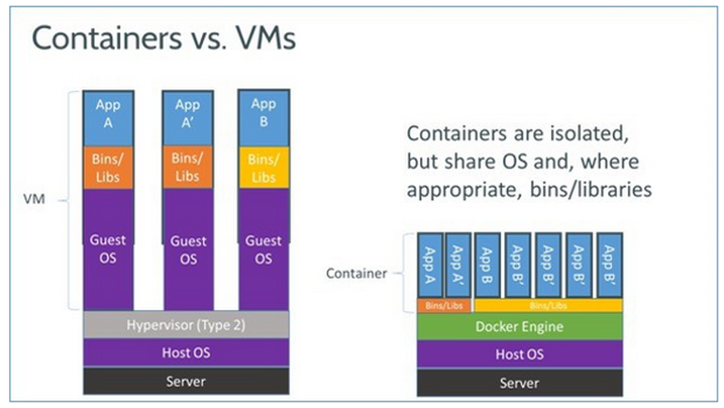

Slide 8
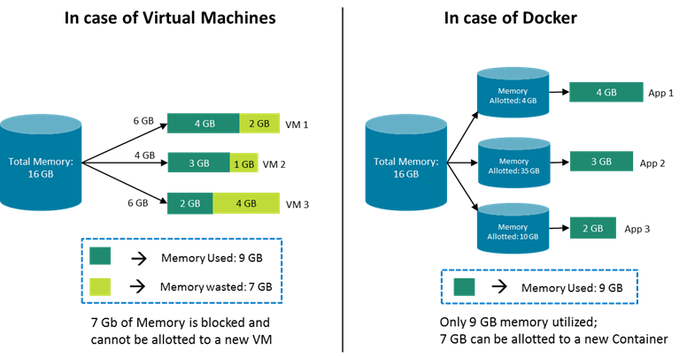

Slide 9
How things worked before docker:
Development team would give these artifacts to operations team along with instructions.
Operations team would configure this on server
Problems with this approach:
1. Dependency conflict
2. Miscommunication

Slide 10
Docker container and docker image:
Docker image is actual package.
Movable artifact
Docker container is running image
Pulled image on local machine and started

