Slide 1

A Presentation Report on GameToh Food Ordering System Submitted in partial fulfillment of the requirement for the award of the degree INTEGRATED MASTER OF COMPUTER APPLICATIONS Of Gujarat Technological University (GTU)
Project Guide: Prof Vivek Gondaliya
Akash Trivedi (175220686001)
Marwadi Education Foundation’s Group of Institutions
(MEFGI)
Rajkot, Gujarat
2019 - 2020

Slide 2
SYNOPSIS
The aim of developing GameToh Food services project is to replace the traditional way, of taking orders, with computerized system. Another important reason for developing this project is to digitize the summary reports and user friendly format at any point of time when needed.
GameToh Food services is a part of ecommerce through which we can carry-out selling, distributing, marketing for the outlet owner also providing Service over internet to remote public.
Also, for building a Food Service website we need to upload variety of cuisine online to attract potential and diverse customers. The GameToh food services gives restaurant the ability to increase sales and expand their business by giving customers the facility to order food online. With an online restaurant menu service the customer can place orders online 24x7. Thus it is a simple, fast and convenient food services giving an edge over the competition at an affordable price.
Internet has experienced a tremendous growth in terms of coverage and awareness. So, giving the business an online presence has become very crucial and advantageous. With GameToh Food Services, we can set up restaurant menu online and the customers can easily place order with a simple mouse click/tap. Also with an online service we can easily track the orders, maintain customer's database and improve our food delivery service.
Customers can order food directly over internet. The restaurants can even customize online restaurant menu and upload images easily. Having restaurant menu over internet, potential customers can easily access it and place order at their convenience venue.
Also these days women are no less than men, in any field, so, in big cities even wives are working women, therefore mostly the small families manage to have food order from somewhere as they lack time, so this service will be of great help to them also.

Slide 3
PREAMBLE
Project Description
This project is developed in order to help the people so they can reach food services 24/7, no need to go to the restaurant to buy the food. This increases the convenience for customers for food any time. Through our website customers can easily view the menu of their own choice’s cuisine and can easily order/book them to eat according to their convenience.
Through our service the people can order their favorite food from remote location any time. By using this kind of service owner/customer/organization can easily track the order details, destination time and weekly cost percentage.
Customer can also provide feedback about the quality of food and delivery services, thus helping the food outlet/restaurant get better in delivering the services and improving the food quality. This will help the organization to grow further and provide better service.

Slide 4
PREAMBLE
Modules
1.Admin
2.Deliverer
3.Customer

Slide 5
PREAMBLE
Modules Description
1.Admin
•Admin will verify the details of restaurant, provided by the restaurant manager, at the time of registering.
•Admin will also add gift coupons/deals on special days.
•Admin will also review the feedback from the customers and pass them to the respected restaurant.
•Admin can also review the activity of suspected customers and if applicable can also suspend the account for some period of time.
2.Manager
•Manager requests the admin to add their restaurant with our web service.
•Manager adds items, deletes items.
3.Customer
•Customer logins/signup to place an order.
•Customer goes through the food items of his/her choice from the menu.
•Customer also gets the facility of multi cuisine to choose from.
•Customer can also avail the benefits of the coupons.
•Customer gives the feedback of the food service provided to him/her by that restaurant.

Slide 6
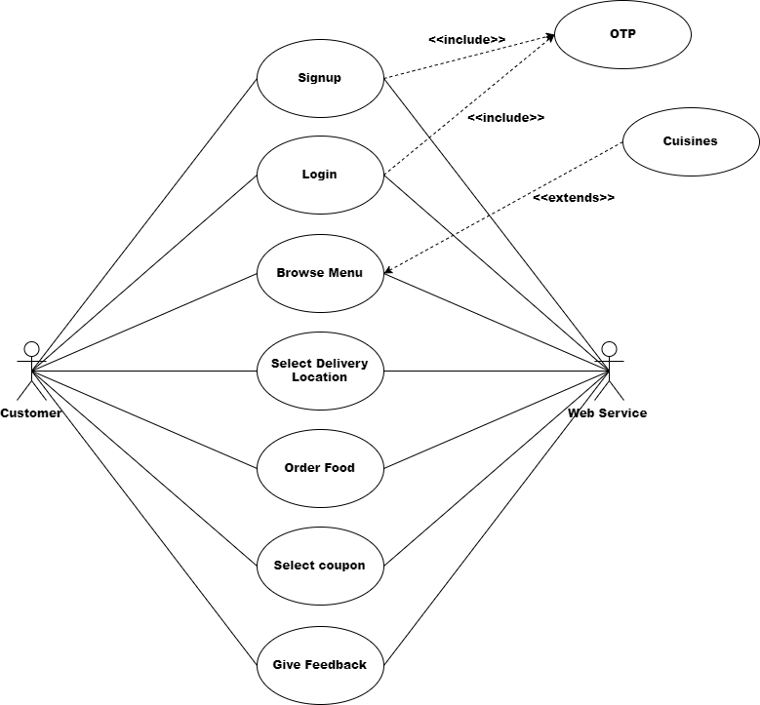
SYSTEM DESIGN
Use Case Diagram

Slide 7
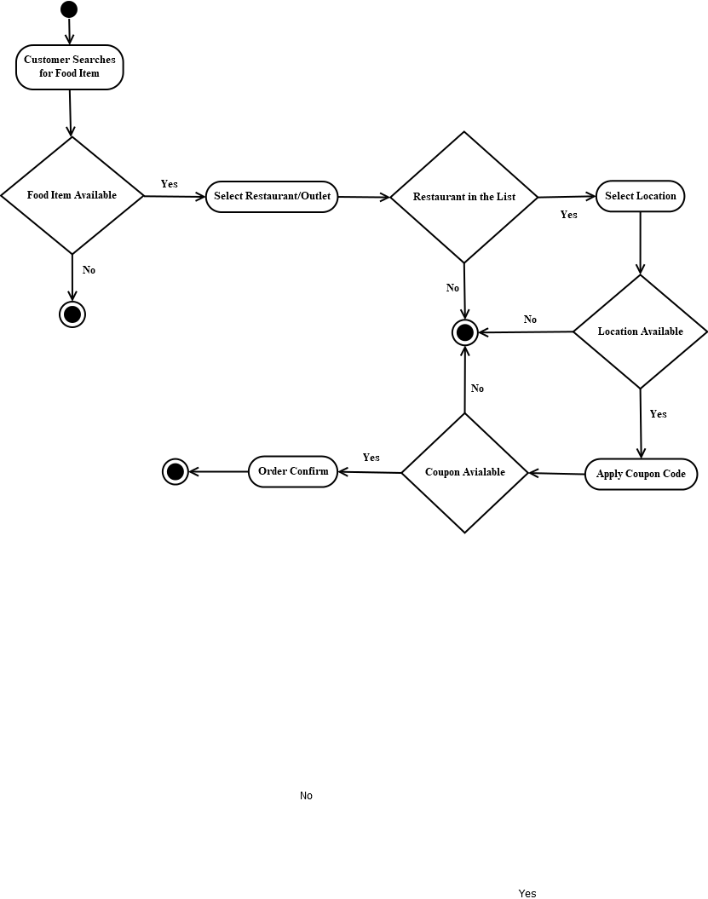
SYSTEM DESIGN
Activity Diagram

Slide 8
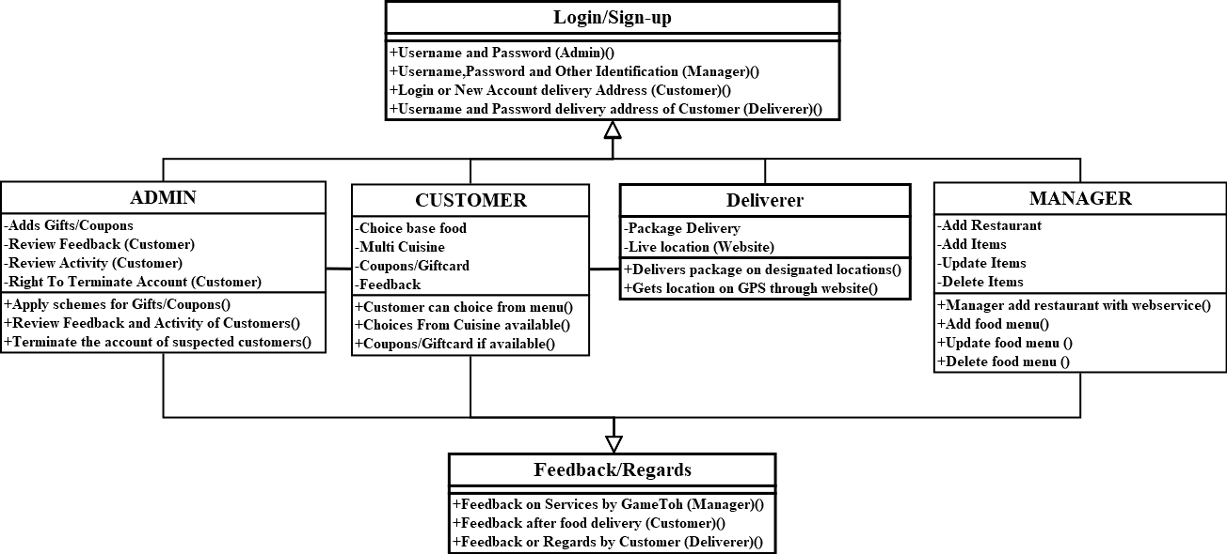
SYSTEM DESIGN
Class Diagram

Slide 9
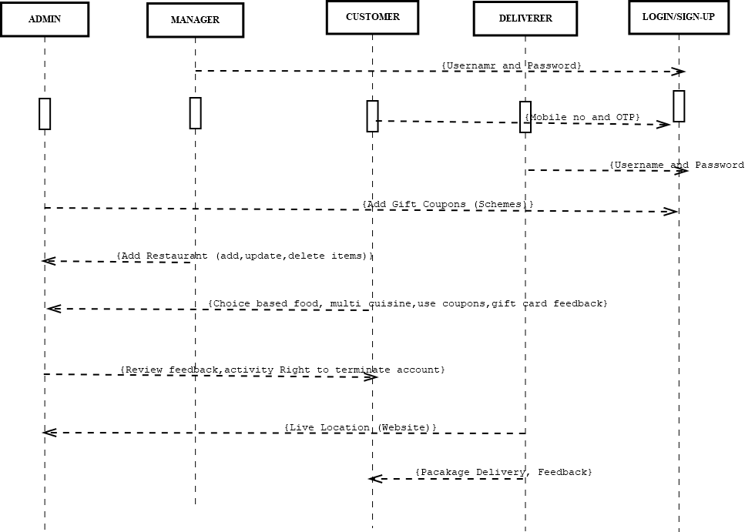
SYSTEM DESIGN
Interaction Diagram

Slide 10
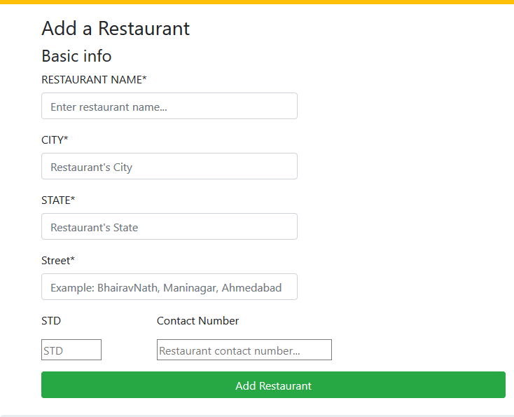
SCREENSHOTS
List new restaurant

Slide 11
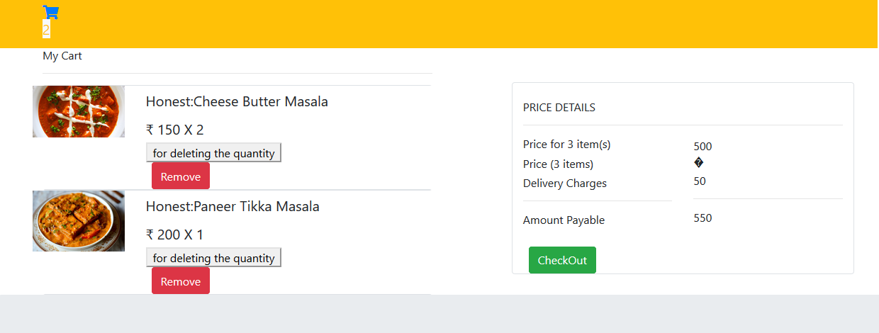
SCREENSHOTS
Add to cart

Slide 12
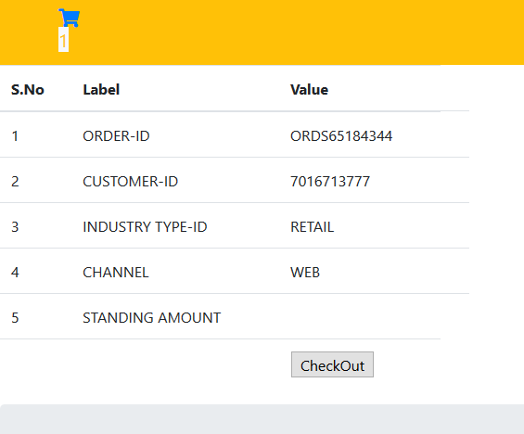
SCREENSHOTS
Check out

Slide 13
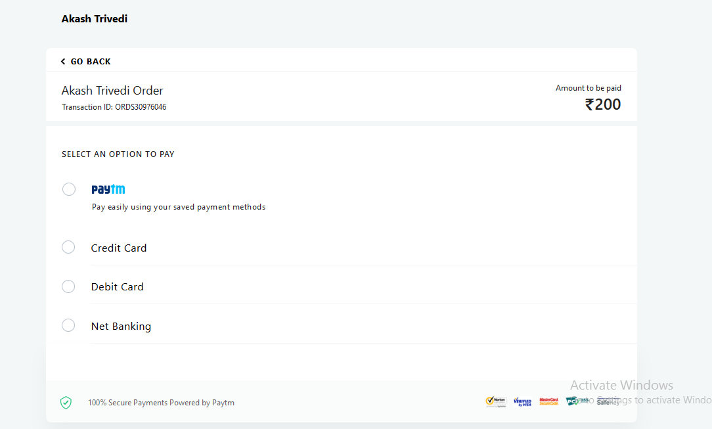
SCREENSHOTS
Redirecting To payment

Slide 14
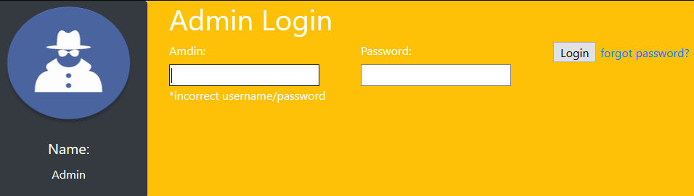
SCREENSHOTS
Admin Login

Slide 15
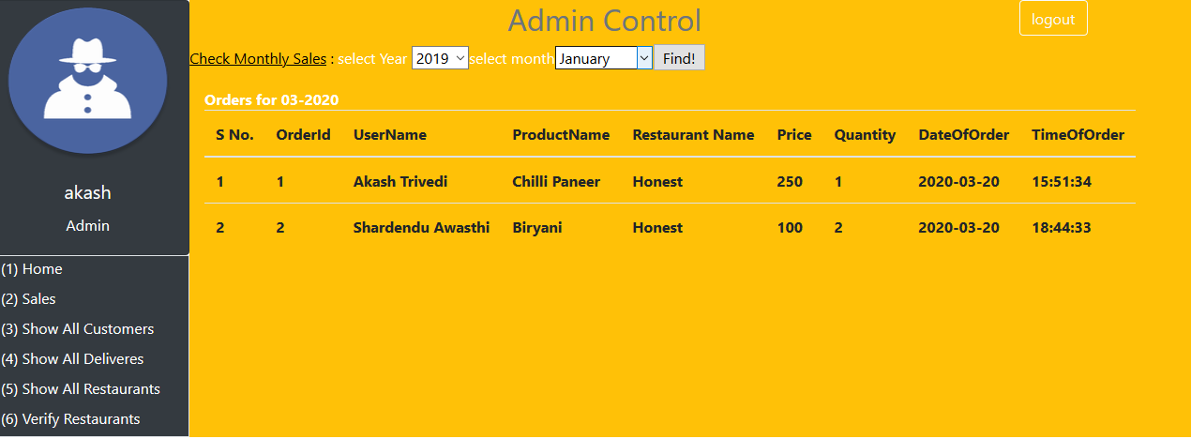
SCREENSHOTS
Monthly Sales

Slide 16
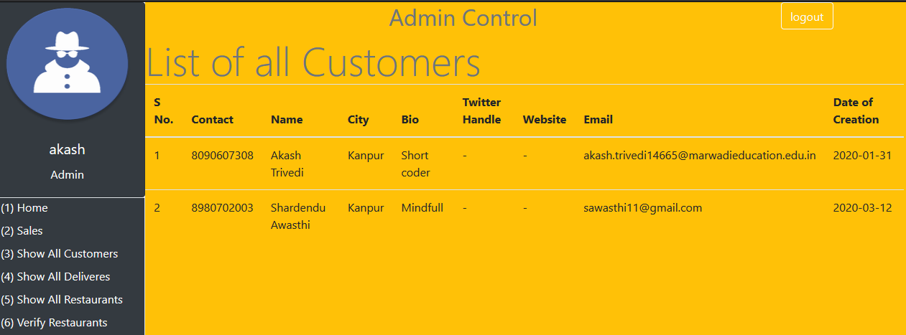
SCREENSHOTS
List customers

Slide 17
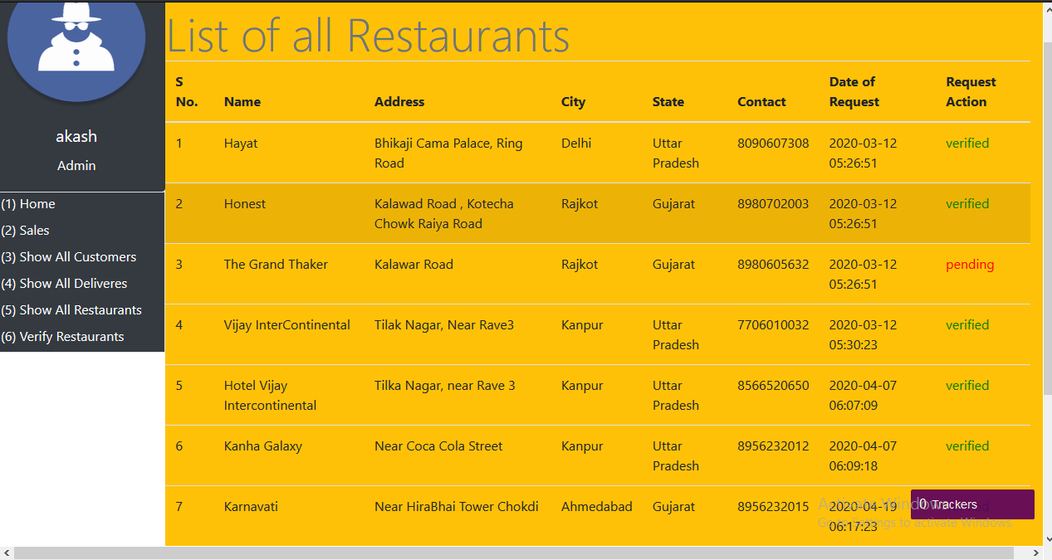
SCREENSHOTS
List Restaurants

Slide 18
CONCLUSION
At the end of our project we are conclude that our project is error free and all the modules run successfully and all its operation are also perfectly performing its Corresponding work.
Also we mentioned that our project is used for using our food delivery service related to Edible Items only. We in future are trying to reach out every Person’s need and add as many restaurant we can reach.
We want to grow this Network around India and Provide India a better and fast at home service.
Online Food Ordering system is developed on the basis of user's requirements. This system is based on solving one of the common problems of everyday life. It gives information needed in making food orders.
Customers can order any food as per their convenience. The system made for restaurant can help receiving orders and modifying its data. Also admin has control over the system. With online food ordering system, a restaurant can upload their menu online and customers can easily place order. Orders can be tracked easily. Food delivery service can be improved as maintenance of customer's database is done. The restaurants can even customize online restaurant menu.
Potential customers can easily access menu and place order. Hence, an automated food ordering system is presented with features of wireless communication. As more and more people are migrating to urban cities, they can avail this benefit of food services at any period of time. As food are brought to the doorstep, the unnecessary transportation will be reduced and thereby pollution will be decreased.

Slide 19
BIBLIOGRAPHY
Online References
youtube.com
tutorials point
w3schools

Slide 20
Offline References
1. Sams teach yourself php.
2. PHP and Mysql web development – Pearson Publications.
3. Html and css by John Duckett.

