Slide 1
Elements of Enterprise Software Development
CS 512 Software Systems
Prof. Chandrashekar R

Slide 2
Outline
Elements
Enterprise
Software
Development
Deployment

Slide 3
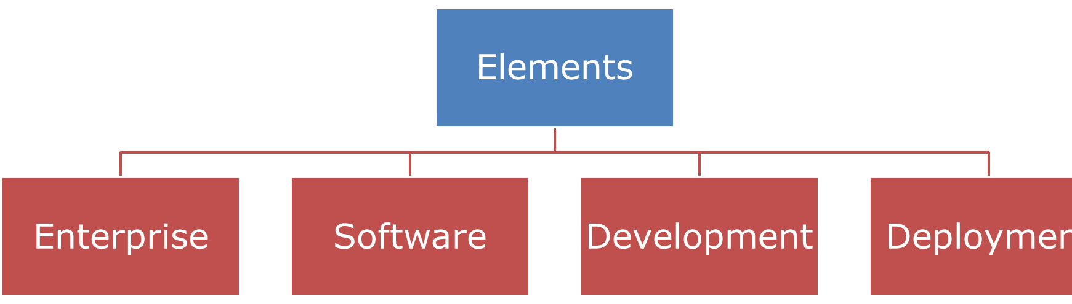
Enterprise Software
What is it for?
Where is used?
How is it used?
When is it used?
Who is it for?

Slide 4

Enterprise Software Deliverables
Requirements (“What”)
Architecture and Design (“How”)
Code
What makes these deliverables “good”?

Slide 5
Development Process
Environments
Configuration Management
Quality Management

Slide 6

Development Process
Environments
Dev
Test
Prod

Slide 7
Development Process
Code
Test
Check-in
Check-out
Software Configuration Management

Slide 8
Development Process
Quality Management
Process Quality
Product Quality

Slide 9
Elements of Deployment
Compute
Storage
Network
CPU & RAM
System Software
DAS
SAN
NAS
SSD
Routers and Switches
Node
Load balancer
Firewall
Umm, What is the role of developer here?

Slide 10
The Enterprise Software Team
Programmers
Architect / Designers / Leads
Business Analysts
Project Manager
Testers
Deployment Engineers
System Administrators
EST

Slide 11

Summary
Many diverse elements need to come together to make Enterprise Software work
Developer plays a critical role in this
BUT, Developer is not the ONLY one in the picture!
I promise to be nice to everyone from business analyst to sys-admin!!

Slide 12
GOING forward

Slide 13

Deep Dive Coming Up
Database Design and implementation
UML Class Diagrams, MySQL, SQL, Hibernate, etc.
User interaction
Microservices
Javascript, HTML, React, etc.
Business layer

