Slide 1
UML Class Diagrams
CS 512 Software Systems
Prof. Chandrashekar R

Slide 2
Outline
Using UML for database design
UML notations

Slide 3
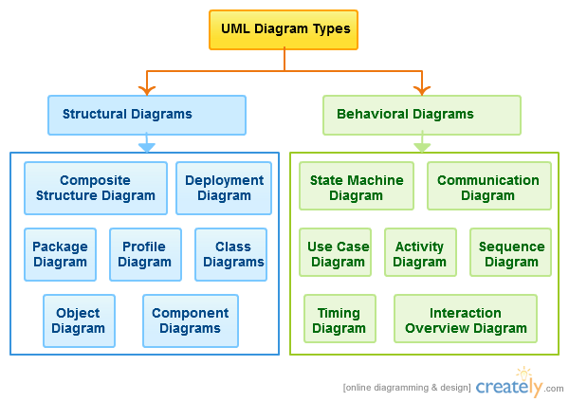
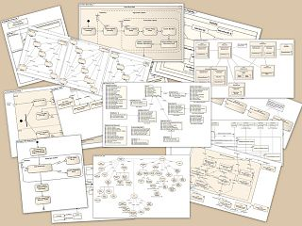
UML Components

Slide 4
Elements of Class Diagram
Class
Attribute
Relationships
Association
Aggregation
Composition
Inheritance

Slide 5
Class and attributes
Course
Class name
Course_name
Class_room
Course_credits
Attributes
Generally no methods in conceptual database designs
Data types may be added as part of refinement

Slide 6
Association
Association name
Course
Instructor
Course_name
Class_room
Course_credits
Instr_name
Office
e_mail
Courses_taught
1
1..n
teacher
Cardinality
Role name (optional)

Slide 7
Association cardinality
One:One
One:Many
Many:Many
Course
Instructor
Course_name
Class_room
Course_credits
Instr_name
Office
e_mail
Courses_taught
1
teacher
What is the interpretation of cardinalities?

Slide 8
Aggregation (HAS-A)
Cardinality
Computer
Peripheral
Serial_No
Make
Peripheral_name
1..n
Unfilled diamond placed on container class
Parent class
Container class
Child class
Computer has-a peripheral

Slide 9
Aggregation (HAS-A)
Aggregation is similar to association
The association name is fixed to “HAS-A”
Cardinality cannot be “many:many”
Child can exist independently until attached to a parent

Slide 10
Composition (IS-PART-OF)
Cardinality
Computer
Peripheral
Serial_No
Make
Peripheral_name
1..n
Filled diamond placed on container class
Parent class
Container class
Child class
Peripheral is-part-of computer

Slide 11
Composition (IS-PART-OF)
Aggregation is similar to composition
The relationship name is fixed to “IS-PART-OF”
Cardinality cannot be “many:many”
Child CANNOT exist independently until attached to a parent (“existence dependency”)
Deletion semantics – All child objects get deleted when parent is deleted

Slide 12
Inheritance (IS-A)
Student
SID
Name
GPA
Super class
Open triangle
TA
Research Engg
Hours_clocked
Project_name
Sub-classes
A student can be either a TA or research engineer or neither

Slide 13
Inheritance (IS-A)
The relationship name is fixed to “IS-A”
Child object inherits all attributes of parent objects
Class hierarchy can be arbitrarily deep
Cardinality
cannot be “one:many”
cannot be “many:many”
Cardinality can only be 1:1 or 1:0
So no need to (and must not) mention cardinality

Slide 14
Partitioned subclasses
Parent object cannot exist stand-alone
Student
Every student MUST be either a TA or research engineer
SID
Name
GPA
Filled triangle
TA
Research Engg
Hours_clocked
Project_name

Slide 15
Describe this in 100 words!
Pre_Req
Course
Instructor
Skill
Experience
Course_name
Class_room
Course_credits
Instr_name
Office
e_mail
1..n
1
1..n
Enrolled_courses
course_assisted
1..n
Enrolled_students
Student
SID
Name
GPA
assistant
1
TA
Research Engg
Hours_clocked
Project_name

