Slide 1
Layered Architecture for Enterprise Applications
CS 513 Software Systems - ESD
Prof. Chandrashekar R
Ref: Software Architecture Patterns by Mark Richards

Slide 2
Software Architecture
Software Architecture is concerned with all necessary computing needs of a given IT solution
It includes the software needed to provide compute, storage and networking capabilities
 | Elements
Components |  | Software
 | Compute
 | Storage
 | Network

Slide 3
N-Tier Architecture
Choice of different cohesion forces leads to different types of layered architecture
N-Tier Architecture is a type of layered architecture in which FUNCTIONAL forces are dominant
The layers in N-Tier Architecture are strictly CLOSED
Following is an example of Web Application N-Tier Architecture

Slide 4
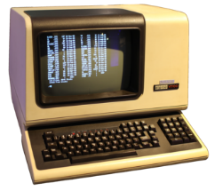
1-Tier Architecture
Tier
Technology
Tools
1-Tier System
(Monolithic Design)
Dumb Terminals
Mainframe servers
Legacy Databases
COBOL
IMS
Etc.

Slide 5
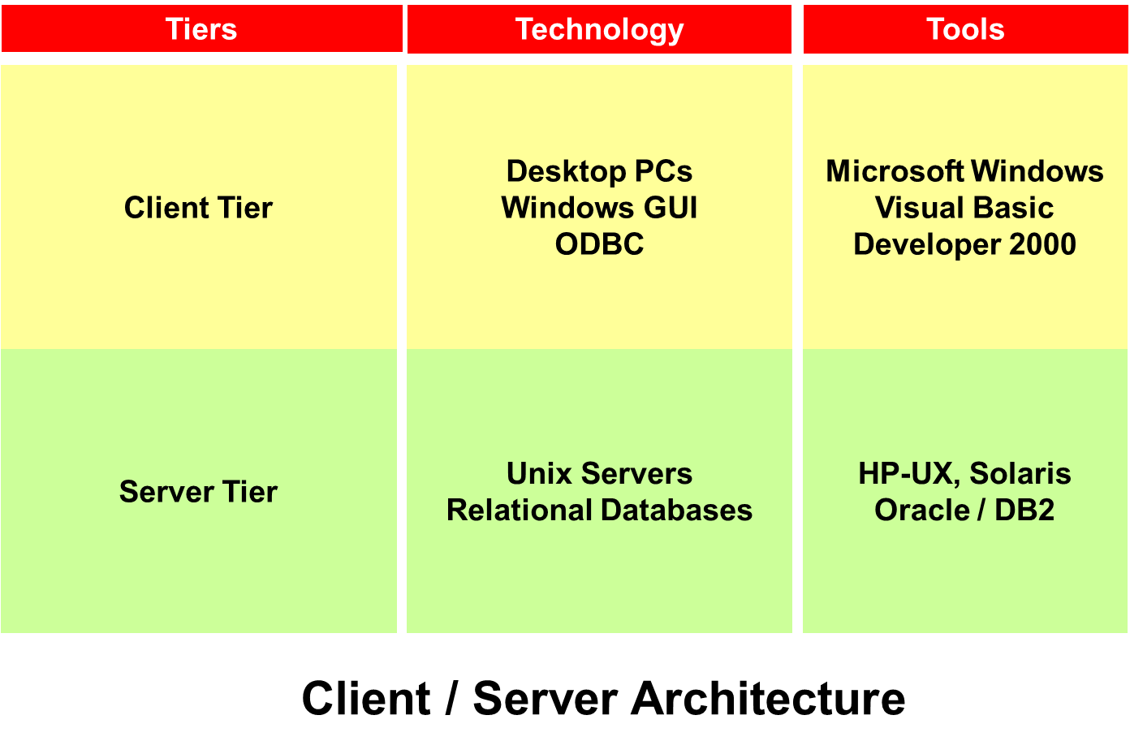


2-Tier Architecture

Slide 6
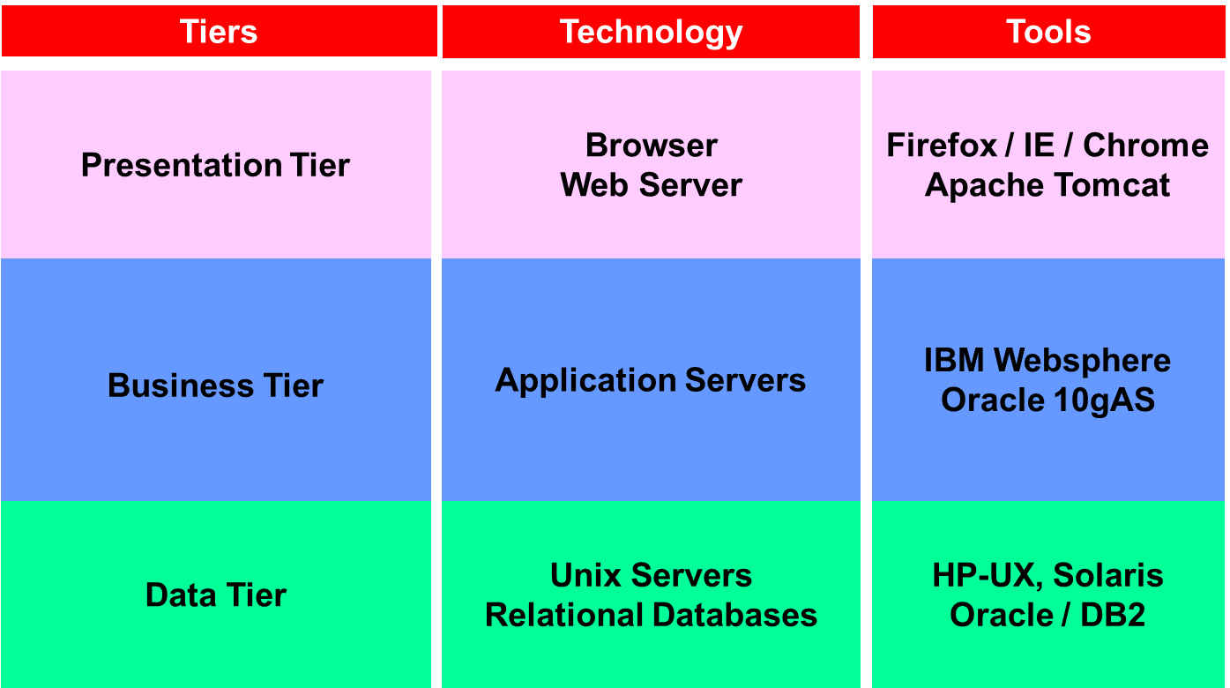



3-Tier Architecture

Slide 7

4-Tier Architecture
Tiers
Technology
Tools
Client Tier
Javascript, AJAX
Flash, HTML5
Presentation Tier
Browser
Web Server
Firefox / IE / Chrome
Apache Tomcat
Presentation Tier
Web Server
Apache Tomcat
Business Tier
Application Servers
IBM Websphere
Oracle 10gAS
Data Tier
Unix Servers
Relational Databases
HP-UX, Solaris
Oracle / DB2
And so-on for N-Tier Architectures!

Slide 8
Example
Ref: Software Architecture Patterns by Mark Richards

Slide 9
Backend Interaction Using REST APIs
Representational State Transfer (REST) is a mechanism for backend to provide services to the higher layers like the front-end
REST Application Programming Interface (API) uses HTTP/HTTPS protocol to provide request / response interaction
Backend implemented REST APIs are language-neutral

Slide 10
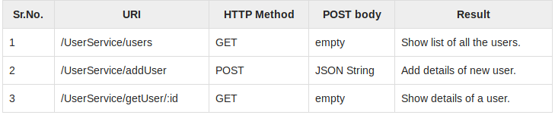
RESTful Services Example

Slide 11
SUMMARY

Slide 12
Summary
Monolithic coding practices have evolved into distributed applications
The full stack is divided into multiple layers
Interactions between layers are enabled using REST APIs

