Slide 1
Spring boot
Web server

Slide 2
Web server
Introduction
The term web server can refer to hardware or software, or both of them working together.
On the hardware side
A web server is a computer that stores web server software and a website's component files (for example, HTML documents, images, CSS stylesheets, and JavaScript files).
A web server connects to the Internet and supports physical data interchange with other devices connected to the web.
On the software side
a web server includes several parts that control how web users access hosted files and resources
A HTTP server is software that understands URLs (web addresses) and HTTP (the protocol your browser uses to view webpages).
A HTTP server can be accessed through the domain names of the websites it stores, and it delivers the content of these hosted websites to the end user's device.
A static web server, or stack, consists of a computer (hardware) with an HTTP server (software). We call it "static" because the server sends its hosted files as-is to your browser.
A dynamic web server consists of a static web server plus extra software, most commonly an application server and a database.

Slide 3
What is Spring boot
Spring boot
Spring Boot is an open-source framework for building Java-based, production-grade, stand-alone, and microservices-based web applications
It is part of the larger Spring Framework, which is a comprehensive framework for enterprise Java development
"Convention over Configuration" (CoC)
is a software design paradigm that suggests that developers should follow a set of conventions and defaults in their projects
Minimises the need for explicit configuration.
The idea is to reduce the amount of boilerplate code and configuration that developers have to write by establishing sensible defaults based on common practices.
Interestingly, the Spring framework leans more towards “Configuration over convention”
Embedded Web Server Support
Can run the Java application without the need for an external web server
Auto-Configuration
Spring Boot attempts to automatically configure your application based on the dependencies you have added to your project
Spring Boot Starters
These are pre-built templates that contain a set of dependencies for common tasks, such as data access, and messaging

Slide 4
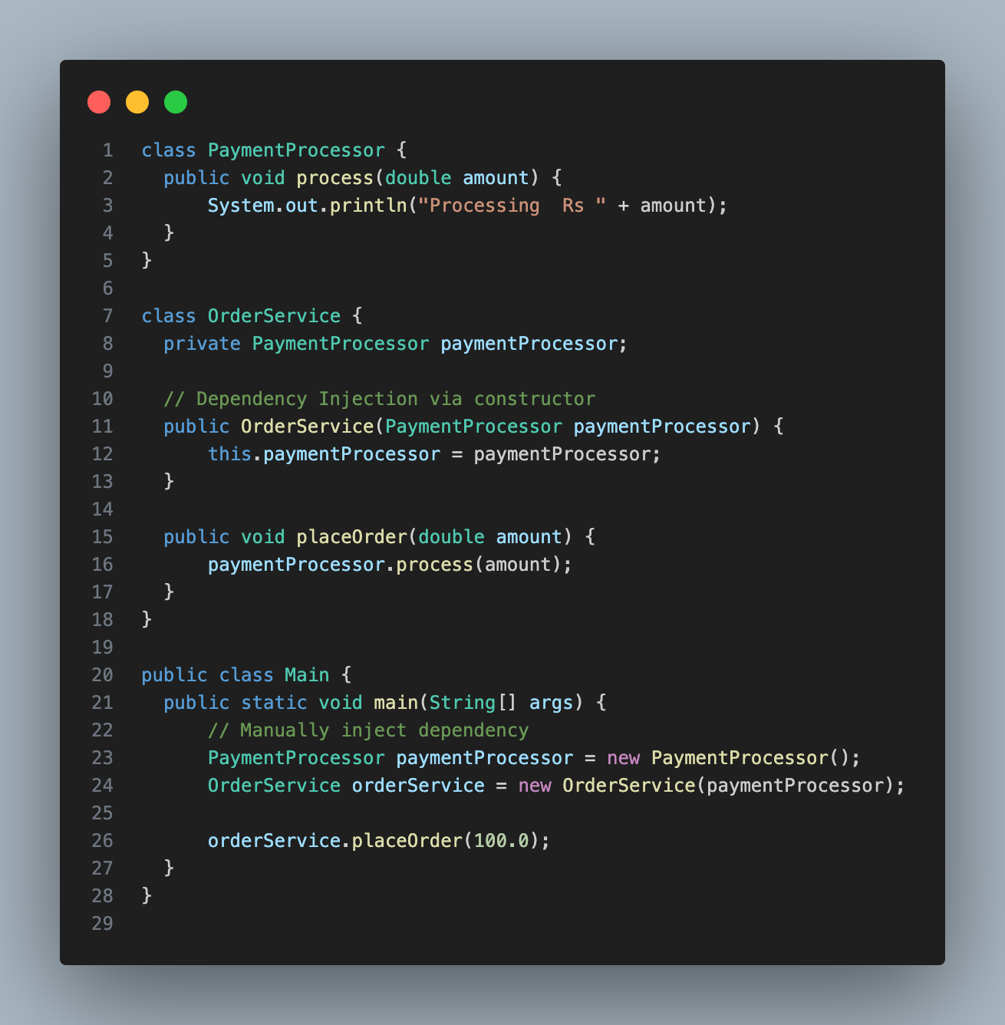
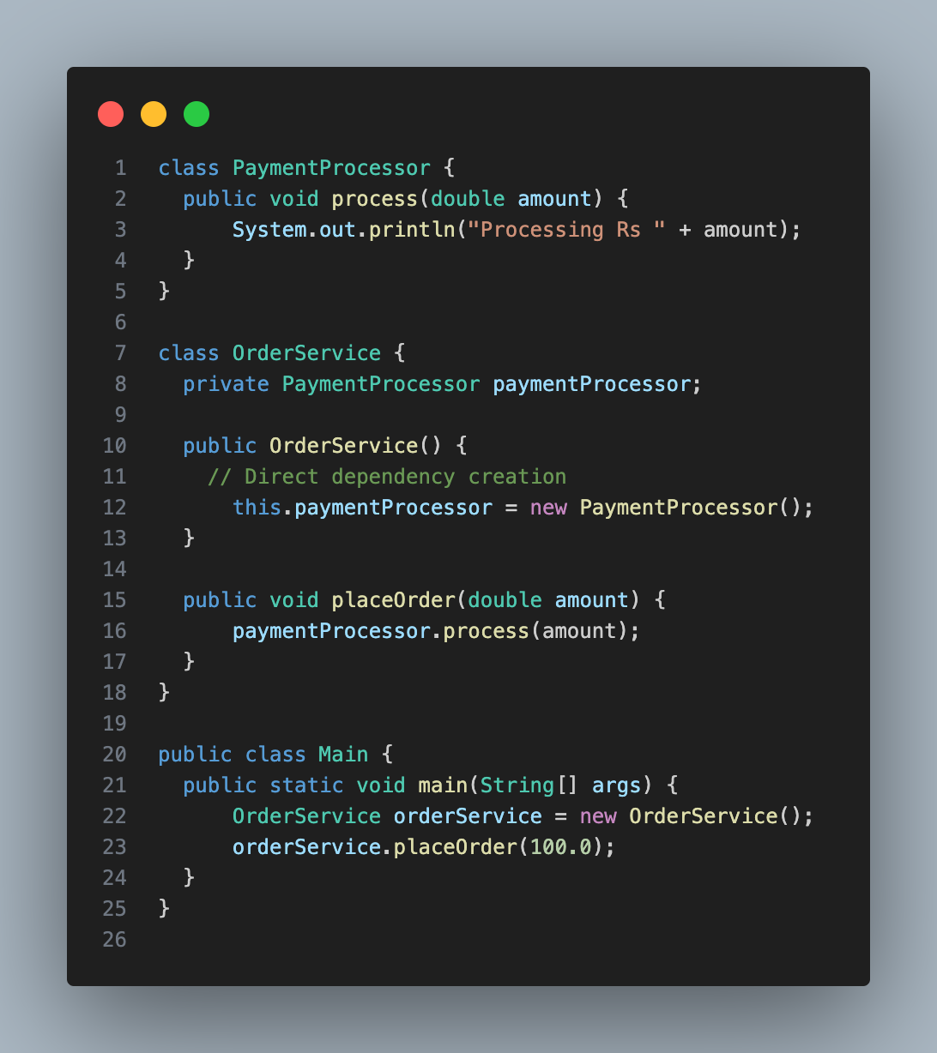
Dependency
Spring boot
How an object gets another object/service on which it depends?
Application wiring

Slide 5
Application wiring
Spring boot
Process of connecting different components of an application together to form a cohesive and functional system
Many approaches
Manual wiring
Dependency Injection frameworks
Config files

Slide 6
Dependency injection
Spring boot
A dependency is any object or service that a class or function requires to perform its job
Instead of an object creating its dependencies directly (using new or instantiating them), dependencies are "injected" by an external component.
Constructor injection
Setter injection
A container (an external entity) controls how dependencies are created and assigned
Control of object creation and binding is inverted (IoC)

Slide 7
Dependency injection
Spring boot
Advantages
Code is cleaner
Object decoupling is more effective
Testing becomes easy
Mocking becomes easy
Ref: https://docs.spring.io/spring-framework/reference/core/beans/dependencies/factory-collaborators.html

Slide 8
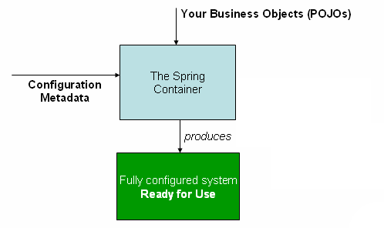
Spring container
Spring boot
is responsible for instantiating, configuring, and assembling the beans
Also know as the Spring IoC container
The container gets its instructions on what objects to instantiate, configure, and assemble by reading configuration metadata
The configuration metadata is represented in XML, Java annotations, or Java code.
It lets you express the objects that compose your application and the rich interdependencies between those objects.
Ref: https://docs.spring.io/spring-framework/reference/core/beans/basics.html

Slide 9
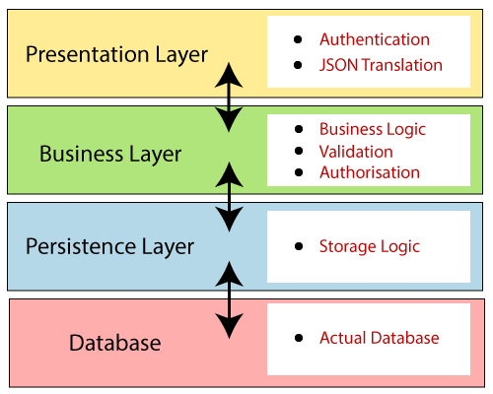
Spring boot architecture
Spring boot
Presentation Layer
Handles the HTTP requests, translates the JSON parameter to Java object and vice versa, authenticates the request and transfer it to the business layer.
Consists of Views (or the front end) of the application
Business layer
The business layer contains all the business logic.
It consists of services classes.
It is responsible for validation and authorization.
The persistence layer
contains the database storage logic.
It is responsible for converting business objects to the database rows and vice-versa.
The database layer
Layer where the data is actually stored
contains the databases such as MySql, MongoDB, etc.
This layer can contain multiple databases. It is responsible for performing the CRUD operations.

Slide 10
flow
Spring boot
The Client makes an HTTP request(GET, PUT, POST, etc.)
The HTTP request is forwarded to the Controller.
The controller maps that request and handles it
After that, it calls the service logic if required
The business logic resides in the Service layer.
The request is processed using the data in the DB either directly or by using the JPA model classes in the Model layer.
A view is returned as Response from the controller.
The View can be a JSON response or a JSP page (HTML, CSS, JS)

Slide 11
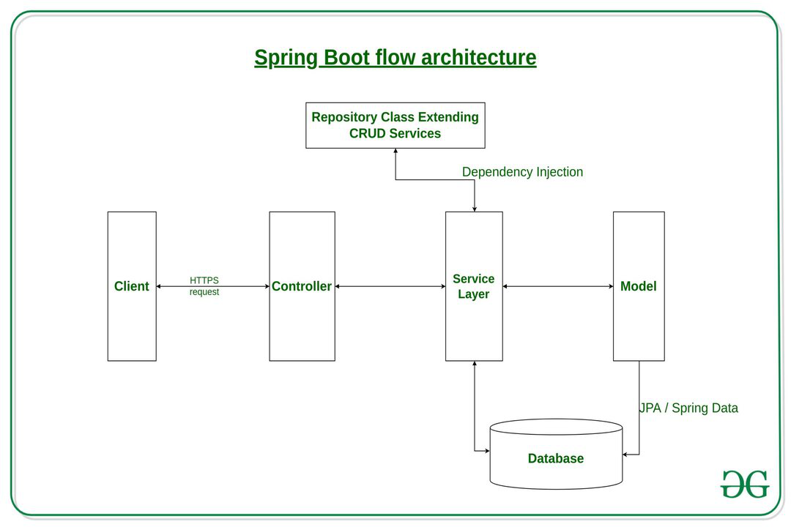
flow
Spring boot
src: https://www.geeksforgeeks.org/spring-boot-architecture/

Slide 12
HTTP & REST

Slide 13
What is rest?
Rest
Representational State Transfer (REST) is an architectural style that defines a set of constraints to be used for creating web services.
REST determines how the interaction between client and server is designed
RESTful system
Server has resources
Clients request the resource(s)
A request is sent (from client to server) as a HTTP GET or POST or PUT or DELETE.
A response can be HTML, JSON, plain text, image, etc. Most popular format is JSON

Slide 14
Architectural constraints
Rest
Client-Server
REST application should have a client-server architecture.
A Client is someone who is requesting resources and are not concerned with data storage, which remains internal to each server
A Server is someone who holds the resources and are not concerned with the user interface or user state.
Uniform Interface
It suggests that there should be an uniform way of interacting with a given server irrespective of device or type of application (website, mobile app).
Self-descriptive Messages (or Stateless): Each message includes enough information to describe how to process the message so that server can easily analyses the request.
Resource-Based: Individual resources are identified in requests. For example: API/users.
Manipulation of Resources Through Representations: Client has representation of resource and it contains enough information to modify or delete the resource on the server, provided it has permission to do so.
Example
Client requests for User info (identified by a user ID) from the server
Server returns representation of the user (usually JSON object)
Client modifies the representation (JSON object) and sends it to server
Server updates the User record in the DB with the modifications from client

Slide 15
Architectural constraints
Rest
Stateless
It means that the necessary state to handle the request is contained within the request itself and server would not store anything related to the session.
In REST, the client must include all information for the server to fulfill the request
Advantage - Servers can scale easily
Disadvantage - Client has to send more information over the network.
Cacheable
Responses from the server can be explicitly marked as cacheable or non-cacheable.
This allows clients to cache responses, improving performance and reducing the load on the server.

Slide 16
http & CRUD
rest
HTTP methods
GET: Read the representation of a resource
POST: Create a resource.
PUT: Update a resource
DELETE: Delete a resource
CRUD operations
C (create) - POST
R (read) - GET
U (update) - PUT
D (delete) - DELETE
URI | HTTP Verb | Description
api/users | GET | Get all users
api/users | POST | Add a user
api/users/1 | PUT | Update a user with id = 1
api/users/1 | DELETE | Delete a user with id = 1
api/users/1 | GET | Get a user with id = 1
Source: https://www.geeksforgeeks.org/rest-api-architectural-constraints/

Slide 17
Hibernate

Slide 18
What is hibernate?
hibernate
Hibernate is a powerful and widely used open-source Object-Relational Mapping (ORM) framework for Java.
Most application development is done in object oriented programming languages
Data is stored in relational tables
A translation layer is required between the objects and the tables, rows/columns
ORMs form this translation layer
Hibernate allows developers to map Java classes to database tables.
Each Java class represents an entity, and the properties of the class map to columns in the corresponding database table.
This mapping is typically done through the use of annotations or XML configuration files

Slide 19
features
hibernate
Hibernate Query Language (HQL)
Hibernate provides its own query language called HQL, which is a powerful and database-agnostic query language.
HQL queries are written in terms of Java objects and properties, rather than SQL tables and columns.
Automatic Table Generation
Hibernate can automatically generate database tables based on the entity classes, eliminating the need for manual table creation.
It can also update the schema as the Java classes evolve.
Caching
Hibernate includes caching mechanisms to improve performance. It supports both session based and global caching
Transaction Management
Hibernate integrates with Java Transaction API (JTA) or Spring’s transaction management
Ensures transactions are bound by the ACID properties
Lazy Loading
Hibernate supports lazy loading, a technique where related objects are loaded from the database only when they are explicitly requested.
Association Mapping
Hibernate supports various types of associations between entities, such as one-to-one, one-to-many, and many-to-many relationships

