Slide 1
Javascript - programming language
Basic concepts

Slide 2
Expressions
Basic concepts
Piece of javascript code that produces a value
1 -> produces 1
“What nonsense” -> produces “What nonsense”
3 * 5 -> produces 15
num > 20 -> produces either ‘true’ or ‘false’
(3 + 7) * 5 -> produces 50

Slide 3
Statement
Basic concepts
Its an instruction to the computer
let x = 10;
if(x < 50) { do something }
let num = (3 + 7) * 5;
Expressions are always part of a statement

Slide 4
Bindings (variables)
Basic concepts
To catch and hold values JavaScript provides a thing called binding (or variable)
let x = 10;
The = operator can be used at any time on existing bindings to disconnect them from their current value and have them point to a new one
You should imagine bindings as tentacles, rather than boxes. They do not contain values; they grasp them
two bindings can refer to the same value
A function definition is a regular binding where the value of the binding is a function

Slide 5
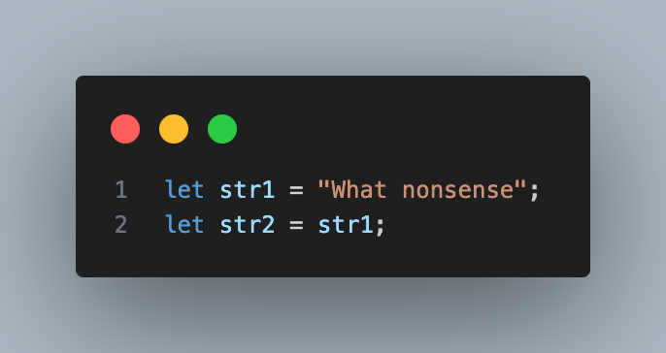
Bindings (variables)
Basic concepts
You should imagine bindings as tentacles, rather than boxes.
They do not contain values; they grasp them
str1
What nonsense
str2

Slide 6
Bindings & scope
Basic concepts
Each binding has a scope, which is the part of the program in which the binding is visible.
Where is this binding visible
For bindings defined outside of any function or block, the scope is the whole program - Global Scope
Bindings created for function parameters or declared inside a function can be referenced only in that function - Local scope
Every time the function is called, new instances of these bindings are created.
Each local scope can also see all the local scopes that contain it, and all scopes can see the global scope
This approach to binding visibility is called lexical scoping.

Slide 7
JS key concepts used in practice
Basic concepts
Closure
Arrow functions
Rest parameters, Spread Operator, Destructuring

Slide 8
Arrow functions
Basic concepts
An arrow function expression is a compact alternative to a traditional function expression
https://developer.mozilla.org/en-US/docs/Web/JavaScript/Reference/Functions/Arrow_functions
Arrow functions don't have their own bindings to this
Code examples
https://www.codementor.io/@dariogarciamoya/understanding-this-in-javascript-with-arrow-functions-gcpjwfyuc

Slide 9
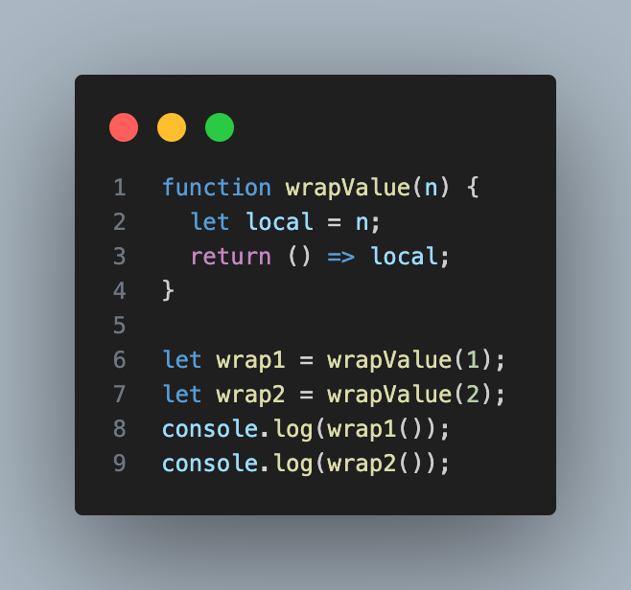
Closure
Basic concepts
Functions can be treated as values
Local binding are recreated every time a function is called
What happens to local bindings when the function call that created them is no longer active?

Slide 10
Closure
Basic concepts
Local bindings are created anew for every call
Different calls can’t trample on one another’s local bindings.
Being able to reference a specific instance of a local binding in an enclosing scope—is called closure
A function that references bindings from local scopes around it is called a closure
Think of function values as containing both the code in their body and the environment in which they are created
When called, the function body sees the environment in which it was created, not the environment in which it is called

Slide 11
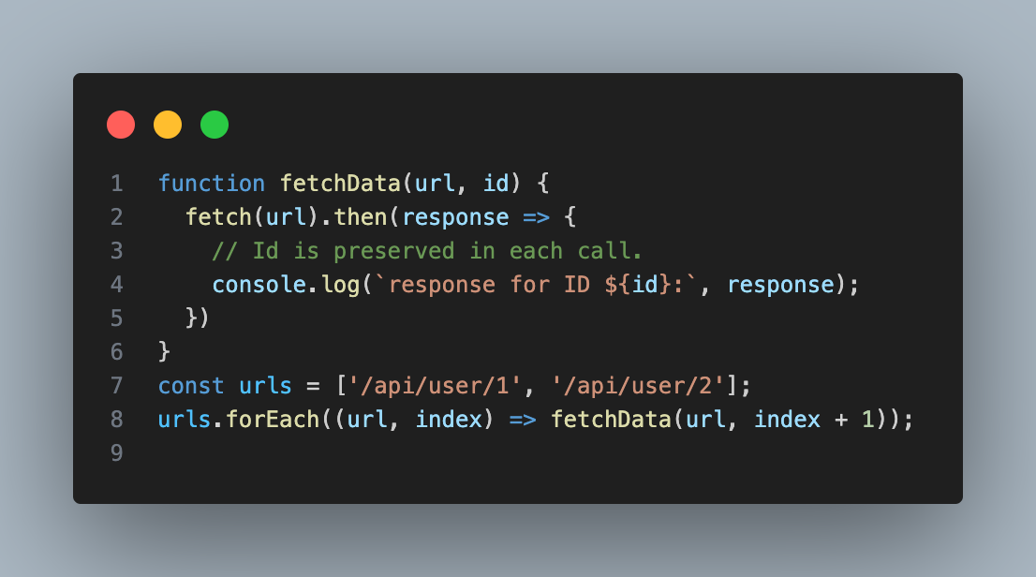
Uses of closure
Basic concepts
Maintaining state in Async calls
Closures allow each API request to retain its context until response is received
Closures help to retain the state for each individual request

Slide 12
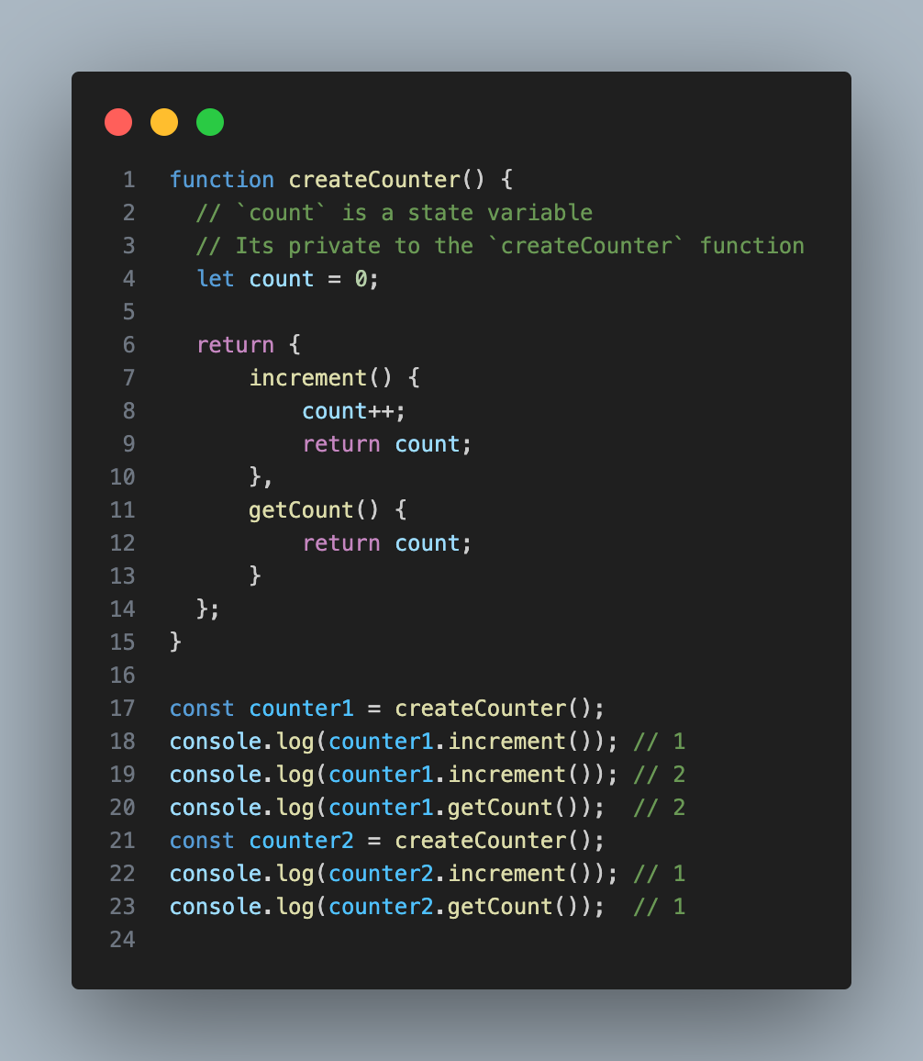
Uses of closure
Basic concepts
Closures create state variables within functions
Each time createCounter is called, a new count variable is created in a separate closure
The variable count is defined inside createCounter and is accessible only to the functions increment and getCount because they form a closure around count
The increment and getCount functions retain access to this specific count variable, even after createCounter finishes executing

Slide 13
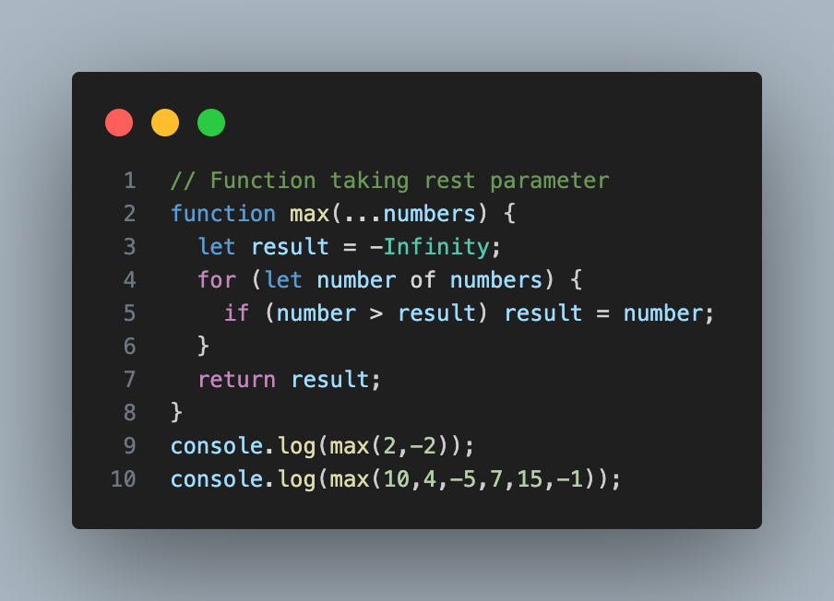
Rest parameters
Basic concepts
It can be useful for a function to accept any number of arguments
For example, Math.max computes the maximum of all the arguments

Slide 14
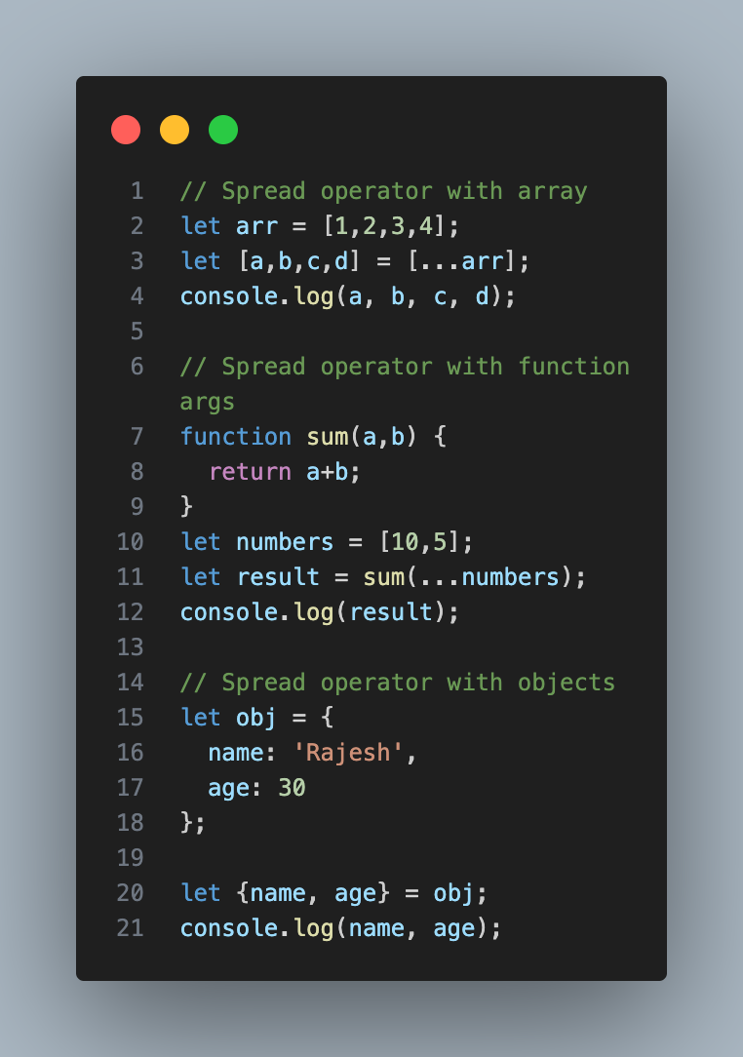
Spread operator
Basic concepts
The spread (...) syntax allows an iterable, such as an array or string, to be expanded in places where zero or more arguments (for function calls) or elements (for array literals) are expected.
In an object literal, the spread syntax enumerates the properties of an object and adds the key-value pairs to the object being created.

Slide 15
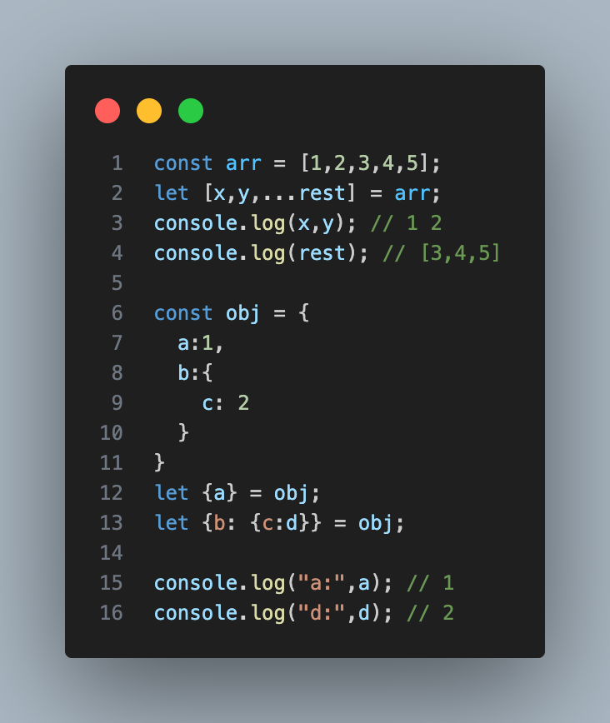
Destructuring
Basic concepts
The destructuring assignment syntax is a JavaScript expression that makes it possible to unpack values from arrays, or properties from objects, into distinct variables.

Slide 16
Asynchronous programming

Slide 17
What’s the problem?
Async programming
Account object
HTTP helper
1. Get me account details from server
2. Get account details
3. I have placed request. I promise to let you know
4. Account details
5. Here it is

Slide 18
Promise
Async programming
The Promise object represents the eventual completion (or failure) of an asynchronous operation and its resulting value
It allows you to associate handlers with an asynchronous action's eventual success value or failure reason.
Instead of immediately returning the final value, the asynchronous method returns a promise to supply the value at some point in the future.
A promise is in one of the following states
pending: initial state, neither fulfilled nor rejected.
fulfilled: meaning that the operation was completed successfully.
rejected: meaning that the operation failed.

Slide 19
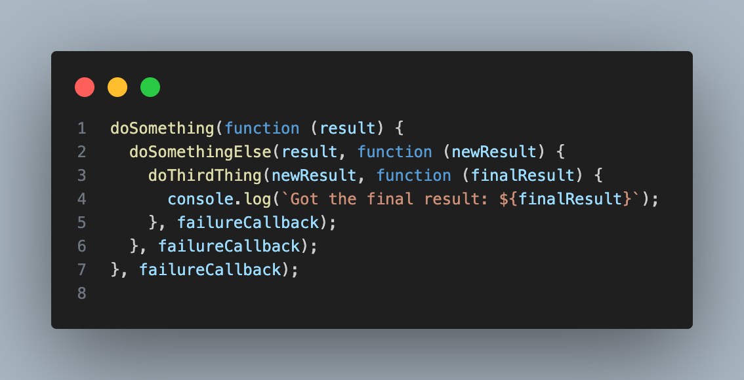
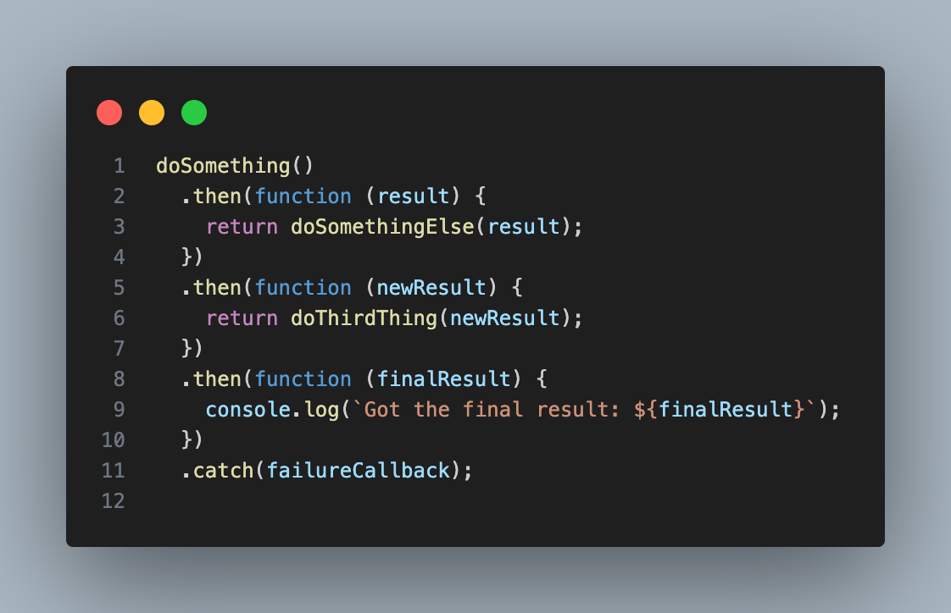
Promise chaining
Async programming

Slide 20
Async function
Async programming
Each time when an async function is called, it returns a new Promise
As soon as the body returns something, that promise is resolved. If it throws an exception, the promise is rejected.
Async functions can contain zero or more await expressions
Inside an async function, the word await can be put in front of an expression to wait for a promise to resolve and only then continue the execution of the function
await makes the async function appear synchronous

Slide 21
Event loop

Slide 22
What is event loop?
Event loop
Event loop is responsible for executing code, collecting and processing events and executing queued sub-tasks
JavaScript language is single-threaded
Can do one thing at a time
Asynchronous behaviour is a part of the “environment”
https://medium.com/front-end-weekly/javascript-event-loop-explained-4cd26af121d4
https://developer.mozilla.org/en-US/docs/Web/JavaScript/Event_loop
https://www.youtube.com/watch?v=8aGhZQkoFbQ&t=6s
(12:48 - 14:50) - execution of code and event loop

Slide 23
Architecture
Event loop
Heap - Objects are allocated in a heap which is just a name to denote a large mostly unstructured region of memory
Stack
This represents the single thread provided for JavaScript code execution.
Function calls form a stack of frames
Browser or Web APIs -
Not a part of JS runtime
Built on JS language
Queue
JavaScript runtime uses a message queue, which is a list of messages to be processed.
Each message has an associated function that gets called to handle the message.
Event loop
Wait for messages to appear in the queue
Take the first message (oldest) out and put the associated function on the stack and start execution

Slide 24
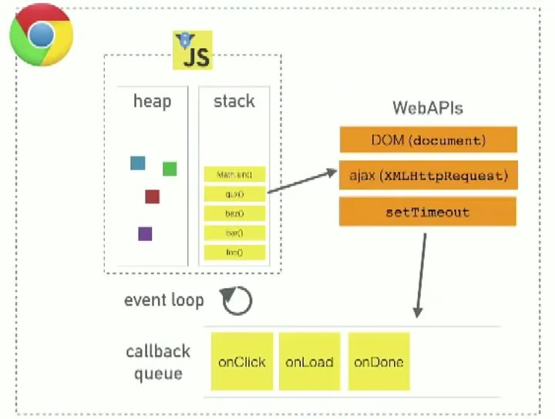
Architecture
Event loop
src: https://medium.com/front-end-weekly/javascript-event-loop-explained-4cd26af121d4

Slide 25
JS & Browser

Slide 26
DoM
Introduction
Document Object Model
https://developer.mozilla.org/en-US/docs/Web/API/Document_Object_Model/Introduction
DOM is the data representation of the objects that comprise the structure and content of a document on the web
DOM is also the programming interface for web documents. It represents the page so that programs can change the document structure, style, and content. The DOM represents the document as nodes and objects
It resides in the browser’s memory
Its a tree like structure
DOM exposes many APIs to query and update the DOM structure.

Slide 27
DOM APIs
Dom
https://developer.mozilla.org/en-US/docs/Web/API/Document_object_model/Using_the_Document_Object_Model
The DOM APIs become available when the browser loads the JS
document or window object to access DOM
Fundamental data types
document - entry point to the DOM tree
Node
Abstract base class.
There are different types of nodes
Methods for traversal of the DOM
Element
Type of node
Methods that describe an element (For example: Table)
Attr - Elements attributes are represented as objects

Slide 28
Frequently used APIs
Dom
Selector interface
The Selectors API provides methods that make it quick and easy to retrieve Element nodes from the DOM by matching against a set of selectors
https://developer.mozilla.org/en-US/docs/Web/API/Document_object_model/Locating_DOM_elements_using_selectors
Creating DOM tree
createElement()
setAttribute()
appendChild()
https://developer.mozilla.org/en-US/docs/Web/API/Document_object_model/How_to_create_a_DOM_tree

Slide 29
Events
DOM
https://developer.mozilla.org/en-US/docs/Learn/JavaScript/Building_blocks/Events
Events are fired inside the browser window, and tend to be attached to a specific item that resides in it
Single or multiple elements may be associated with the event
Types of events
Click, hover, select
Key press event
Window resized
Page loaded
Form submission
Error
To react to an event, you attach an event handler to it - addEventListener(event, handler)

