Slide 1
React applications
Principles of developing

Slide 2
Capabilities of a front-end application
Capabilities
Take control of screen space (real estate)
HTML/CSS
Handle user interaction
Javascript
Interaction with server - HTTP(S)
State Management
Handle modifications to DOM
Can’t we do all the above using just HTML/CSS/JS ?

Slide 3

Seen this?
Src: https://mx.pinterest.com/pin/521854675571762272/

Slide 4
React
Introduction
Was introduced in 2013
Declarative UI
Developers describe the UI
Instead of imperative DOM manipulations
Component based architecture
Components are self-contained, reusable, composable building blocks of UI
JSX Syntax
A syntax that allowed developers to write HTML-like code within JavaScript
Blends UI and logic
State management
Allows components to manage dynamic data internally
Support for state at various levels - component level or across many components or global
Ecosystem and flexibility
React focuses on the “View” layer (in MVC), but integrates well with other libraries and frameworks
Compatibility with Typescript - easier to write type-safe and predictable code

Slide 5
Jsx
syntax
Javascript extended
https://react.dev/learn/writing-markup-with-jsx
Describe what the UI should look like
JSX produces React “elements”
Its HTML code inside JS
React transforms JSX to HTML and JS
Browsers do NOT understand JSX

Slide 6
React component
Component
Components are self-contained, reusable, composable building blocks of UI
Each component encapsulates its own logic, state, and rendering, promoting modularity and code reuse
Components can be nested within other components to build complex interfaces
Components are customisable by using Props
Components promote separation of concerns
The UI can be split into independent pieces. Each piece can be modelled as a component
A react allocation is made up of a hierarchy (or tree) of components

Slide 7
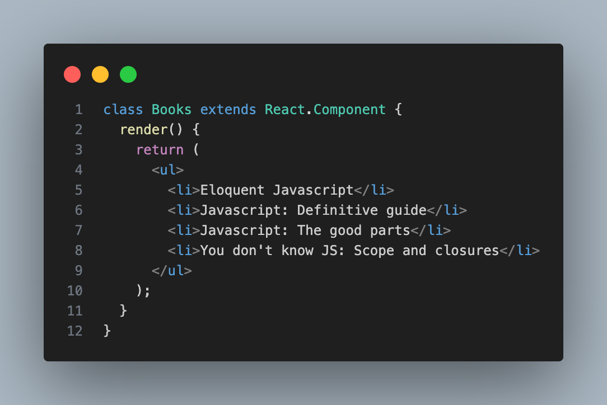
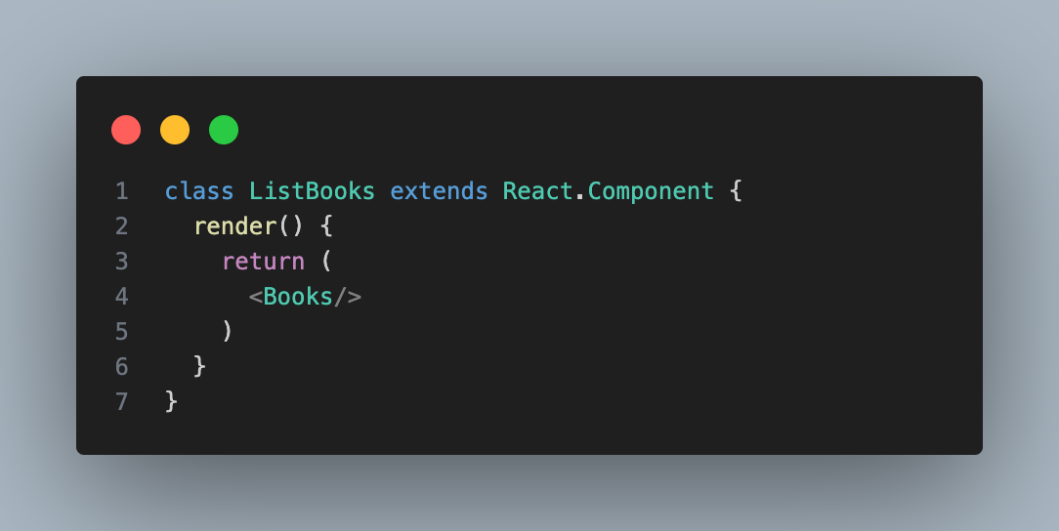
Class component
Component
React lets you define components as classes
Must define the render() method
It returns the markup

Slide 8
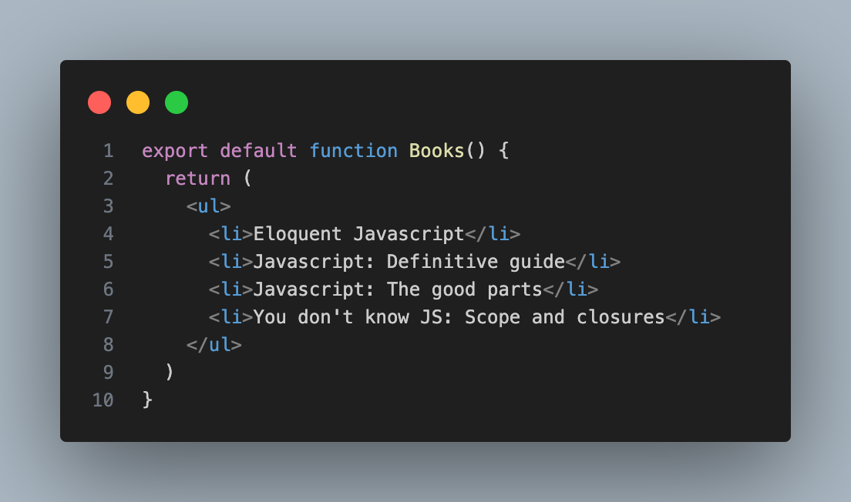
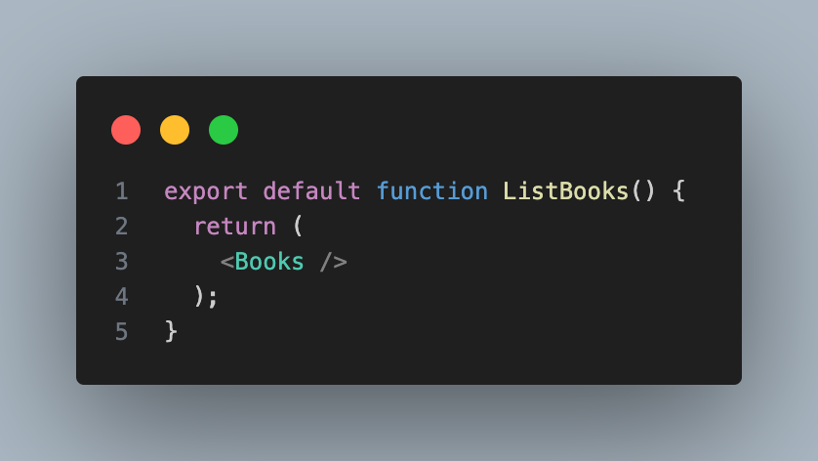
Function component
Component
React component is a JavaScript function that you can sprinkle with markup
1. Export component
2. Define function
3. Return markup
4. Use component

Slide 9
Props
component
React components use props to communicate with each other
Every parent component can pass some information to its child components
Read-only
Makes a component dynamic and customisable
Any number of props
Props can be of any type. Any js value can be passed
Objects, arrays, functions
https://react.dev/learn/passing-props-to-a-component

Slide 10
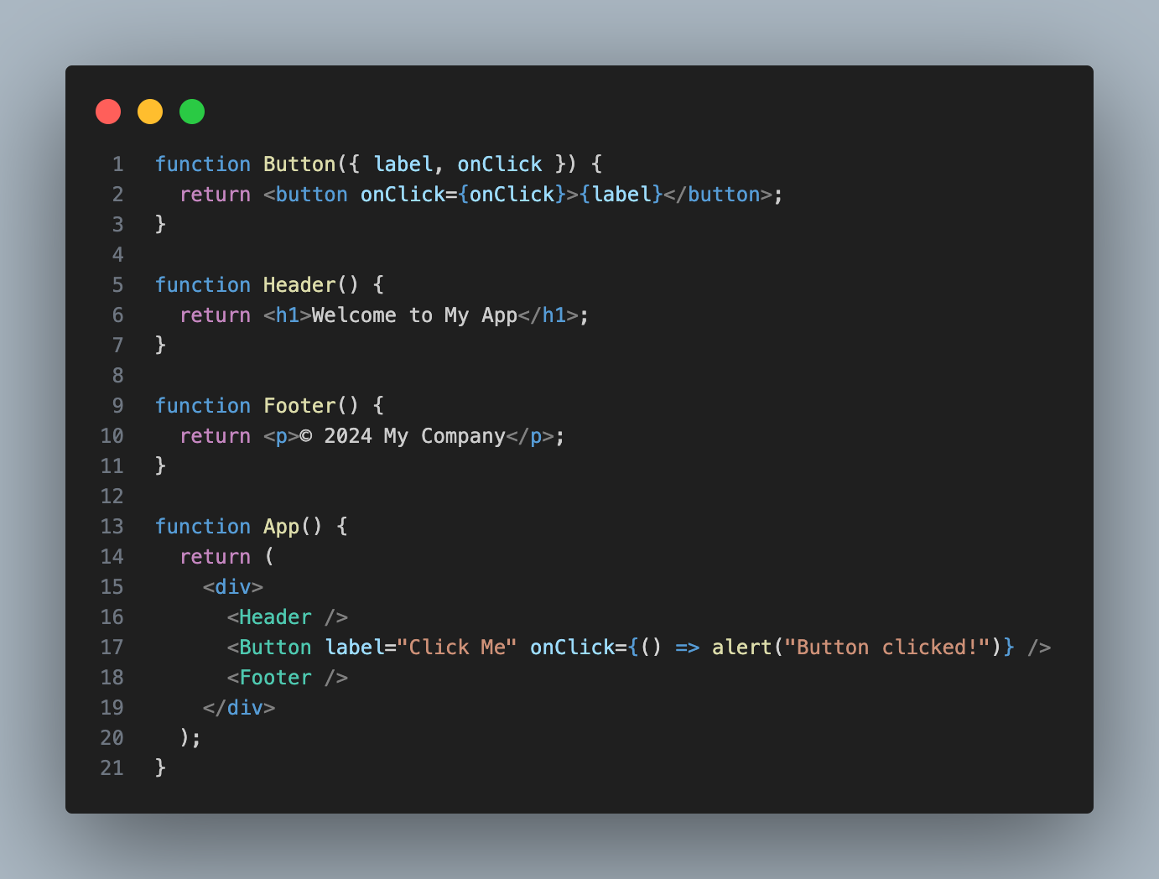
Example
Component
JSX element
App
Header
Button
Footer

Slide 11
Component tree
Component
App
App Component is the root of the component tree
C1 is instantiated only when its encountered in App’s render()
C1 is inserted in the DOM
C1’s render is not called again until:
Input props from App change
State of C1 changes
C1
C2
C3
C4
C5
C6
Same component, multiple instances

Slide 12
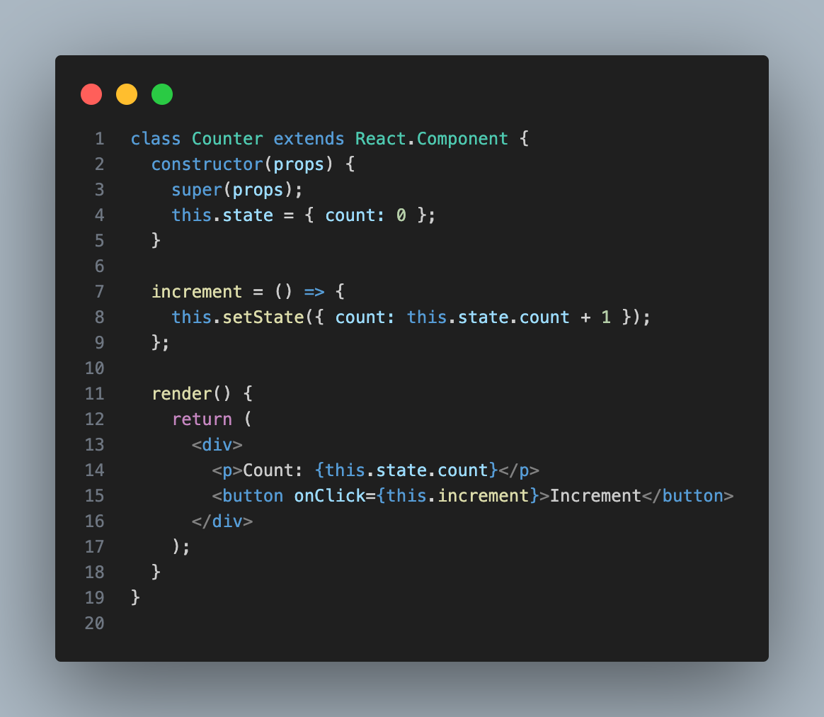
Understanding state
State
State is an object that holds some dynamic data
State is mutable
State is updated using specific methods (setState in this case)
Functional programming emphasizes immutable data structures
Ensures that the state is replaced, not modified in place
Immutability helps React efficiently compare previous and current states
When state changes, the component re-renders

Slide 13
Re-rendering components
Component
A component can be rendered multiple times
A component is re-rendered when
State of the component changes
Props change
Parent component is re-rendered
A few other cases
What happens
Component redraws the UI with the changed state or props

Slide 14
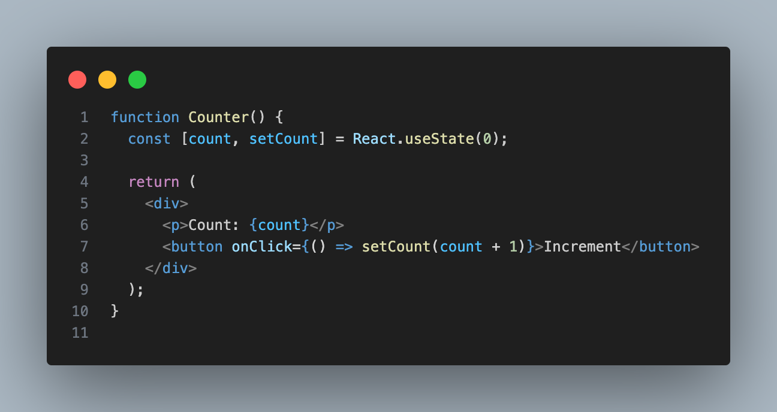
State in functional components
State
useState hook
useState returns an array of two objects
State object
Function to change the state
useState takes one param - initial value of state
State object is managed by React. Component just uses it
When state changes, the component re-renders

Slide 15
Components - Render, state and props
Component
Component renders JSX
JSX describes the UI
The description of UI uses Props and state
User interaction or other events changes state
Component re-renders with the changed state

Slide 16
useEffect() hook
Handling side effects
1. Render
Side effects - Mutations to state, timers, subscriptions, etc
Side effects to happen outside of the render phase
Use useEffect() hook instead of the function body.
Component
Render phase
Latest state
2. Run effect hook
useEffect
Function

Slide 17
useEffect syntax and usage
Handling side effects
Function
() => {}
useEffect(()=>{}, [dependencies])
() => {} - Function that gets executed.
Can cause side effects
[dependencies] - Prop or state variables (or any variable)
Empty dependency list [] makes the effect run only once
This function is executed after the
render phase, IF the dependencies
have changed.
Array of Dependencies
The effect function is run only if one
or more dependencies change.

Slide 18
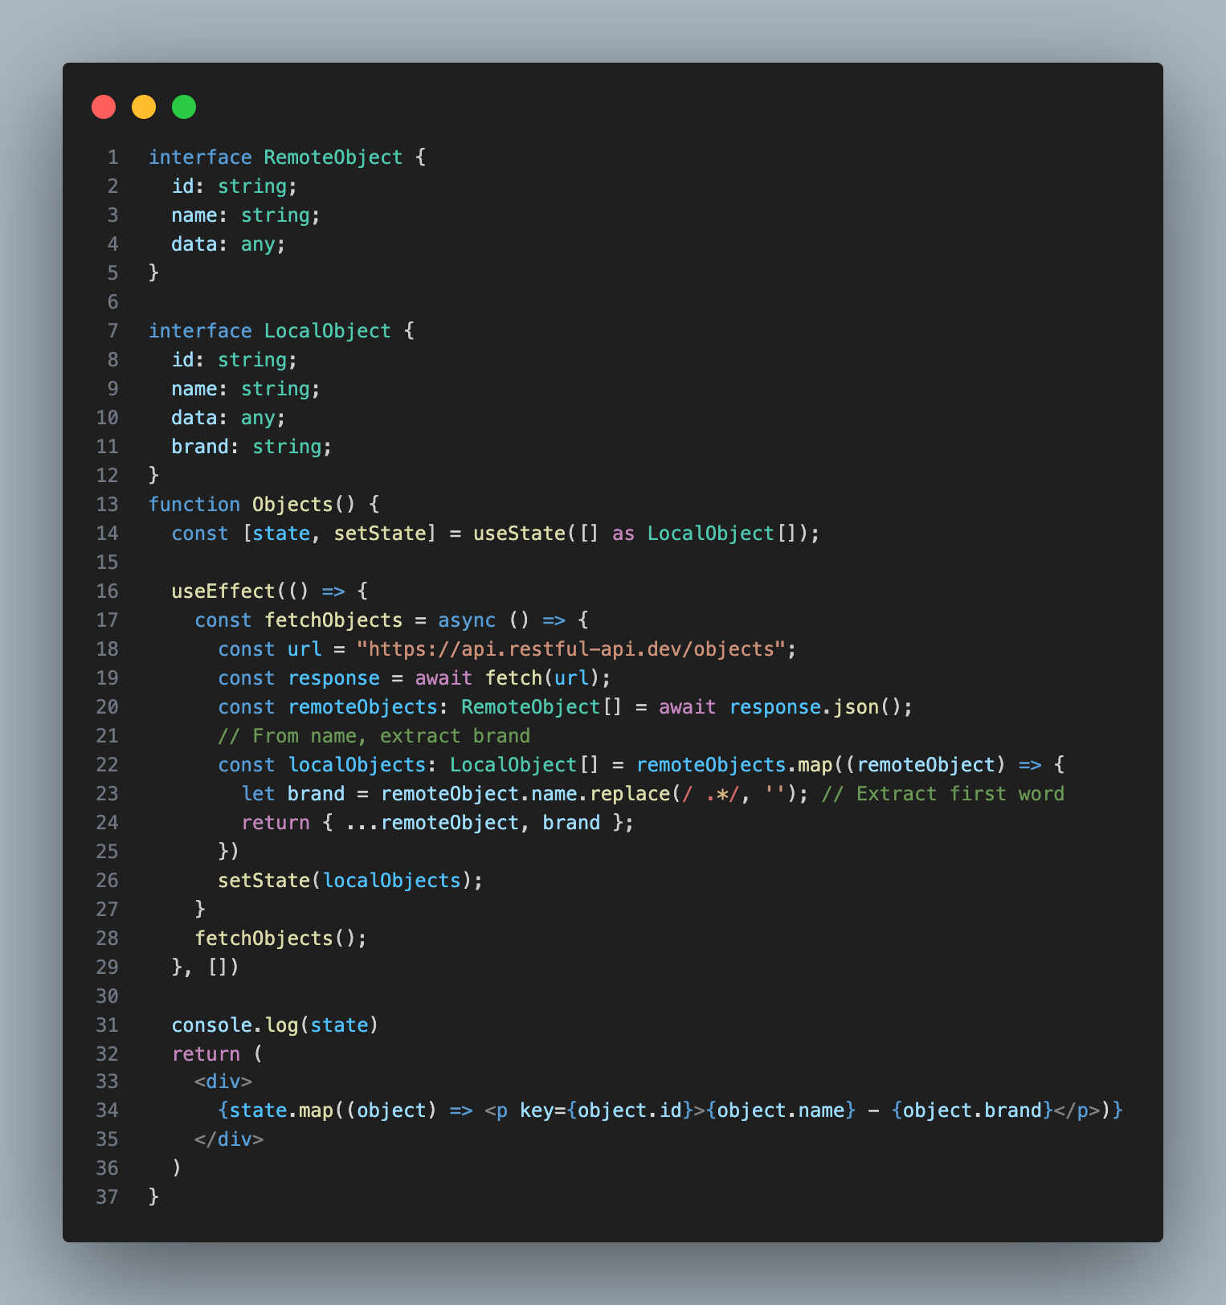
Understanding useEffect hook
State
API calls are primarily made using useEffect
Response to API call is stored in state
When state changes, the component re-renders

Slide 19
Architecture of react apps

Slide 20
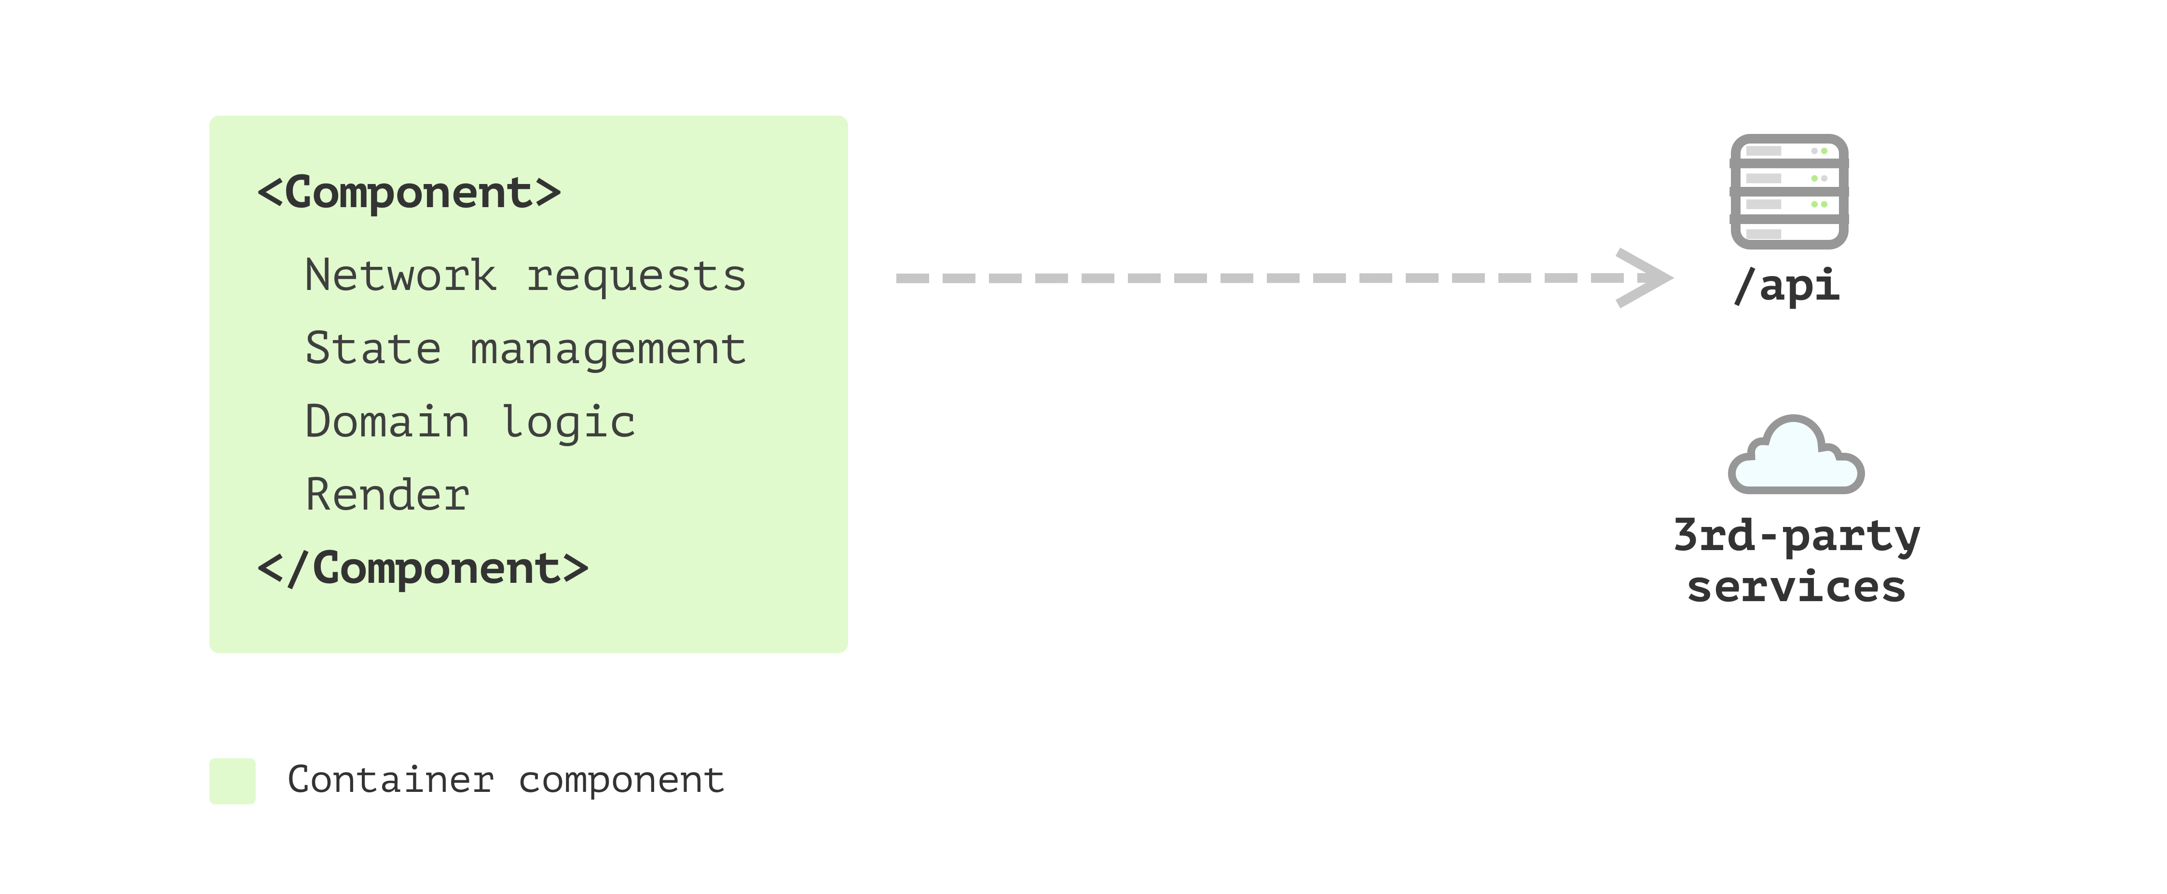
Single component application
Architecture
Ref: https://martinfowler.com/articles/modularizing-react-apps.html#ApartFromTheUserInterface

Slide 21
Container - presentational components
Architecture
Container Components
Concerned with how things work.
Manage state, handle logic, and interact with APIs or Redux stores.
Pass props to presentational components.
Presentational Components
Concerned with how things look.
Focus on rendering UI based on props received.
Stateless and reusable.

Slide 22
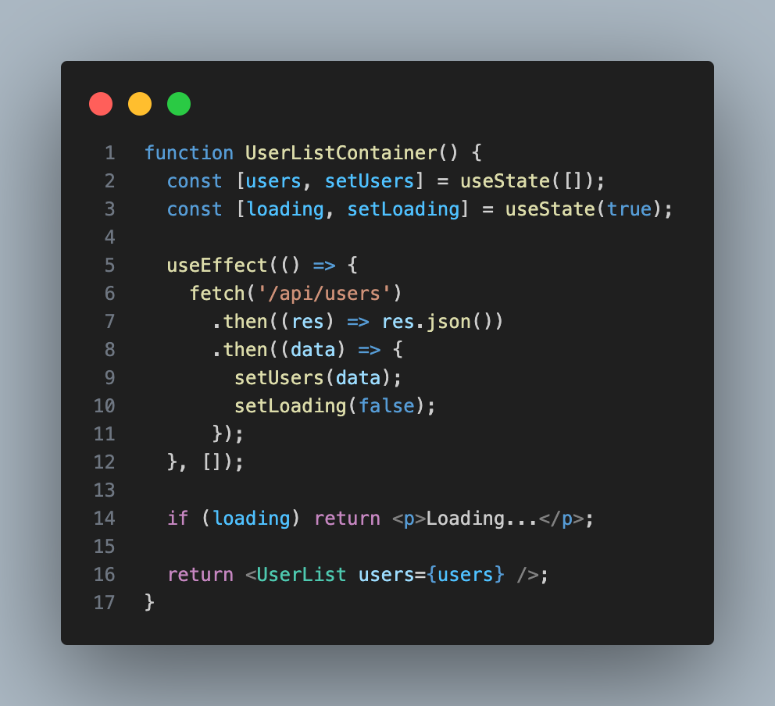
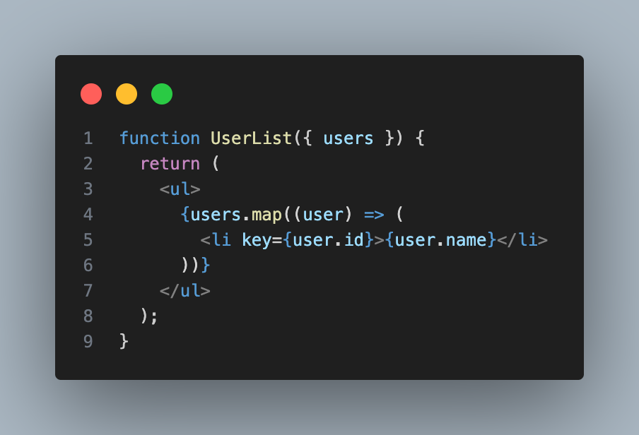
Container - presentational components
Architecture

Slide 23
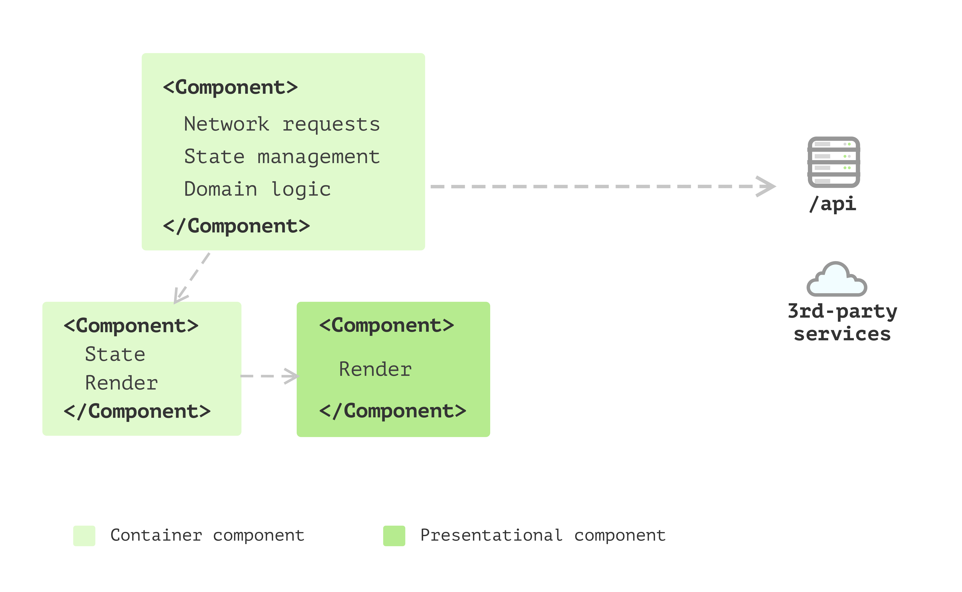
Multiple component application
Architecture
Ref: https://martinfowler.com/articles/modularizing-react-apps.html#ApartFromTheUserInterface

Slide 24
State management using hooks
Architecture
Apart from rendering, what are the other things the components are doing?
network requests
converting data into different shapes (types)
State management
Can it be moved out?

Slide 25
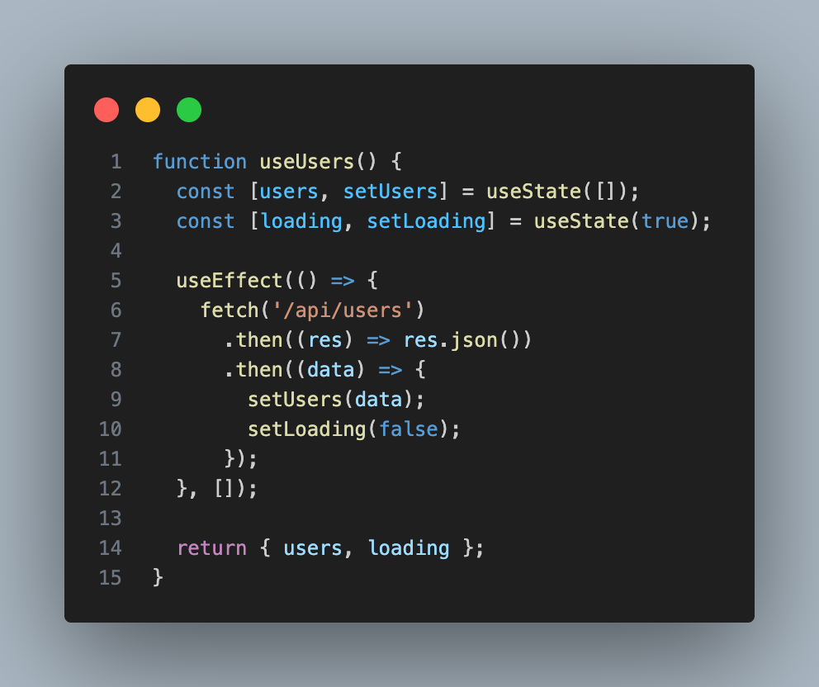
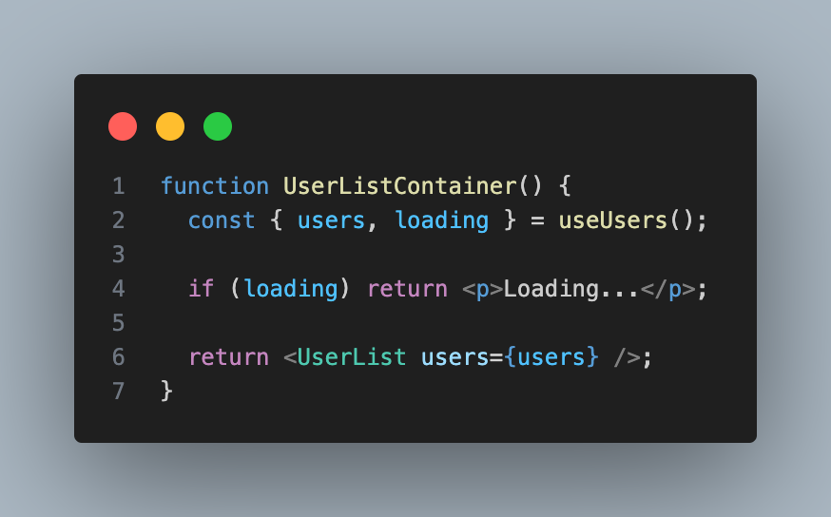
State management using hooks
Architecture

Slide 26
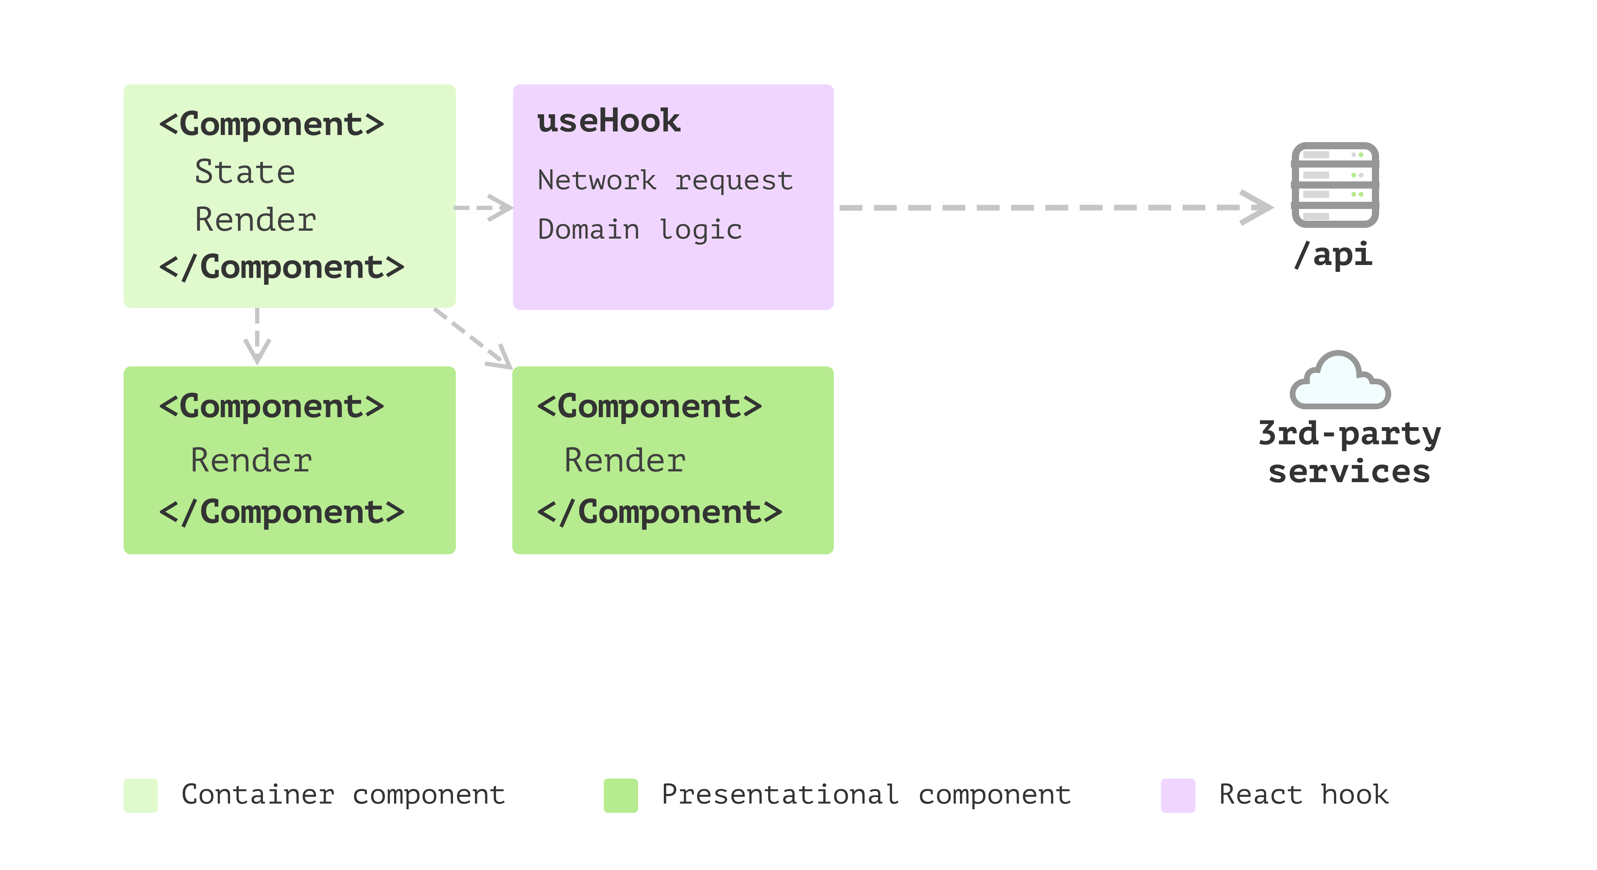
State management with hooks
Architecture
Ref: https://martinfowler.com/articles/modularizing-react-apps.html#ApartFromTheUserInterface

Slide 27
Business models
Architecture
A domain object corresponds to a real-world concept or entity in the problem domain
Examples: User, Order, Product, Invoice
Encapsulates behaviour and data
Contains both data (attributes) and behaviour (methods) that define the entity’s responsibilities and rules
Example: An Invoice domain object might have an addLineItem() method or a calculateTotal() method
Domain objects are derived from the business rules and requirements
Typically mapped to DB entities
Typically, a lighter version, called DTO is sent as a response to API calls (/api/getUser)
Where should domain objects (or business models) be defined in a React App ?

Slide 28
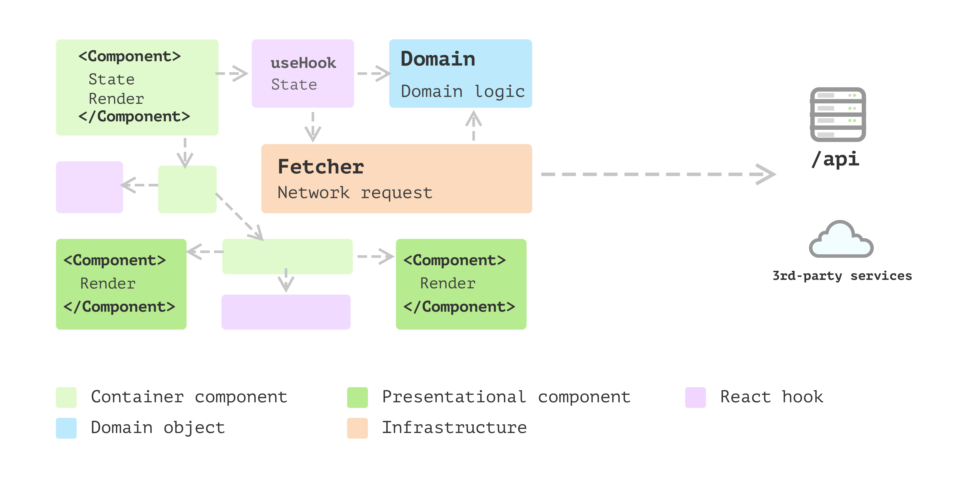
Business models & domain logic
Architecture
Ref: https://martinfowler.com/articles/modularizing-react-apps.html#ApartFromTheUserInterface

Slide 29
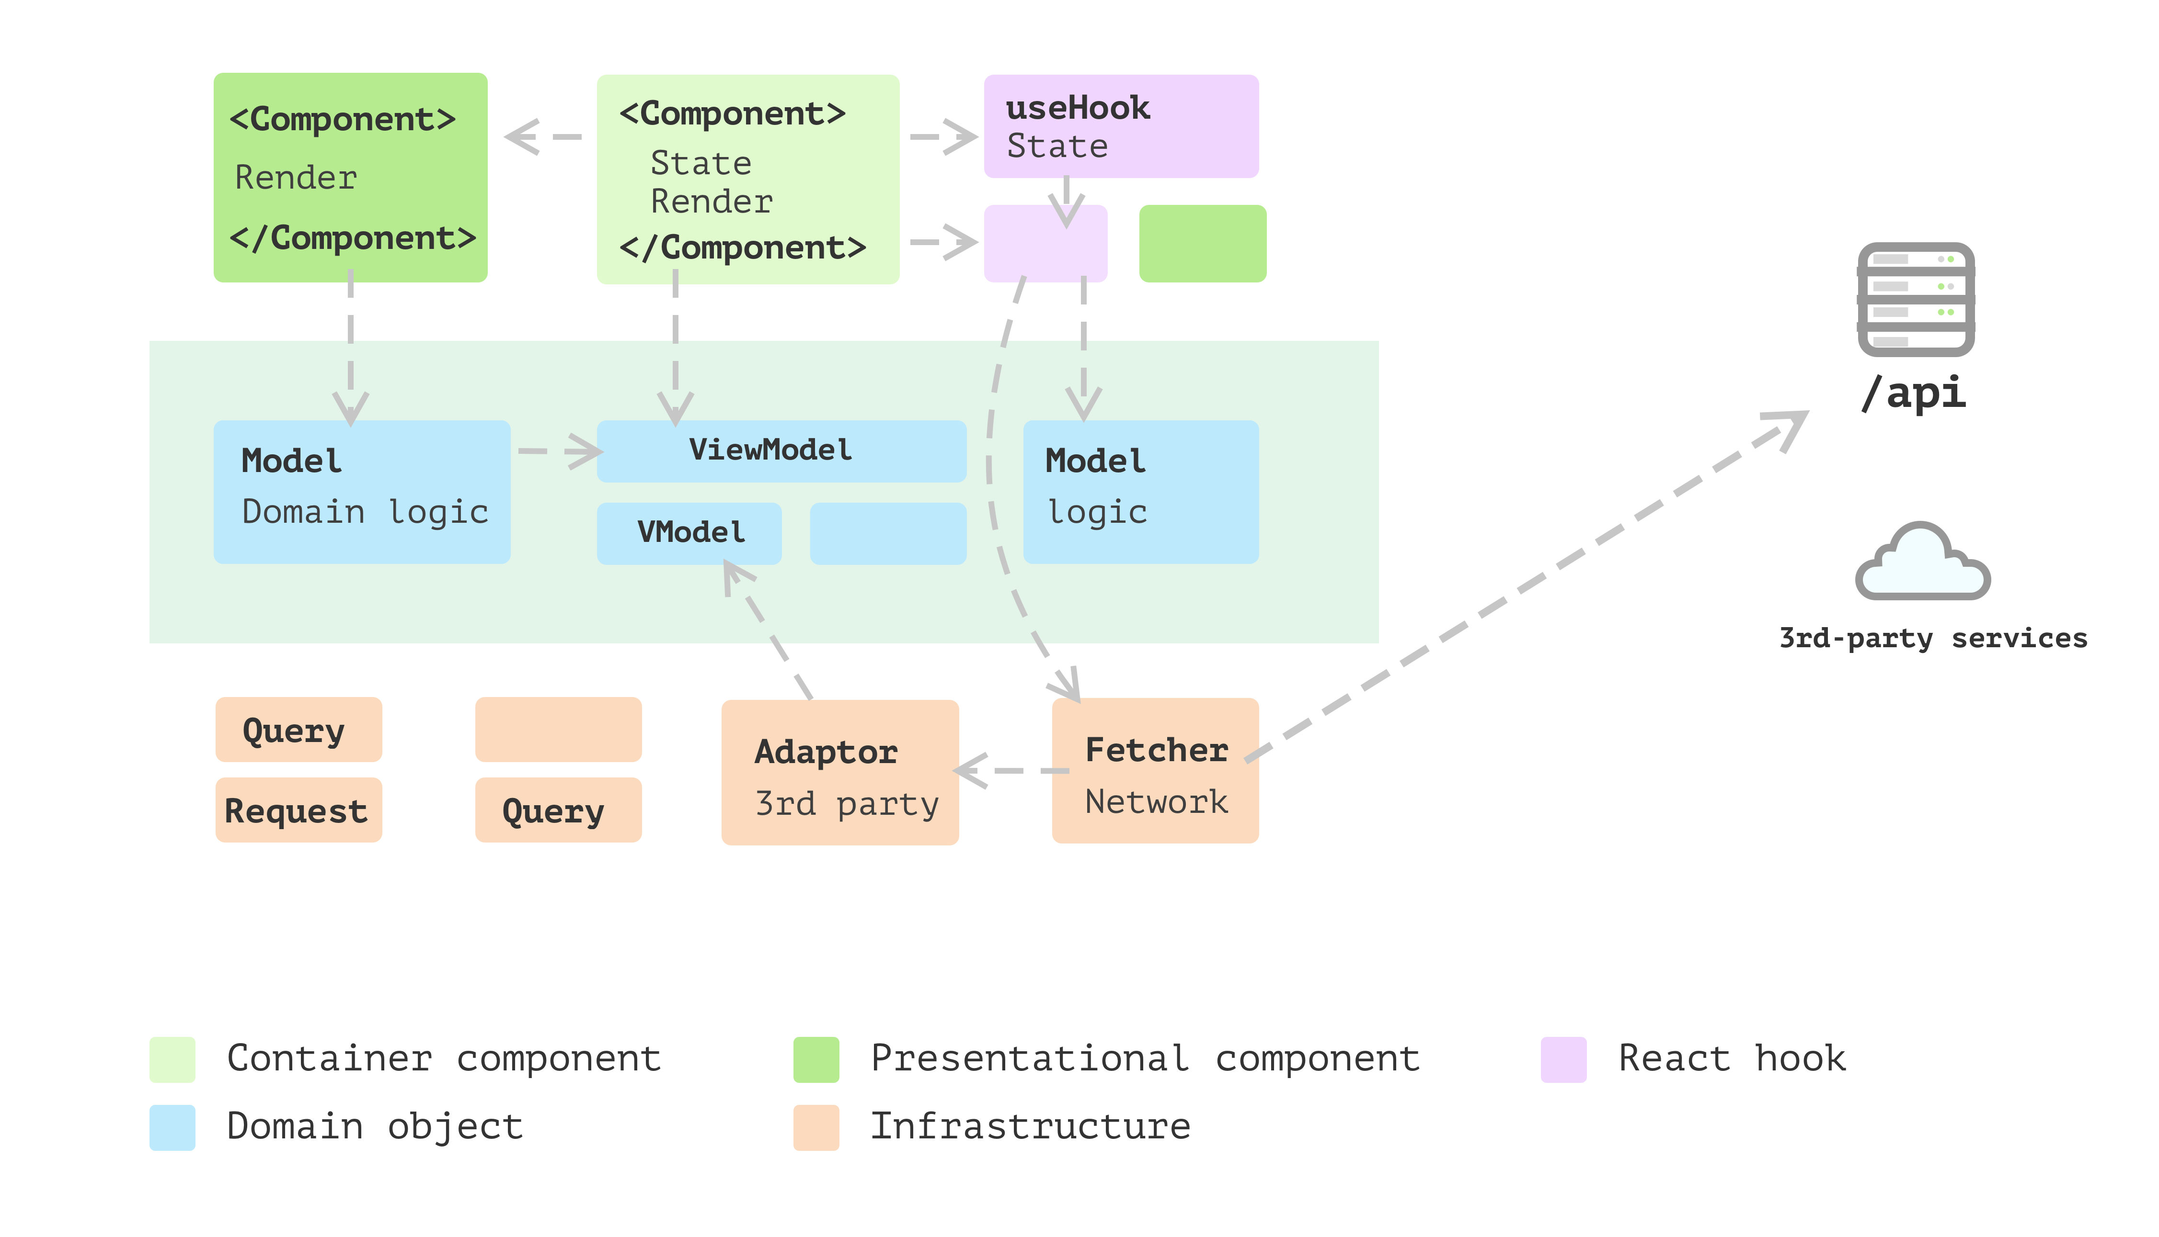
Layered frontend application
Architecture
Ref: https://martinfowler.com/articles/modularizing-react-apps.html#ApartFromTheUserInterface

Slide 30
Layered frontend application
Architecture
Presentation - Domain - Data layering
Presentation layer
Responsible for presenting views and handling user interaction
Domain layer
Responsible for representing data
Domain logic/business logic
Transformations from one form to another
Data layer
Responsible for fetching data and network handling

