Slide 1


Automatic Attendance using Face Recognition
Maulana Azad National Institute Of Technology , Bhopal
Guided by : Dr. G.S. Thakur
Submitted by : - 1) Akanksha Jain (222120117)
2) Akash kumar (222120119)

Slide 2
CONTENTS :
Introduction
Programming Language and Library
Flow Chart
Steps involved in face recognition
Diagrammatic Representation
CNN Model
Harr Cascade Algorithm
Material and Methods
Description Of Dataset
Data Preparation for Training
Model Development
Fitting the data in Model
Result
SVM Model
Material and Methods
Result
Attendance sheet
Web-Camera Screen
Comparison
Conclusion

Slide 3
Introduction
In today's fast-paced world, efficient attendance management systems are crucial for organizations of all sizes. Traditional methods of attendance marking, such as paper-based registers or manual entry systems, are prone to errors and time-consuming.
Our project aims to revolutionize attendance marking through the use of face recognition technology. By leveraging the power of artificial intelligence and machine learning, we have developed a robust system capable of accurately identifying individuals based on their facial features.

Slide 4
Programming Language
Python
Python is a high-level, interpreted programming language known for its simplicity and readability.
Python has emerged as a dominant language in data science and machine learning due to its rich ecosystem of libraries and frameworks.
Libraries like NumPy, pandas, scikit-learn, TensorFlow, and PyTorch provide powerful tools for data manipulation, analysis, and building machine learning models.
Python's open-source nature encourages collaboration and innovation within the developer community.
The Python Package Index (PyPI) hosts thousands of open-source packages, providing solutions to a wide range of problems.

Slide 5
Libraries Development
OpenCV
OpenCV is a powerful computer vision library used for various image and video processing tasks.
It provides functions for face detection, image manipulation, object tracking, and more.
Numpy
NumPy is a fundamental package for scientific computing with Python.
It provides support for large, multi-dimensional arrays and matrices, along with a collection of mathematical functions to operate on these arrays efficiently.
TesorFlow
TensorFlow.keras.models.load_model is used to load pre-trained Keras models saved in the Hierarchical Data Format (HDF5) file format.
Tensorflow.keras.preprocessing.image is used for real-time data augmentation and preprocessing of image data during model training. It provides methods for generating batches of augmented images, such as rotation, zoom, flip, and normalization.

Slide 6
Sklearn
LabelEncoder (from sklearn.preprocessing):
LabelEncoder is used to encode categorical labels into numerical representations.
It assigns a unique integer to each label, enabling machine learning algorithms to work with categorical data.
SVC (from sklearn.svm):
SVC (Support Vector Classifier) is a supervised learning algorithm used for classification tasks.
It constructs a hyperplane or set of hyperplanes in a high-dimensional space to separate different classes.
PCA (from sklearn.decomposition):
PCA (Principal Component Analysis) is a dimensionality reduction technique used to reduce the number of features in a dataset.
It transforms the data into a lower-dimensional space while preserving most of its variance.
make_pipeline (from sklearn.pipeline):
make_pipeline is a utility function used to construct a pipeline of multiple transformers followed by a final estimator.
It simplifies the creation of machine learning pipelines by automatically naming each step based on its class name.
StandardScaler (from sklearn.preprocessing):
StandardScaler is a preprocessing technique used to standardize features by removing the mean and scaling to unit variance.
It ensures that each feature contributes equally to the model's decision-making process.
OneVsRestClassifier (from sklearn.multiclass):
OneVsRestClassifier is a strategy used to extend binary classification algorithms to multi-class classification problems.
It trains multiple binary classifiers, each responsible for distinguishing between one class and the rest.

Slide 7
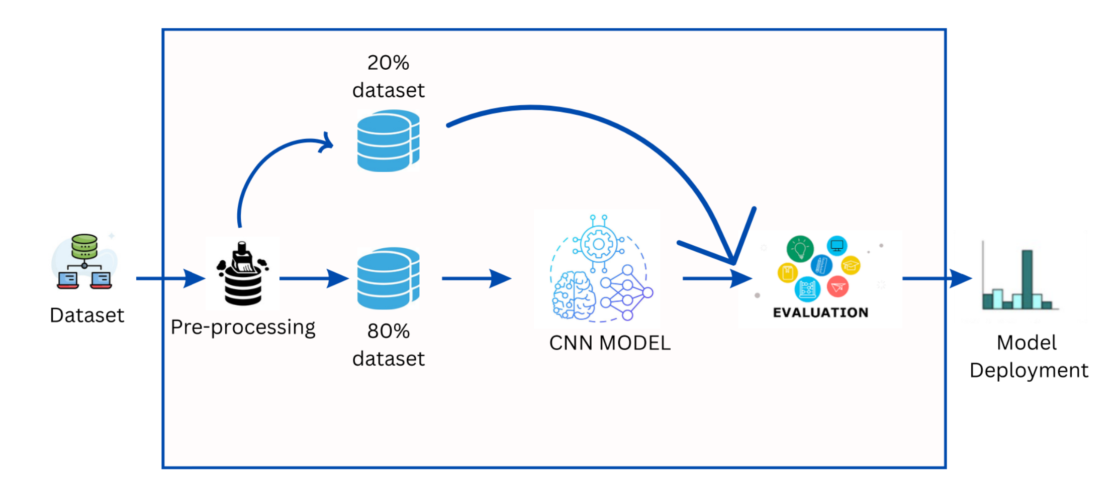
Flow chart a. CNN

Slide 8
b. SVM
SVM MODEL

Slide 9
Haar Cascade Algorithm:
The Haar Cascade algorithm is a machine learning-based approach used for object detection in images or videos. It was developed by Viola and Jones in their seminal paper titled "Rapid Object Detection using a Boosted Cascade of Simple Features" in 2001. The algorithm is particularly known for its efficiency and accuracy in detecting objects in real-time applications.
The Haar Cascade algorithm detects faces by following these general steps:
Integral Image Calculation
Feature Selection
Adaboost Training
Cascade Classifier
Sliding Window Approach
Non-Maximum Suppression
Output

Slide 10
How Face Recognition systems Work
If we look at the mirror we can see that our face has certain distinguishable landmarks which make up different facial features.
Software defines these landmarks as nodal points.
There are about “80 nodal points” on a human face.
Here are few nodal points that are measured by the system.
Distance between the eyes
Width of nose
Depth of the eye socket
Cheekbones
Jaw line
Chin

Slide 11
CNN
Convolutional Neural Networks (CNNs) are a class of deep neural networks designed for processing structured grid-like data, such as images.
They are particularly effective in tasks involving image recognition, classification, object detection, and segmentation.
CNNs consist of multiple layers, including convolutional layers, pooling layers, and fully connected layers.
Convolutional layers apply learnable filters (kernels) to input images, extracting features through convolutions.
Pooling layers downsample feature maps, reducing spatial dimensions while retaining important information.
Fully connected layers combine extracted features to make predictions or classifications.

Slide 12
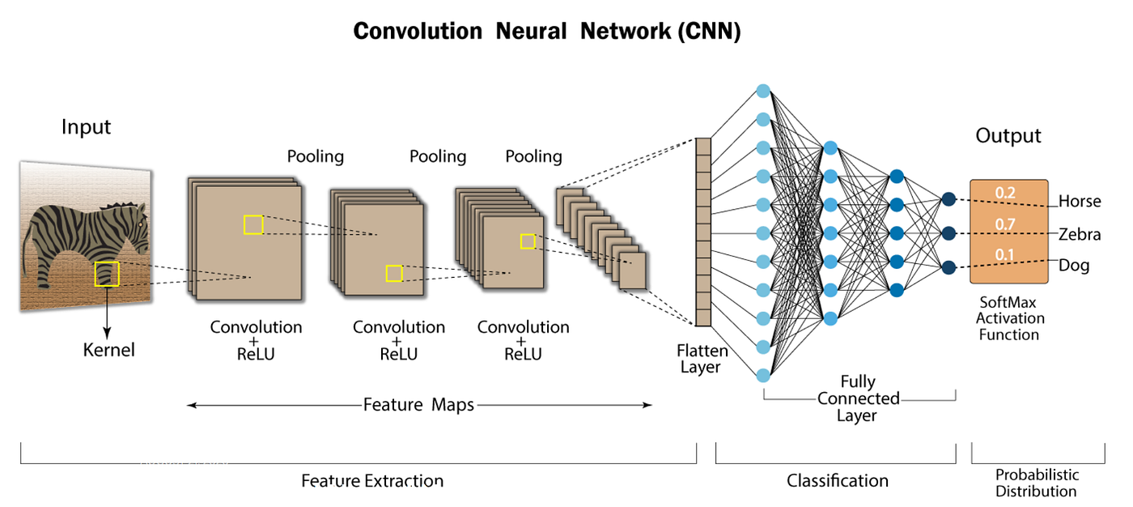
CNN Architecture

Slide 13
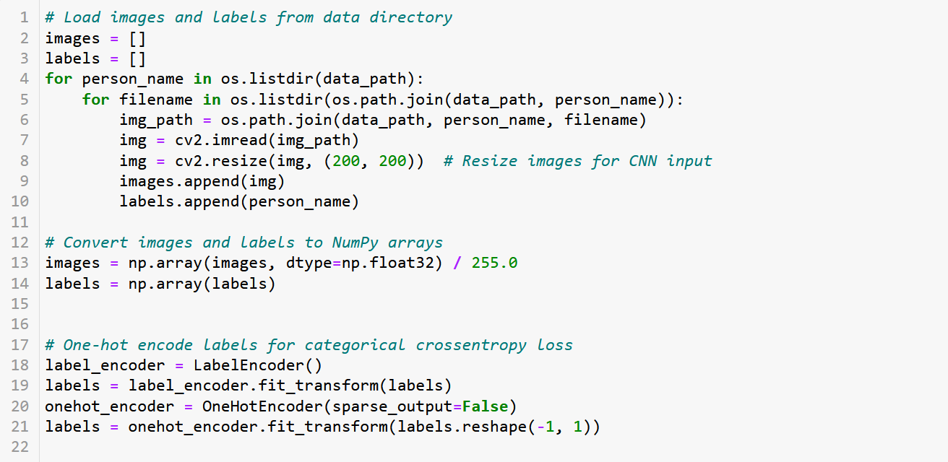
DATA PREPRATION FOR TRAINING

Slide 14
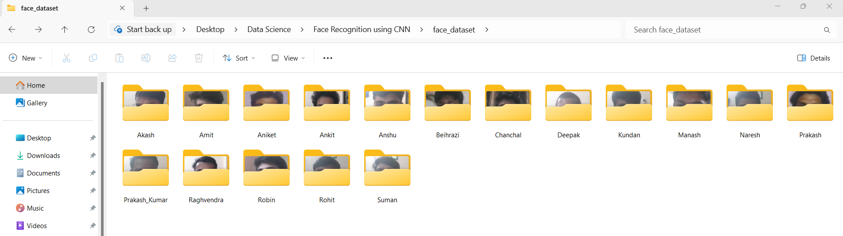
DataSets

Slide 15
Descriptive Dataset
Dataset Contains 1700 images.
Every person has 100 images.
Size of each image is 200x200
Images are taken from different angles and in different lighting condition

Slide 16
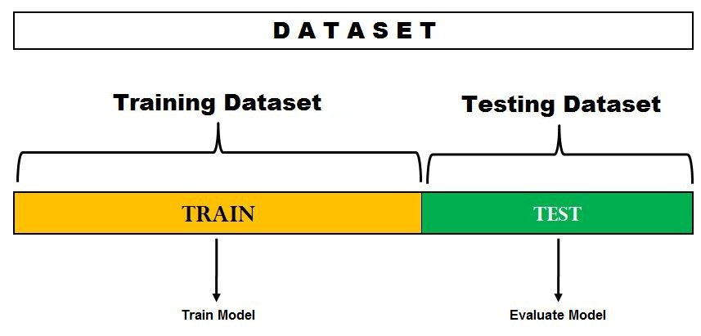
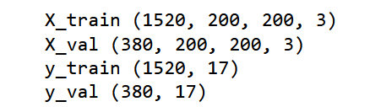
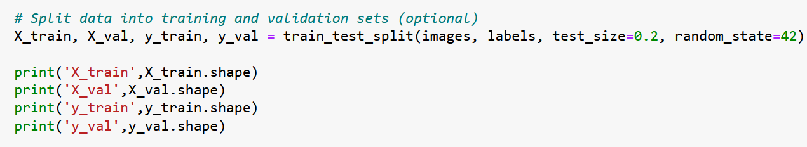
SPLITING DATASET

Slide 17
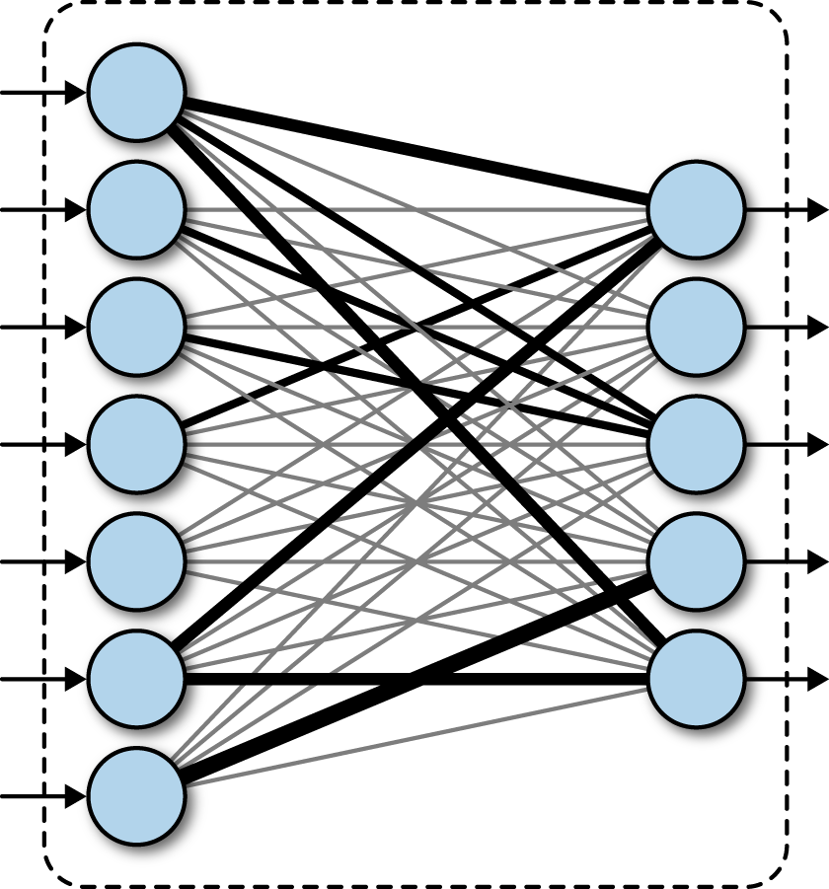
MODEL DEVELOPMENT
200X200
3x3 filter (32)
stride =1
Padding = same
200X200
X32
100X100
X32
3x3 filter (64)
stride =1
Padding = same
100X100
X64
2x2 maxpool
50X50
X64
2x2 maxpool
Layer 2
3x3 filter (128) stride =1
Padding = same
Convolutional
Operation
+
Maxpooling
Layer 1
flatten
50X50
X128
Layer 3
2x2 maxpool
25X25
x128
Class
Fully Connected
Layer

Slide 18
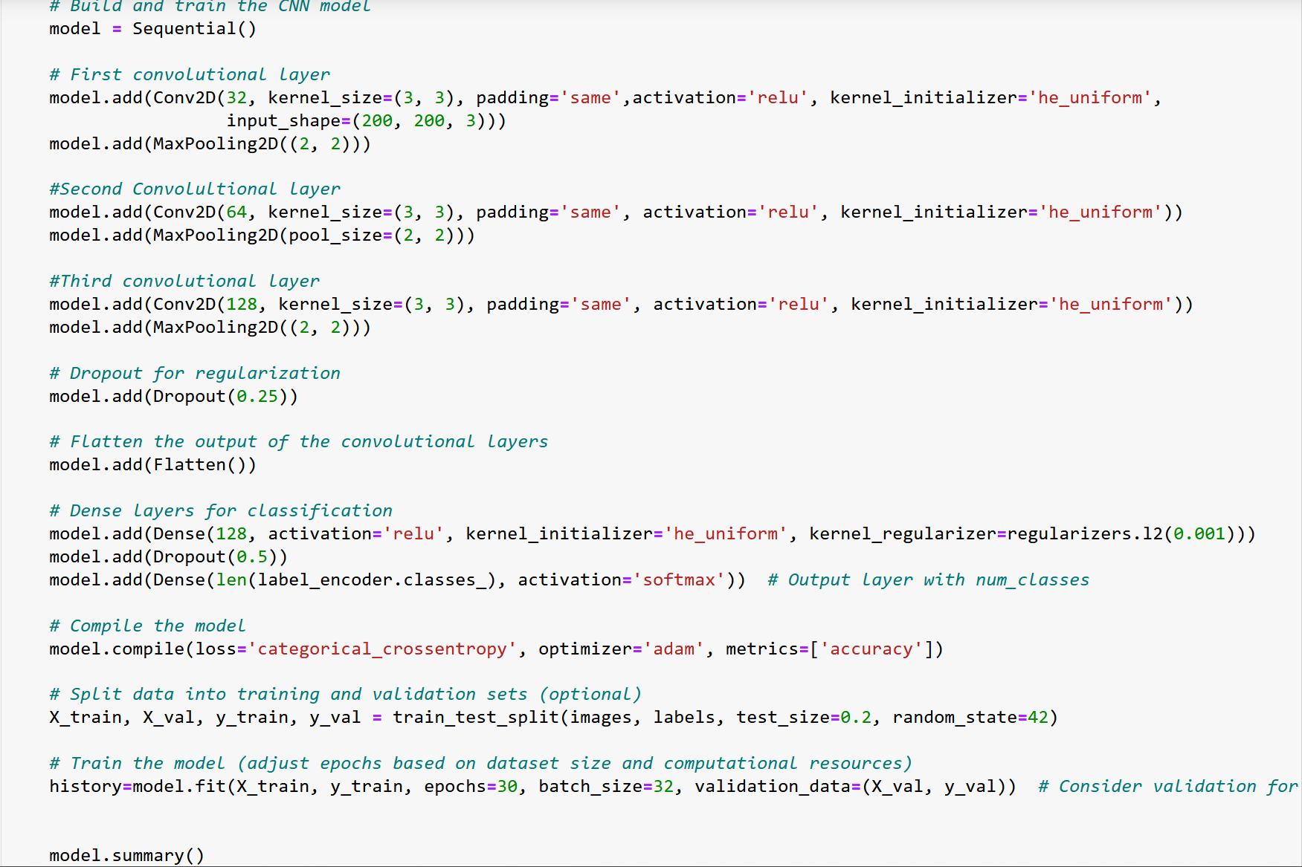
MODEL CODE

Slide 19
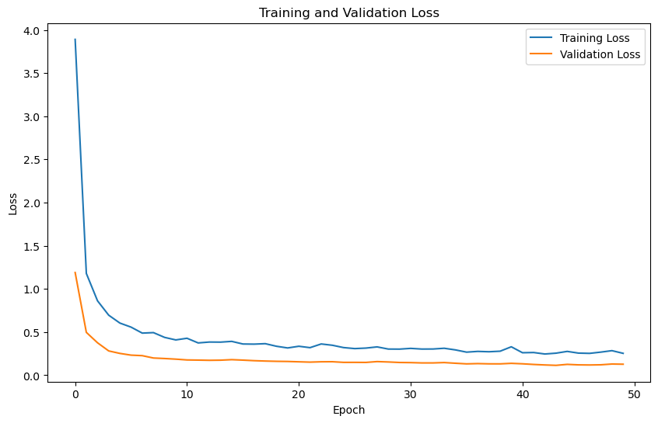
GRAPH OF TRAINING AND VALIDATION LOSS

Slide 20
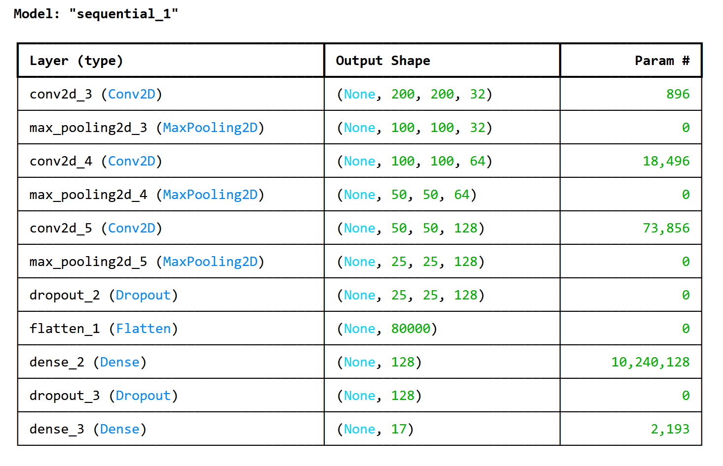
MODEL SUMMARY

Slide 21
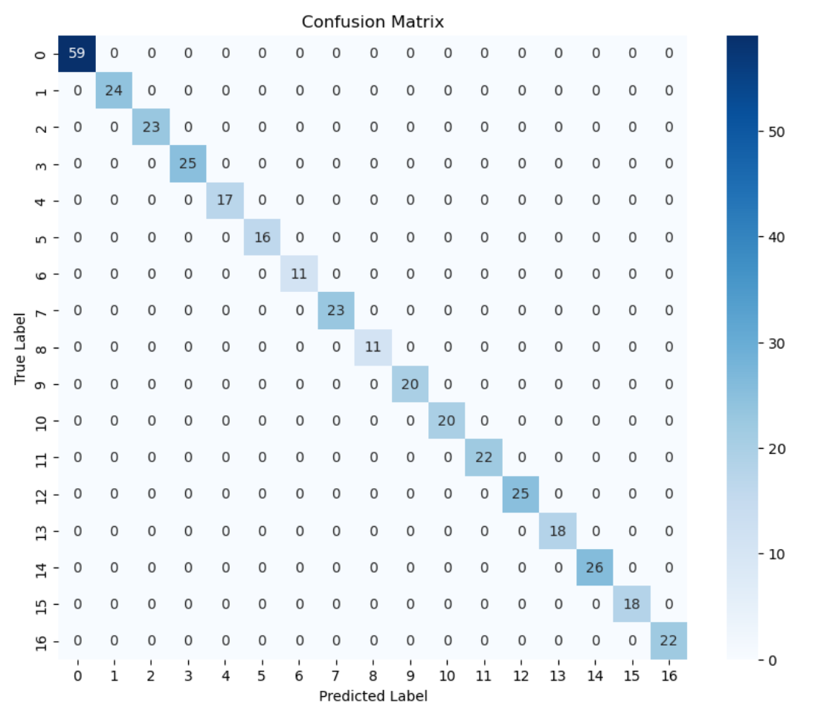
Confusion Matrix

Slide 22
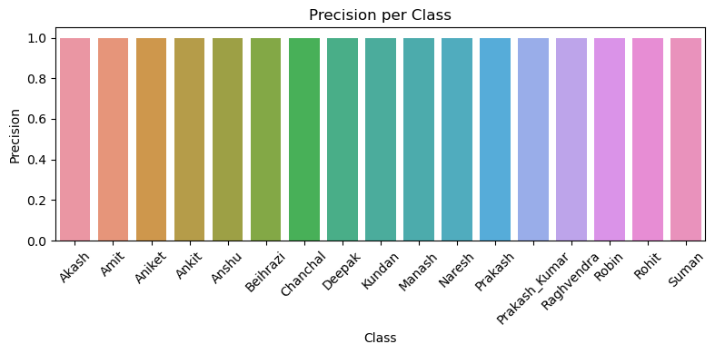
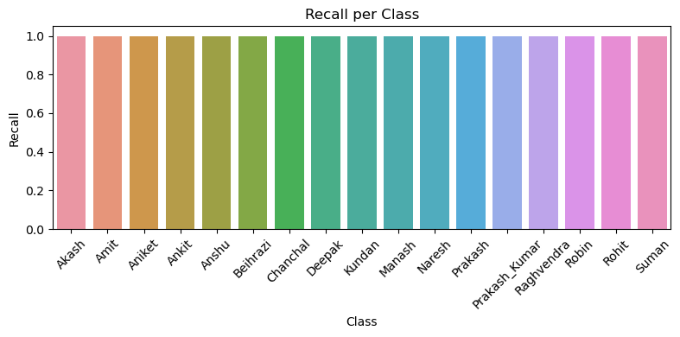

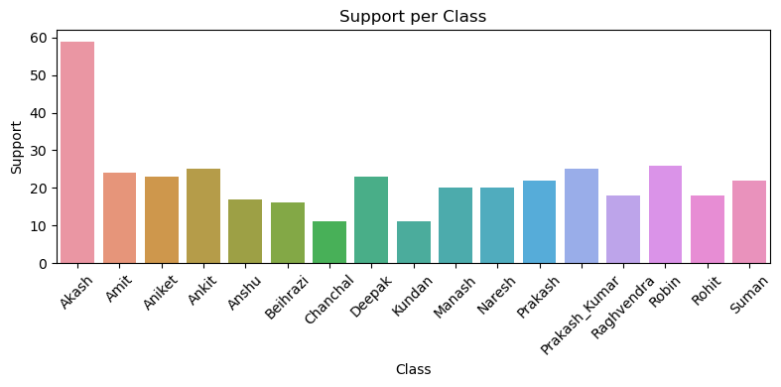
GRAPHS

Slide 23
SVM
Support Vector Machine (SVM):
SVM is a powerful supervised machine learning algorithm used for classification and regression tasks.
In classification tasks, SVM aims to find the optimal hyperplane that separates the data points into different classes with the maximum margin.
The hyperplane is determined by a subset of the training data points called support vectors.
SVM can handle both linear and non-linear classification tasks by using different kernel functions, such as linear, polynomial, radial basis function (RBF), and sigmoid.

Slide 24

SVM Working

Slide 25
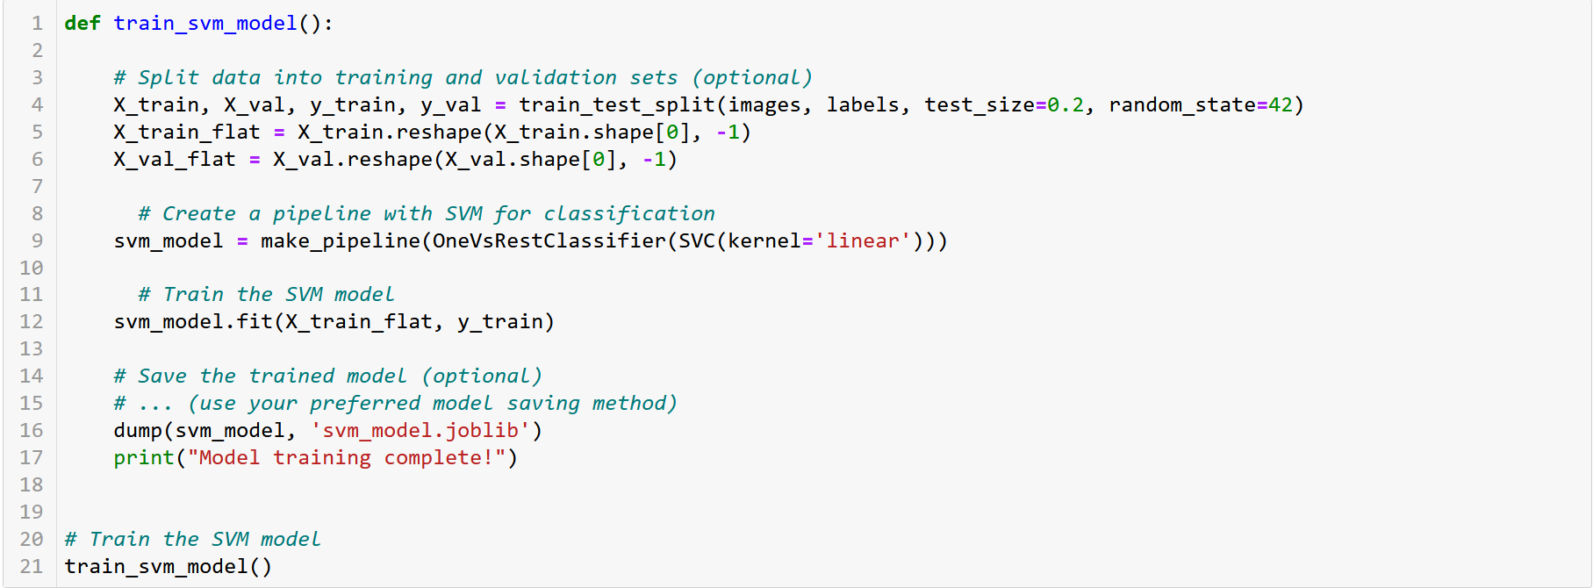
MODEL CODE

Slide 26
CONFUSION MATRIX

Slide 27
GRAPHS

Slide 28

Attendance Sheet

Slide 29
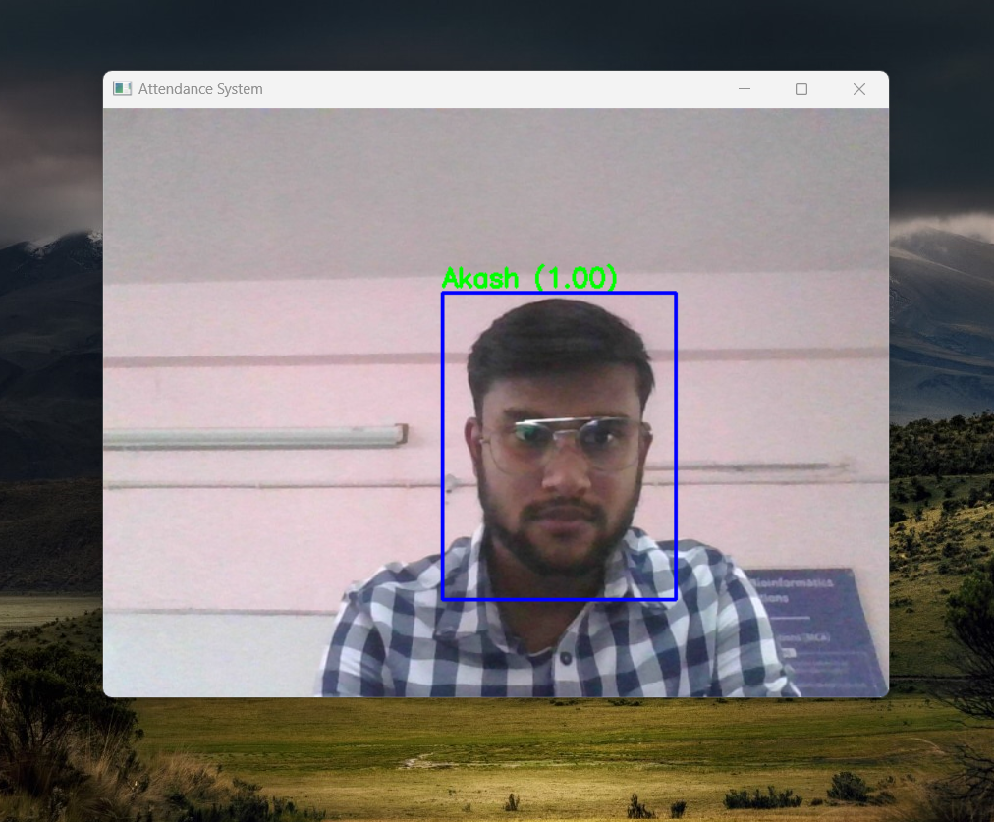
Web-Cam Screen

Slide 30
Advantages
Automated Time Tracking System
Cost-Effective
Touchless sign in system : A post pandemic requirement
More accurate and better worker attendance
Easy to manage

Slide 31
Challenges faced by Face recognition system
Illumination : It is observed that the slight changes in lighting conditions cause a significant impact on its results.
Pose : If the database is only trained on frontal face view it may result in faulty recognition or no recognition
Facial Expression : Different expressions of the same individual are another significant factor that needs to be taken into account.
Low Resolution : Training of recognizer must be done on a good resolution picture, otherwise the model will fail to extract features.
Aging : With increasing age, the human features shape, lines, texture changes which are yet another chanllenge.

Slide 32
Applications
Face recognition is currently being used to make the world safer, smarter, and more convenient.
There are a few use cases:
Finding Missing Person
Retail Crime
Security Identification
Identifying accounts on social media
School Attendance System
Recognizing Driver in Cars

Slide 33
Conclusion
This presents Face recognition using 100 images of every person. A convolutional neural network (CNN) and SVM was implemented to classify whether a face image recognised by camera is in the database or not and according to the output mark the attendance in the excel file. The model was able to achieve accuracy of 86.4% and 94.78% from two different algorithms named SVM and CNN respectively.
Model Name | Accuracy
Support Vector Machine | 80.7%
Convolutional Neural Network | 88.2%

