Slide 1
final report
- Agile technology

Slide 2
Features
Self organising
Product progress in a series of month long sprint
Requirment are captured as item in a list of product backlog
Sprint backlog which is a subset of product backlog is prepared
Dynamic(changing based on customer priority at any point of time)

Slide 3
Ceremonies included
Sprint planning
Sprint review
Sprint retrospective
Weekly scrum meetings

Slide 4
All stories in sprint backlog are selected from product backlog based on
Customer priority
Skills
Estimate
Team size

Slide 5
Tools used
Microsoft visual studio(2017)
.Net
C# programming language
Sqllite database
Stored procedure techniques

Slide 6
Scrum meeting
Discussing the requirement given by product owner
Prepeare product and sprint backlog
Division of work
Presenting the software developed

Slide 7
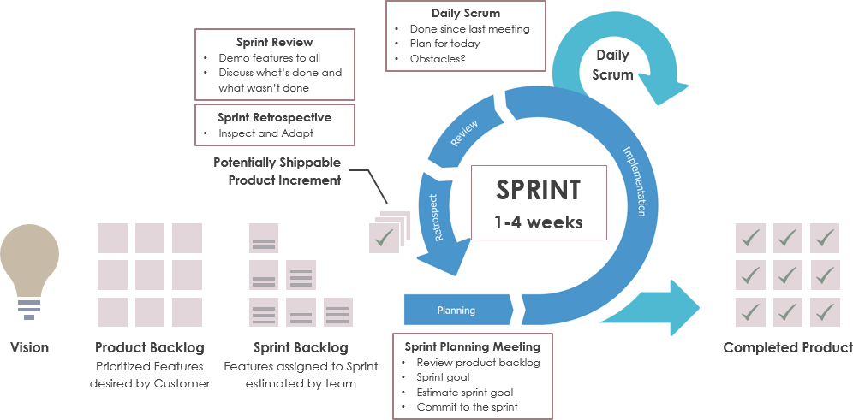

Slide 8
Product backlog
Category | Stories | Estimated Hours | assigned to
User Authentication | departement library staff login pagedesign | 2 | akash
Dashboard | dashboard page design | 3 | sammera
 | Dynamic user control effect | 1.5 | akash
 | addding sliddig panel effect to dashboard buttons | 2 | akash
 | designing add student appform | 2 | kunal
 | creating an instance of add student app form in appbody | 1 | kannapa
 | designing add book appform | 2 | akarsh
 | creating an instance of add book app form in appbody | 1 | akarsh
 | designing transcation app form | 2 | gowthan
 | creating an instance of transcation app form in appbody | 1 | gowtham

Slide 9
backend design | creating tables in a sqllite database | 2 | akash
 | Creating stored procedures | 2 | akash
 | linking backend with frontend | 1 | akash
add student | every student details of the departement should be added to borrower table | 3 | sammera
 | search student button design | 3 | kannapa
 | search student button programming | 1 | kunal
add books | should add every book in a library and when new book arrives it should be added to database | 3 | sammera
 | delete book button programming | 3 | kunal
 | delete book button design | 3 | akarsh

Slide 10
 | Search book button design | 1 | gowtham
 | Search book button programming | 3 | kannapa
Transcations | issue book button design | 1 | gowtham
 | isuue book button programming | 3 | akash
 | return book button design | 1 | sammera
 | return book button programming | 1 | akash
about | about app form design | 1 | sammera
 | designing in ms word | 0.5 | gowtham
 |  | total=50

Slide 11
Sprint Backlog
sprint1
Category | Stories | Estimated Hours | assigned to
User Authentication | departement library staff login pagedesign | 1 | akash
Dashboard | dashboard page design | 3 | sammera
 | Dynamic user control effect | 1 | akash
 | addding sliddig panel effect to dashboard buttons | 3 | akash
 | designing add student appform | 2 | kunal
 | creating an instance of add student app form in appbody | 1 | kannapa
 | designing add book appform | 2 | akarsh
 | creating an instance of add book app form in appbody | 2 | akarsh
 | designing transcation app form | 1 | gowthan
 | creating an instance of transcation app form in appbody | 1 | gowtham
 |  | total = 17

Slide 12
Sprint 2
Category | Stories | Estimated Hours | assigned to
backend design | creating tables in a sqllite database | 2 | akash
 | Creating stored procedures | 3 | akash
 | linking backend with frontend | 1 | akash
add student | every student details of the departement should be added to borrower table | 2 | sammera
 | search student button design | 3 | kannapa
 | search student button programming | 1 | kunal
 |  | total=12 hour

Slide 13
sprint 3
Category | Stories | Estimated Hours | assigned to
add books | should add every book in a library and when new book arrives it should be added to database | 4 | sammera
 | delete book button programming | 3 | kunal
 | delete book button design | 2 | akarsh
 | Search book button design | 1 | gowtham
 | Search book button programming | 2 | kannapa
 |  | total =12hour

Slide 14
sprint 4
Category | Stories | Estimated Hours | assigned to
Transcations | issue book button design | 2.5 | gowtham
 | isuue book button programming | 3 | akash
 | return book button design | 3 | sammera
 | return book button programming | 1 | akash
about | about app form design | 1 | sammera
 | designing in ms word | 0.5 | gowtham
 |  | total=11

Slide 15
Burn down chart

