Slide 1
SCRUM TEAM
Team Lead : Akash . H R
Product owner : Sameera m s Harishta
Scrum master : Kunal V
Scrum team : kannapa goud
akarsh.m
Goutham Raju
Project guide : Asst proffessor Shalini . K B

Slide 2
Artificial intelligence

Slide 3
PROJECT ON BUILDING AN AI PROTOTYPE (rover)TO SELF learn USING AGILE METHoDOLOGY (SCRUM TECHIQUES)

Slide 4
OBJECTIVE
To build a software prototype using python ,KIVY application, and pytorch based on reinforcement

Slide 5
GOAL To build a self learning agent to drive upstream and downstream avoiding obstacles

Slide 6
SUCCESS CRITERIA LEVEL 1:rover (learning agent) WITH NO OBSTACLES LEVEL 2: rover (Learning agent) WITH SIMPLE OBSTACLES LEVEL 3: rover(learning agent) WITH COMPLEX OBSTACLES

Slide 7
SOFTWARE REQUIRMENTS
Operating System: ubuntu 18.04
Language : python.
Environment : idle
Distribution : anaconda distribution.
Idle : spyder

Slide 8
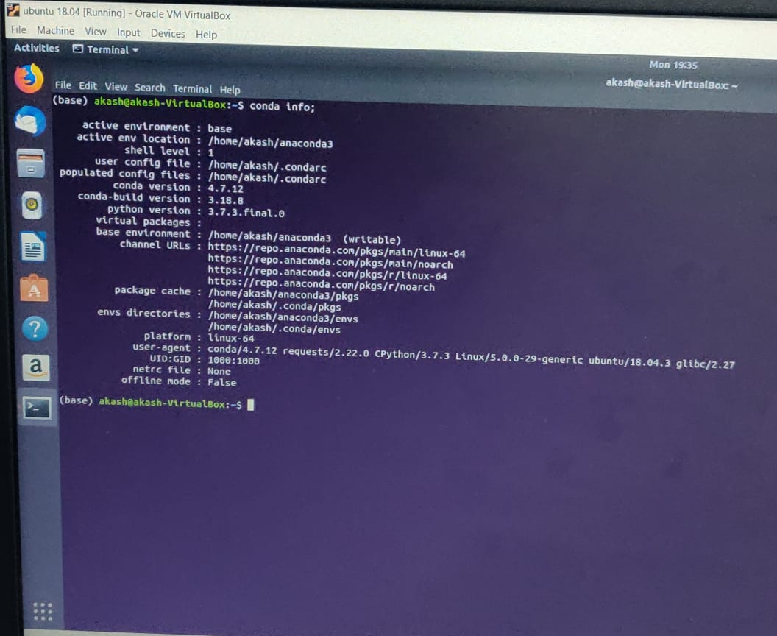
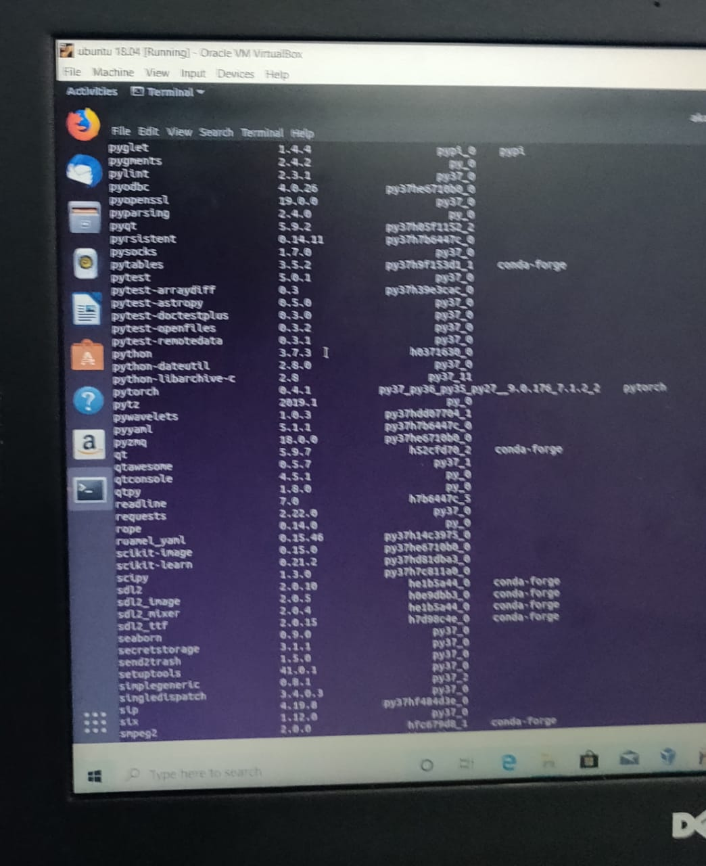
Version of anaconda and pytorch

Slide 9
any question

