Slide 1
UE20CS302 : MACHINE INTELLIGENCE
PROJECT PRESENTATAION
BATCH ID - 8
SECTION - H
SHRUTESH REDDY L PES2UG20CS464
SUMANT KULKARNI PES2UG20CS469
AKASH HEGDE
PES2UG20CS492

Slide 2
PROBLEM STATEMENT
Churn (loss of customers to competition) is a problem for companies because it is expensive to acquire a new customer and companies want to retain their existing customers. Most telecom companies suffer from voluntary churn.
Customer churn is when a company’s customers stop doing business with that company.
The most effective way for a company to stop customers from unsubscribing their service is to understand them.
we will examine customer data from Sample Data Sets with the aim of building and comparing several customer churn prediction models.

Slide 3
ABSTRACT AND APPLICATION:
Customer churn is a major problem and one of the most important concerns for large companies.
As companies will be directly affected by the customers if they unsubscribe their service, companies are trying to develop a means to predict whether customers will unsubscribe the service or not.
The main concept of our project is to develop a churn prediction model which assists telecom operators,banking system etc.. to predict customers who are most likely subject to churn.
The model developed here will be heavily dependent on MACHINE LEARNING ALGORITHMS.
Algorithms used in our project include Random forest classifier,decision trees,linear regression,PCA etc.
The churn prediction classifies the customers into churn and non-churn customers based on their purchase. The datasets are mostly collected from the churn customers.
By exploring raw data and performing data analysis, one can predict in advance whether the customer agitates or proceed with the organization

Slide 4
APPLICATION AND USES:
1)Churn prediction is used for predicting which customers are at high risk of leaving the company or canceling a subscription to a service, based on their behavior with your product.
2)Churn prediction is one of the best way in finding the feedback from the customers and it sustain the customers by giving some offers.
3)Used in medical,telecommunication,banking and many more other fields
4)Used to predict which customer is in the verge of unsubscribing the company/organizations.

Slide 5
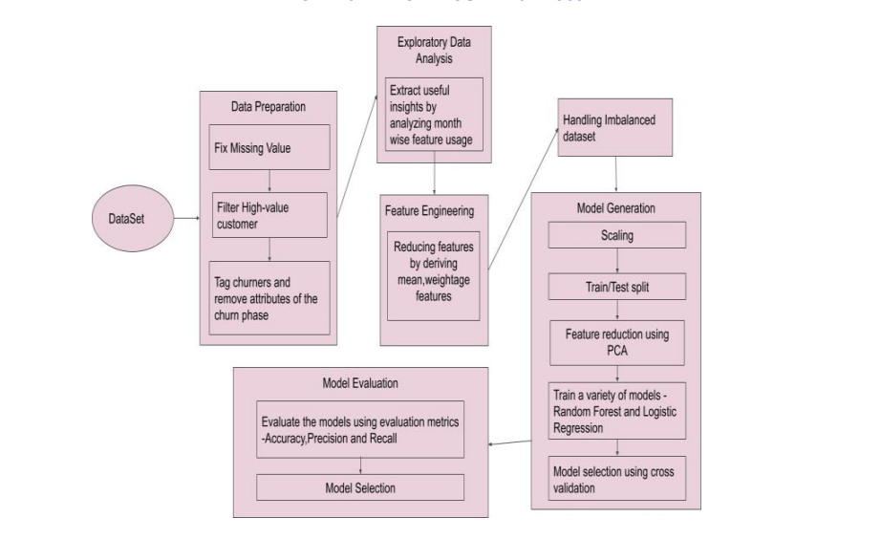
HIGH LEVEL ARCHITECTURE

Slide 6
LITERATURE SURVEY:
Title of the paper | Year of Publication | Journal/Conference Name | Advantages | Limitations
Customer Churn Prediction In Telecommunication Industry Using Random Forest Classifier | 2020 | IEEE ICSCAN 2020 | -Gave insights of importance of Random Forest Classifier. -compared few algorithms along with Random Forest Classifier and gave accuracy of most efficient algorithm | This algorithm is substantially slower than other classification algorithms because it uses multiple decision trees to make predictions
Customer Churn Analysis and Prediction in Banking Industry using Machine Learning | 2020 | 2020 6th international conference on parallel,distributed,and grid computing | - Explained various types of algorithms like KNN,RF,DT. - Explained about precision, recall and resulting tables has results consisting of recall,precision and accuracy | KNN:Not great for large datasets,since the entire training data is processed for every prediction
CUSTOMER CHURN PREDICTION | 2021 | International Advanced Research Journal in Science, Engineering and Technology | 1)unwanted data is removed and only valuable data is kept. 2)The dataset used here consists of many features out of which we choose the needed features. 3)reducing the number of irrelevant attributes increases the performance of classification. | Gives good accuracy only when valuable data is there.

Slide 7
Title of the paper | Year of Publication | Journal/ Conference Name | Advantages | Limitations
Research on a Customer Churn Combination Prediction Model Based on Decision Tree | 2020 | Research on a Customer Churn Combination Prediction Model Based on Decision Tree and Neural Network | Advantage of the combined customer churn prediction model is that it can integrate the results of the two models to clearly distinguish between churn customers and non-churn customers, and for customers in between, it gives the probability of churn. | 1)The problem that a single model is difficult to achieve high-precision customer churn prediction. 2)Decision tree will overfit if we allow to grow it i.e., each leaf node will represent one data point 3)Decision Tree wont perform for regression
A Comparative Study Using KNN and Decision Trees | 2019 | Sixth HCT Information Technology Trends (ITT) | 1)Decision Tree support automatic feature interaction 2)KNN is used for both Classification and regression | 1)One of the most complicated issues is dealing with incomplete datasets that have missing values 2)In addition, large datasets can be hard for researchers to organize and handle because of the existence of noisy data records
Machine Learning Based Telecom-Customer Churn Prediction | 2020 | International Conference on Intelligent Sustainable Systems (ICISS) | Random forest performs well on a large dataset and handles missing variables without deletion of variables[ | 1)Random forest, not only performs well on large datasets 2) A forest is less interpretable than decision tree.

Slide 8
Title of the paper | Year of Publication | Journal/ Conference Name | Advantages | Limitations
Research on Customer Churn Intelligent Prediction Model based on Borderline-SMOTE and Random Forest | 2022 | IEEE 4th International Conference on Power, Intelligent Computing and Systems (ICPICS) | 1)It solves the difficulty of unbalanced data. 2)It removes the noise in the data. 3)randomness in the data removes overfitting. | 1)Random Forest is actually slow when compared to other model. 2)SMOTE oversamples noisy data also that is not required. 3)It oversamples the uninformative samples also.
Customer Churn Prediction by Classification Models in Machine Learning | 2022 | 2022 9th International Conference on Electrical and Electronics Engineering | 1)Gini is used to classify sample that contains one category 2)Overall, the random forest model was superior to the decision tree model in predicting the unknown instances in the testing set. | Gini captures the order of values while ignoring the distance between them.
Towards Accurate Predictions of Customer Purchasing Patterns | 2017 | International Conference on Computer and Information Technology IEEE(CIT) | 1)The biggest advantage of linear regression models is linearity. 2)Linear regression performs exceptionally well for linearly separable data | 1)The assumption of linearity between dependent and independent variables 2)It is often quite prone to noise and overfitting

Slide 9
PROPOSED APPROACH :
First importing all the required methods
Reading the dataset using the method called pd.read csv method
First we have preprocessing methods. In that we took first and last 5 rows of the data to confirm if it’s working correct or not.
After this , we took the information of the dataset using the methods called .info() and .describe() , these methods gives what is the datatype of each column, maximum values in every column, min,mean etc..
In customer churn prediction project the main aim is on how many customers are churned and how many are not. So for this we can use the matplotlib method for drawing the graph.
For doing the analysis, we can use graphs as main tool. Here we are calculating the churn rate of the company , for drawing a graph we took churn column as a main part with the other columns on the other side of the graph.This is done by using the univariate method.

Slide 10
PROPOSED APPROACH :
After univariate analysis, we took scatter plot and kdeplot as a visualizaion technique because it gives clear picture about the dependencies and gives clear visualization.
After this we came to the main part i.e. modelling of the dataset.First we took decision tree as the
initial model part. Here we split the dataset into two parts i.e test and train dataset, then we predict some values on the basis of test data and finally printed the classification report using inbuilt method.
Next comes the random forest classifier, it is the group of decision trees.though it’s slow compared to decision trees it gives very accurate results . First we imported the inbuilt method for the random forest and then use same method as decision trees.
Next step is the PCA (Principal Component Analysis) ,it is the dimensionality reduction method
But it preserves all the information of the original dataset.Here also we calculate accuracy.
In above all these methods the accuracy came little less , so we smote the data i.e. imbalance the data and again calculated the accuracy, from this we got very great accuracy .

Slide 11
PROPOSED APPROACH :
we optimize the dataset using the method called KNN.for k=27 we got highest accuracy for this dataset.
Finally we used linear and polynomial regression method .

Slide 12
THANK YOU

