Slide 1
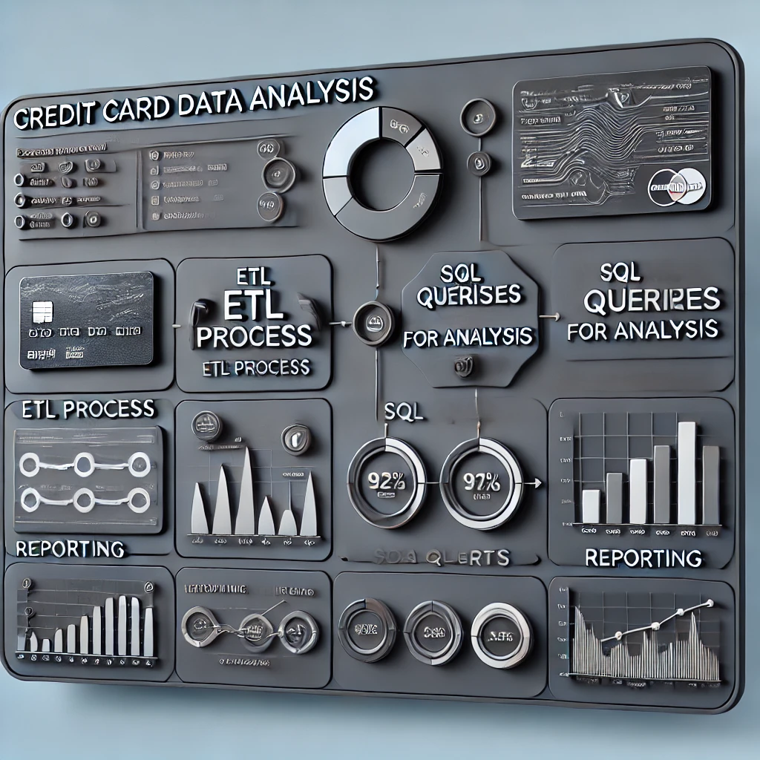

Slide 2
Credit Card Data Analysis Project
Title: Credit Card Data Analysis Project
Subtitle: A Comprehensive ETL and Reporting Solution
Presented by: Akash
Date: 04-02-2025

Slide 3
Introduction
Objective:
To analyze credit card transaction data for better business decision-making.
Provide insights into customer spending patterns, detect fraud, and generate actionable reports.

Slide 4
Project Overview
Components:
ETL Pipeline (Extract, Transform, Load)
SQL Queries for Data Analysis
Reporting Layer
Technologies Used: Python, PostgreSQL, SQL, Matplotlib, GitHub

Slide 5
Project Architecture
ETL Pipeline: Extract, transform, and load data from multiple sources.
Database Layer: PostgreSQL database for data storage and optimized queries.
Reporting Layer: Automated report generation with Python.
Visualization Tools: Graphs and charts for better insights.

Slide 6
ETL Process
Extract:
Data extracted from CSV files and databases.
Handled using Python Pandas.
Transform:
Data cleaning, handling missing values, and formatting.
Business rules for categorizing transactions.
Load:
Batch loading into PostgreSQL.
Optimized for large datasets.

Slide 7
Database and Table Design
Key Tables:
Transactions: Stores credit card transaction details.
Customers: Stores customer information.
Merchants: Contains merchant details.
Optimization: Proper indexing for faster query performance.

Slide 8
SQL Queries
Sample Queries:
Total spending per customer.
Monthly transaction trends.
Merchant performance analysis.
Fraud detection for high-value transactions.

Slide 9
Reporting Layer
Report Generation:
Automated using Python.
Charts and visual reports using Matplotlib.
Sample Reports:
Monthly transaction trends.
Top 10 spending customers.
Merchant performance analysis.

Slide 10
Tools and Technologies Used
ETL Tools: Python, Pandas, Psycopg2
Database: PostgreSQL
Reporting: Matplotlib, Pandas
Version Control: GitHub
Operating System: Windows/Linux

Slide 11
Challenges and Solutions
Data Quality Issues: Implemented data validation checks.
Performance Optimization: Indexed database columns for faster queries.
Automating Reporting: Automated the report generation process.

Slide 12
Key Achievements
Built a scalable and automated ETL pipeline.
Provided meaningful insights through SQL-based data analysis.
Generated automated reports for stakeholders.

Slide 13
Use Cases
Customer Insights: Identified high-spending customers.
Fraud Detection: Flagged suspicious high-value transactions.
Business Reporting: Monthly transaction trend reports.

Slide 14
Deployment Strategy
Scheduling: Task automation using Windows Task Scheduler or Cron jobs.
Database Deployment: PostgreSQL locally or in the cloud.

Slide 15
Conclusion
Demonstrated end-to-end data solution capabilities.
Optimized SQL queries for actionable insights.
Generated impactful reports for business stakeholders.

Slide 16
Q&A
Thank You!
Ready to answer your questions

