Slide 1
Coursera Capstone Project
IBM Applied Data Science Course
Opening a new Shopping Mall in Sydney
By: Akash M

Slide 2
Business Problem
Location of the shopping mall is one of the most important decisions that will determine whether the mall will be a success or a failure
Objective: To analyse and select the best locations in the city of Sydney to open a new shopping mall
Business question
If a property developer is looking to open a new shopping mall in the busy city of Sydney, where would you recommend that they open it?

Slide 3
Data
Data required
List of neighbourhoods in Sydney
Latitude and longitude coordinates of the neighbourhoods
Venue data, particularly data related to shopping malls
Sources of data
Wikipedia page for neighbourhoods (https://en.wikipedia.org/wiki/List_of_Sydney_suburbs)
Geocoder package for latitude and longitude coordinates or csv file
Foursquare API for venue data

Slide 4
Methodology
Web scraping Wikipedia page for neighbourhoods list
Get latitude and longitude coordinates using Geocoder or csv file if available
Use Foursquare API to get venue data
Group data by neighbourhood and taking the mean of the frequency of occurrence of each venue category
Filter venue category by Shopping Mall
Perform clustering on the data by using k-means clustering
Visualize the clusters in a map using Folium

Slide 5
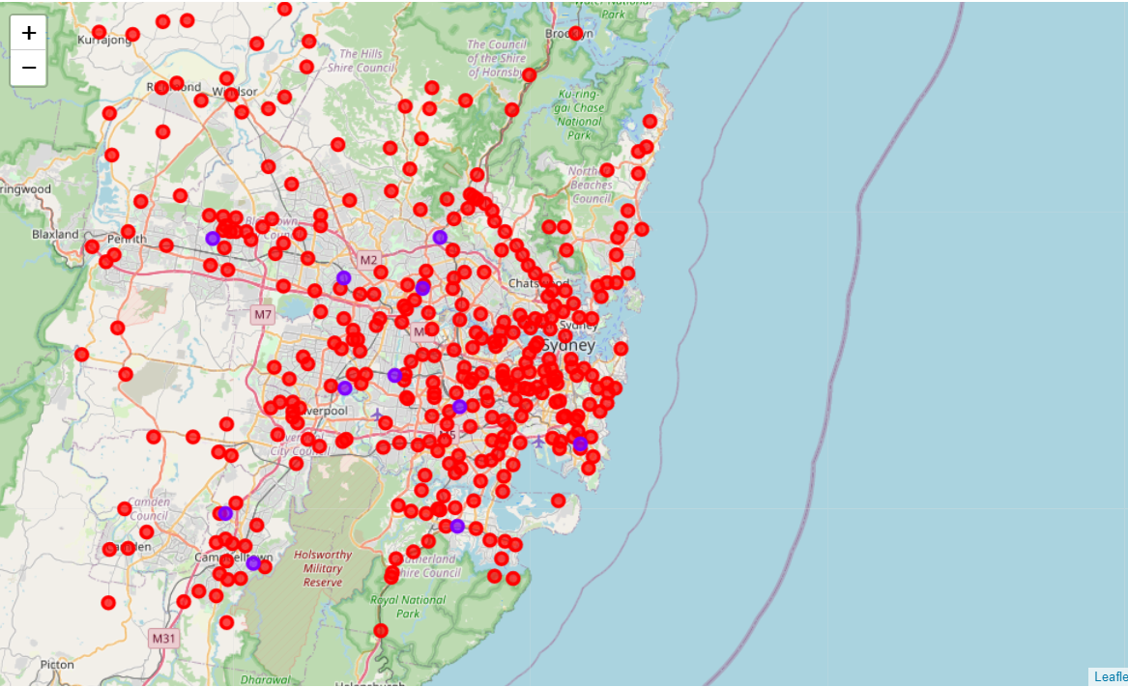
Results
Categorized the neighbourhoods into 2 clusters :
Cluster 0: Neighbourhoods with no shopping malls
Cluster 1: Neighbourhoods with shopping malls

Slide 6
Observation
All shopping malls in cluster 1
Cluster 0 has no shopping mall in the neighbourhoods

Slide 7
Recommendations
Open new shopping malls in neighbourhoods in cluster 0 with no competition
Even though the shopping malls are all concentrated in cluster 1 the total number of them in the cluster still provides an opportunity for opening malls.

Slide 8
Conclusion
Answer to business question: The neighbourhoods in cluster 0 are the most preferred locations to open a new shopping mall
Findings of this project will help the relevant stakeholders to capitalize on the opportunities on high potential locations in their decisions to open a new shopping mall

Slide 9
THANK YOU

