Slide 1
BIOFUELS

Slide 2
Why governments are interested in bioenergy?
Climate change – CO₂ abatement
Energy security
  High energy dependence on politically unstable regions (Russian gas, Middle East)
  Rising price of fossil fuels; crude oil <$25/barrel in Sept 2003, now over $100/bl
Diversification of farm activities; rural development
…but concern over environmental impacts
  Biofuel technology is land intensive

Slide 3
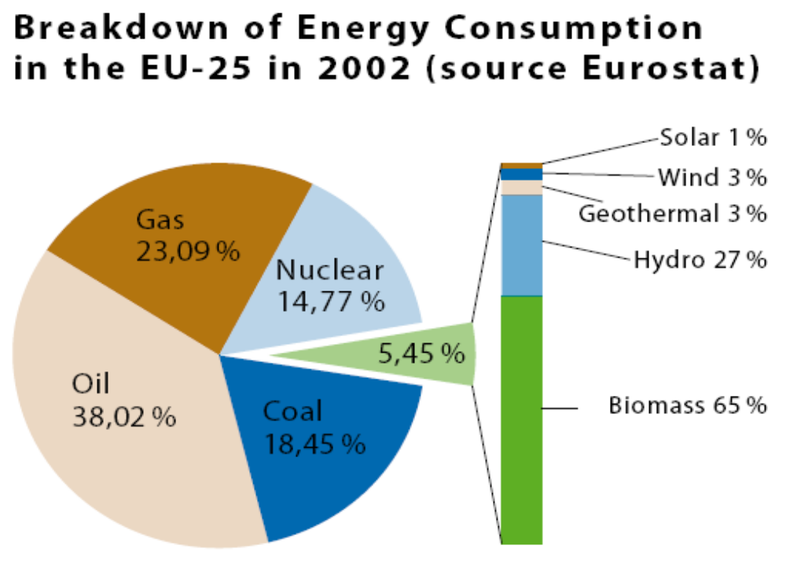
Source: Commission, Fact Sheet on Biofuels, 2006

Slide 4
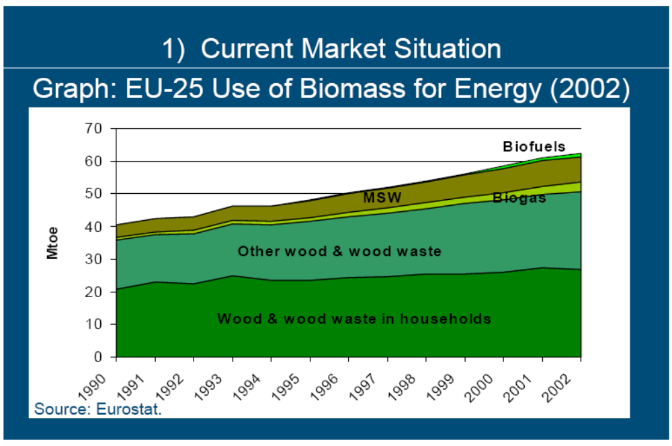
Source: Banse, 2007

Slide 5
Main questions
What is economic viability of biofuel production?
What polices are in place to promote production and use of biofuels?
What will be effect of biofuels on agricultural land use and markets?
Are current biofuels policies sensible?
  In terms of economic efficiency, climate change, world hunger, trade and the environment
What are challenges for the future?

Slide 6
Reading suggestions
Vast and growing literature
Commission documents
NGO and interest group documents
Impact on agricultural markets (Schmidhuber, OECD, IFPRI)
Surveys (Bamière et al., World Bank)
Reviews of policies (Global Subsidies Initiative, Commission annual progress reports)

Slide 7
Main bioenergy feedstocks
Wood
  Forest management residues
  Fuel timber
Crops
  Annual (cereals, oilseed rape, sugarbeet)
  Perennial (miscanthus, reed canary grass, short rotation coppice)
Wastes
  Straw
  Animal manure
Source: Mortimer, 2007

Slide 8
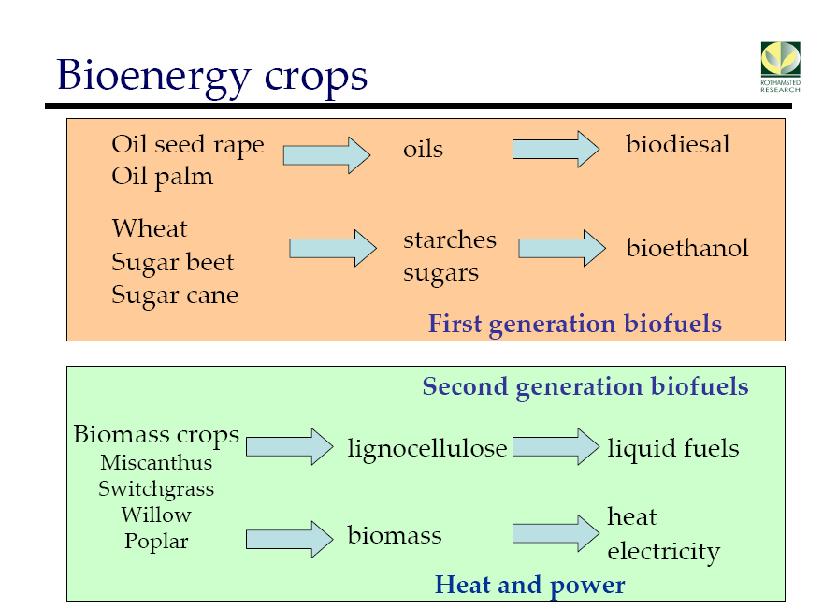
Source: Karp, Rothamsted Research, 2007

Slide 9
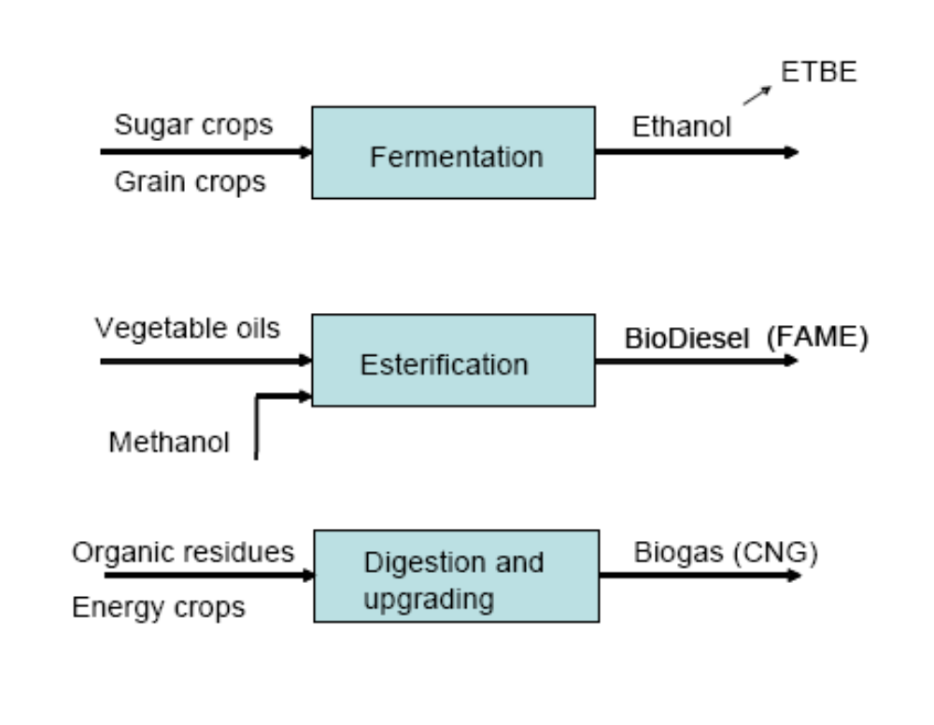
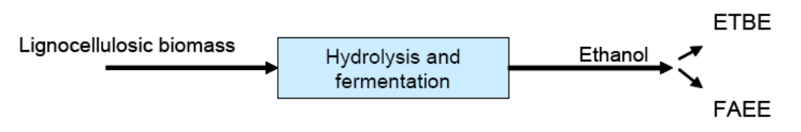
Biofuel transformation processes
First generation
Second generation

Slide 10
Biofuel uses
Bioethanol
  Used as neat ethanol (E95, blend of 95% ethanol and 5% water)
  Used as E85 (85% volume ethanol with petrol) in flex-fuel vehicles
  Used as blend smaller than 5% volume (E5) in ordinary petrol or as its derivative ETBE
Biodiesel
  Current maximum 5% in diesel blends, otherwise can only be used in modified diesel engines
Current 5.75% EU target cannot be met with ordinary blends of petrol and diesel
  Need for separate infrastructure (pumps, storage, delivery for E85 and biodiesel or pure plant oil)

Slide 11
Production and trade trends
Brazil (sugar) and the US (maize) are the leading producers of ethanol
EU (esp. Germany) is leading producer of biodiesel (rapeseed) although production in the US (soybean) is rising
Malaysia and Indonesia are increasing production of biodiesel from palm oil
Very limited trade in biofuels to date, mainly some Brazilian bioethanol to EU

Slide 12
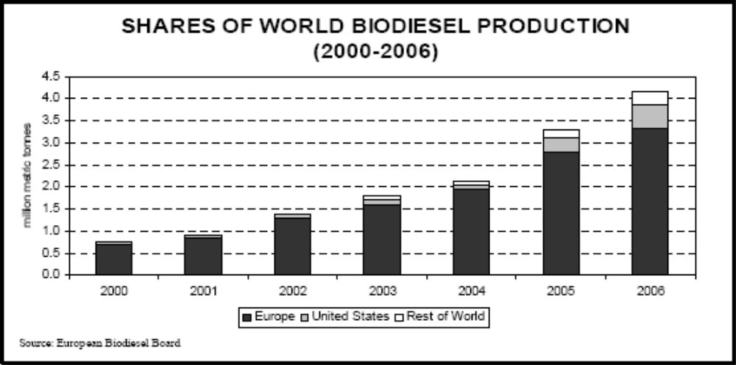
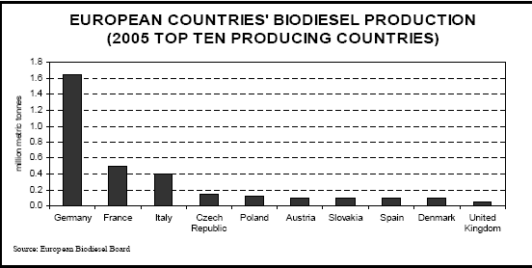

Slide 13
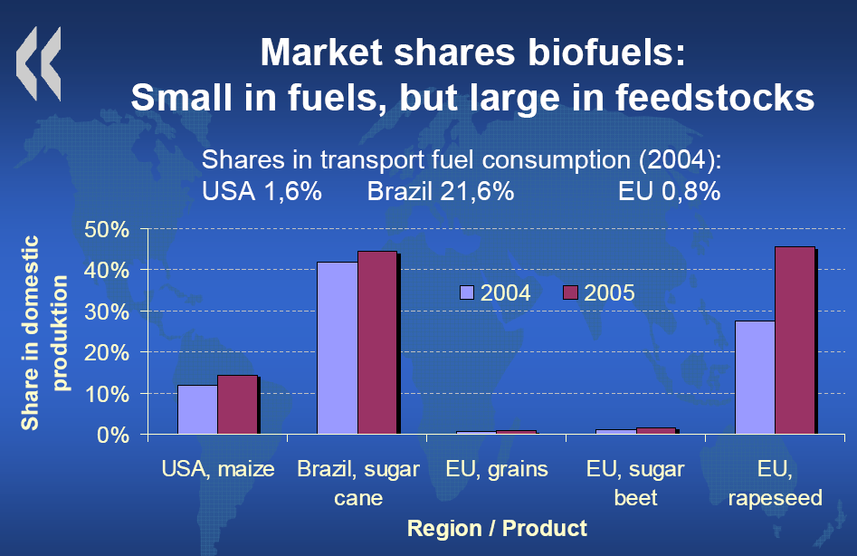
Source: von Lampe, OECD, 2007

Slide 14
Economics of biofuel production
The rise in oil prices is the most important factor boosting the competitiveness of alternative fuels, including biofuels.
  future outlook for oil prices?
Feedstock costs are the most significant cost of biofuel production, up to 40-50% for US corn based ethanol, 80% for EU biodiesel from rapeseed.
Energy is also a major cost component, up to 20% of biofuel operating costs in some countries.
The sale of byproducts, such as dried distillers’ grains, also contributes to a biofuel plant’s profitability.
The ratio of crude oil prices to feedstock prices offers a simple indicator of the competitiveness of biofuel made from various feedstocks.

Slide 15
Economics of biofuel production
Past economics very influenced by subsidy contribution…
…but higher crude oil prices make competitive production more likely
Qualifications
  Increased biofuel production as well as higher energy costs will push up feedstock costs
  As production grows, the market contribution of by-products may diminish as outlets become satiated
  The difficulties facing German biodiesel production in 2007 provide a cautionary example

Slide 16
II. Policies to support biofuels

Slide 17
Instruments for supporting biofuels
biofuel blending obligations (mandates)
excise duty exemptions
tariff protection
crop (feedstock) subsidies
R&D and investment supports
fuel standards

Slide 18
III. Impacts on land use and agricultural markets

Slide 19
Impact on agricultural markets
How large will be potential demand from energy markets for agricultural products? Will it be large enough to reverse the secular decline in real food prices?
While large technical potential for biomass exists, food prices cannot rise faster than energy prices in the longer term (ceiling price effect)

Slide 20
Floor and ceiling price effects (Schmidhuber 2006)
Agricultural prices always affected by energy prices
Initially largely through higher input costs But as fossil fuel energy prices reach or exceed the energy equivalent of agricultural products, energy market creates demand for agricultural products
Higher energy prices now affecting output prices
OECD estimates show that the effect of oil prices on production costs is comparatively much stronger than that on increased demand for biofuel, but results are sensitive to oil price.

Slide 21
Floor and ceiling price effects (Schmidhuber 2006)
Given large (elastic) demand from energy market with competitive agricultural feedstocks, energy market creates a floor price for agricultural products
Fossil fuel prices also create a ceiling for competitive feedstocks whose price cannot rise faster than energy prices without pricing themselves out of the energy market
Floor and ceiling prices together create a price corridor for agricultural products
Market integration is not complete in practice due to logistical and technical problems
  Apart from Brazilian cane-ethanol complex

Slide 22
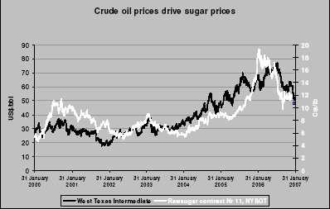
Sugar prices track oil prices above US$35/barrel
Source: Schmidhuber 2006

Slide 23
Differential price effects on agricultural markets
Food price increases will be neither open-ended nor uniform
Agricultural products will be affected differently depending on
  Their break even or parity point
  Balance of energy and protein content
  Bioenergy demand is limited to the energy content of feedstocks, creating additional supply of protein-rich by-products
  Protein prices are likely to rise less rapidly than energy prices and could even fall in absolute terms

Slide 24
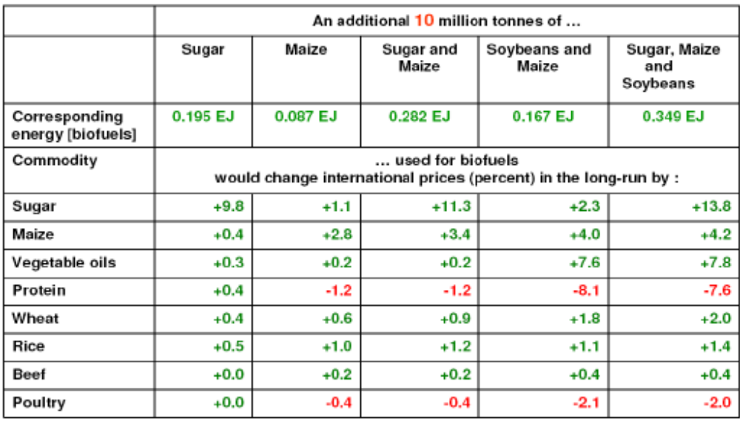
Differential price effects of different bioenergy scenarios
Source: Schmidhuber 2006

Slide 25
Agricultural market effects
With greater share of maize and other markets characterised by inelastic demand (e.g. through biofuel mandates) which is also tied to crude oil prices, together with smaller stocks, increased agricultural crop price and market volatility can be expected

Slide 26
Agricultural market effects
Various empirical studies
  Commission, Impact assessment of 10% biofuels target
  See review of studies in Rajagopal and Zilberman, 2007
Specific results no longer very valuable because of low crude oil price assumptions

Slide 27
Food price effects
First round impact approximated by (change in price of raw ingredient) x (share of food item price represented by that ingredient)
Example (US data)
  Maize is 38% of cost of producing pigmeat, and pigmeat is 28% of final retail price of pork
  Suppose ethanol demand increases maize price by 50%
  Price of pork would then increase by 5.3%
  Overall, doubling of feed grain and oilseed prices would increase food prices by less than 4%

