Slide 1
STEROID
SECONDARY SEX CHARACTERISTICS
CHEMICAL CONTROL
ANTIINFLAMMATORY

Slide 2
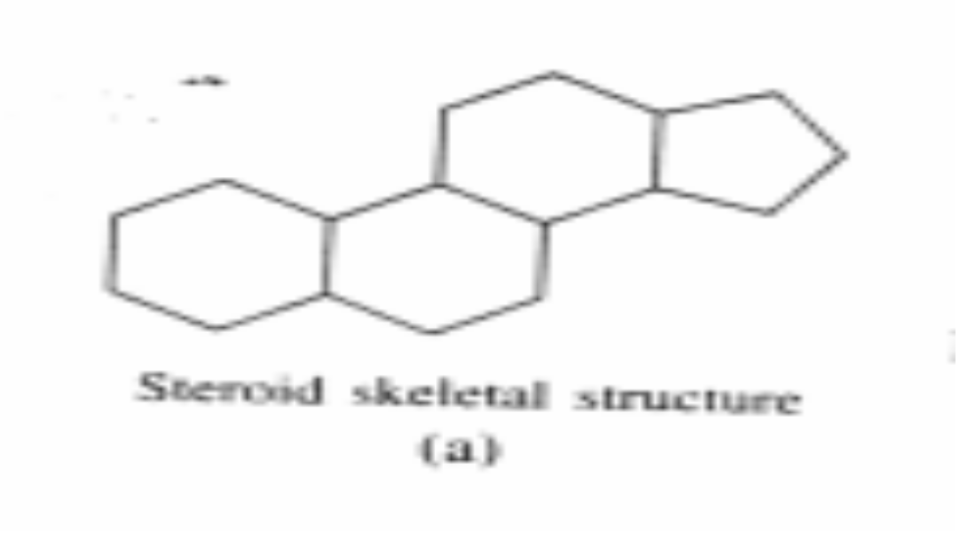
STEROID STRUCTURAL CHARACTERISTICS:
Structure is based on the ring structure below:

Slide 3
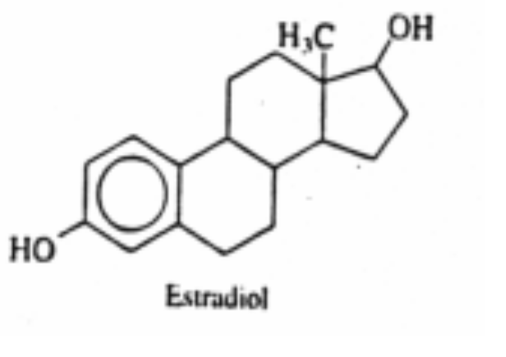
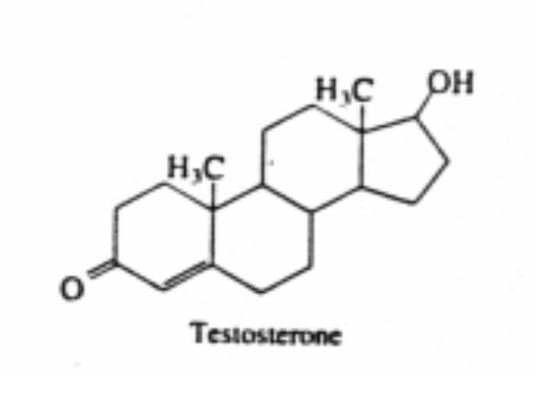
SMALL STRUCTURAL DIFFERENCES HAVE PROFOUND CONSEQUENCES
Estradiol
Testosterone

Slide 4
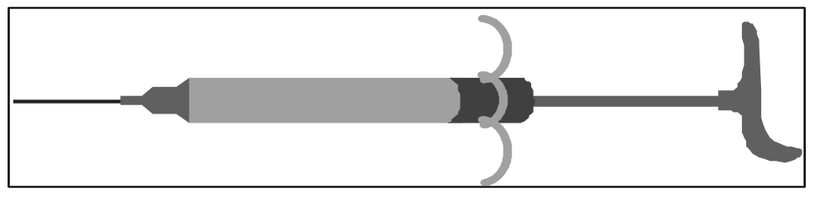
ANDROGENS-1
Produce secondary sex characteristics of males.
Used For:
Muscle Building
Testosterone Replacement

Slide 5
SIDE EFFECTS/ MEN / ANDROGENS
Blood Clotting
Testicular Atrophy
Difficulty in urinating
Male Pattern Balding
Decreased Sperm Production
Impotence
Hypertension

Slide 6
SIDE EFFECTS / MEN / ANDROGENS:
Insulin Resistance
Inability to Ejaculate
High Cholesterol
Fluid Retention
Heart Attack
Risk of Kidney Disease Increased
Mental Disorders (Roid Rage)

Slide 7
ANDROGEN SIDE EFFECTS / WOMEN
Enlargement of Clitoris(1)
Loss of Body Curves
Deepening of Voice
Menstrual Problems
Irreversible Pattern Baldness

Slide 8
ESTROGENS, PROGESTINS- BIRTH CONTROL PILLS
Can control male as well as female fertility- dropped as male pill
Use as male pill dropped when one man was found to have testicular atrophy*
Three women died- the formula was changed and the tests proceeded!!*
In women, the pill simulates pregnancy
*From Dr Ellen Grant “The Bitter Pill”

Slide 9
PILL
“ According to the Western model, pregnancy is a disease, menopause is a disease, and even not getting pregnant is a disease. Dangerous drugs and devices are given to women, but not to men-just for birth control. I’ve reached the conclusion that to many doctors being a woman is a disease.” (Italics are the author’s)
P. xi, Seaman, B, (see references)

Slide 10
.
PILL
The modern pill has a combination of synthetic estrogen and progestin.
In combination these drugs influence the pituitary gland in such a way as to prevent ovulation and therefore fertility.
There are slight variations in administration and effect, but the drugs all chemically induce sterility.
.

Slide 11
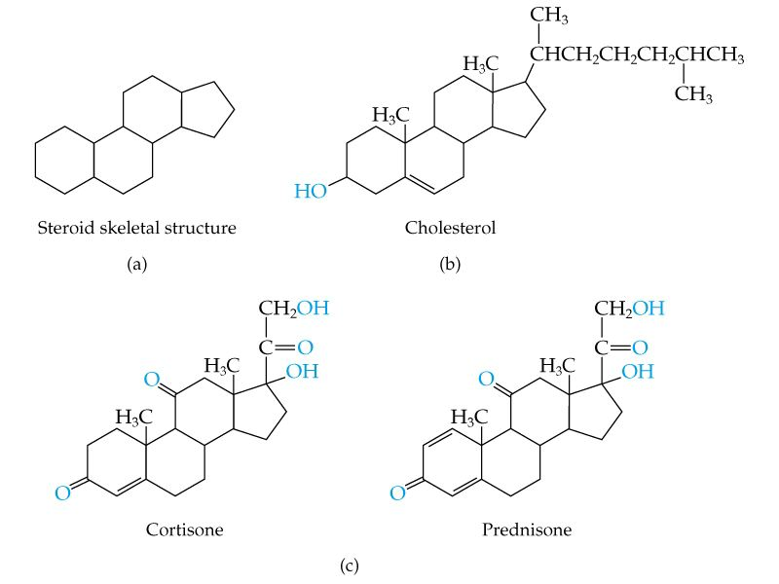

Slide 12
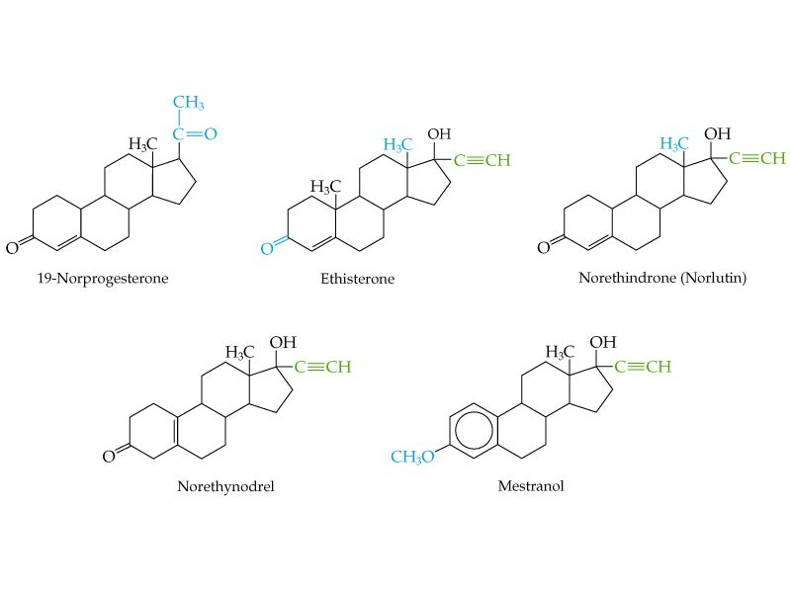

Synthetic Hormones Used In Pills

Slide 13
PROBLEMS WITH THE PILL
“Minor” include: weight gain, nausea, allergic rash, dizziness, headache, facial skin pigment change, problems w/contact lenses, aggravation of varicose veins, mental depression, irregular menstrual flow*.
“Major” include: blood clots, thromboembolism, zinc deficiency, possible cancer (esp. teens), hypertension, increase of blood cholesterol, poor glucose tolerance, vit. B6 deficiency, bleeding liver tumors (rare)*.
Dr Ellen Grant, “Sexual Chemistry”

Slide 14
ESTROGEN THE VILLAIN?
Estrogen clearly causes cancer of the reproductive tract in animals; difficult to prove in humans.
Perhaps also skin and breast cancer
Blood clotting/ approx. 1 in 2000 women hospitalized each year; pill users twice as likely to have a stroke as non-users.
Not recommended for use with these conditions: suspected pregnancy, history of heart problems, irregular periods, diabetes, hypertension, high cholesterol, smoking.

Slide 15
ESTROGEN/ WARNING:KNOWN CARCINOGEN
Sex hormones known as steroidal estrogens recognized as carcinogens .
These include those used in birth control pills and hormone replacement therapy.

Slide 16
Estrogen is a Carcinogen
Estrogens that are used in hormone replacement therapy and birth control pills are carcinogens.
The National Institutes of Health deemed on 11 Dec 2002 that ALL hormones in this class are moved from probable carcinogens be classified as carcinogens.

Slide 17
Pill
The original reason for development of the pill was not primarily to free women, it was to rid the world of “undesirables” -the dream of the moneyed elite and (based on the Auschwitz evidence) the Nazis.
The New Scientist points out that the World Bank calls population control “the most cost effective form of development aid”

Slide 18
Additional News/Steroid Related
Full term pregnancies spur tumor suppressor chemical .Breast cancer reduced when naturally occurring steroids produced during pregnancy induce a cancer protecting protein named p53.

