Slide 1
PROKARYOTIC CELL : ( Bacteria) They lacks well defined nucleus and possess simple structure.
2) EUKARYOTIC CELL: (Animals and Plants) Possess a well defined nucleus and and more complex in their structure and function.
1

Slide 2
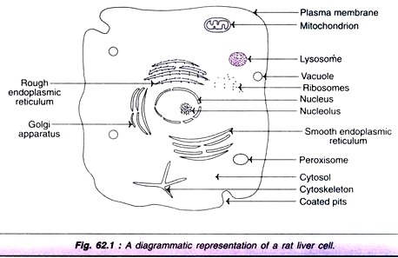
RAT LIVER CELL

Slide 3
NUCLEUS
1) Nucleus is the largest cellular organelle, surounded by a double membrane nuclear envelope.The outer membrane is continuous with the membrane of Endoplasmic reticulum.
2) The pores permit the free passage of the products synthesized in the nucleus into the surrounding cytoplasm.
3) Nucleus contains DNA, the repository of genetic information.
4) DNA is associated with basic protein( histones) to form NUCLEOSOMES.
5) The nucleus contains a dense body known as NUCLEOLUS which is rich in RNA.

Slide 4
MITOCHONDRIA
1) Centre for cellular respiration and and energymetabolism
2) Regarded as POWERHOUSE of the cell
3)The mitochondria are composed of a double layer membrane.The outer membrane is smooth and completely envelopes the organelle.The inner membrane is folded to form cristae.The internal chamber of mitochondria is known as MATRIX or MITOSOL.
4) ATP, Energy currency generated in mitochondria and is exported to all parts of cell
5) Mitochondrial matrix contains a circular double stranded DNA , RNA and Ribosomes.

Slide 5
ENDOPLASMIC RETICULUM
1) The network of membrane enclosed spaces that extends throughout the cytoplasm constitutes the ENDOPLASMIC RETICULUM (ER)
2)ROUGH ENDOPLASMIC RETICULUM – A large portion of ER studded with RIBOSOMES to give granular apperance.Ribosomes are the factories of protein biosynthesis
3) SMOOTH ENDOPLASMIC RETICULUM – does not contain RIBOSOMES.It involved in synthesis of LIPIDS( triacylgycerols,phosphoplipids,sterols)

Slide 6
GOLGI APPARATUS
1)Unique clusters of membrane vesicles
2)Involved in Membrane synthesis for formation of intracellular organelles ( e.g. peroxisomes,lysosomes)

Slide 7
LYSOSOMES
1)Lysosomes are spherical vesicles enveloped by a single membrane
2) Lysosomes are regarded as DIGESTIVE TRACT of the cell
3) Lysosomal enzymes are cateogries as HYDROLASES. These includethe enzymes glycosidase ( glycogen), cathepsins(proteins), lipase( lipids), ribonucleases(RNA).

Slide 8
PEROXISOMES
1)They are single membrane cellular organelles.There are spherical or oval.
2)The contain enzyme CATALSE.Catalase protect the cell from toxic effects of H₂O₂ by converting it to H₂O and O₂.
3) Involved in long chain fatty acid oxidation and synthesis of PLASMALOGENS and GLYCOLIPIDS
4)Zellweger Disease- Absence of Peroxisomes

Slide 9
CYTOSOL OR CYTOSKELETON
The cellular matrix is collectively known as CYTOSOL.It is basically a compartment containing several enzymes,metabolites and salts in an aqueous gel like medium.

Slide 10
APOPTOSIS
Apoptosis is the programmed cell or suicide.This occurs when cell has fulfilled its biological functions. Apoptosis may be regarded as natural cell death and it differs from the cell death caused by injury due to radiation.

