Slide 1


Submitted To:-
Dr. Pankaj Nagar
Submitted by:-Akash Rai

Slide 2
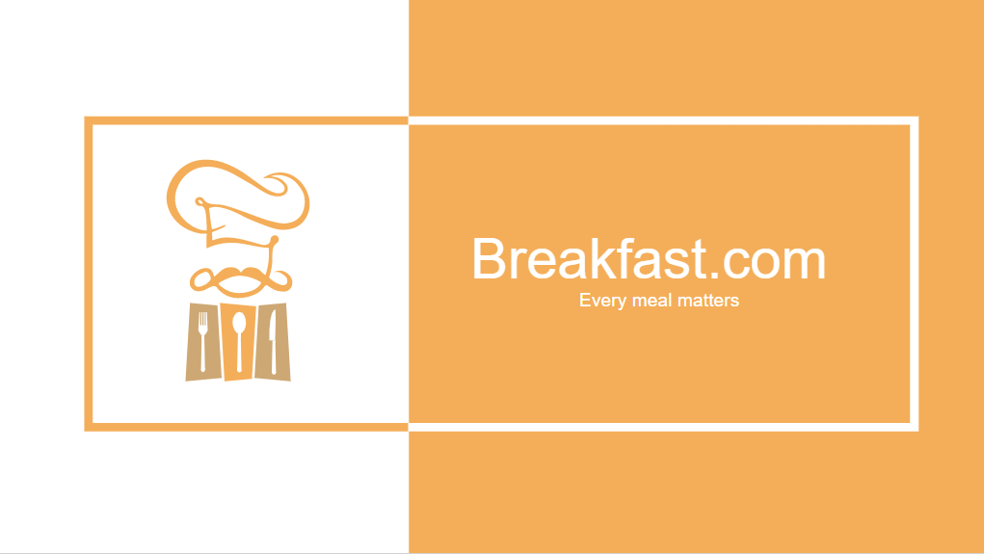

Slide 3
CONTENTS
Company Profile
Abstract
Introduction
Technologies
Working
Conclusion

Slide 4
COMPANY PROFILE
NetParam Technologies Pvt. Ltd. is an IT solution providing a wide assortment of services including website development, web design, E-commerce online solutions, web applications, Mobile Application, Search engine optimization services to exceed the confidence of both small and large enterprises.
It is commenced operating with only two things in mind, innovation and quality NetParam Technologies Pvt. Ltd is the best web and mobile app development company to transform your business through the power of best enterprise IT solutions that comprises of the full range of mobile applications development, web and eCommerce development services.

Slide 5
Abstract
Building a ecommerce website with the help of python with django.
Django, an open source Python web framework that saves you time and makesweb development fun. It's aimed at Computer Science instructors who want to teach how to build elegant web applications with minimal fuss. Django follows the Model-View-Controller (MVC) architectural pattern. Its goal is to ease the creation of complex, database-driven websites.
Python is used throughout, even for settings, files, and data models. Topics that will be covered during the workshop include: setup and configuration, template language, and database integration through object-relational mapping.

Slide 6
Introduction
So,Breakfast.com is a ecommerce website for food delivery directly from famous restaurants with in the reach from location.
Website is provided with Online payment gate way through which a customer can pay their bill online with debit card and paytm
This system is enabled by the internet – it is the internet that connects the restaurant or the food company on one hand, and the customer on other hand
This system for online food delivery is completely safe, secure and is a very popular method that is revolutionizing the way in which the food industry operates

Slide 7
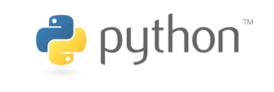
Technologies
Python is an interpreted, high-level, general-purpose programming language. Created by Guido van Rossum and first released in 1991, Python's design philosophy emphasizes code readability with its notable use of significant whitespace.
It can be use for web development purposes.
In this project we used Django python based web framework

Slide 8
Django is a high-level Python Web framework that encourages rapid development and clean, pragmatic design. Built by experienced developers, it takes care of much of the hassle of Web development, so you can focus on writing your app without needing to reinvent the wheel. It's free and open source.
Ridiculously fast:-
Django was designed to help developers take applications from concept to completion as quickly as possible.
Reassuringly secure:-
Django takes security seriously and helps developers avoid many common security mistakes.
Exceedingly scalable:-
Some of the busiest sites on the Web leverage Django’s ability to quickly and flexibly scale.

Slide 9
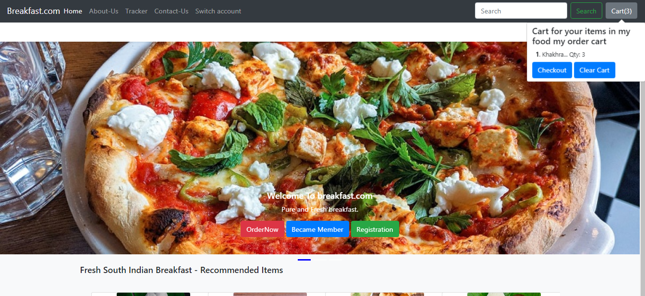
Working
This is home window of our website

Slide 10
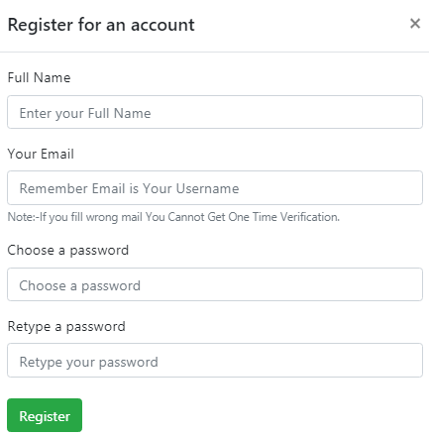
This is the registration window through which a user register himself or herself

Slide 11
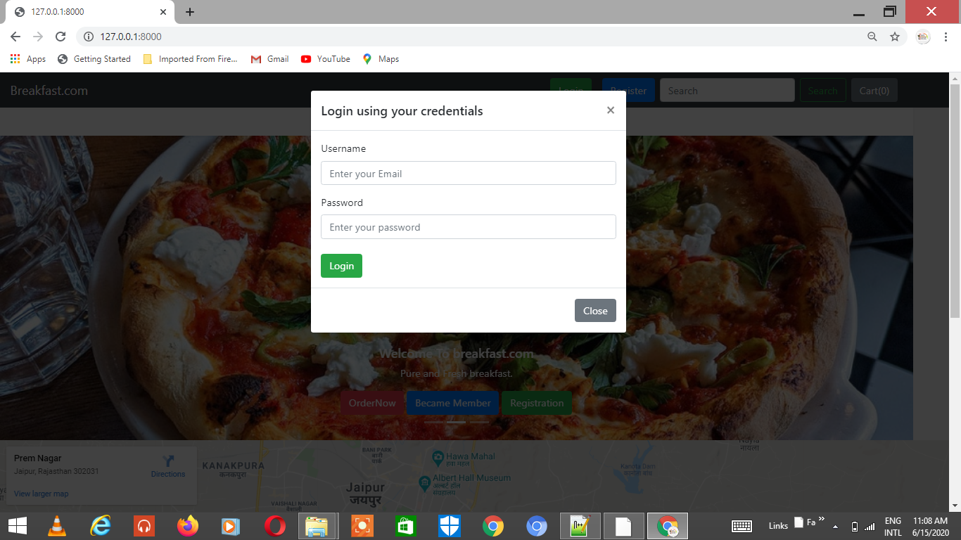
After Registration of new User he will login

Slide 12
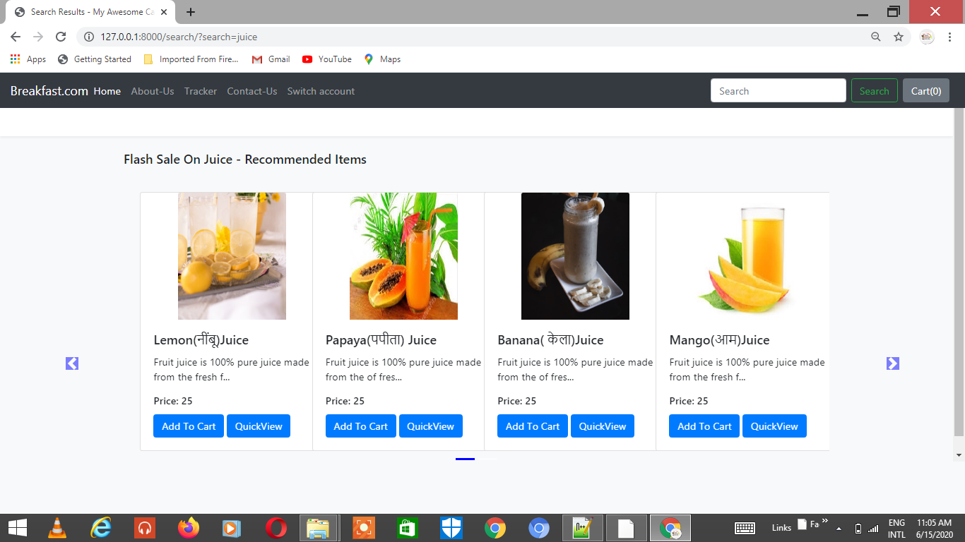
Items available to add in cart for final checkout

Slide 13
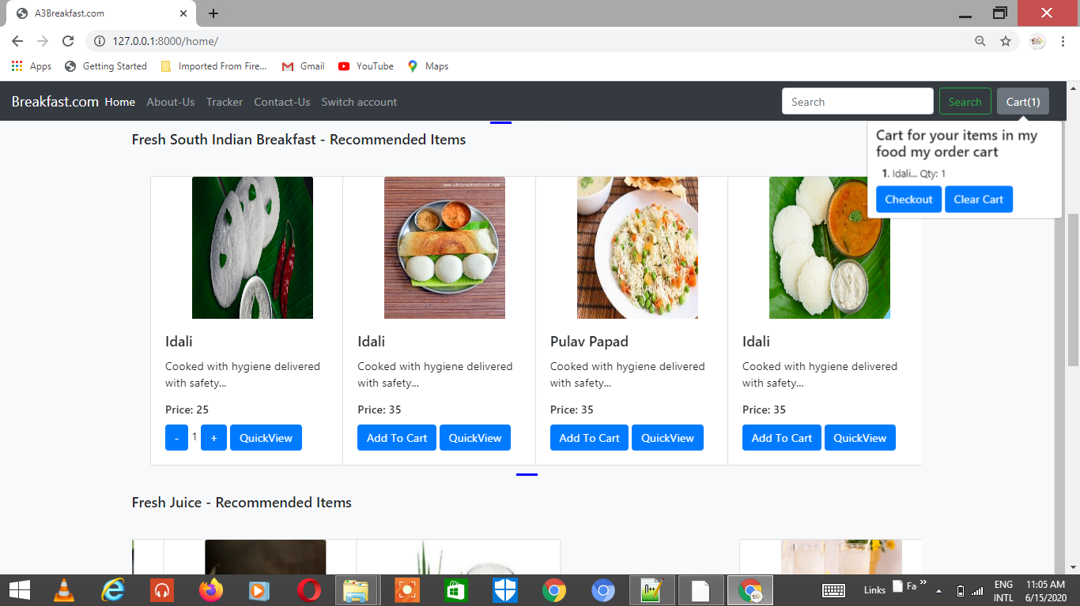
Different meals

Slide 14
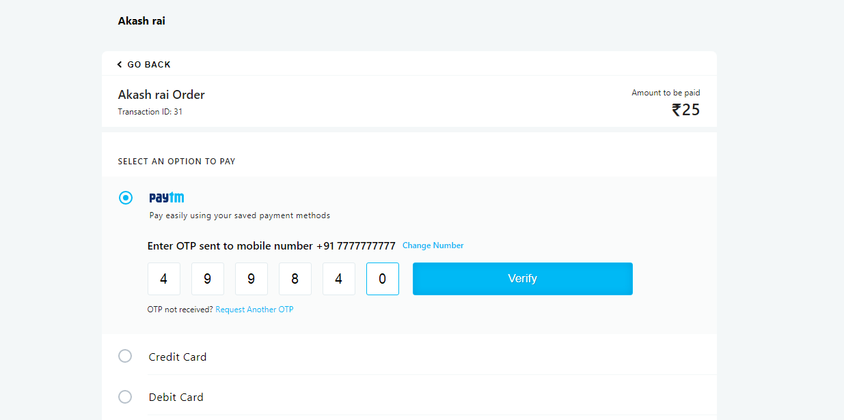
After ordering the food from your favourite restaurant,you can pay your bill via online gate way platform

Slide 15
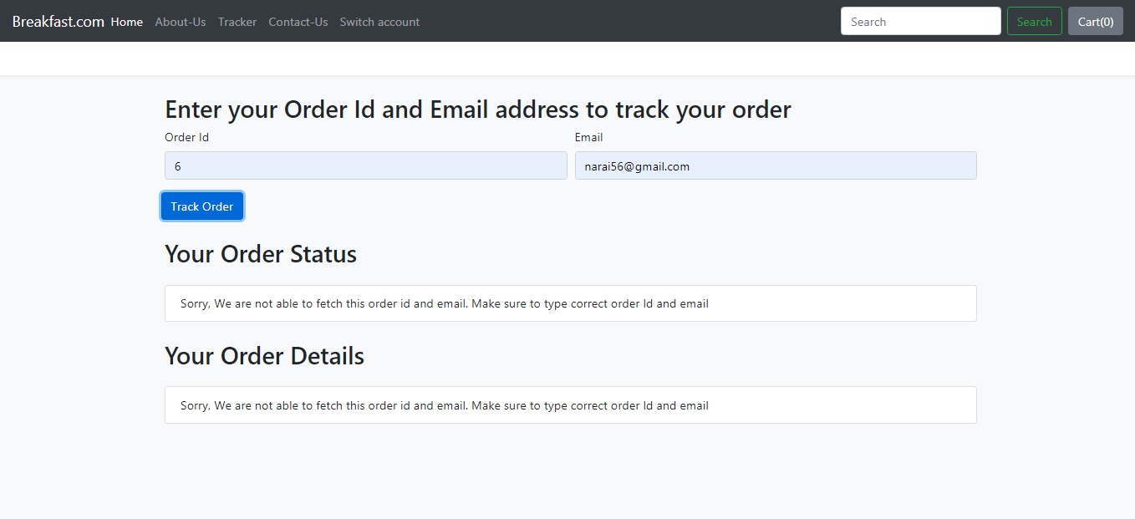
You can also track your order through this feature

Slide 16
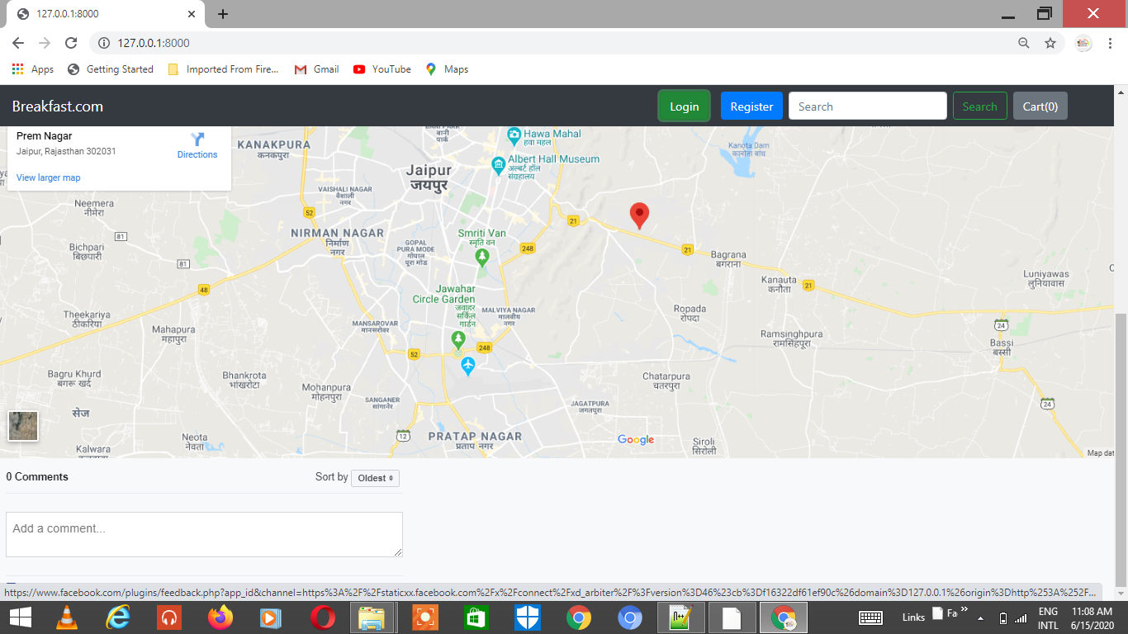
From here we can track order status by entering email and order id.

Slide 17
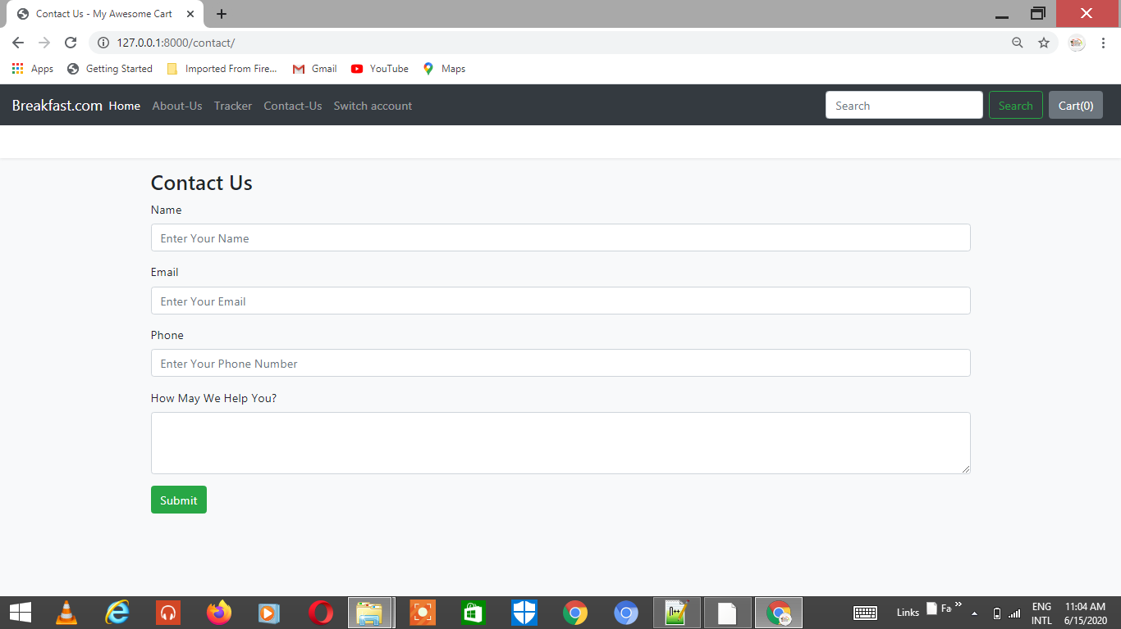
Customer care and support

Slide 18
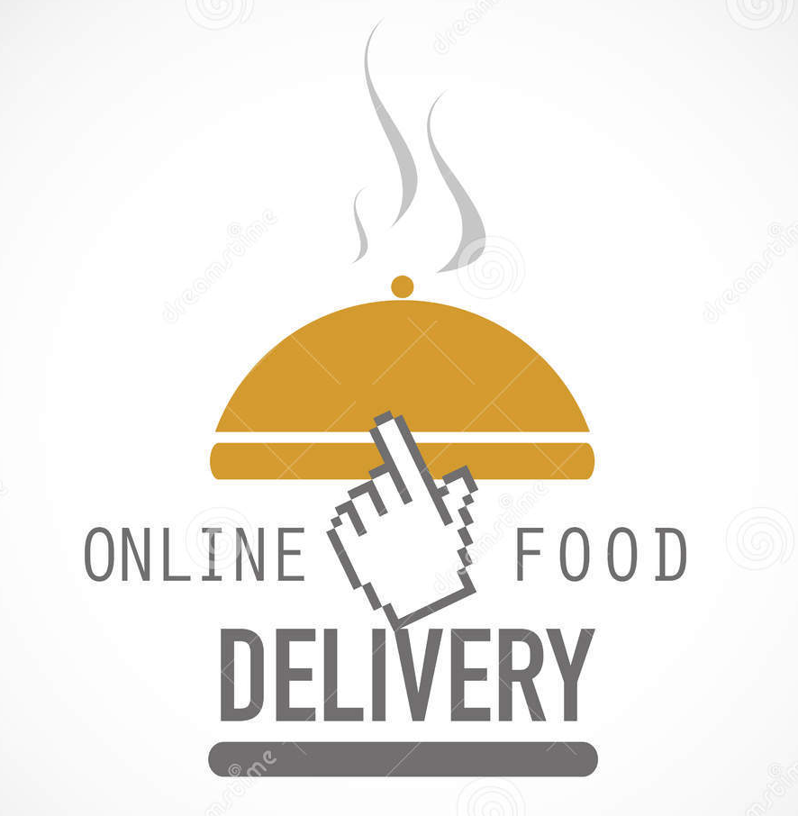

Thank you
Any questions???

