Slide 1
TRACE
T
See your JavaScript run, one step at a time
Project by
P. Akash and Manoj
Notes:
TRACE is a JavaScript execution visualizer built by P. Akash and Manoj. It runs a program step by step and shows what every line does.

Slide 2
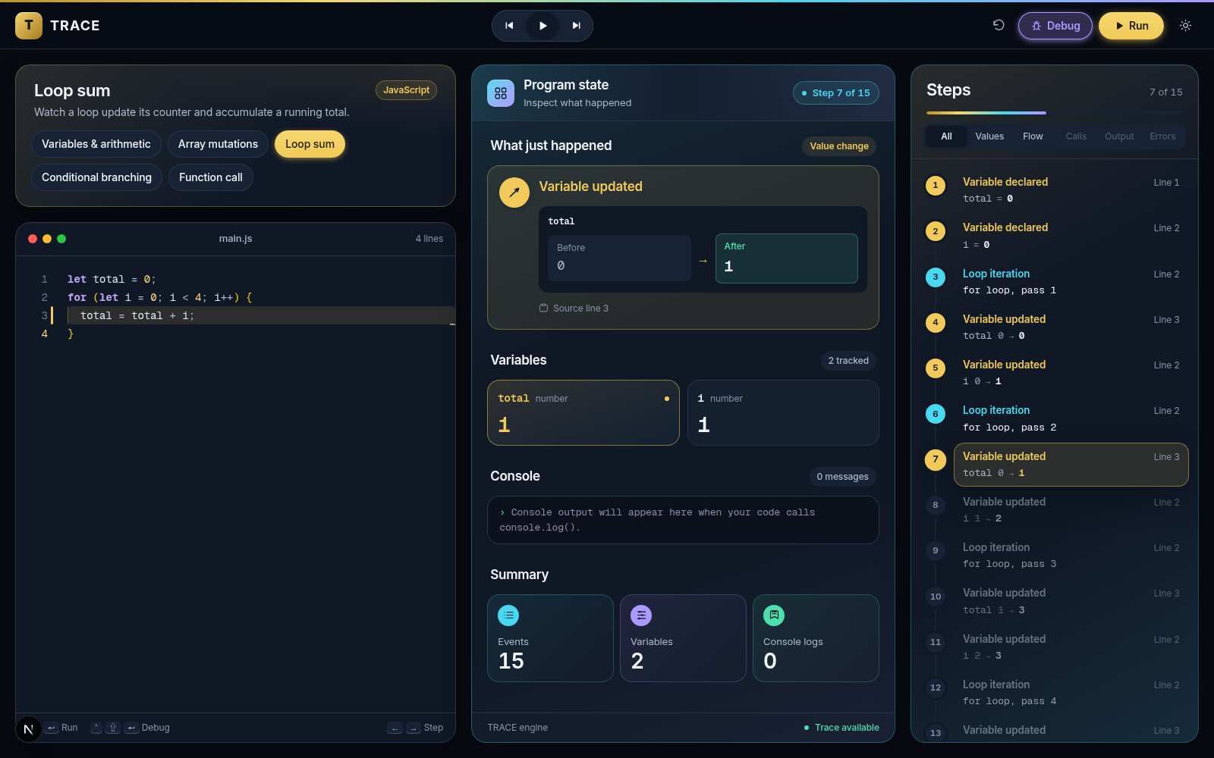
What TRACE does
Beginners see only a program's final output. Loops, conditions and array changes happen out of sight.
TRACE runs your code step by step and shows:
which line ran
what changed, from what to what
every value, at every moment
what was printed
Loop sum example, paused at step 7 of 15
Notes:
Left: the problem and what TRACE shows. Right: the real app mid-run, with code, program state and the full steps list.

Slide 3






Objectives
Make execution visible
Explain each step
Show program state
Show every step a program takes, not only the output
Plain words, like "total 0 → 1"
Every variable and array after each step
Control time
Link steps to code
Fail safely
Run, step forward, step back, play and pause
Highlight the exact source line of each step
Errors with line numbers; stop infinite loops

Slide 4





How it works
1. Code
2. Parse
3. Execute
4. Record
5. Show
Typed in the Monaco editor
Babel turns code into an AST
Custom interpreter walks the AST
An event and a snapshot per step
Editor, state and Steps sidebar
Key idea: the program runs once and every step is recorded. Next, Back and Play only choose which recorded step to show, so stepping backward is instant. Safety limits: 5,000 steps and 100 nested calls.

Slide 5








Tech stack used
Next.js 16
React 19
Tailwind CSS 4
Monaco Editor
Framework and routing
Components and state
Styling and themes
VS Code editor in the browser
@babel/parser
Interpreter
anime.js 4
JavaScript
Code → syntax tree (AST)
Custom step-by-step engine
Spring animations
ES2022+, linted with ESLint

Slide 6






Future enhancements
Correct block scoping
More JavaScript
More languages
let and const vanish when their block ends
Arrow functions, break, +=, array methods
Python, C and Java on the same UI
Call stack and memory
Accounts and sharing
Lessons and AI help
Frames and reference arrows for objects
Save programs, share a run by link
Guided tutorials and plain-language explanations

Slide 7
Thank you
Questions?
Project by
P. Akash and Manoj

