Slide 1

MICROSERVICES
-- #GREENLEARNER --

Slide 2
AGENDA
Application architecture – Monolithic
Application architecture - Microservices

Slide 3
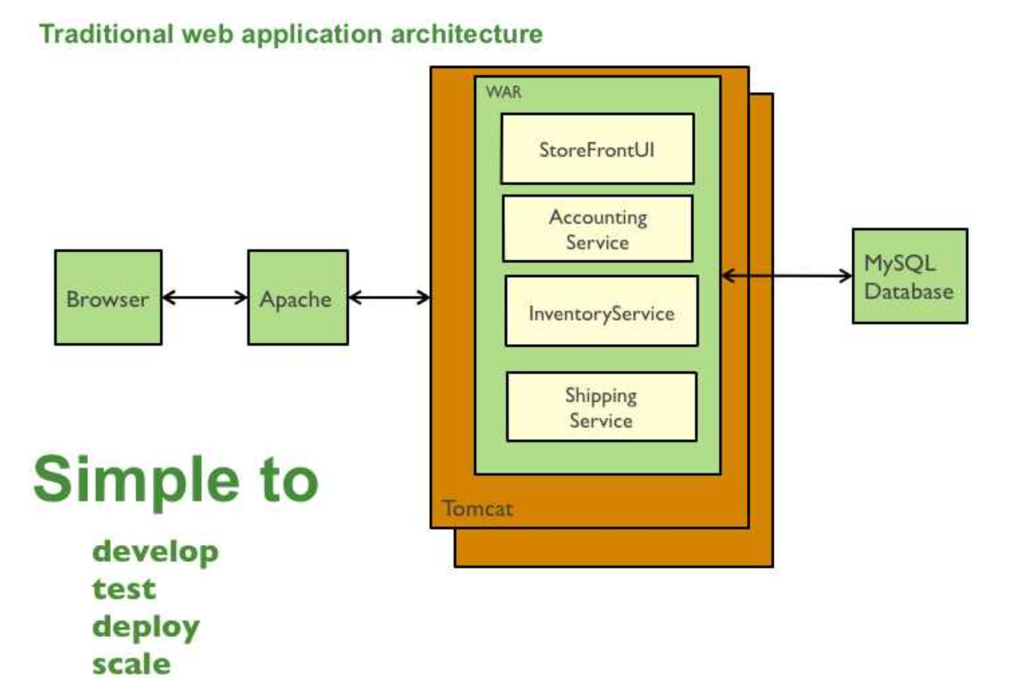
Monolithic ARCHITECTURE
Single jar/war file for whole application
Issues
Less flexible for large team and code base
Overload IDE
Continuous development is difficult
Scaling the app is difficult
Scaling development is difficult
Technology stack change is difficult

Slide 4
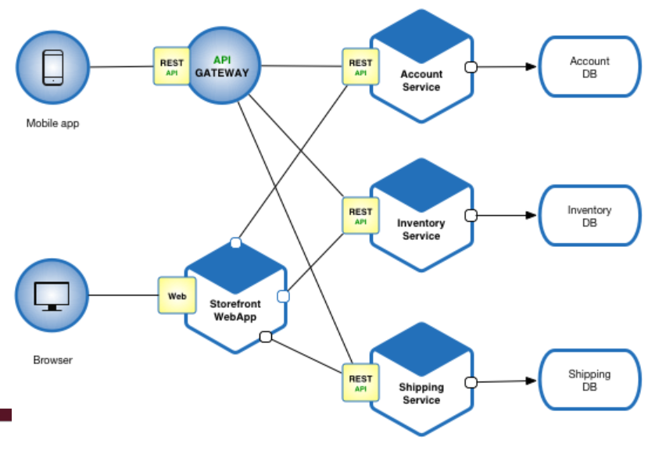
MICROSERVICE ARCHITECTURE
A set of loosely coupled, collaborating services. Each service is :
Highly maintainable and testable
Loosely coupled with other services
Independently deployable
Capable of being developed by a small team
Services can be developed independent of each other
Communication among service via HTTP/REST/AMQP

Slide 5
MICROSERVICES CHARACTERISTICS
Service granularity
Linguistic approach
Technologic agnostic
Some points
Microservices is a specialization of an implementation approach for service-oriented architectures (SOA) used to build flexible, independently deployable software systems.
Followed the introduction of DevOps
Strategy - “Do one thing and do it well”

Slide 6
REFERENCES
https://en.wikipedia.org/wiki/Microservices
https://microservices.io/
https://medium.com/hashmapinc/the-what-why-and-how-of-a-microservices-architecture-4179579423a9
https://www.redhat.com/en/topics/microservices

Slide 7
NEXT
REST API…

