Slide 1

REST API
-- #GREENLEARNER --

Slide 2
AGENDA
Web services
What is REST
REST architectural properties
REST architectural constraints
HTTP methods

Slide 3
Web Services
In a Web service, the Web technology such as HTTP—originally designed for human-to-machine communication—is utilized for machine-to-machine communication.
More specifically for transferring machine-readable file formats such as XML and JSON.
Web service commonly provides an object-oriented Web-based interface to a database server, utilized by another Web server, or by a mobile app, that provides a user interface to the end user.

Slide 4
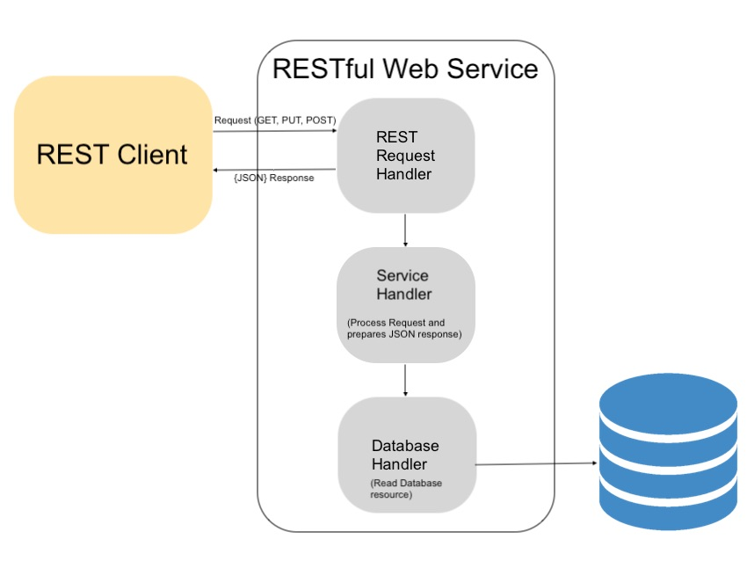
REST
Representational State Transfer
Software architectural style that defines a set of constraints to be used for creating Web services.
Provide interoperability between computer systems on the Internet
There is no "official" standard for RESTful Web APIs.
REST was first introduced by Roy Fielding in 2000.
REST full API is defined with following
Base URI e.g. - http://api.example.com/collection/
HTTP methods – get/put/post/delete/patch
A media type

Slide 5
REST Architectural properties
Performance – in component interactions
Scalability - allowing the support of large numbers of components and interactions among components
Simplicity – of a uniform interface
Modifiability - of components to meet changing needs
Visibility - of communication between components by service agents.
Portability - of components by moving program code with the data.
Reliability - in the resistance to failure at the system level

Slide 6
REST Architectural constraints
Restrict the ways that the server can process and respond to client requests.
If a system violates any of the required constraints, it cannot be considered RESTful.
Client-server architecture - separation of concerns
Statelessness - No client context being stored on the server between requests.
Cacheability - As on the World Wide Web, clients and intermediaries can cache responses.
Layered system - A client cannot tell whether it is connected directly to the end server.
Code on demand (optional)
Uniform interface - It simplifies and decouples the architecture, which enables each part to evolve independently.
Resource identification in requests
Resource manipulation through representations
Self-descriptive messages
Hypermedia as the engine of application state(HATEOAS)

Slide 7
HTTP methods
URI | Collection resource, such as https://api.example.com/collection/ | Member resource, such as https://api.example.com/collection/item3
GET | Retrieve the URIs of the member resources of the collection resource in the response body. | Retrieve representation of the member resource in the response body.
POST | Create a member resource in the collection resource using the instructions in the request body. The URI of the created member resource is automatically assigned and returned in the response Location header field. | Create a member resource in the member resource using the instructions in the request body. The URI of the created member resource is automatically assigned and returned in the response Location header field.
PUT | Replace all the representations of the member resources of the collection resource with the representation in the request body, or create the collection resource if it does not exist. | Replace all the representations of the member resource or create the member resource if it does not exist, with the representation in the request body.
PATCH | Update all the representations of the member resources of the collection resource using the instructions in the request body, or may create the collection resource if it does not exist. | Update all the representations of the member resource, or may create the member resource if it does not exist, using the instructions in the request body.
DELETE | Delete all the representations of the member resources of the collection resource. | Delete all the representations of the member resource.

Slide 8
Characteristics of HTTP methods
GET is read only.
PUT/POST/DELETE are idempotent, meaning that applying them multiple times to a resource result in the same state change of the resource as applying them once, thought the response is different.
The GET and POST methods are cacheable.
Unlike SOAP-based Web services, there is no "official" standard for RESTful Web APIs.
This is because REST is an architectural style, while SOAP is a protocol.
REST is not a standard in itself, but RESTful implementations make use of standards, such as HTTP, URI, JSON, and XML.

Slide 9
References
https://en.wikipedia.org/wiki/Representational_state_transfer
Images from google-image search

Slide 10
Next
RESTful web service with the help of Spring Boot technology

