Slide 1



A fault tolerance library for Java
!!An Introduction!!

Slide 2
What is it all about??
Resilience4j is a lightweight fault tolerance library inspired by Netflix Hystrix, but designed for functional programming
It uses only Vavr only
Vavr (formerly called Javaslang) is a functional library for Java 8+ that provides persistent data types and functional control structures.
Resilience4j provides higher-order functions (decorators) to enhance any functional interface, lambda expression or method reference with a
Circuit Breaker,
Rate Limiter,
Retry and
Bulkhead.
The advantage is that you have the choice to select the decorators you need and nothing else.

Slide 3
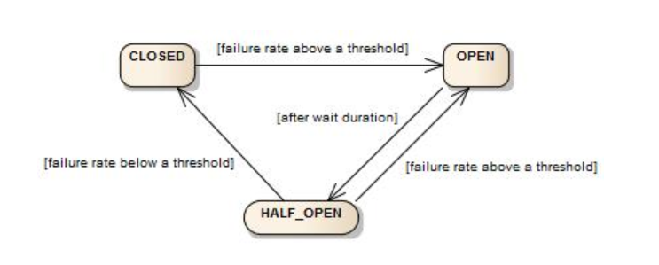
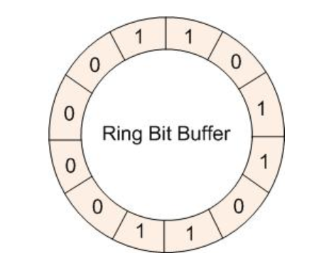
CircuitBreaker
The CircuitBreaker uses a Ring Bit Buffer in the CLOSED state to store the success or failure statuses of function calls.
Success function call – 0
Failure function call - 1

Slide 4
Bulkhead
Resilience4j provides two implementations of a bulkhead pattern that can be used to limit the number of concurrent execution:
A SemaphoreBulkhead which uses Semaphores
A FixedThreadPoolBulkhead which uses a bounded queue and a fixed thread pool.

Slide 5
RateLimiter
In computer networks, rate limiting is used to control the rate of traffic sent or received by a network interface controller and
It is used to prevent DoS attacks

Slide 6
Retry
To check the health status at regular interval

Slide 7
#3
Spring Boot + Annotations

Slide 8
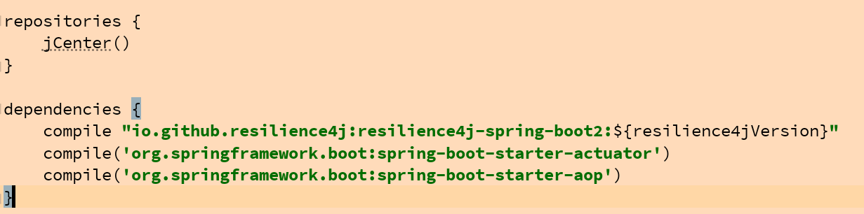
How to add the spring-boot-resilience4j
Gradle

Slide 9
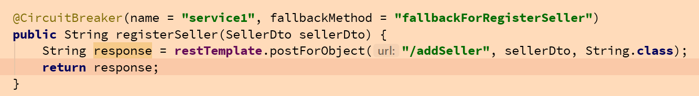
How to inject the circuit breaker point

Slide 10
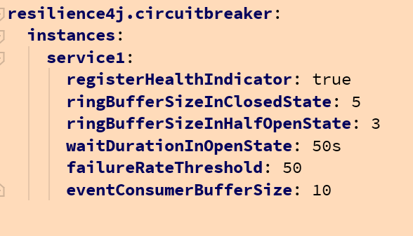
Custom configuration

Slide 11
Demo

Slide 12
Next..
Resilience4j Bulkhead

Slide 13
BulkHead

Slide 14
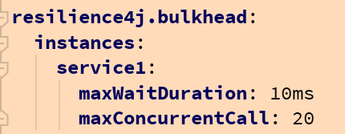
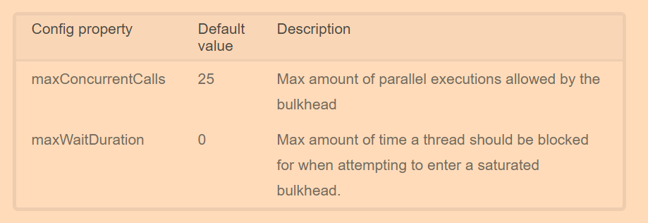
Bulkhead config details

Slide 16
RateLimiter

Slide 18
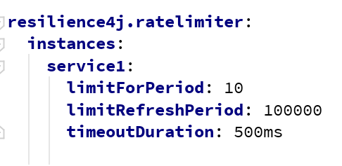
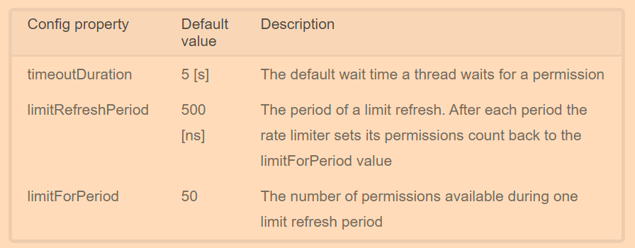
Config details

Slide 20
Retry

Slide 21
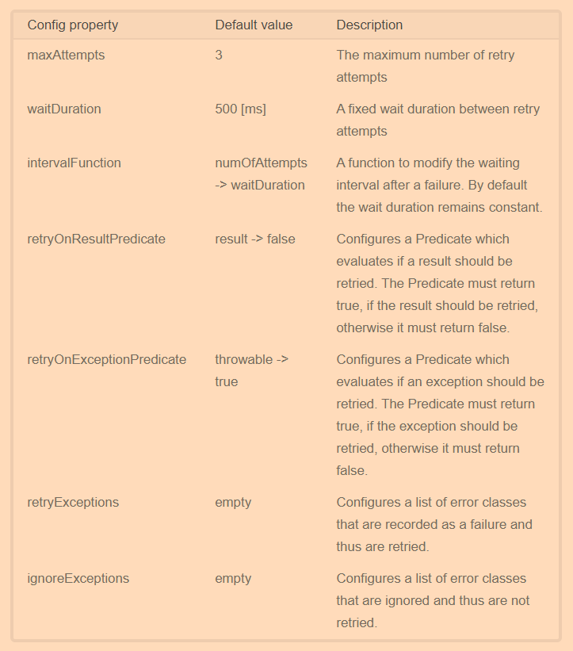
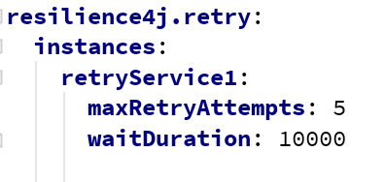
Config Details

Slide 22

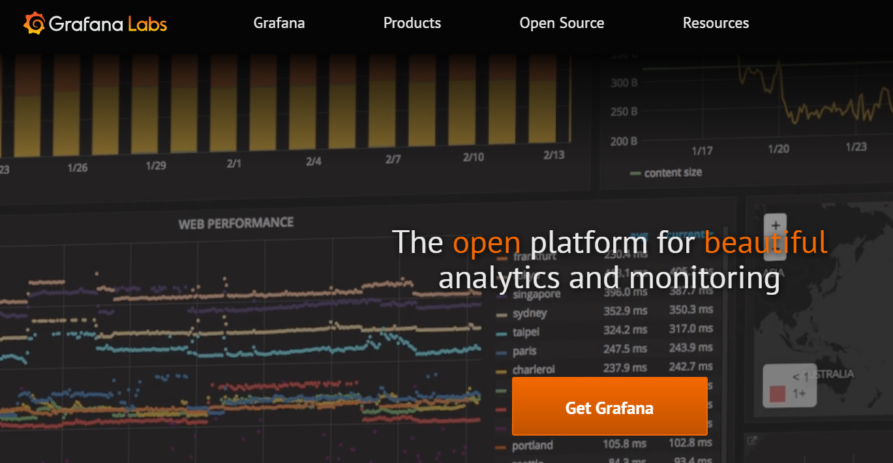


#2
Application Monitoring

Slide 23
References..
https://resilience4j.readme.io/docs/getting-started
https://www.vavr.io/vavr-docs/

