Slide 1
PROJECT REVIEW PRESENTATION
DermTrack Agent
AI-Assisted Non-Diagnostic
Dermatology Support System
TEAM MEMBERS
PROJECT GUIDE
Annam Akash · 23MIA1112
B. Hema · 23MIA1101
Dr. Abhishi Choudhury
DEPARTMENT
Integrated M.Tech CSE (BA)
2026 / INTRODUCTION

Slide 2
PROBLEM IDENTIFICATION
02 / DERMTRACK AGENT
The gap DermTrack addresses
Why this is difficult
THE CORE PROBLEM
01
Unstructured inputs
People struggle to interpret skin symptoms and decide what to do next. Online information is often fragmented, hard to verify, and unsafe without context.
Symptoms, history, and images arrive in different formats.
02
Evidence overload
Reliable medical information is scattered across sources.
03
Safety risk
A confident but unsupported answer can delay appropriate care.
04
Limited continuity
DERMTRACK'S RESPONSE
Structured intake + optional image observations + safety triage + trusted retrieval + consultation history.
Previous consultations and observations are hard to organize.
Supports informed next steps; it does not replace a dermatologist or issue prescriptions.

Slide 3
PROBLEM IDENTIFICATION
03 / DERMTRACK AGENT
Who needs it—and why it matters
TARGET USERS
DOMAIN
MOTIVATION
Patients seeking understandable guidance
Clinicians reviewing structured consultation context
AI-assisted dermatology support
Text + optional skin images + medical knowledge retrieval
Make first-line information more organized, explainable, privacy-conscious, and safety-aware
PRACTICAL RELEVANCE
EXPECTED IMPACT
A realistic workflow for collecting better consultation context, grounding answers in trusted sources, flagging warning signs, and preserving a usable history.
Improve access to understandable, evidence-linked support; encourage earlier professional attention when red flags appear; and reduce unsupported, overconfident health responses.
Expected impact is a design objective, not a claim of clinical effectiveness; validation with clinicians and real-world users remains future work.

Slide 4
LITERATURE REVIEW
04 / DERMTRACK AGENT
How the evidence was selected
The review connects DermTrack's implementation choices to research on dermatology AI, evidence grounding, fairness, and safe deployment.
01 DOMAIN EVIDENCE
02 SYSTEM METHOD
03 SAFETY + FAIRNESS
Dermatology image AI and multimodal models
Question: How well do image-based systems generalize?
RAG and medical language models
Question: How can responses be grounded in external knowledge?
Bias, explainability, and governance
Question: What must the system avoid claiming?
SELECTED SOURCE SET
Liu 2020 · Daneshjou 2022 · Yan 2025 · Zhou 2024
Lewis 2020 · Xiong 2024 · Zakka 2024 · WHO 2021
LITERATURE RUBRIC
Paper → Method → Dataset → Findings → Performance → Limitations
Peer-reviewed research is separated from surveys and organizational guidance.

Slide 5
LITERATURE REVIEW
05 / DERMTRACK AGENT
Dermatology AI: methods and evidence
These papers establish the opportunity while highlighting generalization, skin-tone fairness, and diagnostic-risk concerns.
Paper | Method | Dataset / evaluation | Major findings | Performance / evidence | Limitations
Liu et al. Nature Medicine (2020) | Deep-learning differential diagnosis from clinical skin images. | Clinical dermatology image datasets; internal and external evaluation. | Shows the feasibility of automated differential diagnosis across multiple skin conditions. | Strong reported image-classification results; clinician comparison included. | Dataset shift, image quality, subgroup coverage, and diagnosis-risk concerns.
Daneshjou et al. Science Advances (2022) | Evaluates dermatology AI across skin-tone groups using a curated clinical set. | DDI: Diverse Dermatology Images dataset; subgroup evaluation. | Performance disparities were observed across skin-tone groups. | Demonstrates that aggregate performance can hide subgroup underperformance. | Limited dataset size and representativeness; benchmark fairness ≠ clinical fairness.
Yan et al. Nature Medicine (2025) | Multimodal vision foundation model for clinical dermatology. | Multi-source dermatology image–text evaluations; model and clinician tasks. | Shows the promise of foundation-model transfer across dermatology tasks. | Reports benchmark and clinician-oriented evaluations; exact metrics require full-text extraction. | Foundation-model opacity, dataset bias, hallucination, and prospective validation needs.
Zhou et al. Nature Communications (2024) | Pre-trained multimodal LLM, SkinGPT-4, for dermatology image–text reasoning. | Dermatology image–text data and diagnostic evaluation tasks. | Demonstrates multimodal generation for dermatological descriptions and predictions. | Reports diagnostic and generation evaluations; not evidence of autonomous clinical safety. | Possible hallucinations, limited generalization, and diagnosis may overstate capability.
Comparison is based on the selected source's stated task and evaluation setting; benchmark success is not equivalent to clinical validation.

Slide 6
LITERATURE REVIEW
06 / DERMTRACK AGENT
RAG, clinical AI, and governance
These sources support DermTrack's grounded, privacy-conscious, non-diagnostic and human-supervised design.
Paper | Method | Dataset / evaluation | Major findings | Performance / evidence | Limitations
Lewis et al. NeurIPS (2020) | Retrieval-Augmented Generation combines a retriever with a generator. | Knowledge-intensive NLP benchmarks including open-domain QA tasks. | External evidence can complement parametric model knowledge. | RAG improved results on several knowledge-intensive tasks in the original study. | Retrieval quality, stale sources, irrelevant context, and unsupported synthesis.
Xiong et al. Findings of ACL (2024) | Medical RAG with domain retrievers, knowledge bases, and context construction. | MedQA, MedMCQA, PubMedQA, and other medical QA benchmarks. | Medical retrieval often improves QA, but configuration and corpus choice matter. | Benchmark accuracy improves in many RAG settings; not a clinical-safety metric. | Multiple-choice benchmarks do not measure triage, calibration, or patient harm.
Zakka et al. NEJM AI (2024) | Almanac: LLM connected to retrieved medical references and clinical tools. | Medical QA benchmarks plus expert assessment. | Grounding can improve factual support and clinical answer quality. | Reported gains over standalone generation in evaluated medical tasks. | Corpus coverage, retrieval errors, limited expert evaluation, and no deployment validation.
WHO (2021) Governance report | Ethical and governance framework for AI in health. | No experimental dataset; evidence synthesis and expert consultation. | Calls for human control, transparency, privacy, equity, and accountability. | No numerical performance; provides safety and governance requirements. | Normative guidance must be translated into concrete product controls and audits.
Comparison is based on the selected source's stated task and evaluation setting; benchmark success is not equivalent to clinical validation.

Slide 7
RESEARCH GAP
07 / DERMTRACK AGENT
What existing approaches still leave unresolved
The literature shows strong progress, but many systems solve only one part of the dermatology-support problem.
01
Image-only focus
02
Unsafe generation
03
Benchmark gap
Many systems classify images but do not combine symptoms, history, medications, and patient context in one workflow.
Language models can produce fluent but unsupported medical content, even when the answer sounds confident.
High accuracy on static datasets does not prove safe triage, calibration, usability, or clinical effectiveness.
04
Representation gap
05
Evidence gap
06
Continuity gap
Skin-tone imbalance, label quality, and dataset shift can reduce reliability for underrepresented groups.
Retrieval can fail through irrelevant, incomplete, stale, or weakly sourced medical information.
Many prototypes do not preserve structured, longitudinal consultation history for follow-up context.
Research gap: there is a need for a bounded end-to-end support workflow—not just a better image classifier or a larger language model.

Slide 8
RESEARCH GAP
08 / DERMTRACK AGENT
DermTrack's response to the research gap
DermTrack addresses the gap by integrating complementary components while keeping the system non-diagnostic and human-supervised.
Patient context
Structured intake + symptom/history fields
Moves beyond image-only analysis
Grounded answers
Local trusted RAG + source metadata
Reduces unsupported medical generation
Current information
Conditional Tavily research with de-identified queries
Adds bounded, optional web evidence
Safety first
Red-flag triage + explicit non-diagnostic boundaries
Prioritizes escalation over false reassurance
Continuity
MongoDB consultation records + GridFS images
Preserves organized longitudinal context
Responsible deployment
Human review, privacy controls, and audit-ready state
Supports evaluation before clinical claims
Contribution boundary: DermTrack is a research prototype for safer information support—not a validated diagnostic or treatment system.

Slide 9
PROPOSED SOLUTION
09 / DERMTRACK AGENT
A bounded, grounded, human-supervised support system
DermTrack addresses the identified gap by combining multimodal intake, safety triage, trusted evidence retrieval, and persistent consultation context in one workflow.
INPUT LAYER
REASONING LAYER
EVIDENCE LAYER
Structured patient details
Optional image upload
Audio transcription through Deepgram
Gemini image observations
Safety red-flag triage
LangGraph orchestration
Local RAG from trusted sources
ChromaDB or Atlas vector search
Conditional Tavily research
SAFETY BOUNDARY
RESPONSE LAYER
PERSISTENCE LAYER
Non-diagnostic language
No invented prescriptions
Escalation when warning signs appear
Evidence-linked educational response
Uncertainty-aware wording
Human professional remains responsible
MongoDB consultation records
GridFS image storage
Longitudinal patient context
The proposed solution is an integrated research prototype, not a replacement for clinical diagnosis or treatment.

Slide 10
PROPOSED SOLUTION
010 / DERMTRACK AGENT
End-to-end solution workflow
Each stage is bounded, testable, and designed to preserve safety and evidence provenance.
1
2
3
4
5
6
Collect
Normalize
Observe
Triage
Ground
Respond
Patient intake
Text / audio / image
Validate fields
Transcribe audio
Analyze image
Describe visible features
Check red flags
Escalate urgent cases
Retrieve trusted sources
Research only when needed
Generate bounded answer
Persist consultation
IMPLEMENTATION STACK
FastAPI · LangGraph · Gemini Vision · Deepgram · ChromaDB / Atlas · Tavily · MongoDB + GridFS
Research contribution: a single workflow connects multimodal context, safety checks, evidence retrieval, and longitudinal persistence.

Slide 11
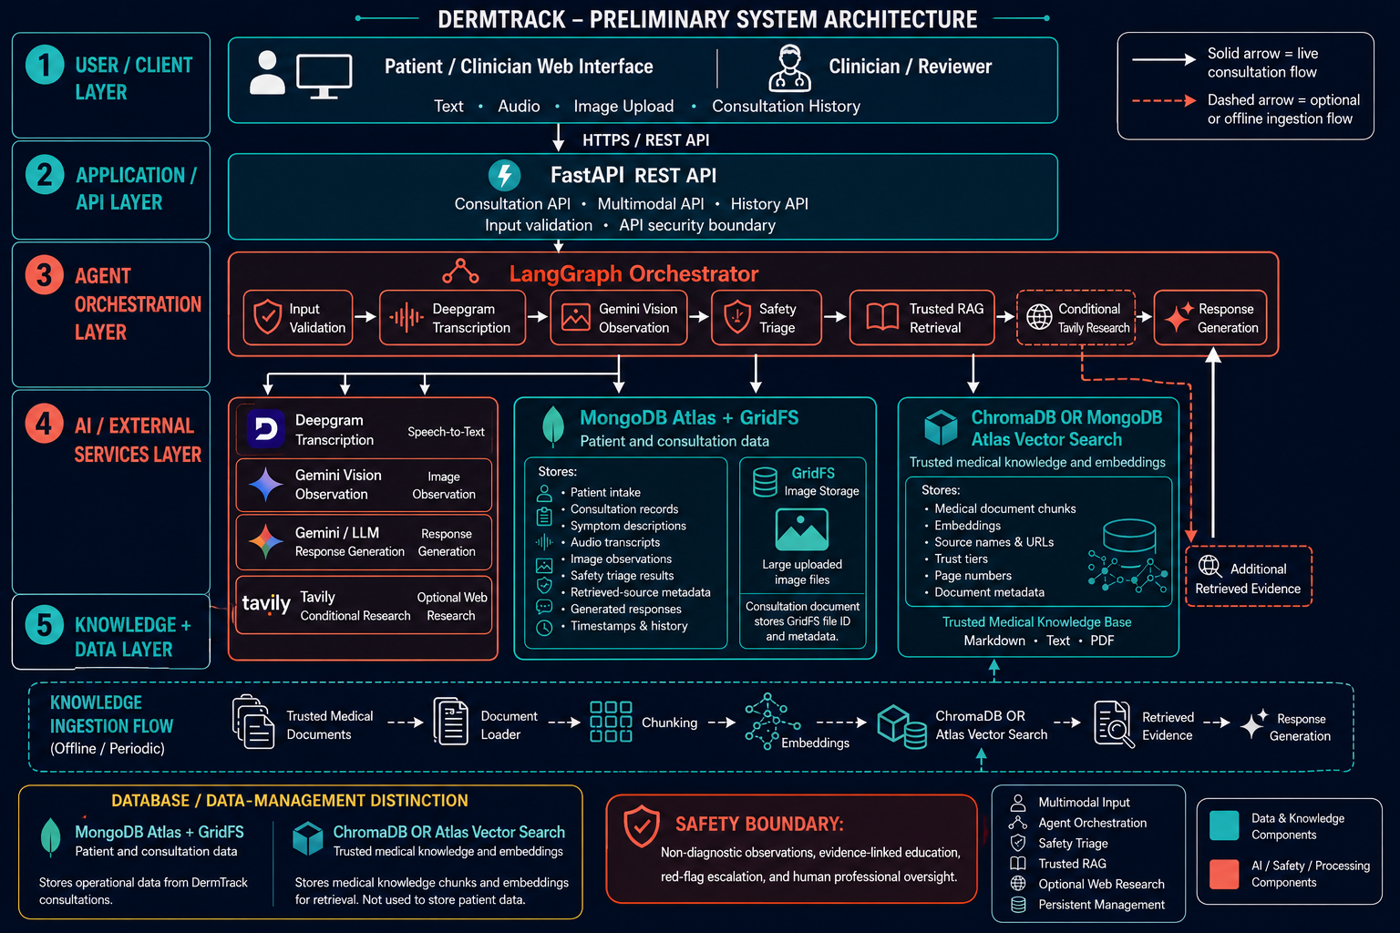
PRELIMINARY ARCHITECTURE
011 / DERMTRACK AGENT
System architecture diagram

Slide 12
PRELIMINARY ARCHITECTURE
012 / DERMTRACK AGENT
Role of the database and data-management layer
DermTrack separates operational patient data from searchable medical knowledge so each data type can be stored and accessed appropriately.
MONGODB ATLAS
GRIDFS
CHROMADB OR ATLAS VECTOR SEARCH
Operational application database
Large-file image storage
Medical knowledge retrieval
Stores structured patient intake, consultation records, transcripts, image observations, triage outcomes, retrieved-source metadata, generated responses, timestamps, and history.
Stores uploaded JPEG, PNG, and WEBP consultation images separately from the consultation document. The record keeps the GridFS file ID and content type.
Stores trusted-document chunks, embeddings, source URLs, trust tiers, page numbers, and document metadata. It is not used as the patient-record store.
DATA LIFECYCLE
Collect → Validate → Process → Retrieve evidence → Generate response → Persist consultation
Design principle: patient data remains in the application database, while medical knowledge is indexed separately for retrieval.

